Slide 1
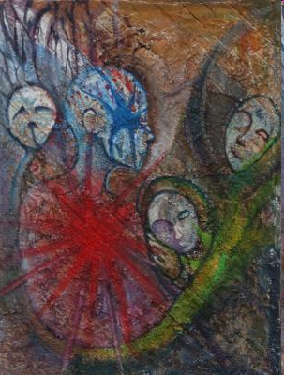
Ethos, Pathos, & Logos
The Art
of
Rhetoric
http://www.pbase.com/jamesnesbitt/image/43604463

Slide 2
What is rhetoric?
Aristotle defines rhetoric as
The ability to discover all available means of persuasion in a given situation.
In simple terms, rhetoric is the art of speaking or writing EFFECTIVELY.

Slide 3
Whenever you read or listen to an argument, you must ask yourself,
”Is this persuasive? And if so, to whom?"

Slide 4
There are several ways to appeal to an audience. Among them are appeals to ethos, pathos and logos.

Slide 5
Again, three methods of persuasion are…
ethos
pathos
logos

Slide 7
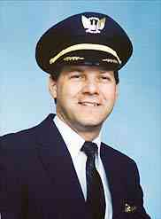
ETHOS: Appeal to Credibility or Image
Ethos is a person’s credibility with a given audience.
It can mean having sincerity, authority, expertise, faithful, or any adjective that describes someone you can trust to do the right thing.

Slide 8
Ethos:
Ethos is related to the English word ethics and refers to the trustworthiness or credibility of the speaker/writer.
Ethos is an effective persuasive strategy because when we believe that the speaker does not intend to do us harm, we are more willing to listen to what s/he has to say.
When a judge comments on a legal precedent, audiences tend to listen because it is the job of a judge to know the nature of past legal cases.

Slide 9
Example
George Foreman and his Grilling Machine
Boxer
Fitness Expert
Preacher, too!

Slide 10
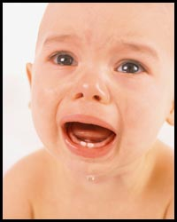
PATHOS: Appeal to Emotions
Pathos appeals rely on emotions and feelings to persuade the audience
They are often direct, simple, and very powerful

Slide 11
Pathos:
Pathos is Greek for emotion or suffer and is related to the words pathetic, sympathy and empathy.
Whenever you accept a claim based on how it makes you feel without fully analyzing the rationale behind the claim, you are acting on pathos.
They may be any emotions: love, fear, patriotism, guilt, hate or joy.

Slide 12
Appeals to pathos touch a nerve and compel people to not only listen, but to also take the next step and act in the world.

Slide 13
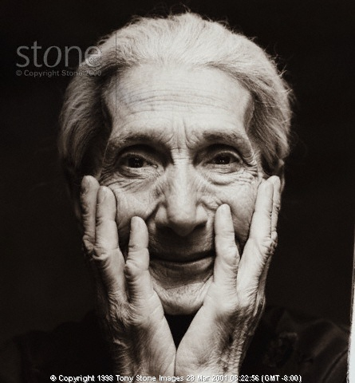
Where do you notice PATHOS appeals?
“America's older citizens have rightly been called the "greatest generation." It is morally unacceptable that the people that built this country -- our senior citizens -- should suffer hunger in a land of plenty, which they helped to create.”
-from America’s Second Harvest program

Slide 14
“America's older citizens have rightly been called the "greatest generation." It is morally unacceptable that the people that built this country -- our senior citizens -- should suffer hunger in a land of plenty, which they helped to create.”
-from America’s Second Harvest program

Slide 15
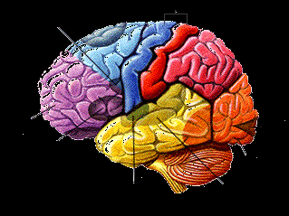
LOGOS: Appeal to Logic or Reason
Logos appeals rely on the audience’s intelligence to persuade them.
Education causes audiences to be more skeptical of emotional arguments and more receptive to logos

Slide 16
Logos:
The Greek word logos is the basis for the English word logic.
Logos refers to any attempt to appeal to the intellect, the general meaning of "logical argument."
Everyday arguments rely heavily on ethos and pathos, but academic arguments rely more on logos: there will be logical chains of reasoning supporting all claims.

Slide 17
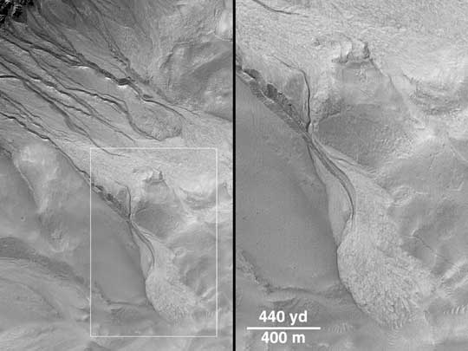
Where do you see a LOGOS appeal?
NASA sees its mission to explore Mars as an endeavor to seek out the possibility of life on that planet. Knowing if water was on Mars is the first step in this research.

Slide 18
NASA sees its mission to explore Mars as an endeavor to seek out the possibility of life on that planet. Knowing if water was on Mars is the first step in this research.

Slide 19
Where do you notice PATHOS and LOGOS appeals?
The Arctic National Wildlife Refuge provides a safe refuge for 180 species of migratory birds, serves as a birthing ground for one of the hemisphere's largest caribou herds and has been home to the Gwinch'in people for a thousand generations. Ninety-five percent (95%) of Alaska's North Slope is already available to Big Oil, but these companies want it all.

Slide 20
The Arctic National Wildlife Refuge provides a safe refuge for 180 species of migratory birds, serves as a birthing ground for one of the hemisphere's largest caribou herds and has been home to the Gwinch'in people for a thousand generations. Ninety-five percent (95%) of Alaska's North Slope is already available to Big Oil, but these companies want it all.

Slide 21
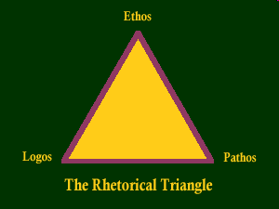
Each appeal is equally important and
potentially affects the others.

Slide 22
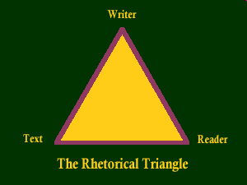
The Appeals Can Also Be Looked at in this Way:

Slide 24
He already knows what he wants to be when he grows up.
What kind of society raises six-year olds on dreams of suicide/homicide and hatred? A society that targets Israel.
They target Israel, because Israel shares America’s values – democracy, freedom of religion, women’s rights, a free press, scientific achievement and a burgeoning, open economy.
By supporting Israel’s struggle against terror, you are helping defend the cause of freedom, not just in Israel, but here in America and throughout the free world.
Israel. The front line of the free world.

Slide 25
Homework: “Three Ways to Persuade”
Read and ANNOTATE the text.
Be an active reader! Ask questions, clarify and evaluate.
At the end of the article, you will use your annotations to guide your summarization of each appeal.

