Slide 1
A-Rated Campus with ALL 7 TEA Distinctions for Excellence
100% Graduation Rate
US Department of Education Blue Ribbon School
Voted by US News & World Report as one of their Best High Schools (#7 in entire San Antonio Metro Area & surrounding counties)
Named 2020 Top Performer in Racial Equity for High Schools by Children At Risk

Slide 2
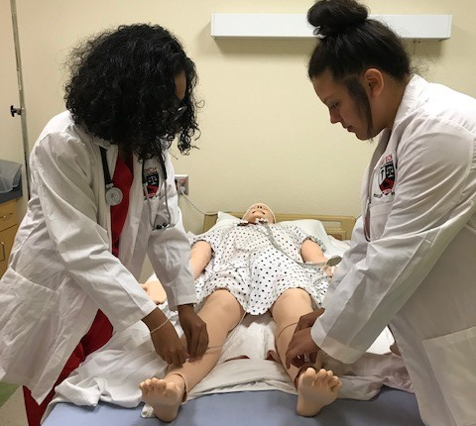
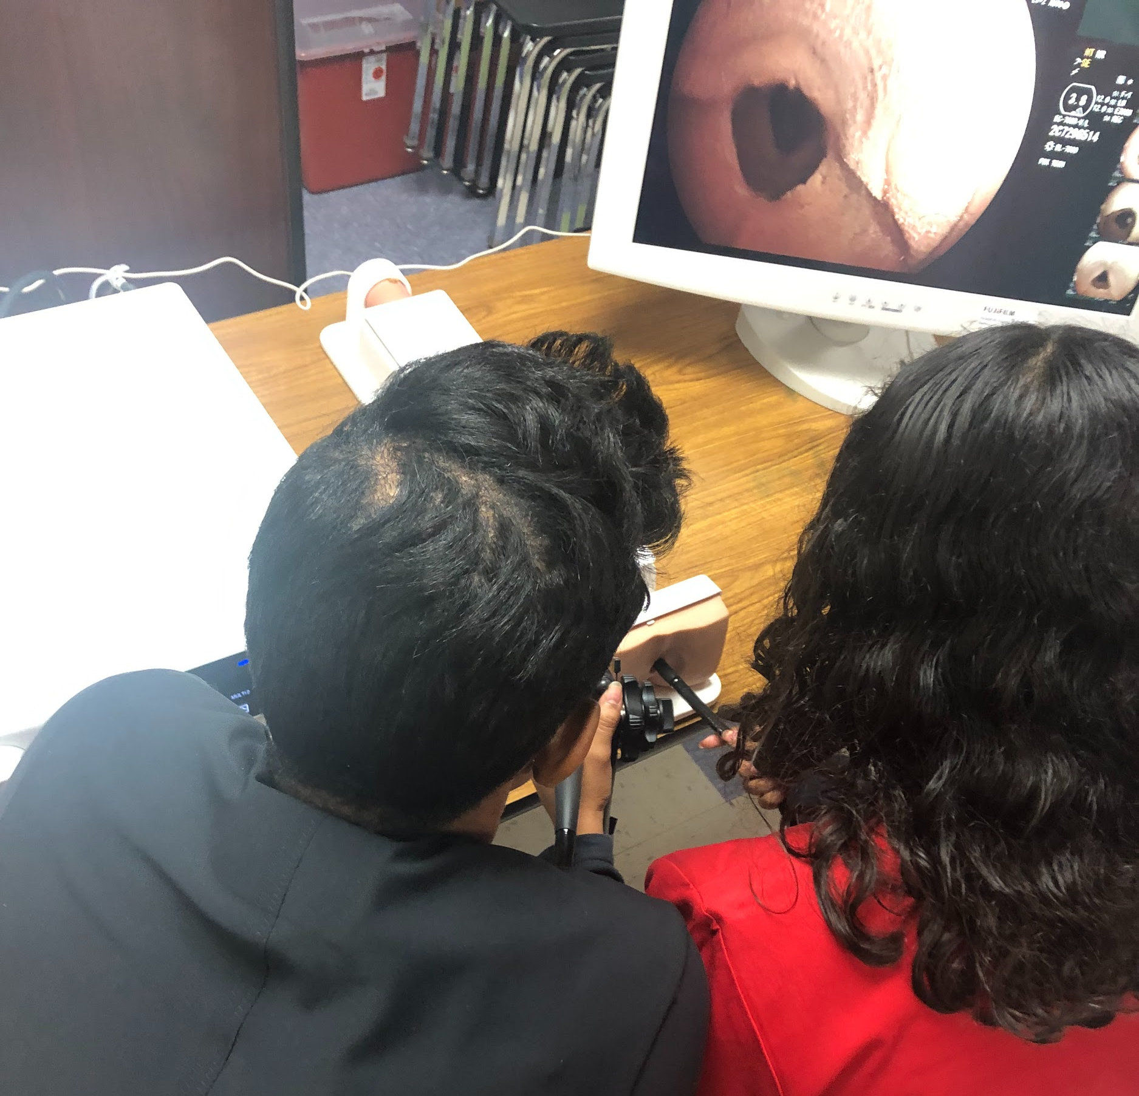
Health Professions Institute & Medical Magnet High School
Hands-on, real-world work-based experience
Mentorships, Internships & Job Shadowing
Innovative Scheduling for Field Experiences
State of the art Facilities in Hospital/ Healthcare Setting
Highly Qualified Faculty & Staff
Master Teachers
Medical Industry Professionals
College Professors
Industry based certifications:
Pharmacy Technician ($32,000)
Patient Care Technician ($38,000)
Phlebotomy ($38,000)
Coming soon: EKG Technician Medical Billing & Coding
Leading Industry Partners
Industry-Based Clubs & Organizations
Competitive events
Service learning
Community Service

Slide 3
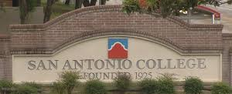
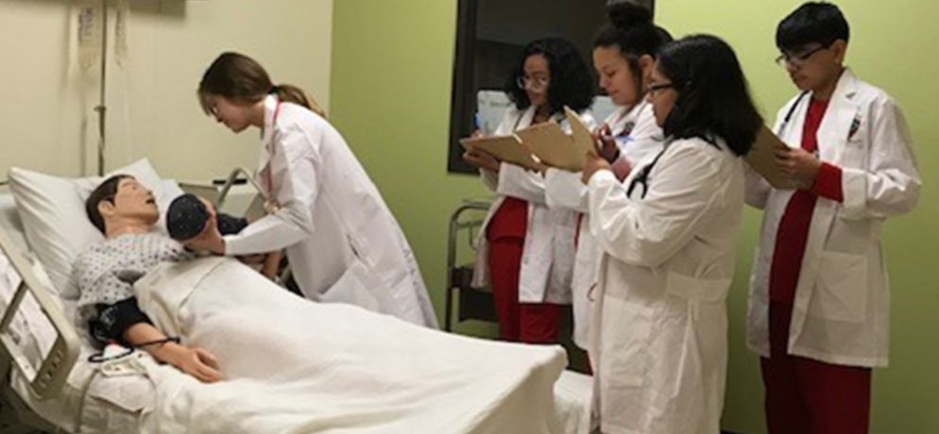
H-TECH
Nursing & Healthcare Early College High School
6 yr program: Bachelor of Science in Nursing with RN Certification (Average annual salary $85,000 ~ziprecruiter )
4 yr program: Associate's of Science degree from San Antonio College
Various Industry-Based Certifications
Guaranteed / preferential job interviews and placement with industry partners
Transferable to a 4-year university for students pursuing other fields of medicine or science (medical, pharmacology, veterinary, or science-based industry)
Access to all the resources of both San Antonio College & SAISD
Multiple levels of support and intervention to ensure student success
Mentorships, Internships, Guest Speakers, Interview Training & Job Shadowing with University Health System & Methodist Health System
Students can earn medical industry-standard certifications, based on individual student interest.
Free College Education, Job Training, & Industry Networking
There are no academic requirements to enter the H-TECH program, however it IS a rigorous program.

Slide 4
Health Professions Institute & H-TECH Nursing Early College High School
Certifications Available to ALL Health Professions & H-TECH Students
Patient Care Technician ($38,000 per yr)
Combination of Certified Medical Assistant and Certified Nurse’s Assistant
More well-rounded, robust certification
Allows for work in the following environments:
Hospitals
Nursing Homes
Doctor’s offices
Medical Laboratories
Blood and tissue centers
Phlebotomy (draws blood) ($38,000)
*This certification can be added to Pharmacy Technician and Patient Care Technician
Allows for work in the following environments (as a stand alone certification)
Blood and plasma centers
Hospitals
Doctor’s offices
Medical labs
·
Pharmacy Technician ($32,000)
o Does not deal directly with patients
o Allows for work in the following environments”
Pharmacies
Coming next year:
· EKG Technician ($38,000)
(Electrocardiogram tests, cardiac stress tests, telemetry monitoring)
*This certification can be added to the Patient Care Technician Certification
Allows for work in the following environments
Specialty doctors’ offices (Cardiologists)
Hospitals
Coming 2022:
· Medical Billing and Coding

Slide 5
Answers to Frequently Asked Questions
YES, we DO have sports, band, dance, clubs, and an award-winning Mariachi!
Uniforms: Scrubs or Khakis/black pants with Fox Tech polo shirt
Our Health Professions learning area looks and feels just like a hospital & we have the same high quality medical equipment and technology used in hospitals
Transportation is available (to and from home campus)
All students have access to dual credit courses AND certifications
What makes H-TECH different than other Early College High Schools or schools that offer a Healthcare pathway?
A Collegiate Network Partnership with SAC & access to the Bachelor of Science in Nursing & Registered Nurse’s Certification
We offer A SCIENCE DEGREE BECAUSE WE ARE A HEALTHCARE/NURSING EARLY COLLEGE HIGH SCHOOL (other Early College High Schools offer a Liberal Arts degree)
SUCCESS: We are an A-Rated Campus with ALL 7 TEA Distinctions
EXCELLENCE: We are a National Blue Ribbon School
STUDENT SUPPORT: We have 100% graduation rate
WE HAVE BEEN DOING THIS A LONG TIME & WE ARE GREAT AT MAKING OUR STUDENTS SUCCESSFUL

Slide 6
Judge Andy Mireles
Law Magnet

Slide 7
Judge Andy Mireles
Law Magnet, Continued

Slide 8
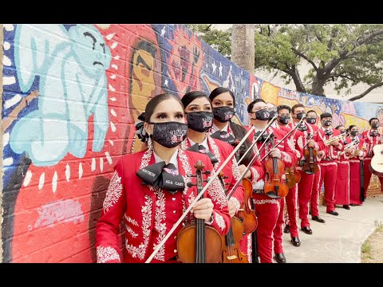
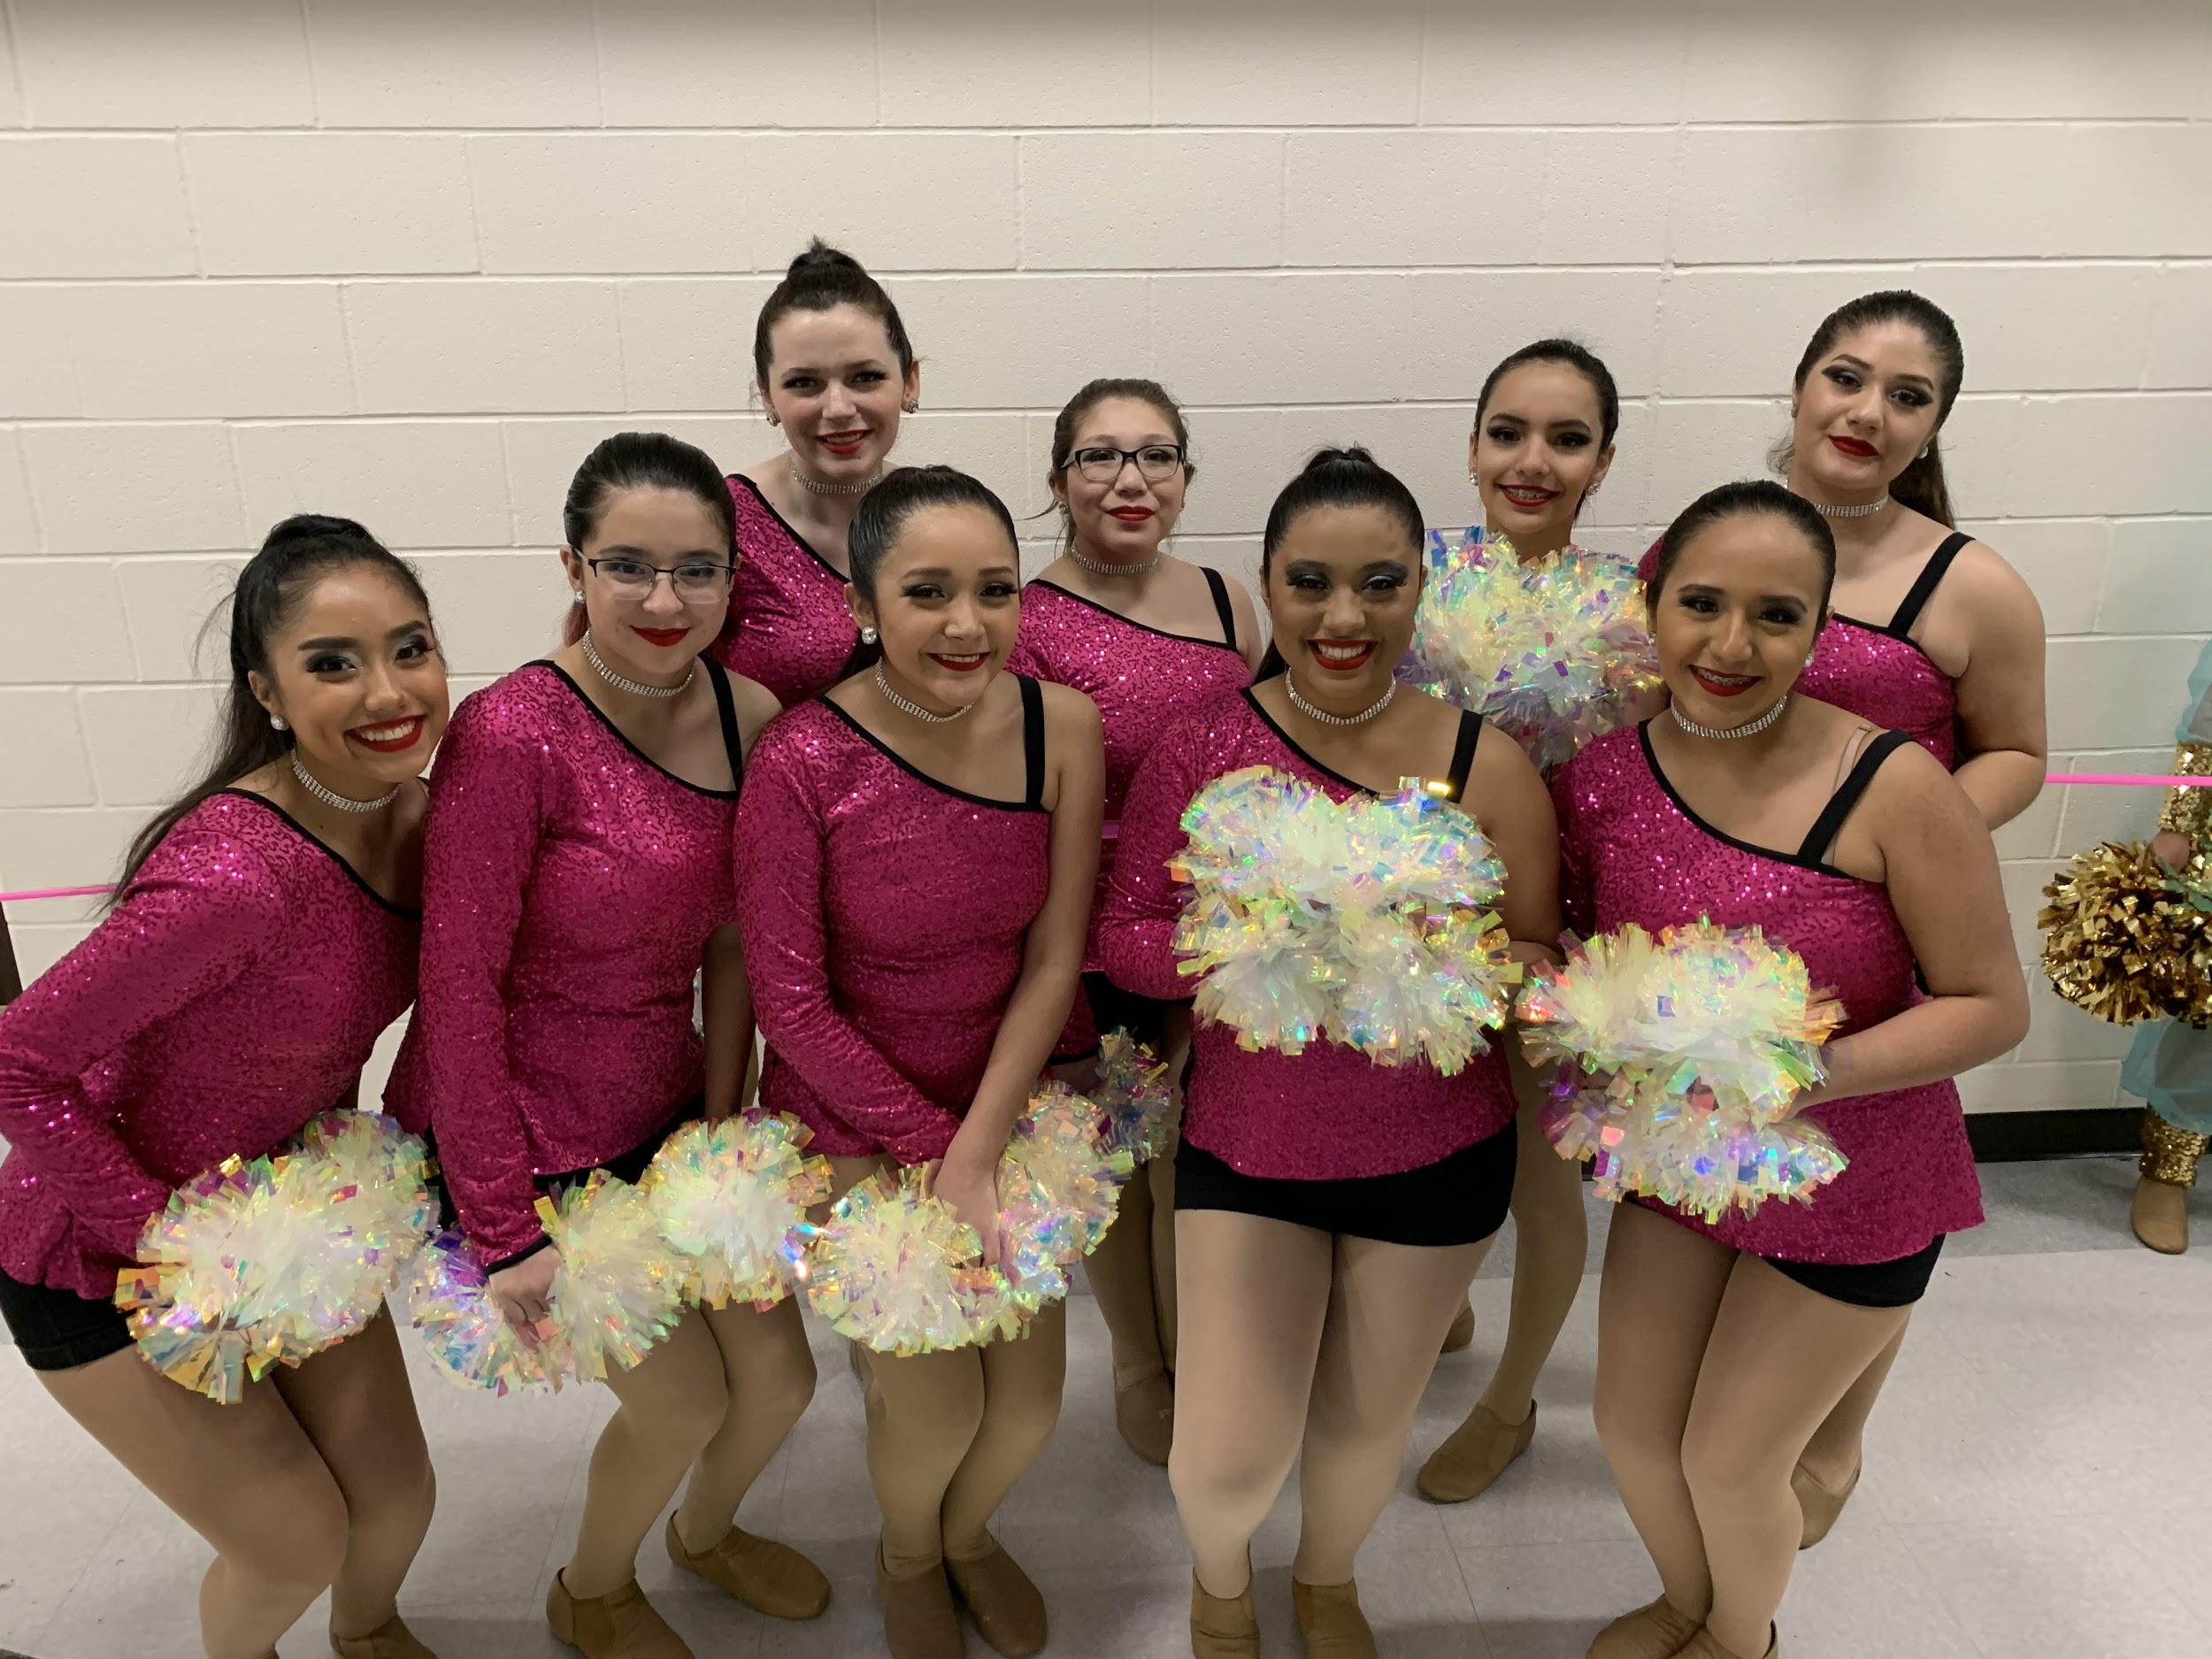
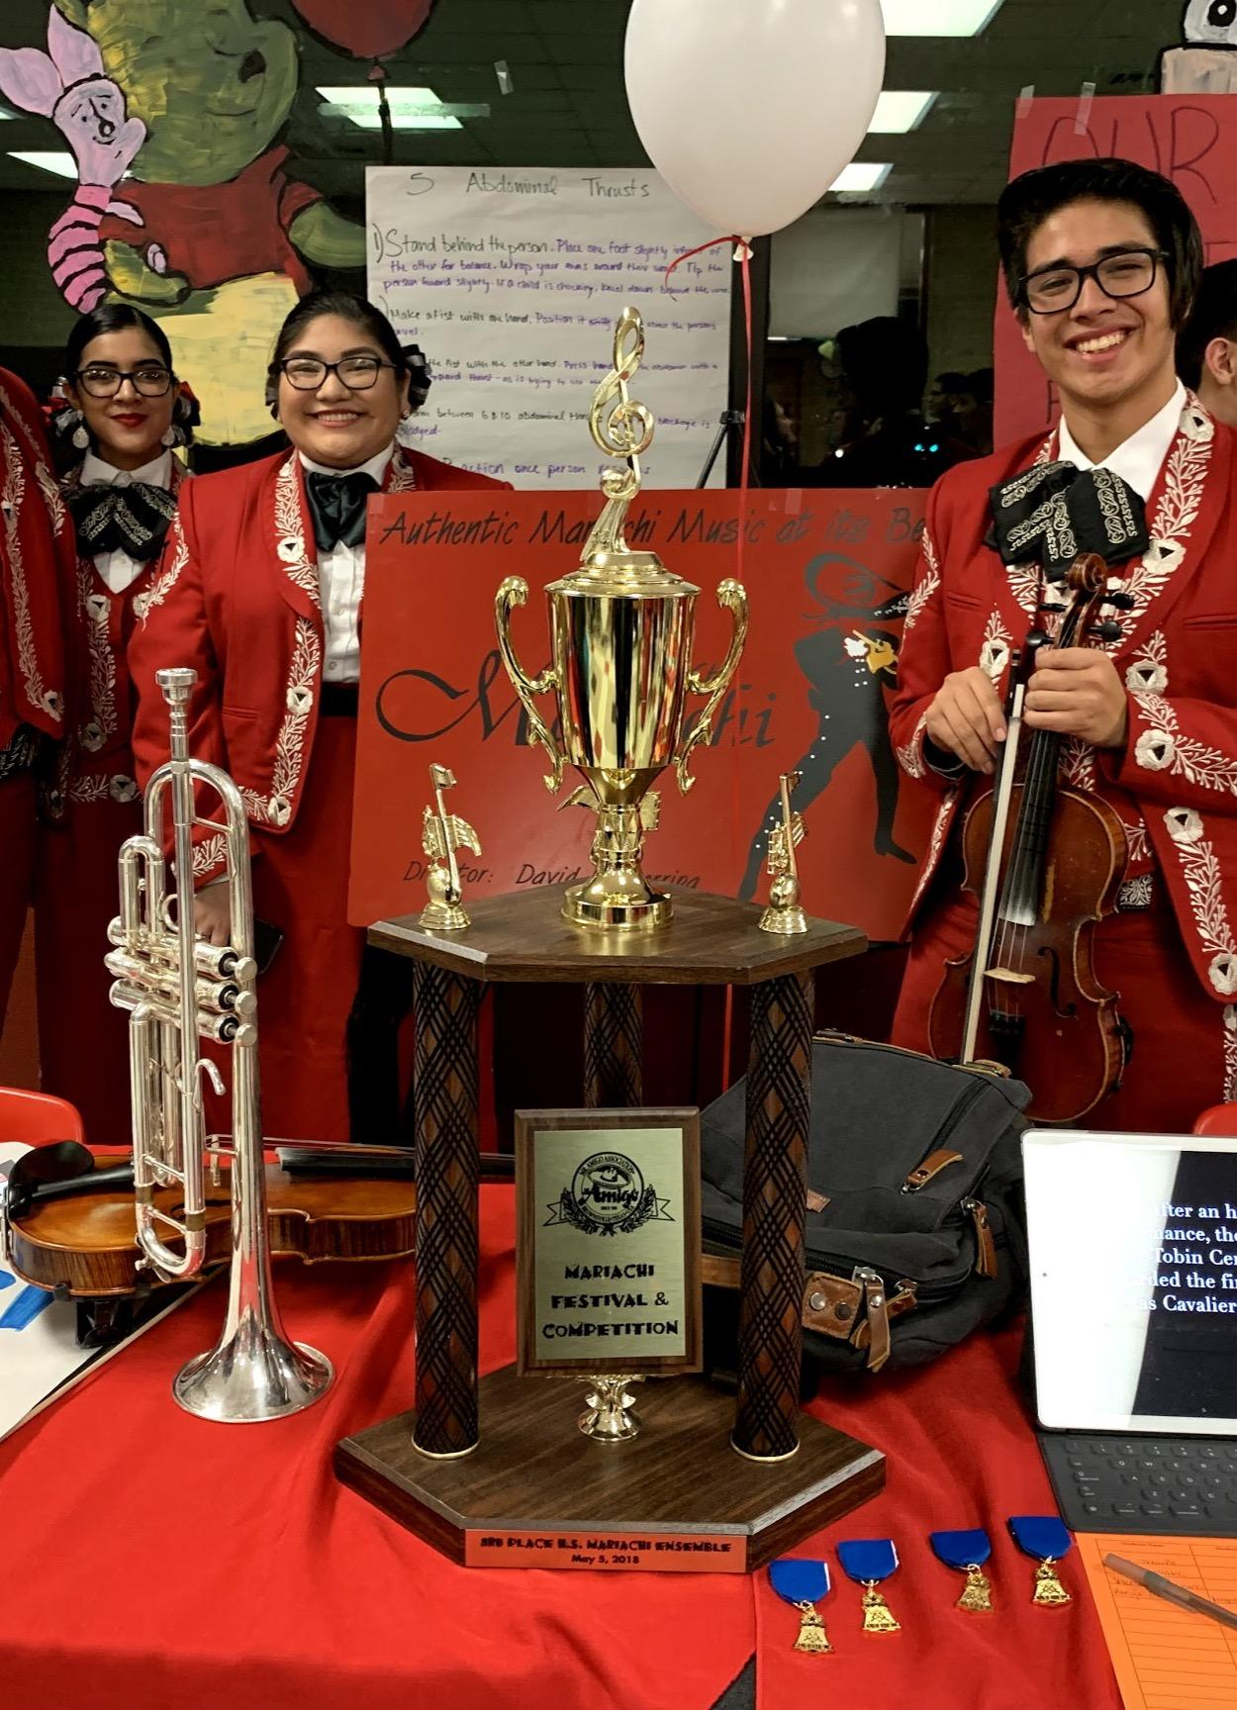
Fine Arts
@ Fox Tech
Class Offerings:
Beginner Dance
Intermediate Dance
Advanced Dance
Extra-Curricular Dance Teams
Red Diamonds Pom Squad- Varsity level
Red Rubies Pep Squad- JV level, tryout not required.
-For tryout information, email ldickinson2@saisd.net

Slide 9
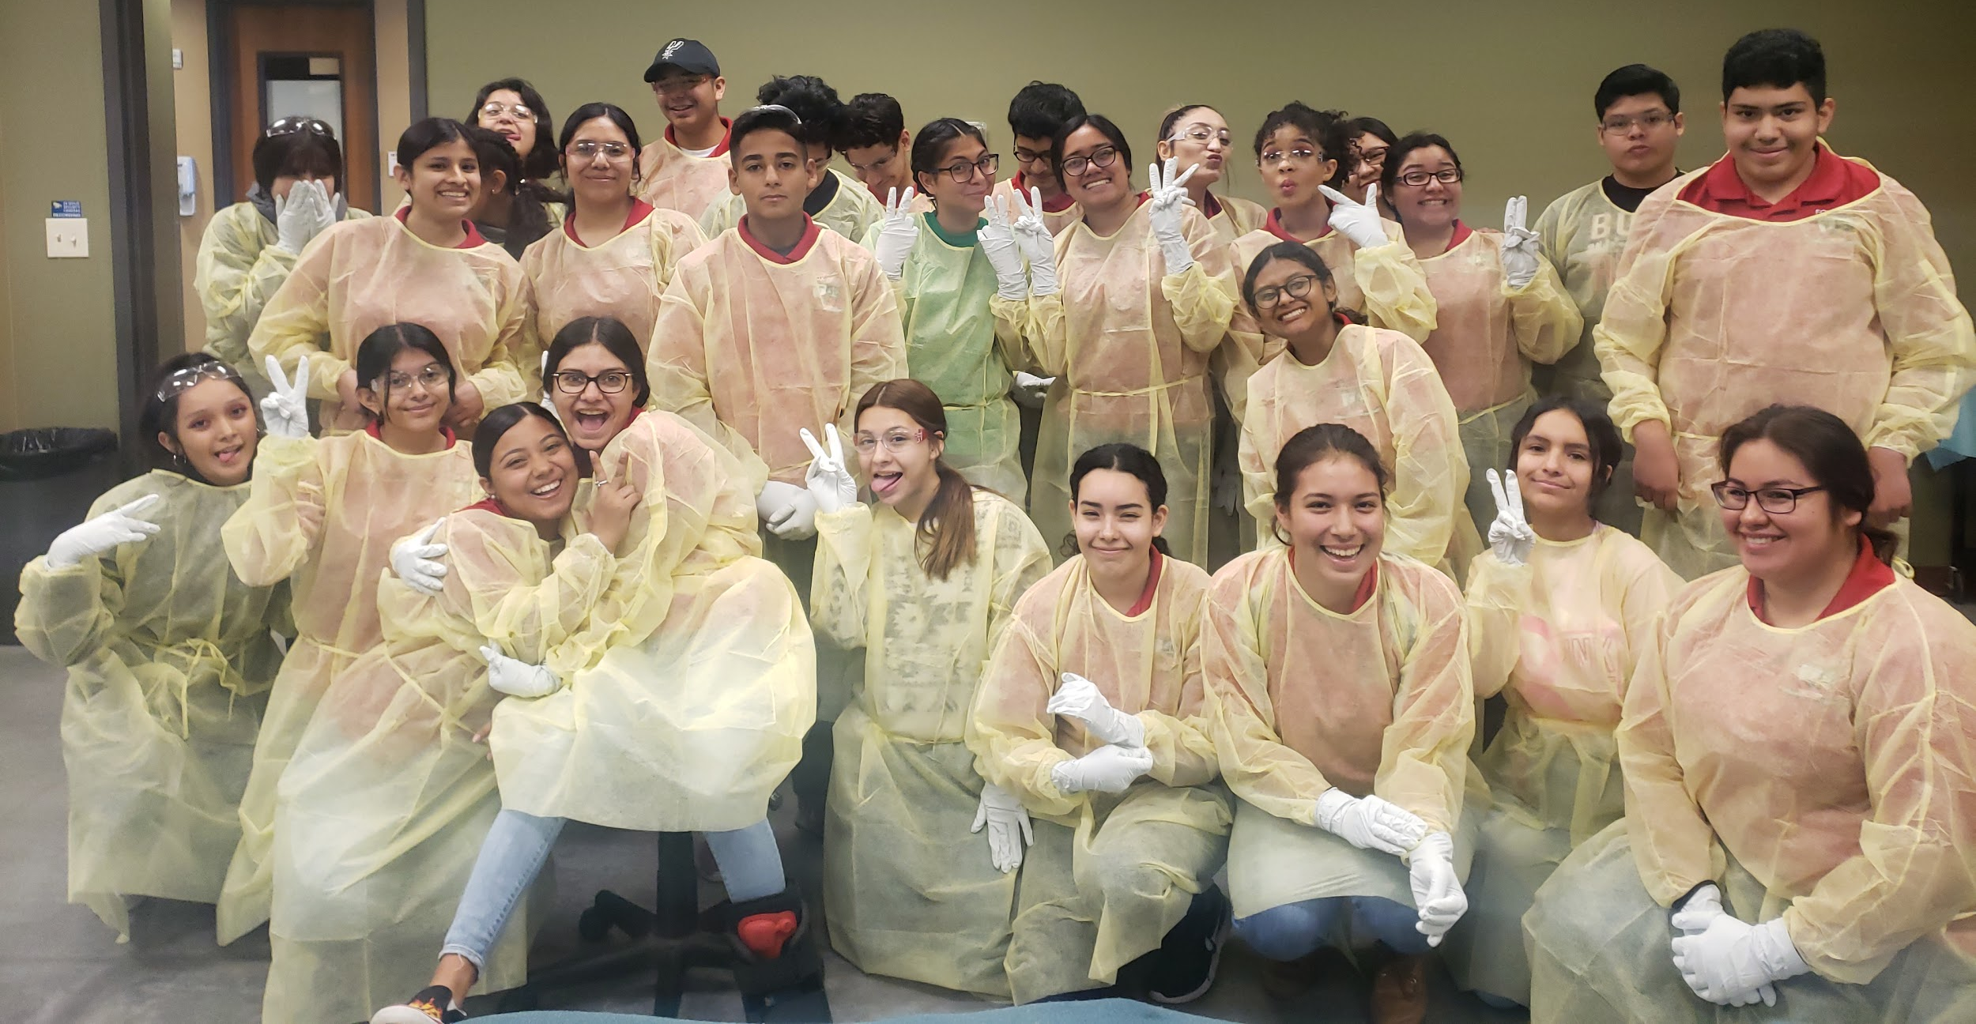
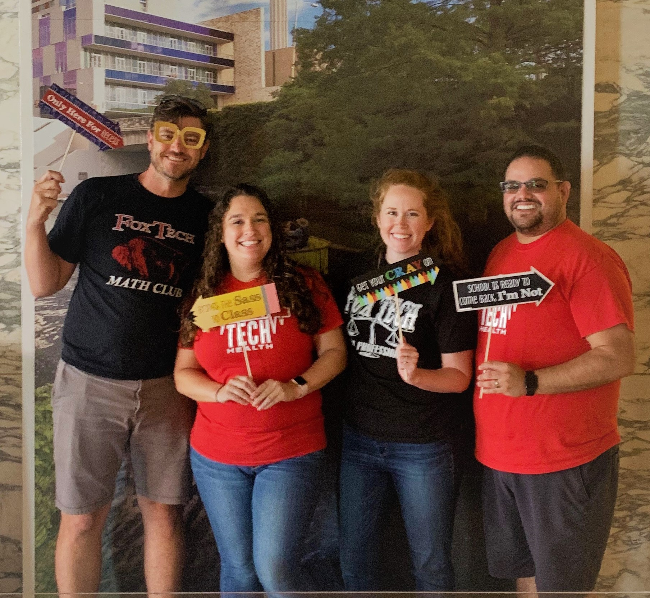
Clubs & Organizations
Math Club
HOSA
Student Council
Academic Decathlon
SKILLS USA

Slide 10
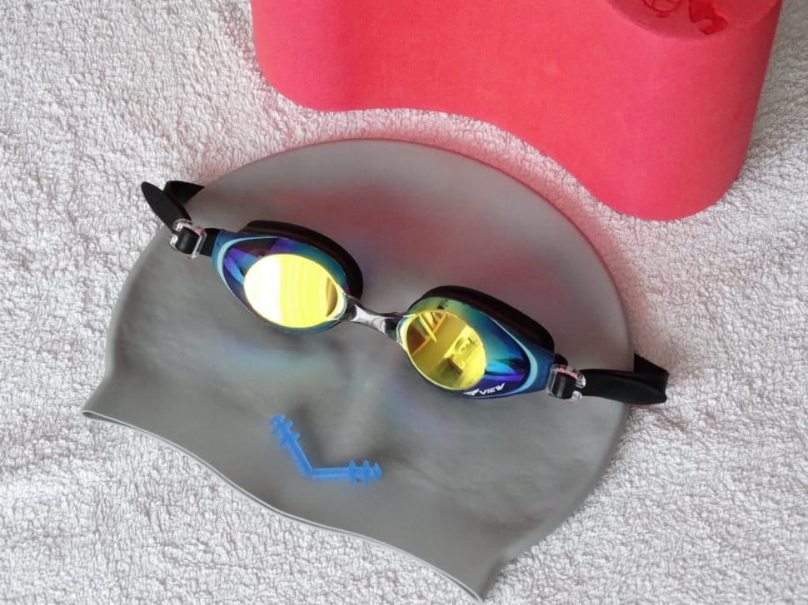
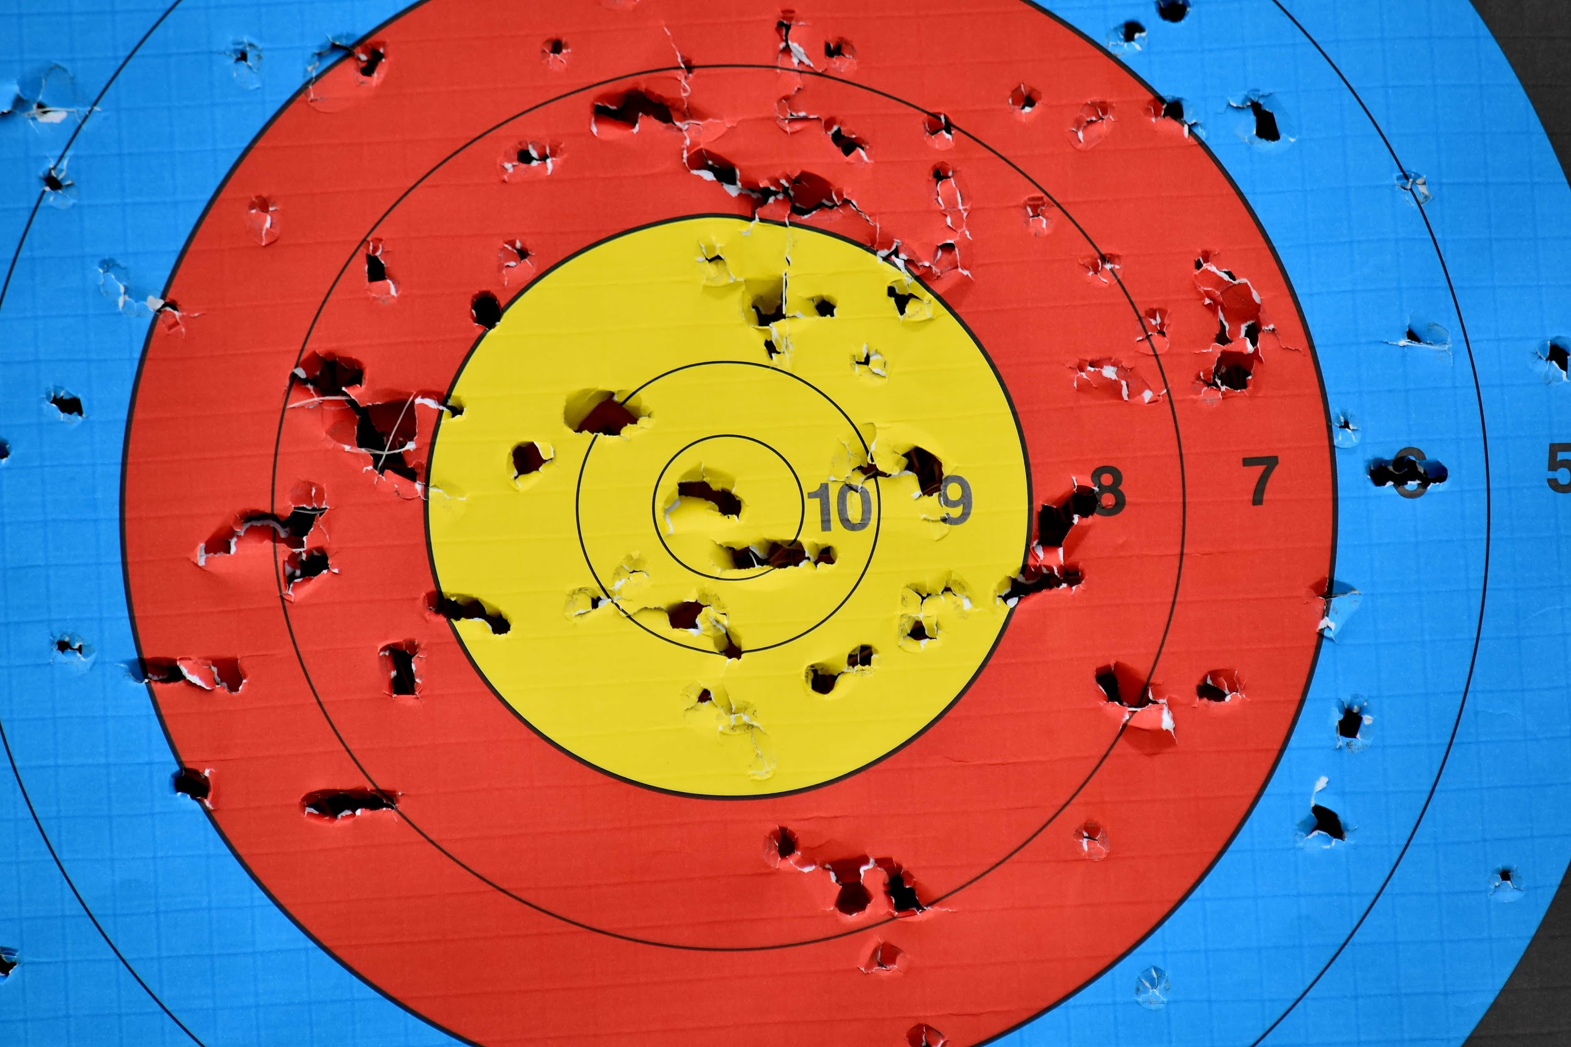
Athletics
Archery
Basketball
Cross Country
Golf
Soccer
Swim
Track & Field
Volleyball

Slide 11
Thank You!
Thank you for visiting Fox Tech- We would love to have you become part of the Fox Tech Buffalo Nation, where your success is our priority.
For additional information, contact us at:
210-738-9730
ehernandez28@saisd.net
or visit our website at: https://schools.saisd.net/page/004.homepage

