Slide 1
8th Grade Parent Night
Showcase
Brackenridge High School
ECHS

Slide 2
THREE P’s
P
P
P
PURPOSE
PROCESS
PAY OFF
Present the Brackenridge HS programs to the upcoming 8th grade students.
Discuss the timeline of when 8th grade students can select the program / pathway they want for their high school career.
Graduate students with a completion of a program or pathway and to be college, career & military ready.
Notes:
Purpose
Process
Payoff

Slide 3
Did you know?
Early College High School Program
Texans with a college degree can earn nearly twice as much (at least $50,441) as those with only a high school diploma ($26,008).
You can start your college degree while still in high school for FREE!
You can do this at Brackenridge High School because of our Early College High School program!

Slide 4
What is ECHS?
Early College High School Program
Students take Alamo Colleges classes in a sequence with the goal of earning an Associates Degree (60 college credits) by the time they graduate high school.
All courses are “dual credit”, i.e. they earn high school credit plus college credit at the same time.
Alamo College Courses credit transfers to any public 2- or 4- year college in Texas.
Alamo College classes are part of the school day, and transportation is provided to and from St. Philip’s college.
Students can start ECHS during the Spring of 9th grade.

Slide 5
Why ECHS?
Early College High School Program
Free tuition, textbooks, transportation!!! - $0 cost to parents/students.
Save at least $10,000 or more depending on the college attended after high school.
Save time and reach your educational goals more quickly.
Prepare for academic success in college after high school.
Access to St. Philip’s support services, facilities, and events.
Benefits from lots of academic support and emotional support from Brackenridge and St. Philip’s staff and services throughout the program.

Slide 6
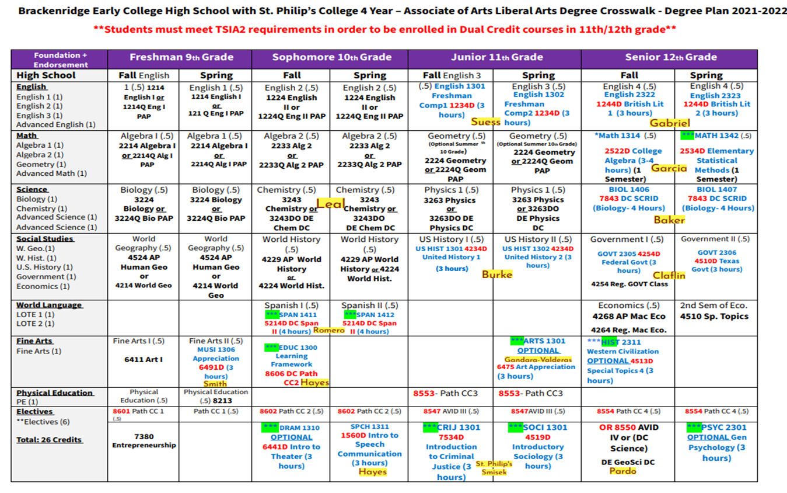
Brackenridge ECHS 4-year Plan

Slide 7
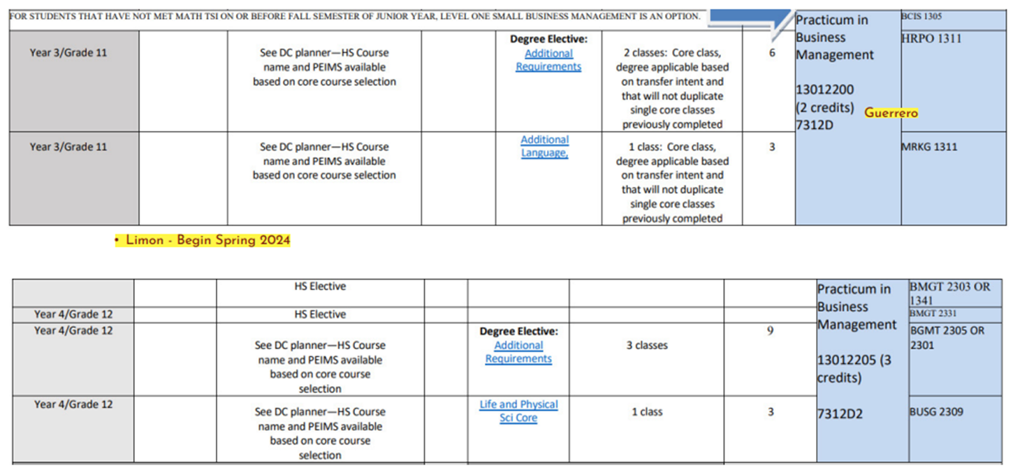
Brackenridge ECHS Level 1 Certificate of Completion
Small Business Management

Slide 8
How to Apply?
Early College High School Program
Submit the Brackenridge ECHS Program application beginning December 1st.
You can pick up paper applications from Brackenridge HS front office OR you can download a copy from https://schools.saisd.net/page/001.echs
Applications are DUE by January 31, 2025
Applications Review - February 2025
Offers from Lottery - March 2025
Accepted Students - May 2025
Summer Bridge - June 2025

Slide 9
THANK YOU

