Slide 1
BRACKENRIDGE High School
ECHS
STEERING COMMITTEE PRESENTATION
Presenter: Dr. David Villalobos / Mrs. Gabriela Menchaca
Location: SAISD Central Office
Date: October 6, 2023
Time: 8:30 AM
www.saisd.net
Notes:
Hello, welcome to our Steering Committee Presentation.
My name is Gabriela Menchaca and I am one of the Aps at Brackenridge.
Also presenting today will be Dr. Villalobos, our lead ECHS administrator.

Slide 2
THREE P’s
P
P
P
PURPOSE
PROCESS
PAY OFF
Provide opportunities and build support networks for Early College / Dual Credit students to have a successful college experience.
Advising, supporting and guiding students throughout their academic journey.
Graduate students with their associate degree of arts or Level 1 Business Certificate (small business).
Notes:
Purpose
Process
Payoff

Slide 3
Student Success Stories
Notes:
Joshua Arzola is on of Brackenridges ECHS Success Stories. Studentw ill be attending our Lad.

Slide 4
Student Success Stories

Slide 5
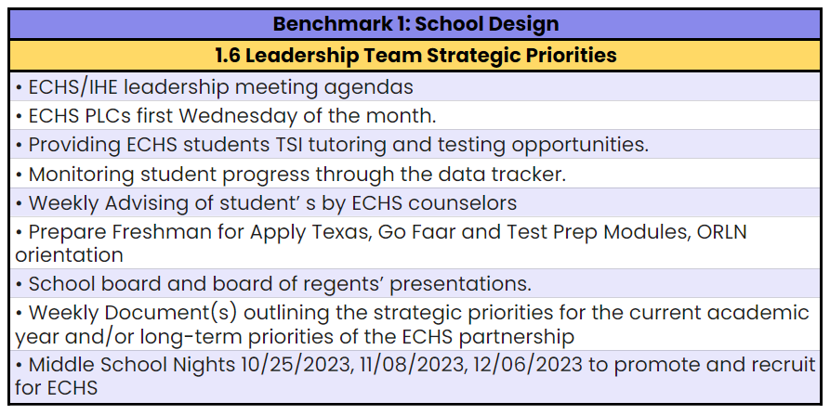
BENCHMARK 1: School Design
The Early College High School (ECHS) shall establish school structures and policies, regularly convene leadership teams and ensure adequate staff capacity for the successful implementation and sustainability of the ECHS program.
Notes:
In our School Design benchmark we have leadership team strategic priorities. In this as a leadership team we meet and make sure to record our agendas. Every first Wednesday of the month we have a PLC with our ECHS teachers to provide the most updates information. For our students we have TSI Tutoring and testing opportunities.
Throughout the semester we track students using a data tracker. This is done during weekly advising by the counselors. We focus on our freshman for apply Texas, Go Faar and Test prep modules.
We will have different middle school night to promote and recruit for echs
And with the community we have the school board and board of regents presentations and weekly documents outlining priorities for the current academic year and long term priorities of the echs partnership.

Slide 6
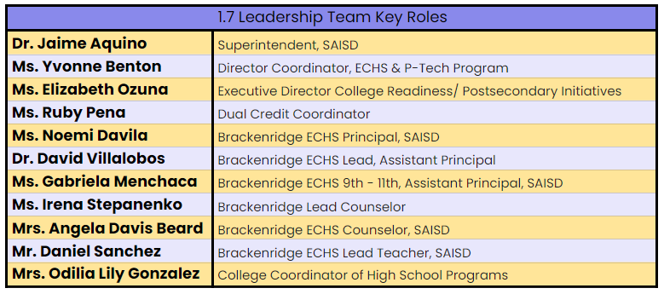
BENCHMARK 1: School Design
The Early College High School (ECHS) shall establish school structures and policies, regularly convene leadership teams and ensure adequate staff capacity for the successful implementation and sustainability of the ECHS program.
Notes:
School design: There are six design elements of which four are required artifacts. All artifacts are present on school site and updated annually.

Slide 7
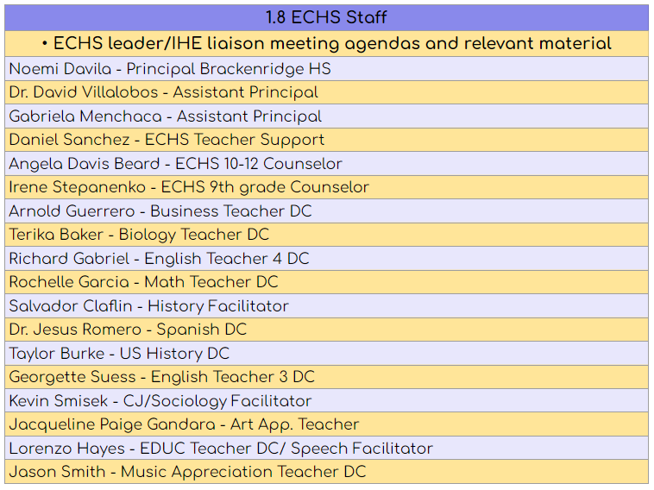
BENCHMARK 1: School Design
The Early College High School (ECHS) shall establish school structures and policies, regularly convene leadership teams and ensure adequate staff capacity for the successful implementation and sustainability of the ECHS program.

Slide 8
BENCHMARK 1: School Design
The Early College High School (ECHS) shall establish school structures and policies, regularly convene leadership teams and ensure adequate staff capacity for the successful implementation and sustainability of the ECHS program.
Notes:
School design: There are six design elements of which four are required artifacts. All artifacts are present on school site and updated annually.

Slide 9
BENCHMARK 2: Partnerships
The Early College High School (ECHS) must have a current, signed memorandum of understanding (MOU) or interlocal agreement (ILA) with each Institution of Higher Education (IHE) that outlines key issues related to the planning, implementation, and sustainability of the ECHS program. Stakeholders shall review the MOU or ILA annually.
St. Philip’s College
Grade Level | Class Year | Number of Students | ATTRITION | ON TRACK TO ASSOCIATES | ON TRACK LEVEL ONE
9 | 2027 | 124 | n/a | 124 | N/A
10 | 2026 | 128 | 12.5% 16/128 | 112 | N/A
11 | 2025 | 118 | 20.3% 24/118 | 18 | 20
12 | 2024 | 134 | 30.6% 41/134 | 38 | 0
Notes:
For benchmark two, talk about the signed MOU and student success resources available to students and staff, briefly, as you will revisit resources in benchmark 5. Recommendation, focus on:
2.4–students on track; crosswalks
2.6–course delivery preference; what’s worked…e.g. visiting professors, hybrid, etc.
2.7–importance of ECHS specific support staff, HS Adjunct credentialing and IHE course availability in relation to staffing
2.11–The MOU or ILA shall outline the commitment that the ECHS and IHE will implement purposeful
and collaborative outreach efforts to inform all students and parents of the benefits and costs of
dual credit, including enrollment and fee policies. Talk about the communication plan your campus uses to explain programming to parents, community, IHE partners, etc.
2.14–necessity of data sharing for student monitoring and success
2.15–Dual credit program outcomes that assist high school students in the successful
transition to and acceleration through postsecondary education

Slide 10
BENCHMARK 3: TARGET POPULATION
The Early College High School (ECHS) shall target and enroll historically underserved students. The campus must enable students who are at-risk of dropping out or those who wish to accelerate completion of high school to combine high school courses and college-level courses.
Enrollment decisions shall not be based on state assessment scores, discipline history, teacher recommendations, parent or student essays, minimum grade point average (GPA), or other criteria that create barriers for student enrollment.
Gender | Campus |  | District
Female | 57.4% | 243 | 49.4% | 22,093
Male | 42.6% | 180 | 50.6% | 22,658
Special Populations | Campus |  | DIstrict
At-Risk | 32.2% | 136 | 32.6% | 14,574
Economically Disadvantaged | 86.8% | 367 | 88.4% | 39,546
Special Education | 4.0% | 17 | 15.6% | 6,960
504 | 5.2% | 22 | 4.3% | 1,923
English Learners | 19.4% | 82 | 23.4% | 10,455
Notes:
The target population for this program is historically underserved students. We include students that are at risk od dropping out of high school or those who wish toto accelerate completion of high school to combine high school courses and college-level courses.
Enrollment decisions shall not be based on state assessment scores, discipline history, teacher recommendations, parent or student essays, minimum grade point average (GPA), or other criteria that create barriers for student
Enrollment to the program is a lottery system with clearly defined procedures. These are public and available to view on our ECHS Website.

Slide 11
BENCHMARK 4: Academic Infrastructure
The Early College High School (ECHS) must provide a rigorous course of study that allows students the opportunity to earn a high school diploma and enable a student to combine high school courses and college-level courses with the goal of earning an associate degree or up to 60 semester credit hours toward a baccalaureate degree.
Notes:
Curriculum and Rigor is now Academic Infrastructure. Remind listening audience of goal for ECHS programming: allows students the opportunity to earn a high school diploma and enables a student to combine high school courses and college-level courses with the goal of earning an associate degree or up to 60 semester credit hours toward a baccalaureate degree.
Explain and display regional need and how ECHS academic plan and targeted postsecondary credentials connect with the local economic needs.
Talk about strategic master scheduling and where a stakeholder can view the current ECHS master schedule on your school site

Slide 12
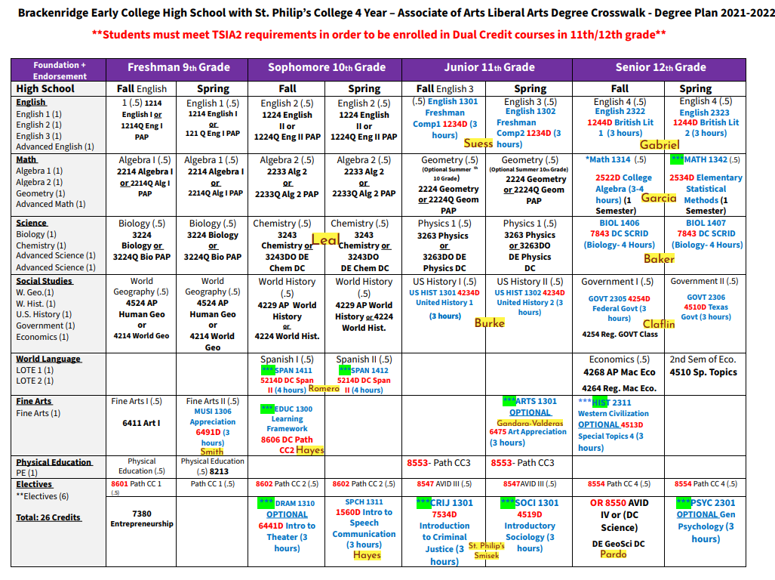

Slide 13
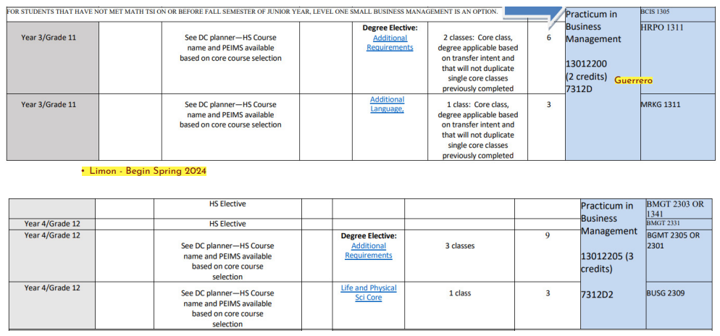

Slide 14
BENCHMARK 4: Academic Infrastructure
The Early College High School (ECHS) must provide a rigorous course of study that allows students the opportunity to earn a high school diploma and enable a student to combine high school courses and college-level courses with the goal of earning an associate degree or up to 60 semester credit hours toward a baccalaureate degree.
Grade | TSIA Math Ready | TSIA ELAR Ready | TSIA Ready Both
9th | 6 | 14 | 5
10th | 12 | 33 | 11
11th | 20 | 53 | 20
12th | 48 | 51 | 46
Notes:
Curriculum and Rigor is now Academic Infrastructure. Remind listening audience of goal for ECHS programming: allows students the opportunity to earn a high school diploma and enables a student to combine high school courses and college-level courses with the goal of earning an associate degree or up to 60 semester credit hours toward a baccalaureate degree.
Explain and display regional need and how ECHS academic plan and targeted postsecondary credentials connect with the local economic needs.
Talk about strategic master scheduling and where a stakeholder can view the current ECHS master schedule on your school site

Slide 15
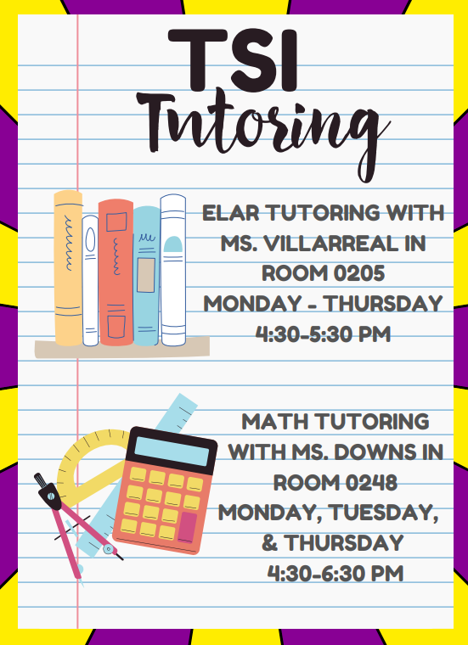
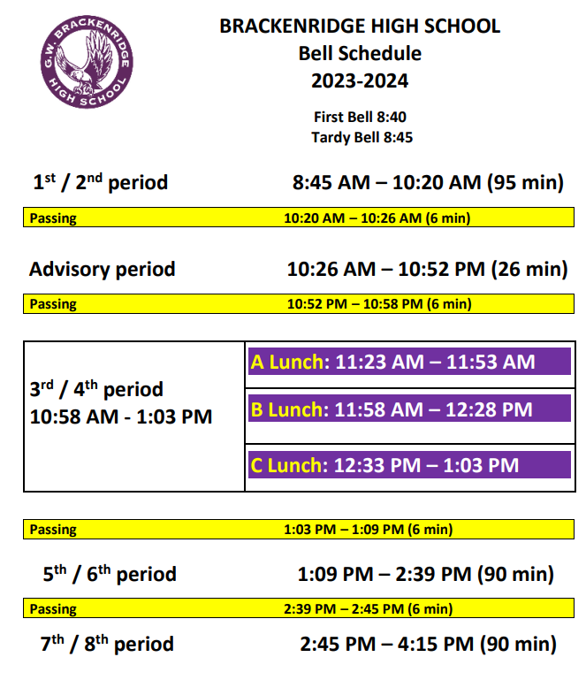
BENCHMARK 4: Academic Infrastructure: 4.7
Notes:
Curriculum and Rigor is now Academic Infrastructure. Remind listening audience of goal for ECHS programming: allows students the opportunity to earn a high school diploma and enables a student to combine high school courses and college-level courses with the goal of earning an associate degree or up to 60 semester credit hours toward a baccalaureate degree.
Explain and display regional need and how ECHS academic plan and targeted postsecondary credentials connect with the local economic needs.
Talk about strategic master scheduling and where a stakeholder can view the current ECHS master schedule on your school site

Slide 16
BENCHMARK 4: Academic Infrastructure: 4.7
Notes:
Curriculum and Rigor is now Academic Infrastructure. Remind listening audience of goal for ECHS programming: allows students the opportunity to earn a high school diploma and enables a student to combine high school courses and college-level courses with the goal of earning an associate degree or up to 60 semester credit hours toward a baccalaureate degree.
Explain and display regional need and how ECHS academic plan and targeted postsecondary credentials connect with the local economic needs.
Talk about strategic master scheduling and where a stakeholder can view the current ECHS master schedule on your school site

Slide 17
Important Testing Dates!
12th Grade - October 11, 2023
11th Grade - February 27, 2024
12th Grade - October 11, 2023
11th Grade - March 6, 2024

Slide 18
BENCHMARK 5: Student Support
The Early College High School (ECHS) must provide wrap-around strategies and services involving multiple stakeholders to strengthen academic, technical, and individual support for students to be successful in their ECHS program.
June 10, 2024 | June 11, 2024 | June 12, 2024 | June 13, 2024
AM: St. Philip’s Orientation Crosswalks explained Syllabus review Study Skills Time Management Apply Texas PM: TSIA2 Prep ELAR | AM: TSIA2 Prep Math PM: TSIA2 Prep ELAR | AM: TSIA2 Prep Math PM: St. Philip’s Campus Tour Bookstore IDs Library Student Learning Center | TSIA2 Testing ELAR Essay Math
Notes:
You may create a packet of items for the group to review that can include a copy of your crosswalk, a copy of your parent engagement calendar, copy of summer learning and bridge calendars, etc.
Explain Bridge programming and display a snippet of your bridge programming on slide.
Explain tutoring schedule/interventions–possibly display a tutoring-testing timeline or tutoring-final grade timeline
Explain other supports and list, minimally, classroom supports and enrichment opportunities.

Slide 19
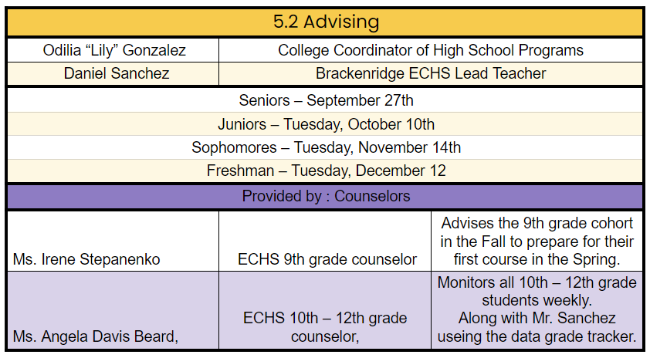
BENCHMARK 5: Student Support
The Early College High School (ECHS) must provide wrap-around strategies and services involving multiple stakeholders to strengthen academic, technical, and individual support for students to be successful in their ECHS program.
Notes:
You may create a packet of items for the group to review that can include a copy of your crosswalk, a copy of your parent engagement calendar, copy of summer learning and bridge calendars, etc.
Explain Bridge programming and display a snippet of your bridge programming on slide.
Explain tutoring schedule/interventions–possibly display a tutoring-testing timeline or tutoring-final grade timeline
Explain other supports and list, minimally, classroom supports and enrichment opportunities.

Slide 20
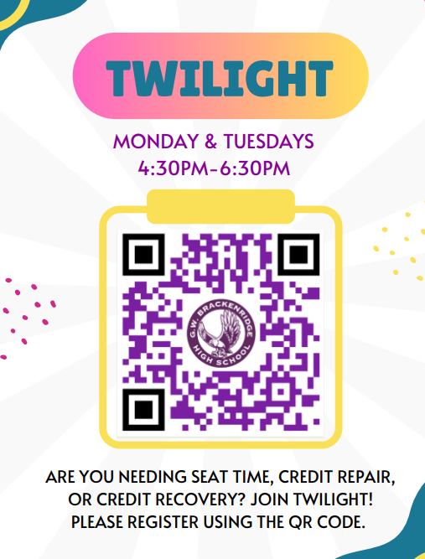
BENCHMARK 5: Student Support
The Early College High School (ECHS) must provide wrap-around strategies and services involving multiple stakeholders to strengthen academic, technical, and individual support for students to be successful in their ECHS program.
Notes:
You may create a packet of items for the group to review that can include a copy of your crosswalk, a copy of your parent engagement calendar, copy of summer learning and bridge calendars, etc.
Explain Bridge programming and display a snippet of your bridge programming on slide.
Explain tutoring schedule/interventions–possibly display a tutoring-testing timeline or tutoring-final grade timeline
Explain other supports and list, minimally, classroom supports and enrichment opportunities.

Slide 21
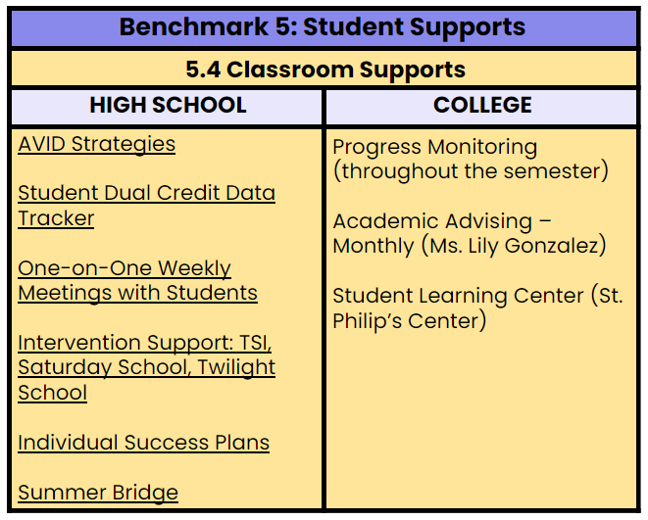
BENCHMARK 5: Student Support
The Early College High School (ECHS) must provide wrap-around strategies and services involving multiple stakeholders to strengthen academic, technical, and individual support for students to be successful in their ECHS program.
Notes:
You may create a packet of items for the group to review that can include a copy of your crosswalk, a copy of your parent engagement calendar, copy of summer learning and bridge calendars, etc.
Explain Bridge programming and display a snippet of your bridge programming on slide.
Explain tutoring schedule/interventions–possibly display a tutoring-testing timeline or tutoring-final grade timeline
Explain other supports and list, minimally, classroom supports and enrichment opportunities.

Slide 22
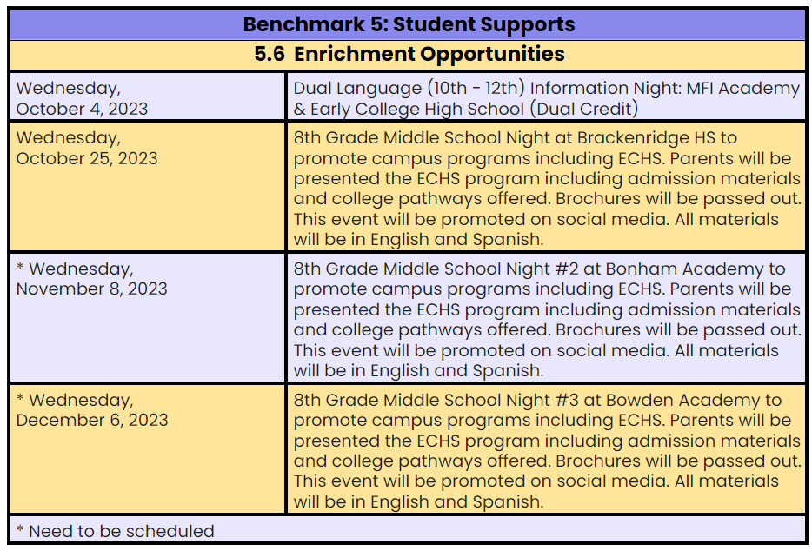
BENCHMARK 5: Student Support
The Early College High School (ECHS) must provide wrap-around strategies and services involving multiple stakeholders to strengthen academic, technical, and individual support for students to be successful in their ECHS program.
Notes:
You may create a packet of items for the group to review that can include a copy of your crosswalk, a copy of your parent engagement calendar, copy of summer learning and bridge calendars, etc.
Explain Bridge programming and display a snippet of your bridge programming on slide.
Explain tutoring schedule/interventions–possibly display a tutoring-testing timeline or tutoring-final grade timeline
Explain other supports and list, minimally, classroom supports and enrichment opportunities.

Slide 23
ACCESS OBMs
Access Outcomes-Based Measures
Data Indicators | Designated | Distinction | Cohort
 | Must meet targets on “At-Risk Students” and “Economically- Disadvantaged Students” designated data indicators | Must meet all designated access data indicators and two access distinction data indicators | Cohort 2024 | Cohort 2025 | Cohort 2026 | Cohort 2027
ECHS proportionate to or over-represents at-risk incoming 9th graders | No more than 25% points under district (9-12) | No more than 20% under district (grades 9-12) | 30.6% 41/134 2.0% under | 23.7% 28/118 8.9% under | 24.0% 30/125 8.6% under | 29.8% 37/124 2.8% under
ECHS proportionate to or over-represents economically disadvantaged students | No more than 10% under district (grades 9-12) | No more than 5% under district (grades 9-12) | 59.7% 80/134 28.7% under | 69.4% 82/118 19% under | 81.6% 102/125 6.8% under | 83.1% 103/124 5.3% under
ECHS proportionate to or over-represents English learners (incoming 9th graders) | Not considered for designation | No more than 10% under district | 16.4% 22/134 7% under | 7.6% 9/118 15.8% under | 15.2% 19/125 8.2% under | 25.8% 32/124 2.4% over
ECHS proportionate to or over-represents students with disabilities | Not considered for designation | No more than 10% under district | 7.5% 10/134 12.4% under | 9.3% 11/118 10.6% under | 5.6% 7/125 14.3% under | 9.7% 12/124 10.2% under

Slide 24
ACHIEVEMENT OBMs
Attainment Outcomes-Based Measures
Data Indicators | Designated | Distinction | Cohorts
 | Must meet targets on at least three attainment data indicators | Must meet targets on at least three attainment data indicators | Cohort 2024 | Cohort 2025 | Cohort 2026 | Cohort 2027
Algebra EOC I Assessment | 70% of students achieve “Approaches Grade Level Performance” or higher by the end of 9th grade | 80% of students achieve “Approaches Grade Level Performance” or higher by the end of 9th grade | 69.4% 93/134 *44 students have COVID Waivers | 78.8% 93/118 *1 student has a Private School Waiver | 88.0% 110/125 | 50% 62/124
English II EOC Assessment | 70% of students achieve “Approaches Grade Level Performance” or higher by the end of 11th grade | 80% of students achieve “Approaches Grade Level Performance” or higher by the end of 11th grade | 62.6% 84/134 | 71.2% 84/118 | 4.0% 5/125 | 0% 0/124
TSIA and STAAR EOC Criteria in Mathematics | 60% of students meet TSIA score or STAAR EOC criteria in mathematics by the end of 11th grade | 70% of students meet TSIA score or STAAR EOC criteria in mathematics by the end of 11th grade | 69.4% 93/134 | 78.8% 93/118 | 88.0% 110/125 | 50% 62/124
TSIA and STAAR EOC Criteria in ELA/Reading | 70% of students meet TSIA score or STAAR EOC criteria in ELA/Reading by the end of 11th grade | 80% of students meet TSIA score or STAAR EOC criteria in ELA/Reading by the end of 11th grade | 62.6% 84/134 | 72.0% 85/118 | 24.0% 30/125 | 11.3% 14/124
High School Graduation Rate | Campus is within 5% of statewide 4-year graduation rate | Campus exceeds the statewide 4-year graduation rate | 94.7% | n/a | n/a | n/a
College Readiness in Mathematics and ELA/Reading | 40% of students meet TSIA criteria in mathematics and ELA/Reading (CCMR definition) by graduation | 50% of students meet TSIA criteria in mathematics and ELA/Reading (CCMR definition) by graduation | 34.3% 46/134 | 16.9% 20/118 | 8.8% 11/125 | 4.0% 5/124
8

Slide 25
ATTAINMENT OBMs
Achievement Outcomes-Based Measures
Data Indicators | Designated | Distinction | Cohorts
 | Must meet targets on at least three attainment designation data indicators | Must meet targets on at least three attainment designation data indicators | Cohort 2024 | Cohort 2025 | Cohort 2026 | Cohort 2027
Earn 9 College Credits | 30% of students earn 9 college credits (any) by the end of 10th grade | 40% of students earn 9 college credits (any) by the end of 10th grade | 62.7% 84/134 | 63.5% 75/118 | 0.8% 1/125 | n/a
Earn at least 3 College Credits in ELA or Mathematics | 40% of students earn an ENGL or MATH college credit by the end of 11th grade | 50% of students earn an ENGL or MATH college credit by the end of 11th grade | 35.8% 48/134 | 3.4% 4/118 | n/a | n/a
Earn 15 College Credits | 50% of students earn 15 college credits (any) by graduation | 60% of students earn 15 college credits (any) by graduation | 41.0% 55/134 | 2.5% 3/118 | n/a | n/a
Core Completion | 50% of students achieve core completion by graduation | 60% of students achieve core completion by graduation | 28.3% 38/134 | n/a | n/a | n/a
Earn an Associate Degree | 50% of students earn an associate degree by graduation | 60% of students earn an associate degree by graduation | 28.3% 38/134 | 15.3% 18/118 | n/a | n/a
Persistence | 75% of students enrolled remain in the ECHS program through graduation | 85% of students enrolled remain in the ECHS program through graduation | 69.4% 93/134 | 80.0% 94/118 | 87.5% 112/128 | n/a
12
29
Notes:
The 93 for the denominator should reflect the original cohort

Slide 26
Success and Opportunities
Brackenridge HS Dual Credit Faculty members are motivated and engaged to support ECHS students.
2023 Graduated 43 students with an Associate’s Degree
Opportunity to receive extra tutoring services and support from St. Philip's College for TSI
Monthly/Bimonthly advising session offered to students from St. Philip's College Coordinator
Notes:
OPTIONAL: Programming highlights and opportunities for continuous improvement

Slide 27
Problem of Practice - Steering Committee
How can we improve TSIA2 scores in reading and math?
How do we improve our recruitment plan to include more male students to apply to be in Early College High School?
How can we support students who struggle with asynchronous college courses?

Slide 28
THANK YOU
+210-228-1200
dvillalobos2@saisd.net
https://schools.saisd.net/page/001.echs
400 Eagleland Drive
San Antonio, TX 78253

