Slide 1
Welcome

Slide 2
Communications Department
Internship
Date: 07/31/2006
Presenter: Luis Hernandez, Andrea Maldonado, and Joshua Bryant

Slide 3
Joshua Bryant
I am a senior at Media and Film Institute at Brackenridge High School. A career pathway or career hope for me is in the entertainment and media business world. I have filmed short films in Orlando, Florida and I have filmed projects at school. I love editing them on Adobe Premiere Pro. A little hobby of mine is doing professional wrestling.

Slide 4
Luis Hernandez
Hey I’m a senior in Media and Film Institute at Brackenridge High School. I hope that once I graduate I can pursue a career in Film Directing/Screenwriter. I hope that leads to me making a movie in the future.
One of my hobbies is to sketch and draw. I really enjoy drawing photorealism and comic art.

Slide 5
Andrea Maldonado
I’m an up-coming 11th grader at Health Professions & Public Service Mange Program at Edison High School. When I graduate from school I want to go to college and become and ultrasound tech.

Slide 6
Department Highlight
The Communications Department strives to increase the value of SAISD among its publics through the creation of clear, honest, timely and targeted communications strategies and products that foster trust with our audiences.
Date:
Presenter: Joshua Bryant

Slide 7
Job Description
We were in charge of making graphics and filming interviews. We were given full responsibilities on how we handle the project. This meant we had to gain proficiencies in time management, video editing and graphics creation.
Presenter: Luis Hernandez

Slide 8
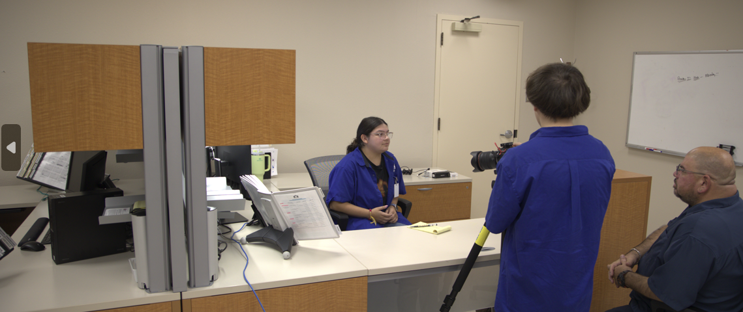
My supervisor would say the standout things ……
“ One of the standout things Luis did was quietly take some amazing photos of the entire internship program. The composition, clarity, and vision for storytelling were amazing, and leave a legacy of this summer program for years to come. “ Allison Boeger, Sr. Publications Editor
Presenter: Luis Hernandez

Slide 9
Examples of my work
Presenter: Luis Hernandez

Slide 10
My supervisor would say the
“One of the standout things Andrea did was design all of the Systems of Care Web Banners for the year. With little initial direction, she created beautiful designs to make families feel welcome and want to engage with the resources available to them.” Allison Boeger, Sr. Publications Editor
Presenter: Andrea Maldonado

Slide 11
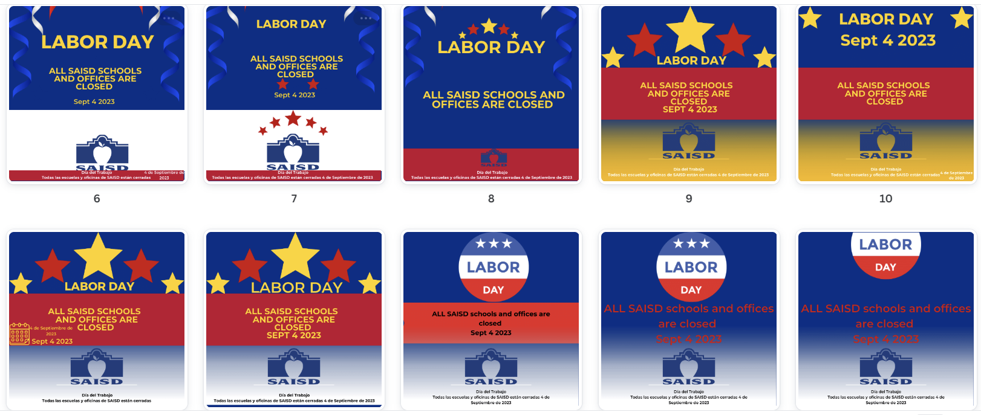
Examples of my work
Presenter: Andrea Maldonado

Slide 12
My supervisor would say the
“One of the standout things Joshua did was his relentless pursuit of tasks. We could give him a project and he would reach out to everyone he could to get the job done. Even if people didn’t respond/weren’t there, he kept going and asking to get things done.” Allison Boeger, Sr. Publications Editor
Presenter: Joshua Bryant

Slide 13
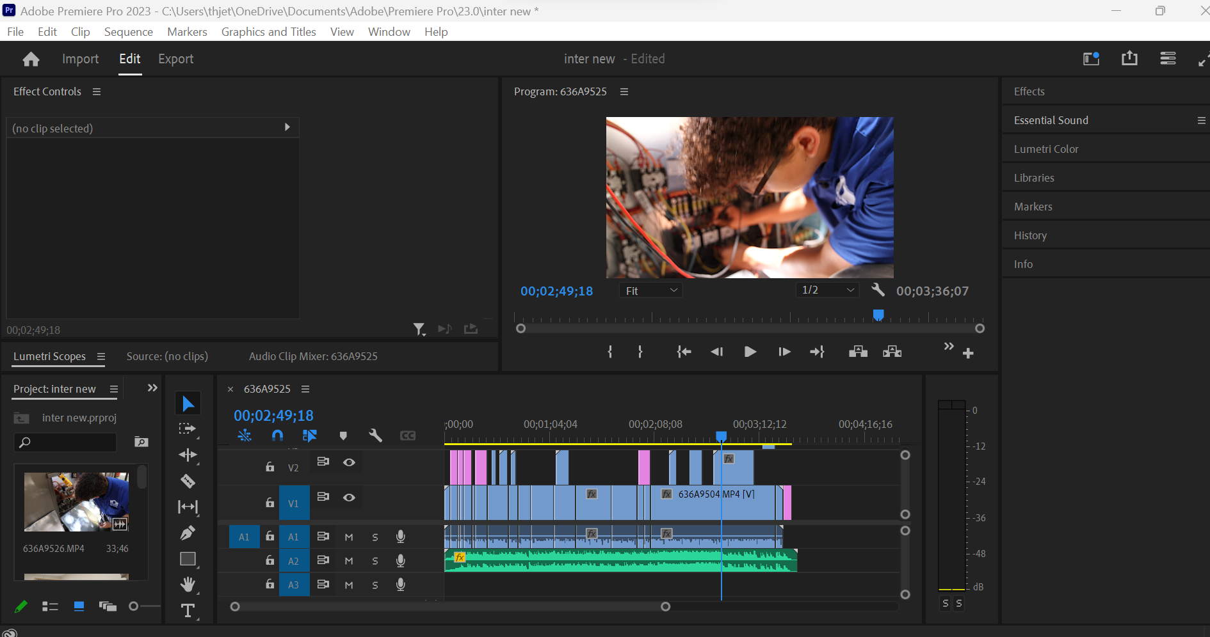
Examples of my work
Presenter: Joshua Bryant

Slide 14
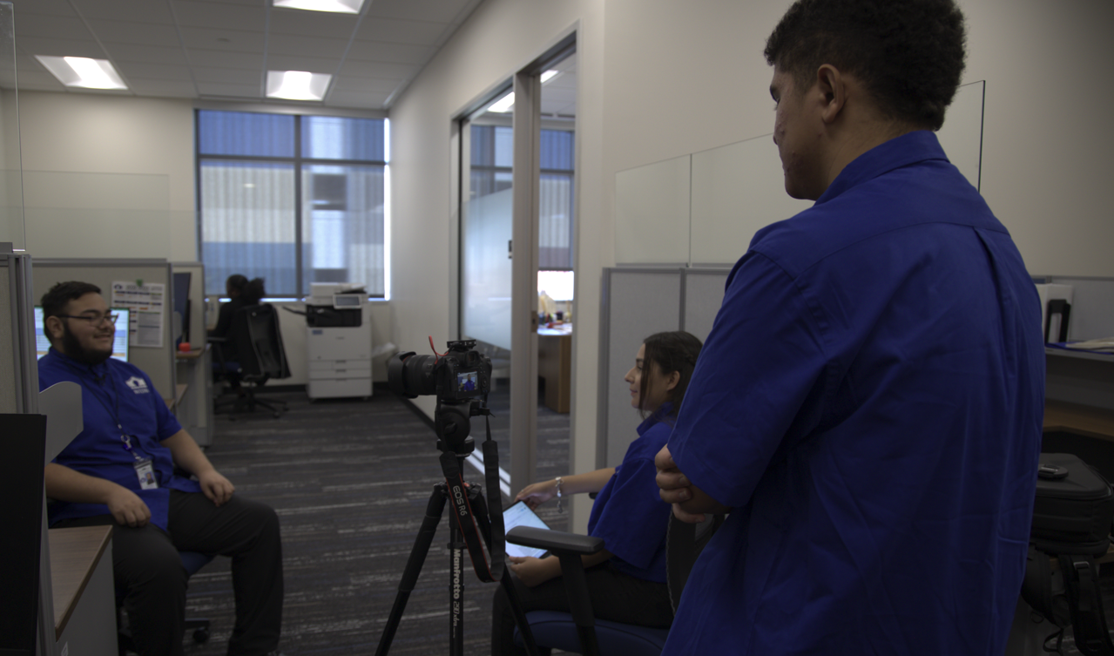
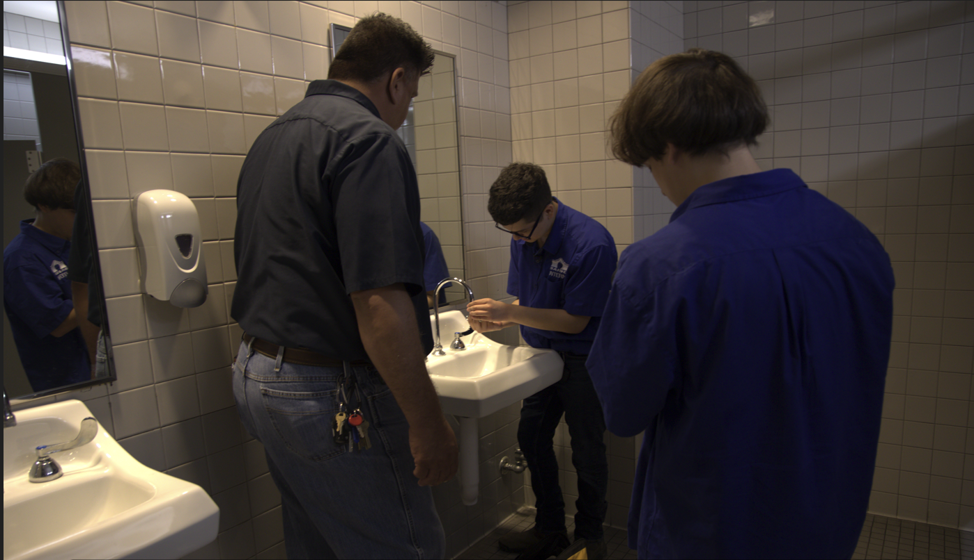
On thing that surprised me….
Luis- I learned to take professional pictures and edit better in Adobe Premiere Pro.
Andrea-I learned how to make graphics.
Joshua- the team work that comes with the projects we get.

Slide 15
A Highlight of My Experience was….
The favorite part of my experience was going to different places to take pictures.
Presenter: Luis Hernandez

Slide 16
A Highlight of My Experience was….
My favorite part was working with everyone and learning how to do new things.
Presenter: Andrea Maldonado

Slide 17
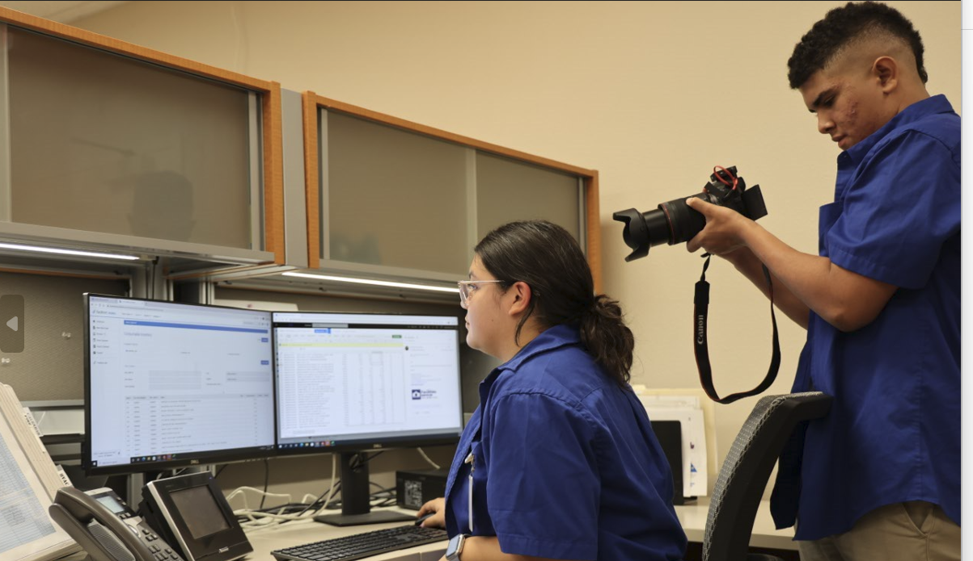
A Highlight of My Experience was….
The highlight of my experience was filming the interviews and editing them on Adobe Premiere Pro.
Presenter: Joshua Bryant

Slide 18
In Conclusion…
I feel I gained communication skills and time management skills.
I would tell my friends to apply for an internship because it will help you in the long run on finding a suitable job for you.

Slide 19
Thank you

Slide 20
Nathan Landin
at FMSR , Procurement Services, & IT
Date: 08/04/2023
Presenter: Nathan Landin

Slide 21
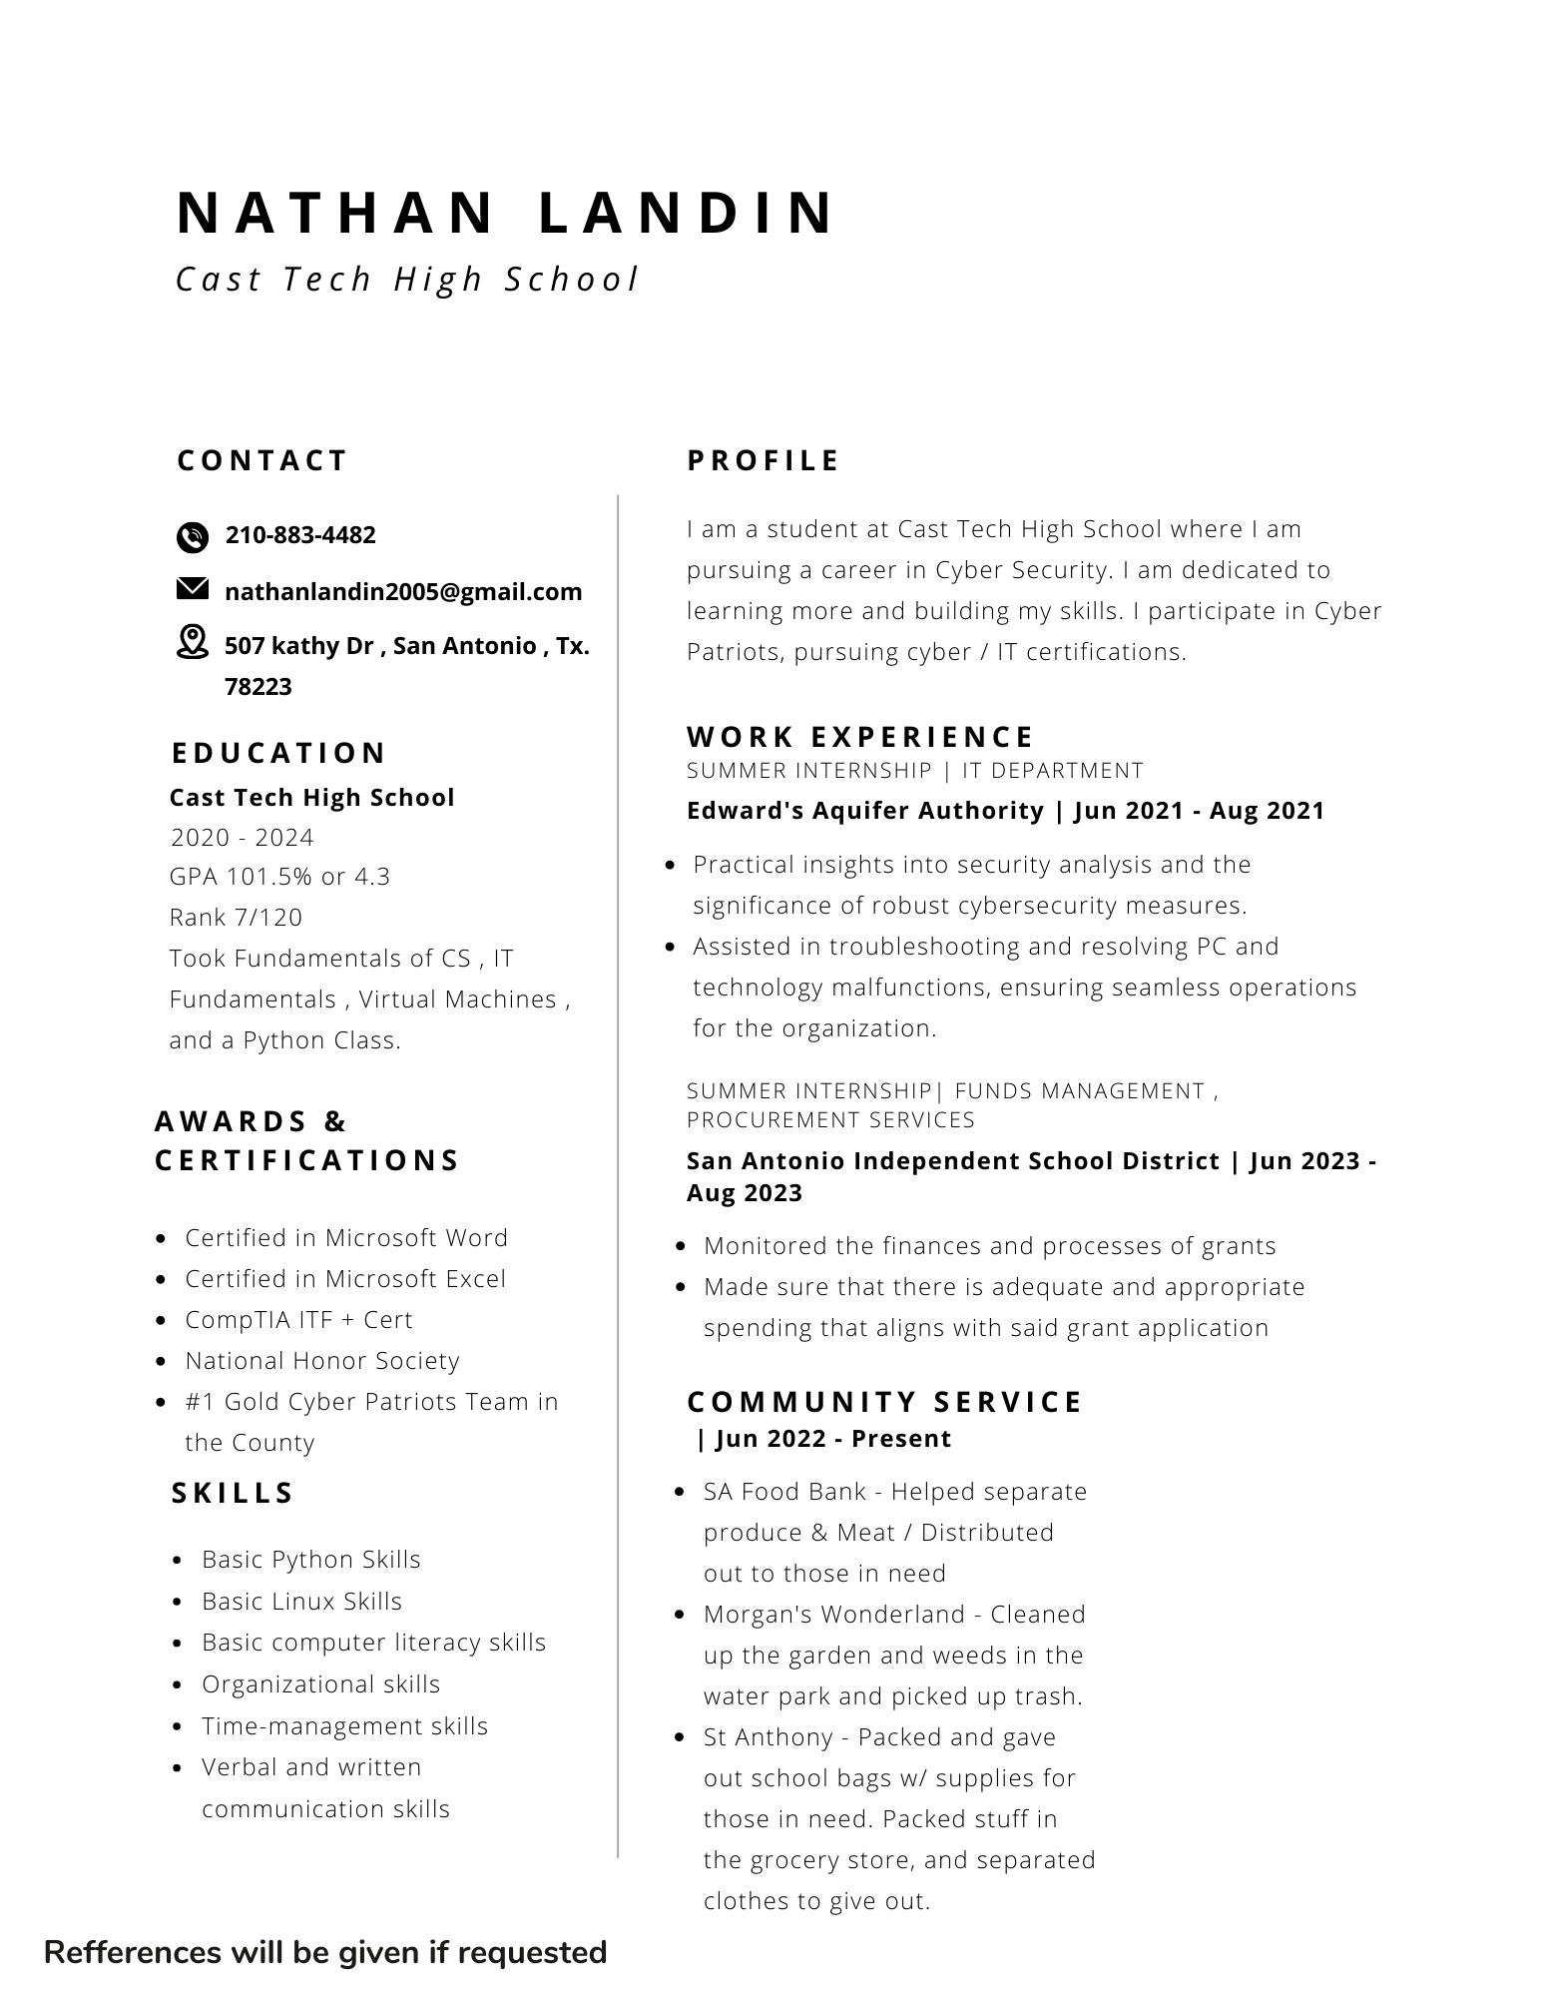
Nathan Landin
Hi, my name is Nathan, and I am an upcoming senior at Cast Tech HS with hopes to go into Cyber Operations preferably with the USAFA. One thing I enjoy in my free time is music, especially playing guitar!

Slide 22
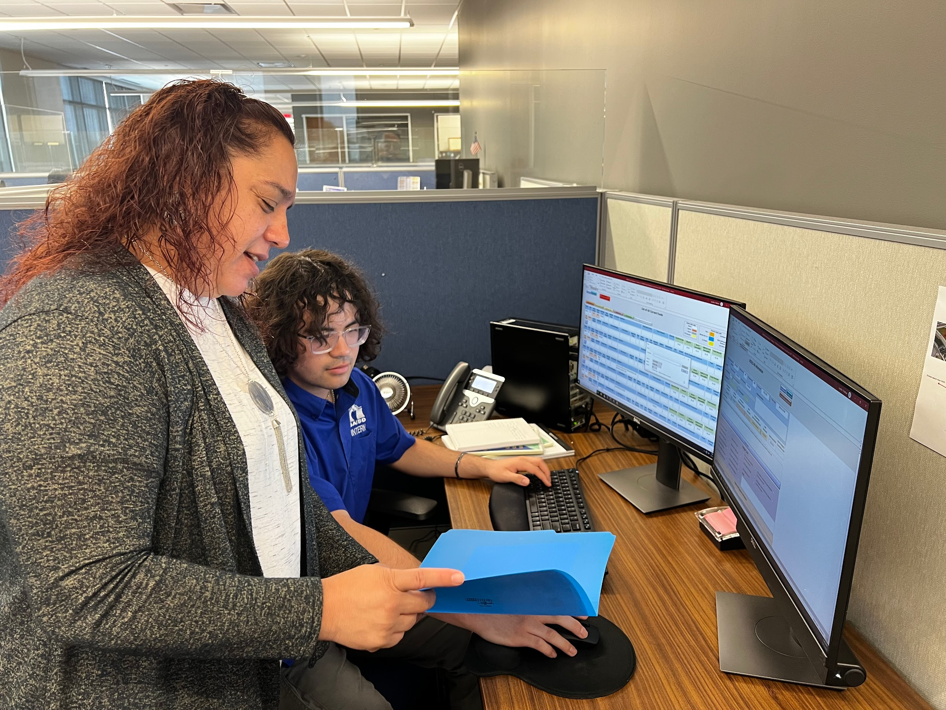
FMSR Department Highlight
“ We monitor the finances and processes of grants, making sure that there is adequate and appropriate spending that aligns with said application“. “We make sure the students are getting the resources they need in time, so they can get the learning they deserve.” - Annette Q.

Slide 23
Procurement Department Highlight
“ We oversee the procurement goods and services for the district within the state and federal statutes “ - Kim Tocci
Procurement Services has a team of specialists that provide procurement guidance and ensure competitive procurement of construction, supplies, services, and equipment needed to provide quality educational services to the students of SAISD.

Slide 24
IT Department Highlight
The Information Technology Department oversees a wide range of programs dedicated to the implementation and support of technological systems that positively impact classroom instruction, data analysis and reporting, student testing, daily staff work functions and other processes that contribute to the District’s overall success.

Slide 25
FMSR Job Description
My job at FMSR was to learn about grants and
how they worked within SAISD.
My responsibilities were:
Populated preliminary grant information for special revenue grants (skeletons)
Prepared D-30s in the database (allocation of personnel units)
Reviewed and updated expired grants in the FMSR Database

Slide 26
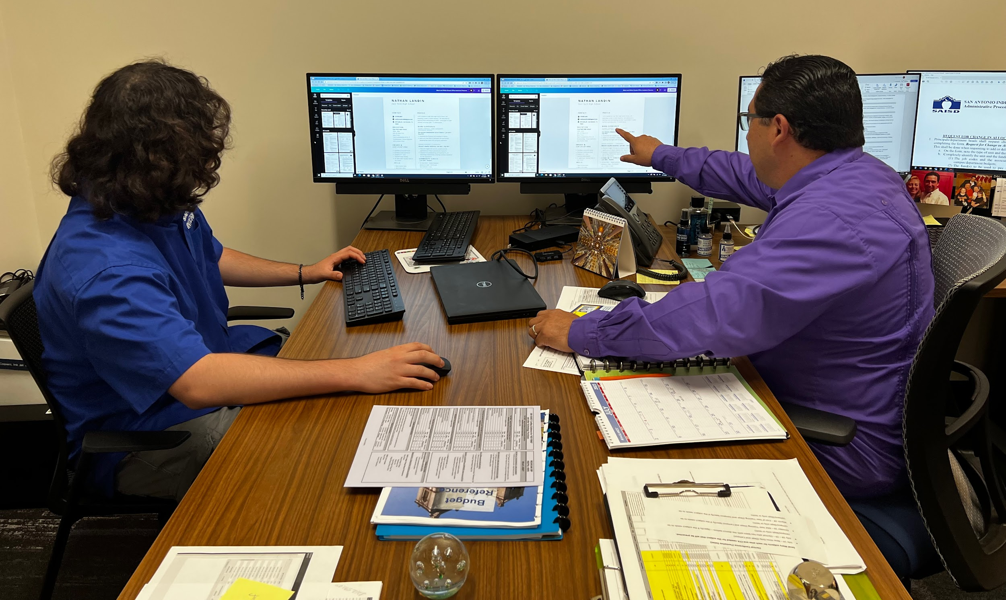
Procurement Job Description
My job at Procurement was to clean up the bonfire database ( max allotted is 2000 contracts), and make an excel spreadsheet of all the contracts, PO #, and money spent in case we get audited.

Slide 27
IT Job Description
My job at IT was to learn and ask all the questions I can to prepare me for my future career in the cyber force. I shadowed with the incident responder, where we investigated an alert on a possible data dump on user credentials, and possibly more PII.

Slide 28
My supervisor would say the best thing I did was…
The best thing that I did was following directions and not needing much supervision. I caught on quickly and once a task was finished I would check in to see what else I could assist on.

Slide 29
On thing that surprised me….
I had no idea how much knowledge and expertise you have to know about budget codes and grants to make sure your correctly and efficiently helping the grant process get completed so the schools and those in it get what they need.
Photos in this section are appropriate!

Slide 30
On thing that surprised me….
I had no idea how often companies get attacked either for malicious reasons or just basic user error, it’s not always a person singling out a company, a lot of the time it’s someone clicking on the wrong link or what they think is something for work, but rather inserts a hidden backdoor in the system!

Slide 31
A Highlight of My Experience was….
My favorite thing about my internship was learning about how grants work and how important it is to know how they work, because without the state and federal grants our schools wouldn’t be able to provide the students with what’s needed. Grants even pay for employee salaries!

Slide 32
A Highlight of My Experience was….
Another highlight of my experience was
being in the Cyber Security department in general. Seeing how fast and knowledgeable all the workers were really inspired me to start learning more again and work on my certs.

Slide 33
In Conclusion…
The skills I gained were:
Knowledge of the account codes and finance system
Demonstrated ability to maintain strict confidentiality
Ability to follow oral and written instructions
Demonstrated ability to work as a member of the team
I would tell my friends to apply for an internship because it helps build your professional skills and gets you ready for your future career.
Overall it was a great experience.

Slide 34
Thank you
Date: 00/00/2023
Presenter: Nathan Landin

Slide 35
Trinity Adams-Martin
at Accounts Payable
​
Date: 7/10/2023

Slide 36
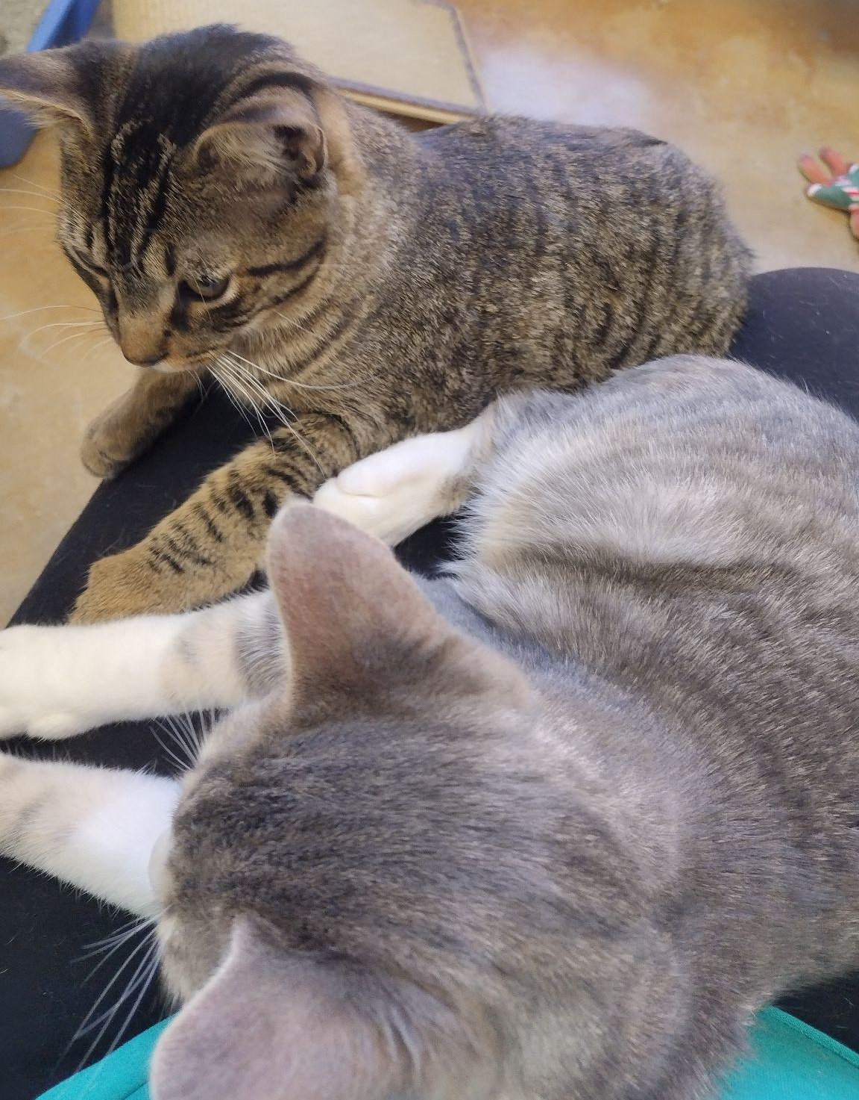
Trinity Adams-Martin
I am a rising senior at St. Philip’s ECHS where I am studying for my Associate of Arts. After graduating, I want to study mathematics or statistics with hopes of becoming an actuary. Something interesting about me is that I started volunteering at ADL and my favorite book is The Perks of Being a Wallflower

Slide 37
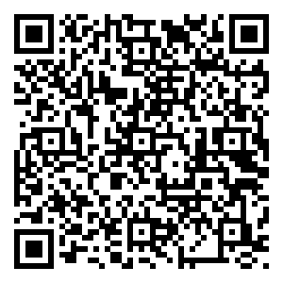
My Resume

Slide 38
Department Highlight
The accounts payable department processes payments for goods, services, and non-salary expenses. Their responsibilities are that they utilize funding correctly by processing invoices in a timely manner with a great deal of accuracy.
To put it simply, accounts payable are the people who make sure everything is paid on time and with the right amount.

Slide 39
Job Description
Through this internship, I was able to communicate with different vendors to request and review W/9s. I also assisted with reconciling vendor statements. In addition to these things, we established that one of my goals at the beginning was to gain proficiency in Excel, and I was able to achieve this through learning various excel functions.

Slide 40
My supervisor would say the best thing I did was…
Getting quickly adjusted to calling people over the phone. I was very nervous about having to speak over the phone, so I asked to listen in on someone doing the first two or so calls. Afterwards, I knew what to say and what to ask for.

Slide 41
On thing that surprised me….
One thing that surprised me is the different kinds of people here. Going to school, I never thought about how much work goes into keeping our district running, but being here surrounded by people whose work directly affects me, I’ve developed a sense of respect and gratitude for every worker I pass here.

Slide 42
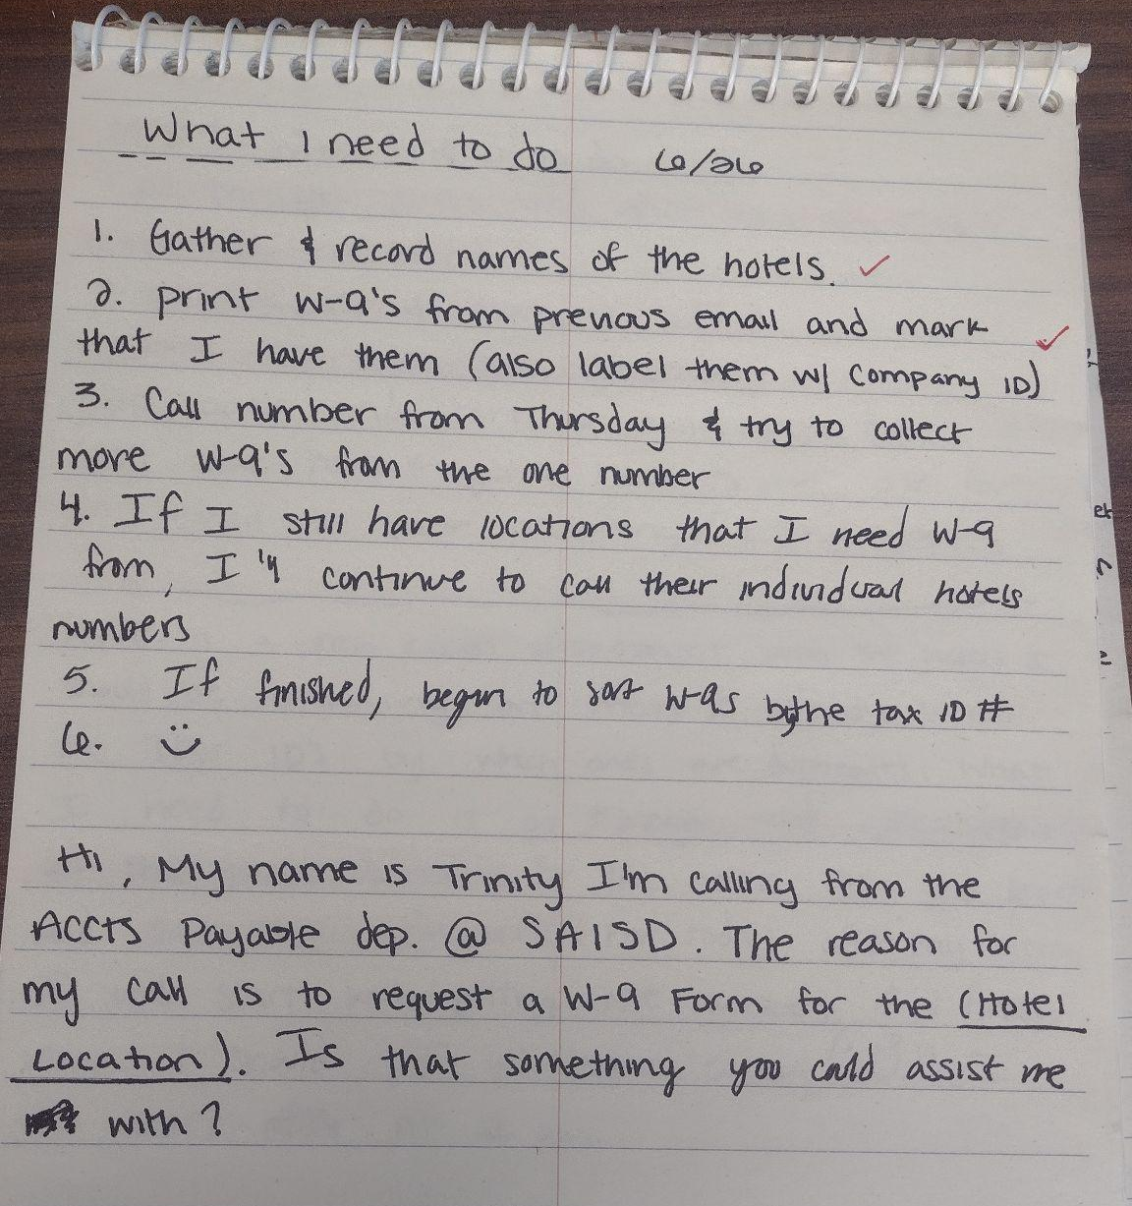
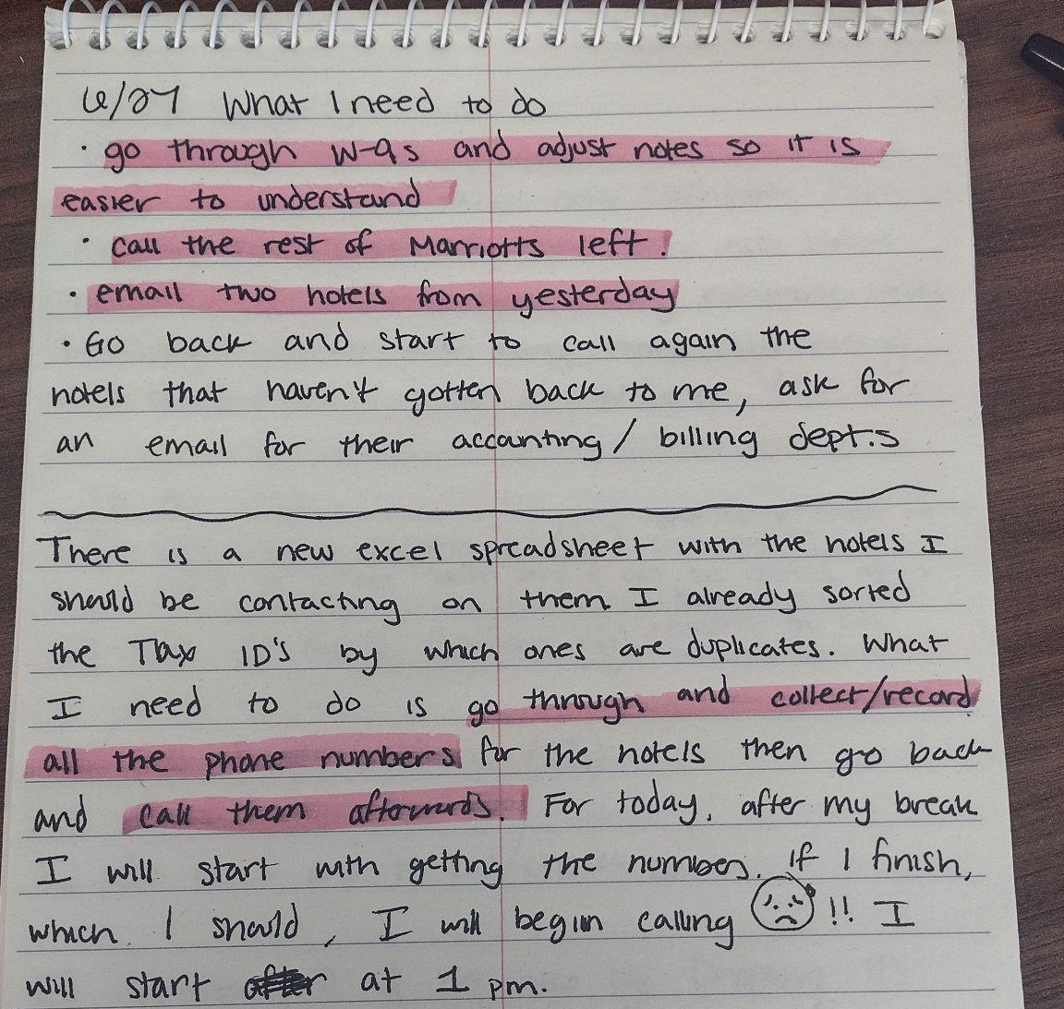
A Highlight of My Experience was….
Planning before I start my tasks was one of my favorite things I did

Slide 43
A Highlight of My Experience was….
Going to a principal’s meeting with my supervisor. It was fun to see all the principal’s in a student position, being taught how to manage their budgets. I also got to see my middle school principal, Ms. Dixon.

Slide 44
In Conclusion…
During my time here, I feel that I gained better communication skills, an understanding of what it is like in a working environment, and I was able to improve my Excel skills.
I have told my friends to apply for an internship because it’s a great opportunity to get real world experience and it's a wonderful chance for them to grow.

Slide 45
Thank you
Date: 7/26/2023
Presenter: Trinity Adams-Martin

Slide 46
Deus Arce-Silva
at Operations/Plumbing
Date: 7/31/2023
Presenter: Deus Arce-Silva

Slide 47
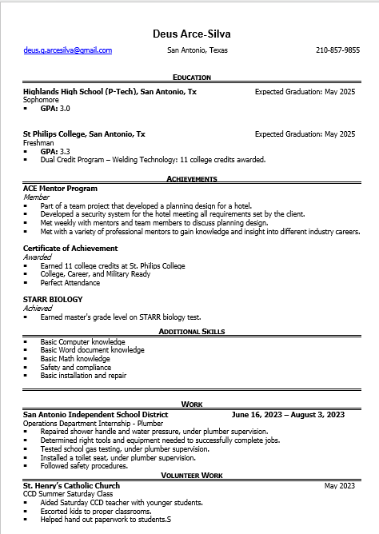
Introduction
Highlands HS
11th
Welding
I play video games.

Slide 48
Department Highlight
We repair and install pipes, valves, and other plumbing fixtures
They help repair and install any plumbing related assignment. They help keep the water and gas system working.

Slide 49
Job Description
My job is to assist the professional plumbers by helping them in assignments.
My supervisor has or is teaching me to how to be proficient on job safety, problem solving, and repair and install plumbing related issues.

Slide 50
My supervisor would say the best thing I did was…
The best performance task they said I did was when I fixed a shower valve by myself.

Slide 51
On thing that surprised me….
Yes, I am very weak, also that feld work will give you more information about what to do then a book.

Slide 52
A Highlight of My Experience was….
Seeing how the professionals problem solve and how they put their plan into action.

Slide 53
A Highlight of My Experience was….
My favorite thing about the internship was how each job they make sure to be cost effective and efficient.

Slide 54
In Conclusion…
I feel I gained experience on the working feld and how to be professional.
I would tell my friends to apply for an internship because it would be a easy to see if you will be interested in any of the job types in the district.

Slide 55
Thank you
Date: 7/31/2023
Presenter: Deus Arce-Silva

Slide 56
Daniel Aguilera
at the Payroll Department
Date: 08/02/2023

Slide 57
Daniel Aguilera
I’m an upcoming junior at Burbank High School. I currently have no particular career pathway but have always found finance, and all it entails, interesting. And one interesting fact about me is that I like to collect comics.

Slide 58
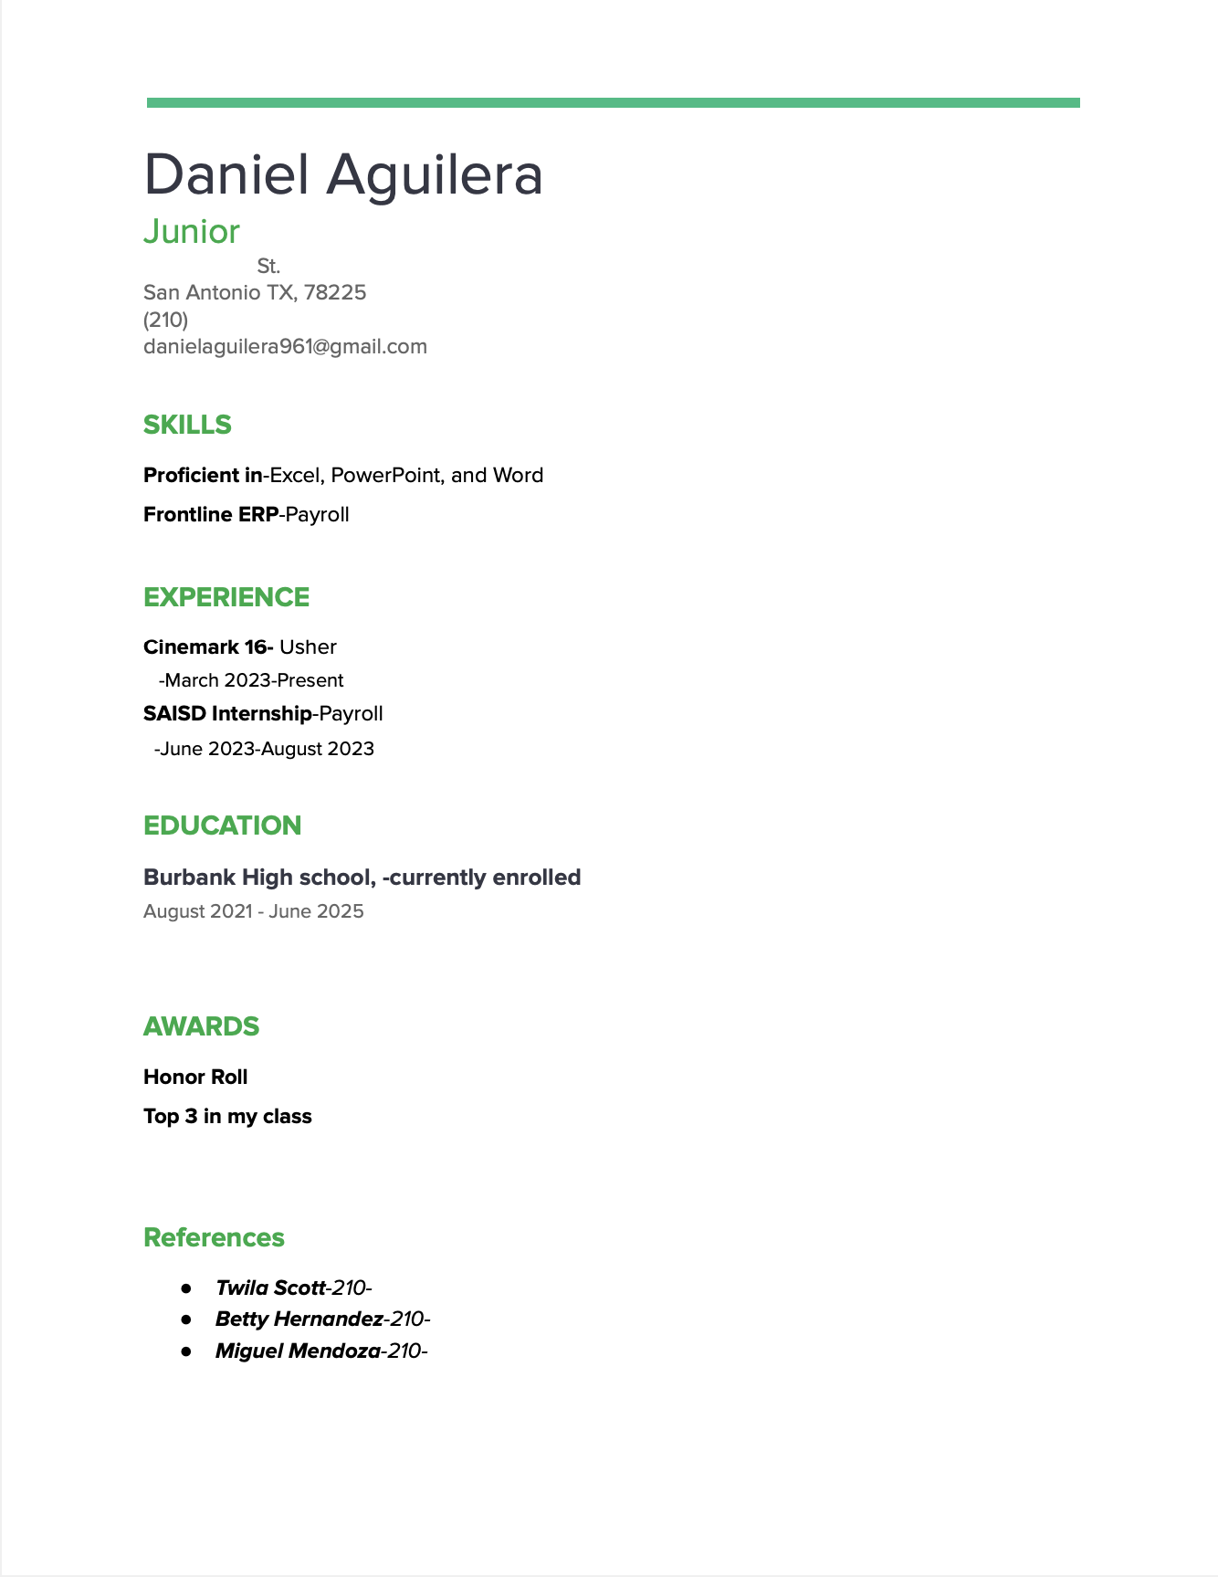
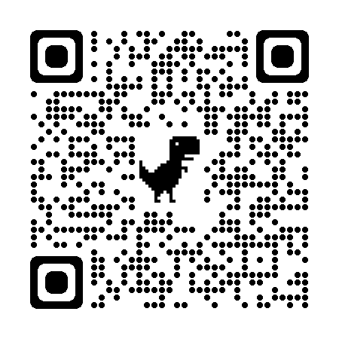

Slide 59
Department Highlight
What does the department that you work for do?
How do they help the organization?
By making sure everything concerning pay is correct or needs correcting, ensuring the organizations financial stability.

Slide 60
Job Description
Keep supervisor apprised of daily progress on assigned tasks.
Perform required duties according to standard practices.
Obtain organizational, communication and interpersonal skills.
Follow district guidelines in maintaining a neat and orderly work environment and confidentiality.
Support mission of school district by serving as a positive role model for students.
Created and formatted excel spreadsheets.
Created PowerPoints
Answered, Placed, diverted calls as needed.
Filed, organized, and distributed correspondence.
Shadowed payroll specialists.
Reviewed and totaled summer school timecards.
Proficiencies in:
Customer Service
Microsoft Office
Frontline ERP

Slide 61
My supervisor would say the best thing I did was…
That I “articulated very well” when passing on information.

Slide 62
On thing that surprised me….
How much work and processing it actually takes to put someone on the payroll, and how the office functions when payday comes around.

Slide 63
A Highlight of My Experience was….
Getting familiar on how payroll interacts with other departments with different occurrences.

Slide 64
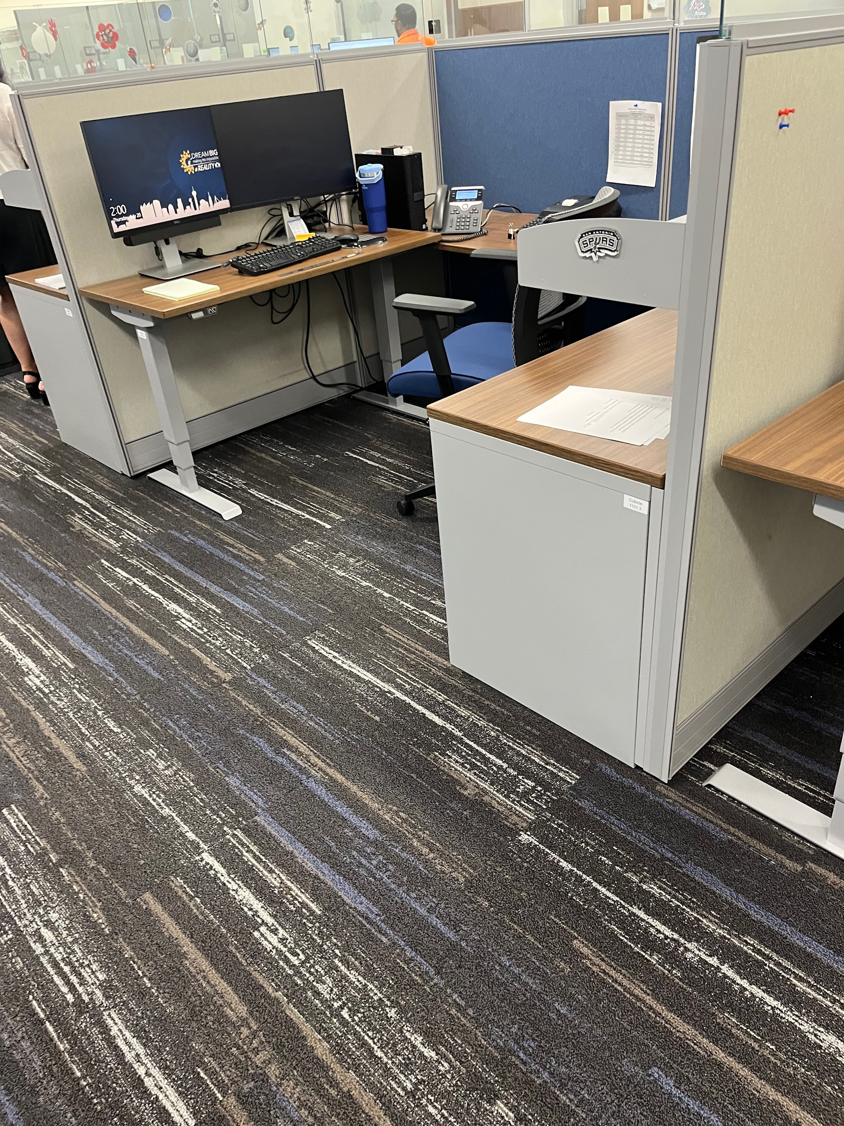
A Highlight of My Experience was….
…really just getting to work and learn through experienced people.

Slide 65
In Conclusion…
I feel I gained a better understanding of how an office environment works, an improvement of microsoft office skills, and an overall growth in my communication skills.
I would tell my friends to apply for an internship because it was a very fun experience with useful information and skills that will definitely pay off in the long run.

Slide 66
Thank you
Date: 08/04/2023
Presenter: Daniel Aguilera

Slide 67
Carlos Sanchez
at the Internal Audit Department
​
Date: 08/04/2023

Slide 68
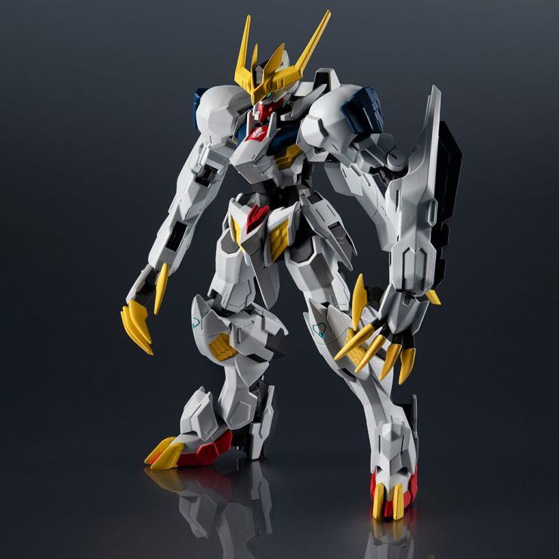
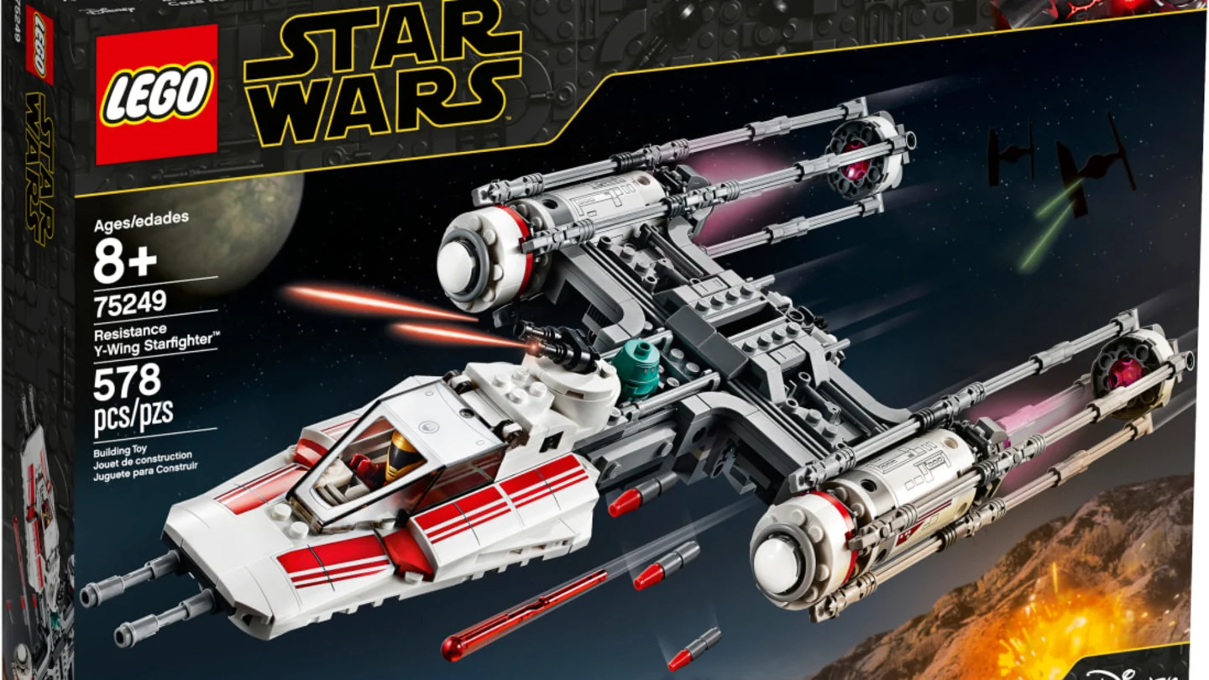
Carlos Sanchez
Upcoming Junior(11th) at Thomas Edison High School.
I want to become an Auditor.

Slide 69
Department Highlight

Slide 70
Department Highlight
Fraud Hotline: where employees and citizens can anonymously report
Missing Cash
Abuse of Work Hours
Embezzlement
Nepotism
Falsified Documents
Personal Use of District Assets
Management Improprieties
Health Benefits Improprieties
Theft of Equipment and Supplies
Computer/Technology Abuse
Conflict of Interest
Workers Compensation Abuse
Vendor Kickbacks
Copyright Infringement
Other Improprieties

Slide 71
Job Description
Assist in audit related tasks that support ongoing audits and activities such as helping with completing tasks in the planning phase (for sample selection), field work phase (workpapers for testing performed), and inventories.
Using the department's audit management system create a watch list of open audit issues.
Shadow an audit professional and get insight into the operations of the district.
My Supervisor and I agreed the proficiencies to demonstrate would be communication, work ethic, and data-managing.

Slide 72
My supervisor would say the best thing I did was
Followed direction with minimum supervision on several tasks performed
Asked questions to clarify the details of the assignments in order to complete them accurately
Communicated effectively
Treated staff professionally and respectfully
Stayed vigilant in order to meet deadlines

Slide 73
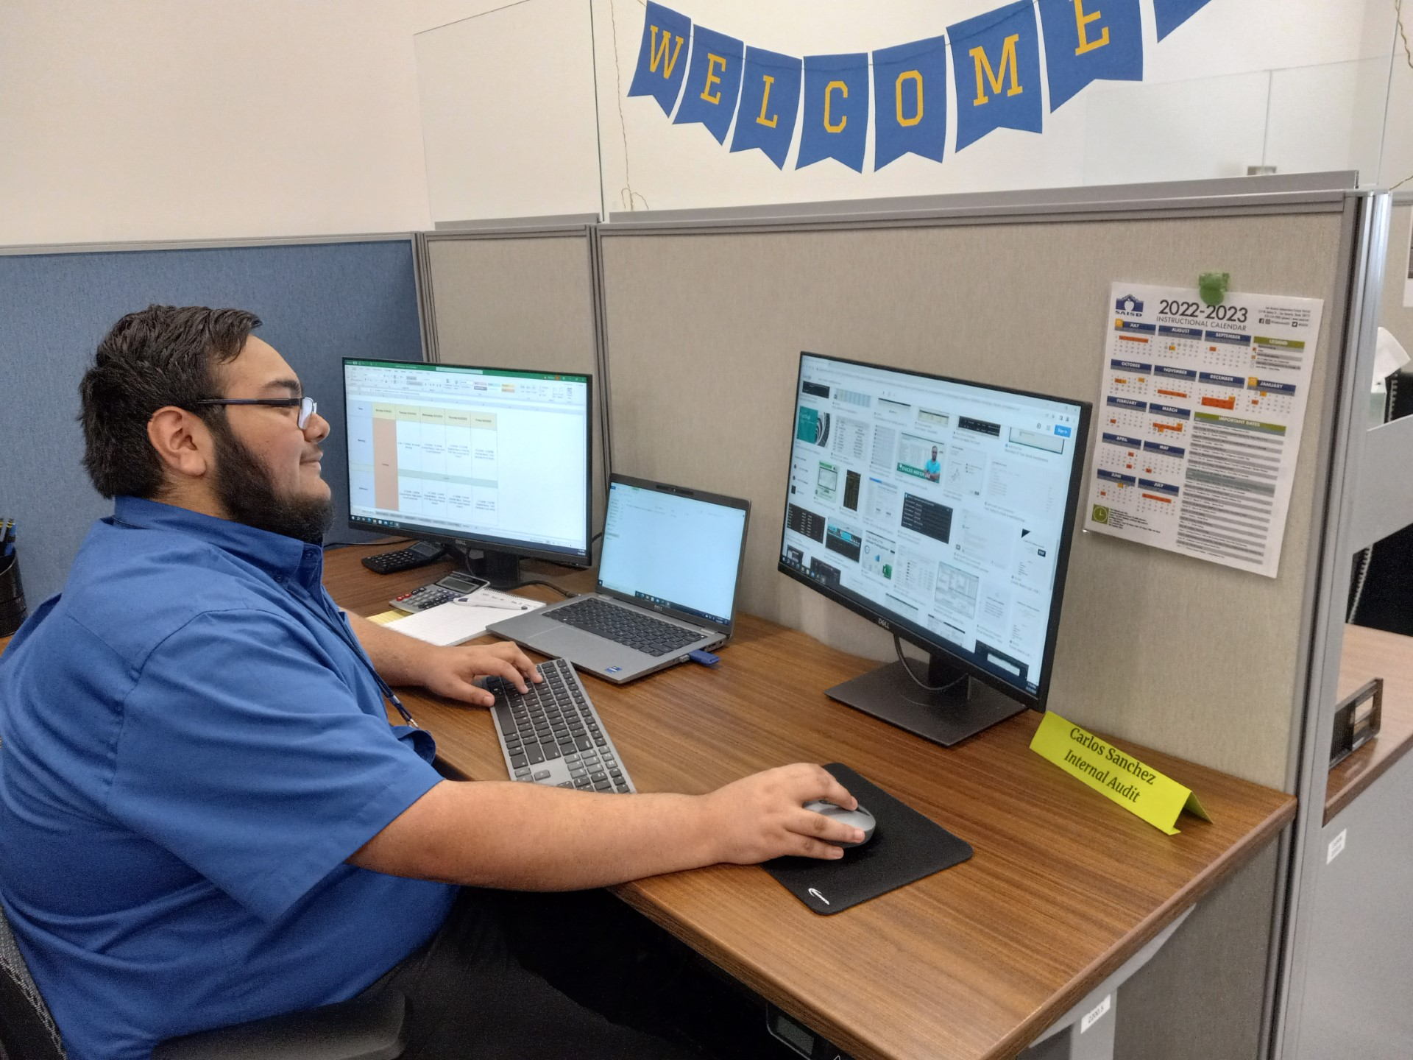
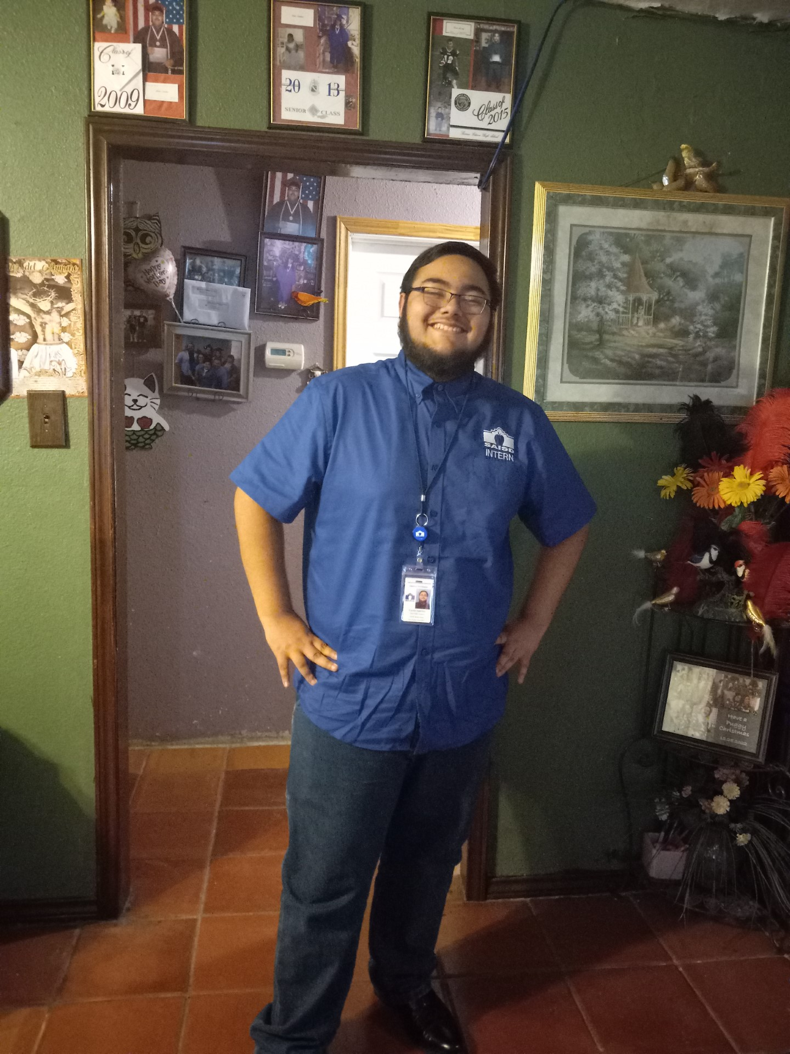
One thing that surprised me
Was how fun it would be to complete work and how fast I would finish up my assignments

Slide 74
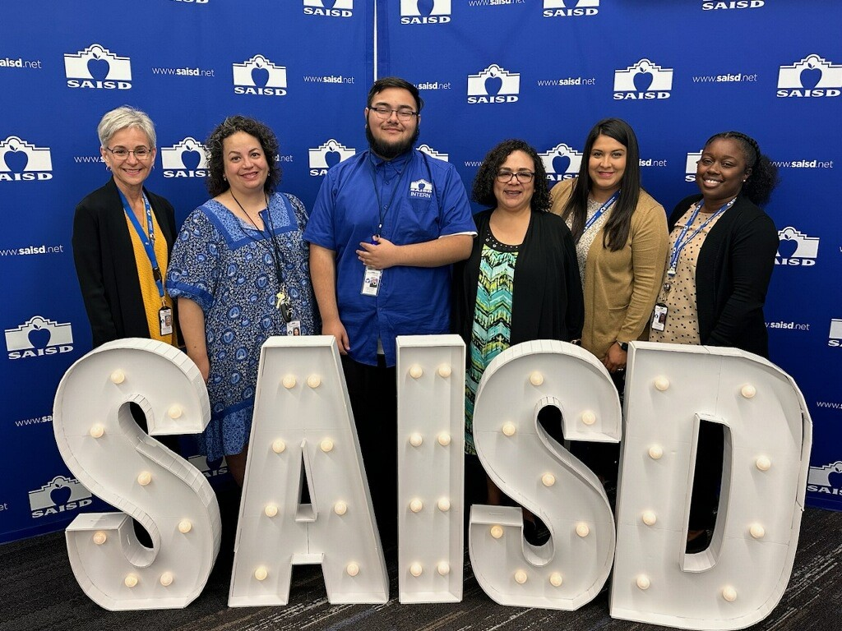
A Highlight of My Experience
Would be talking and learning from the Auditors in the department.

Slide 75
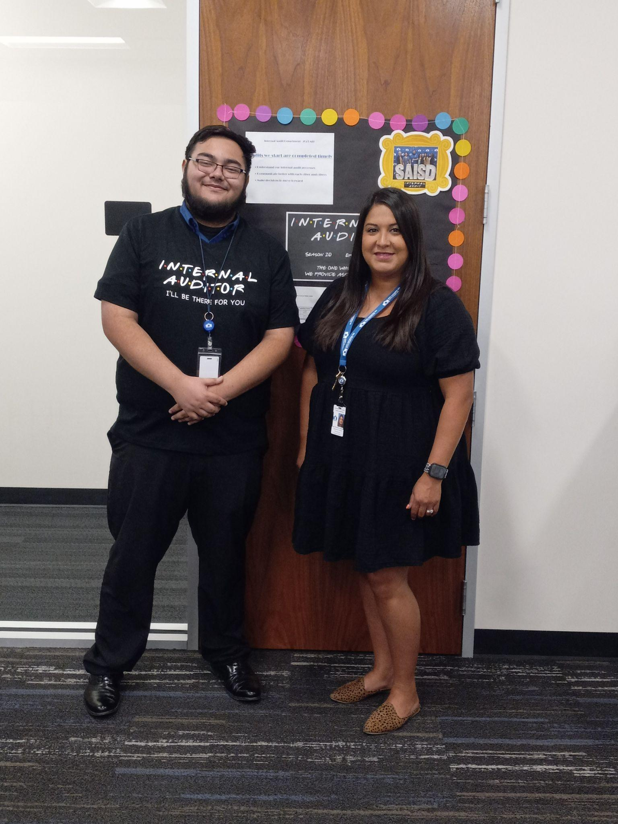
A Highlight of My Experience
Would be performing the Annual Inventory at the Facilities Warehouse.
Counted 25 items from paper to shelf
Counted an additional 10 items from shelf to paper

Slide 76
In Conclusion
I feel I gained a better understanding of the sets of skills and knowledge of an Internal Auditor. I learned a few technical skills on Excel with formulas and formatting.
I would tell my friends to apply for an internship because it was a fun experience to learn and develop soft skills. Another thing would I would tell them to apply for one is to be exposed to a different setting.

Slide 77
Thank you
Date: 08/04/2023
Presenter: Carlos Sanchez

Slide 78
Dominic Goff
at Operations: HVAC
Date: 07/16/2023

Slide 79
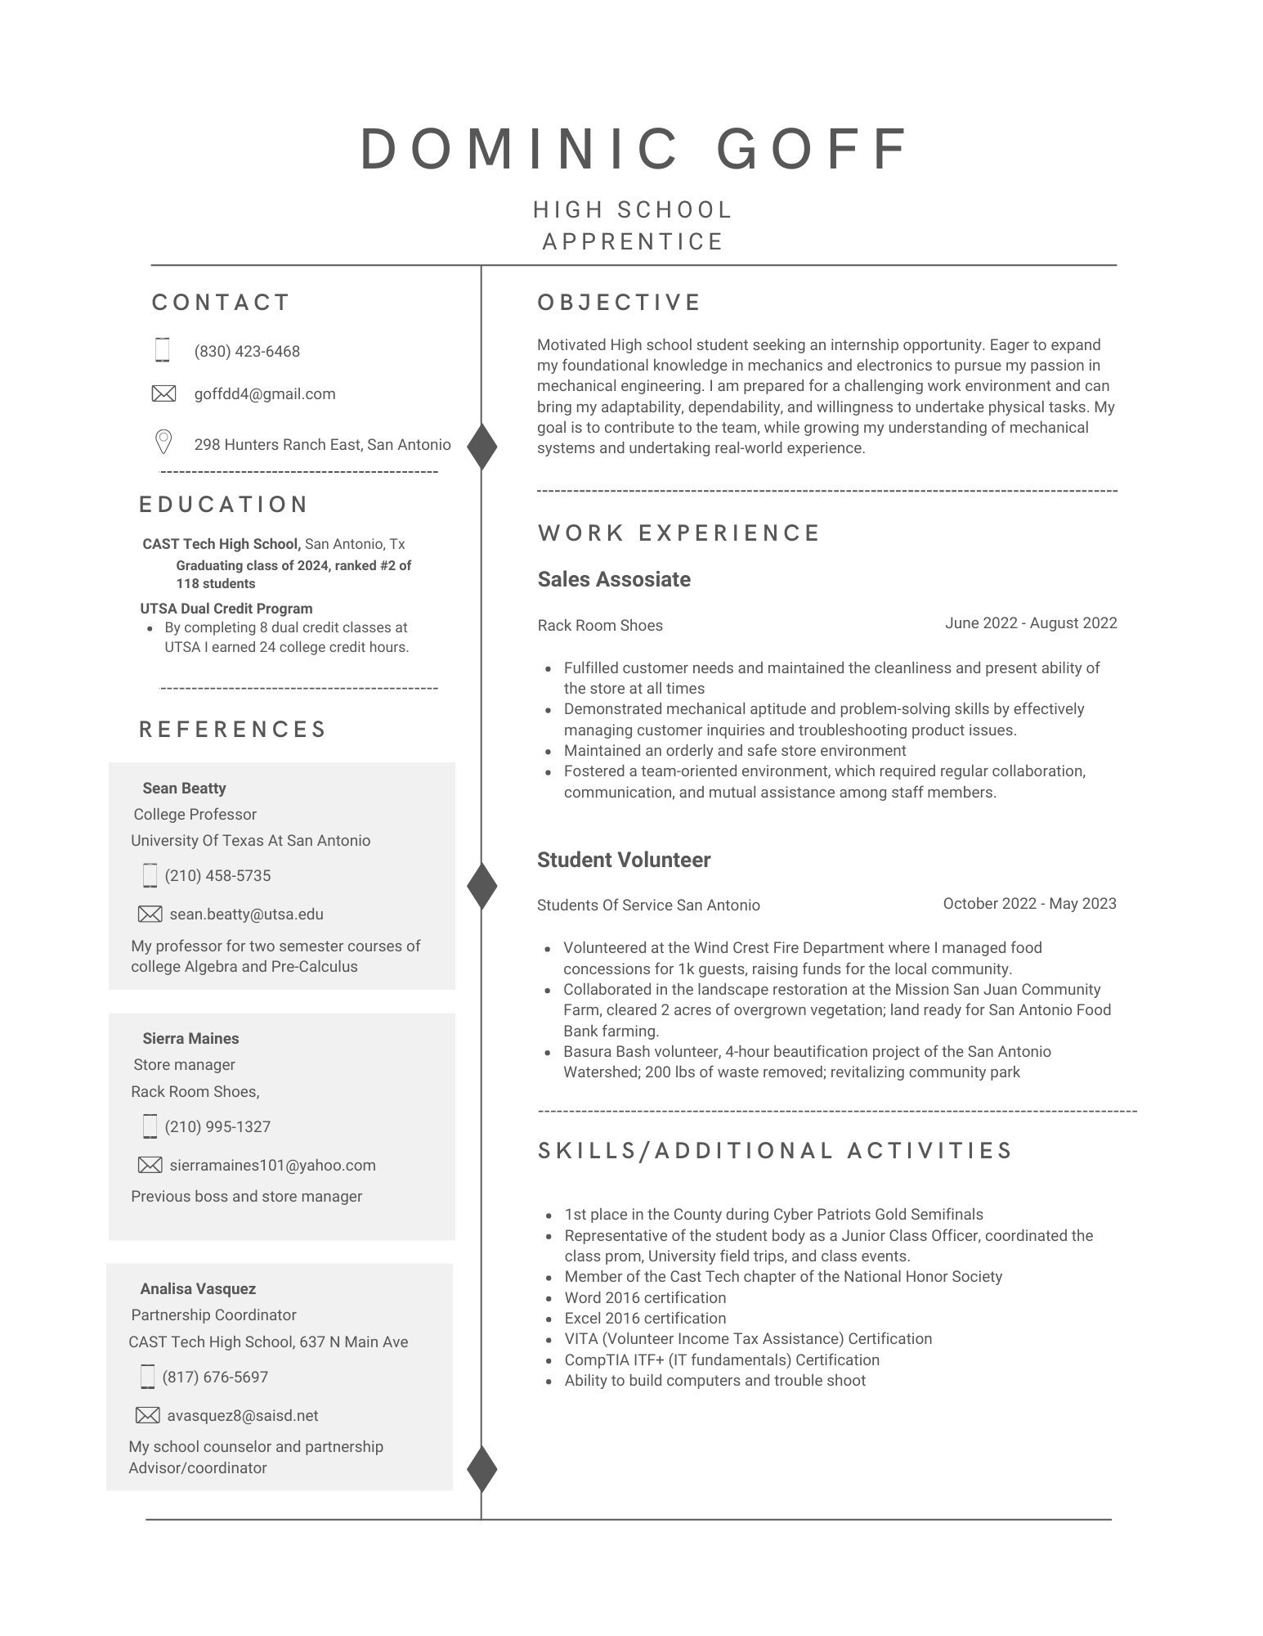
Introduction
Hello everyone!
Some things u want you to know about me is that I…
go to Cast Tech High School
am a Rising Senior
an aspiring engineer
like cars and playing basketball

Slide 80
Department Highlight
The Facilities/Operation Department is responsible for facility maintenance, custodial and grounds upkeep, and management of the physical plants serving all school and support facilities.
For the HVAC office we repair and service AC systems on campuses, this means the technicians are tasked with making sure indoor temperature is optimal and running correctly. This could include fixing leaks, installation errors, and faulty or worn parts/equipment.
Motto: Gets Work Done

Slide 81
Job Description
I’m am to supposed to assists and learn alongside experienced technicians while they troubleshoot and repair ac systems. My responsibilities are mainly getting see what an HVAC technician goes through in a day and picking up skills of the trade by observing and assisting them during tasks.
Me and Charlie agreed that I would be proficient in differentiating BAS systems, understanding the refrigerant cycle, and basic ac systems components.

Slide 82
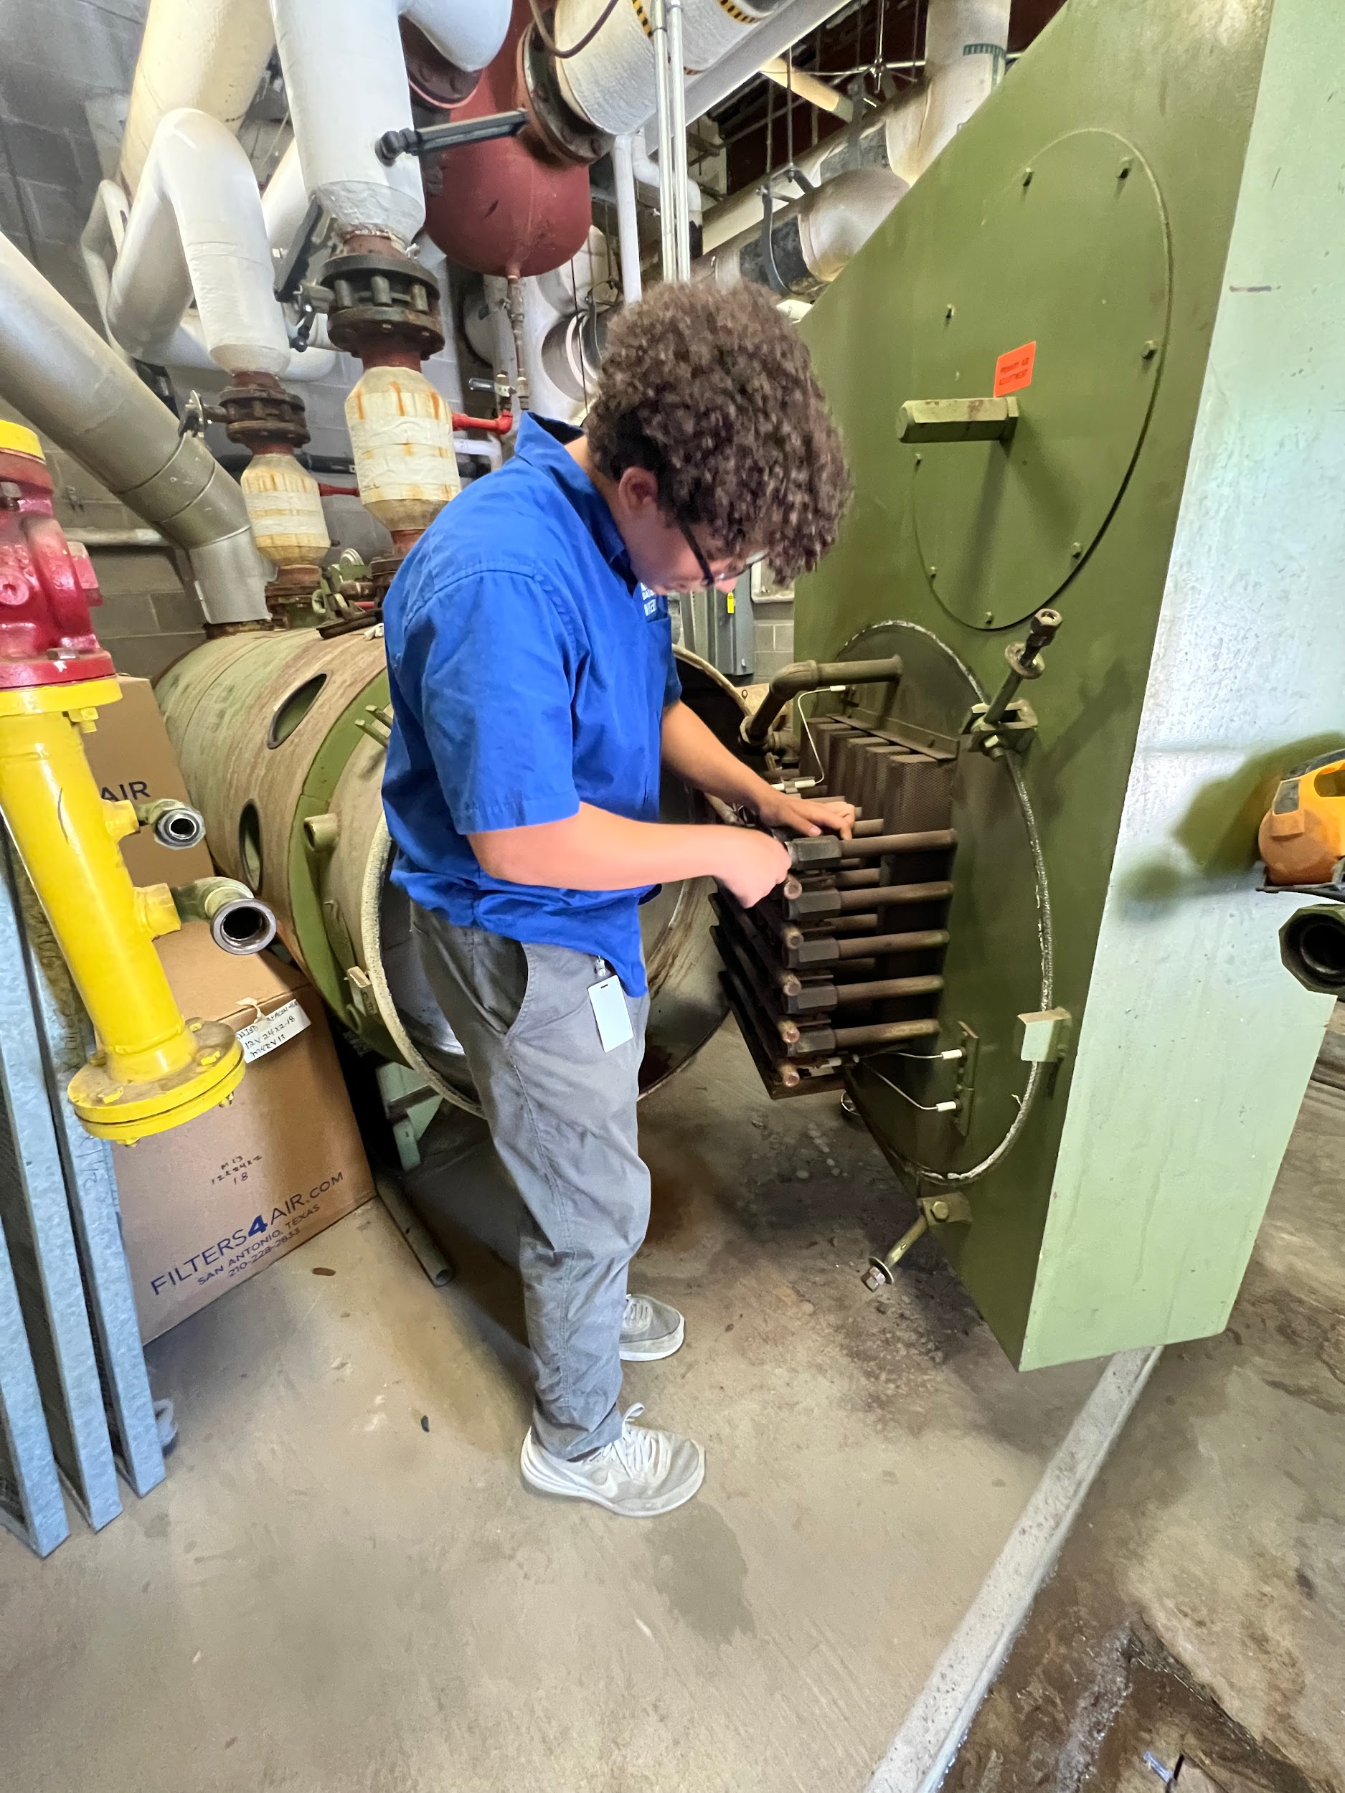
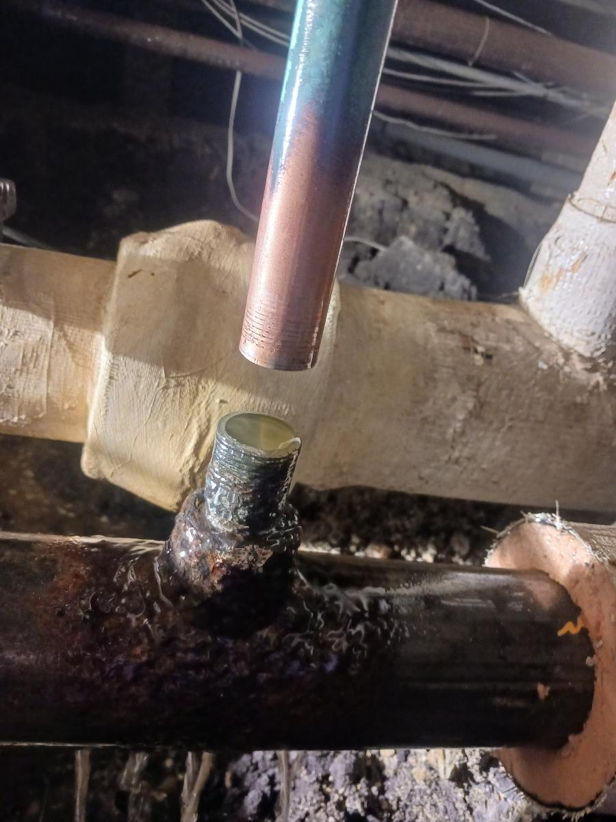
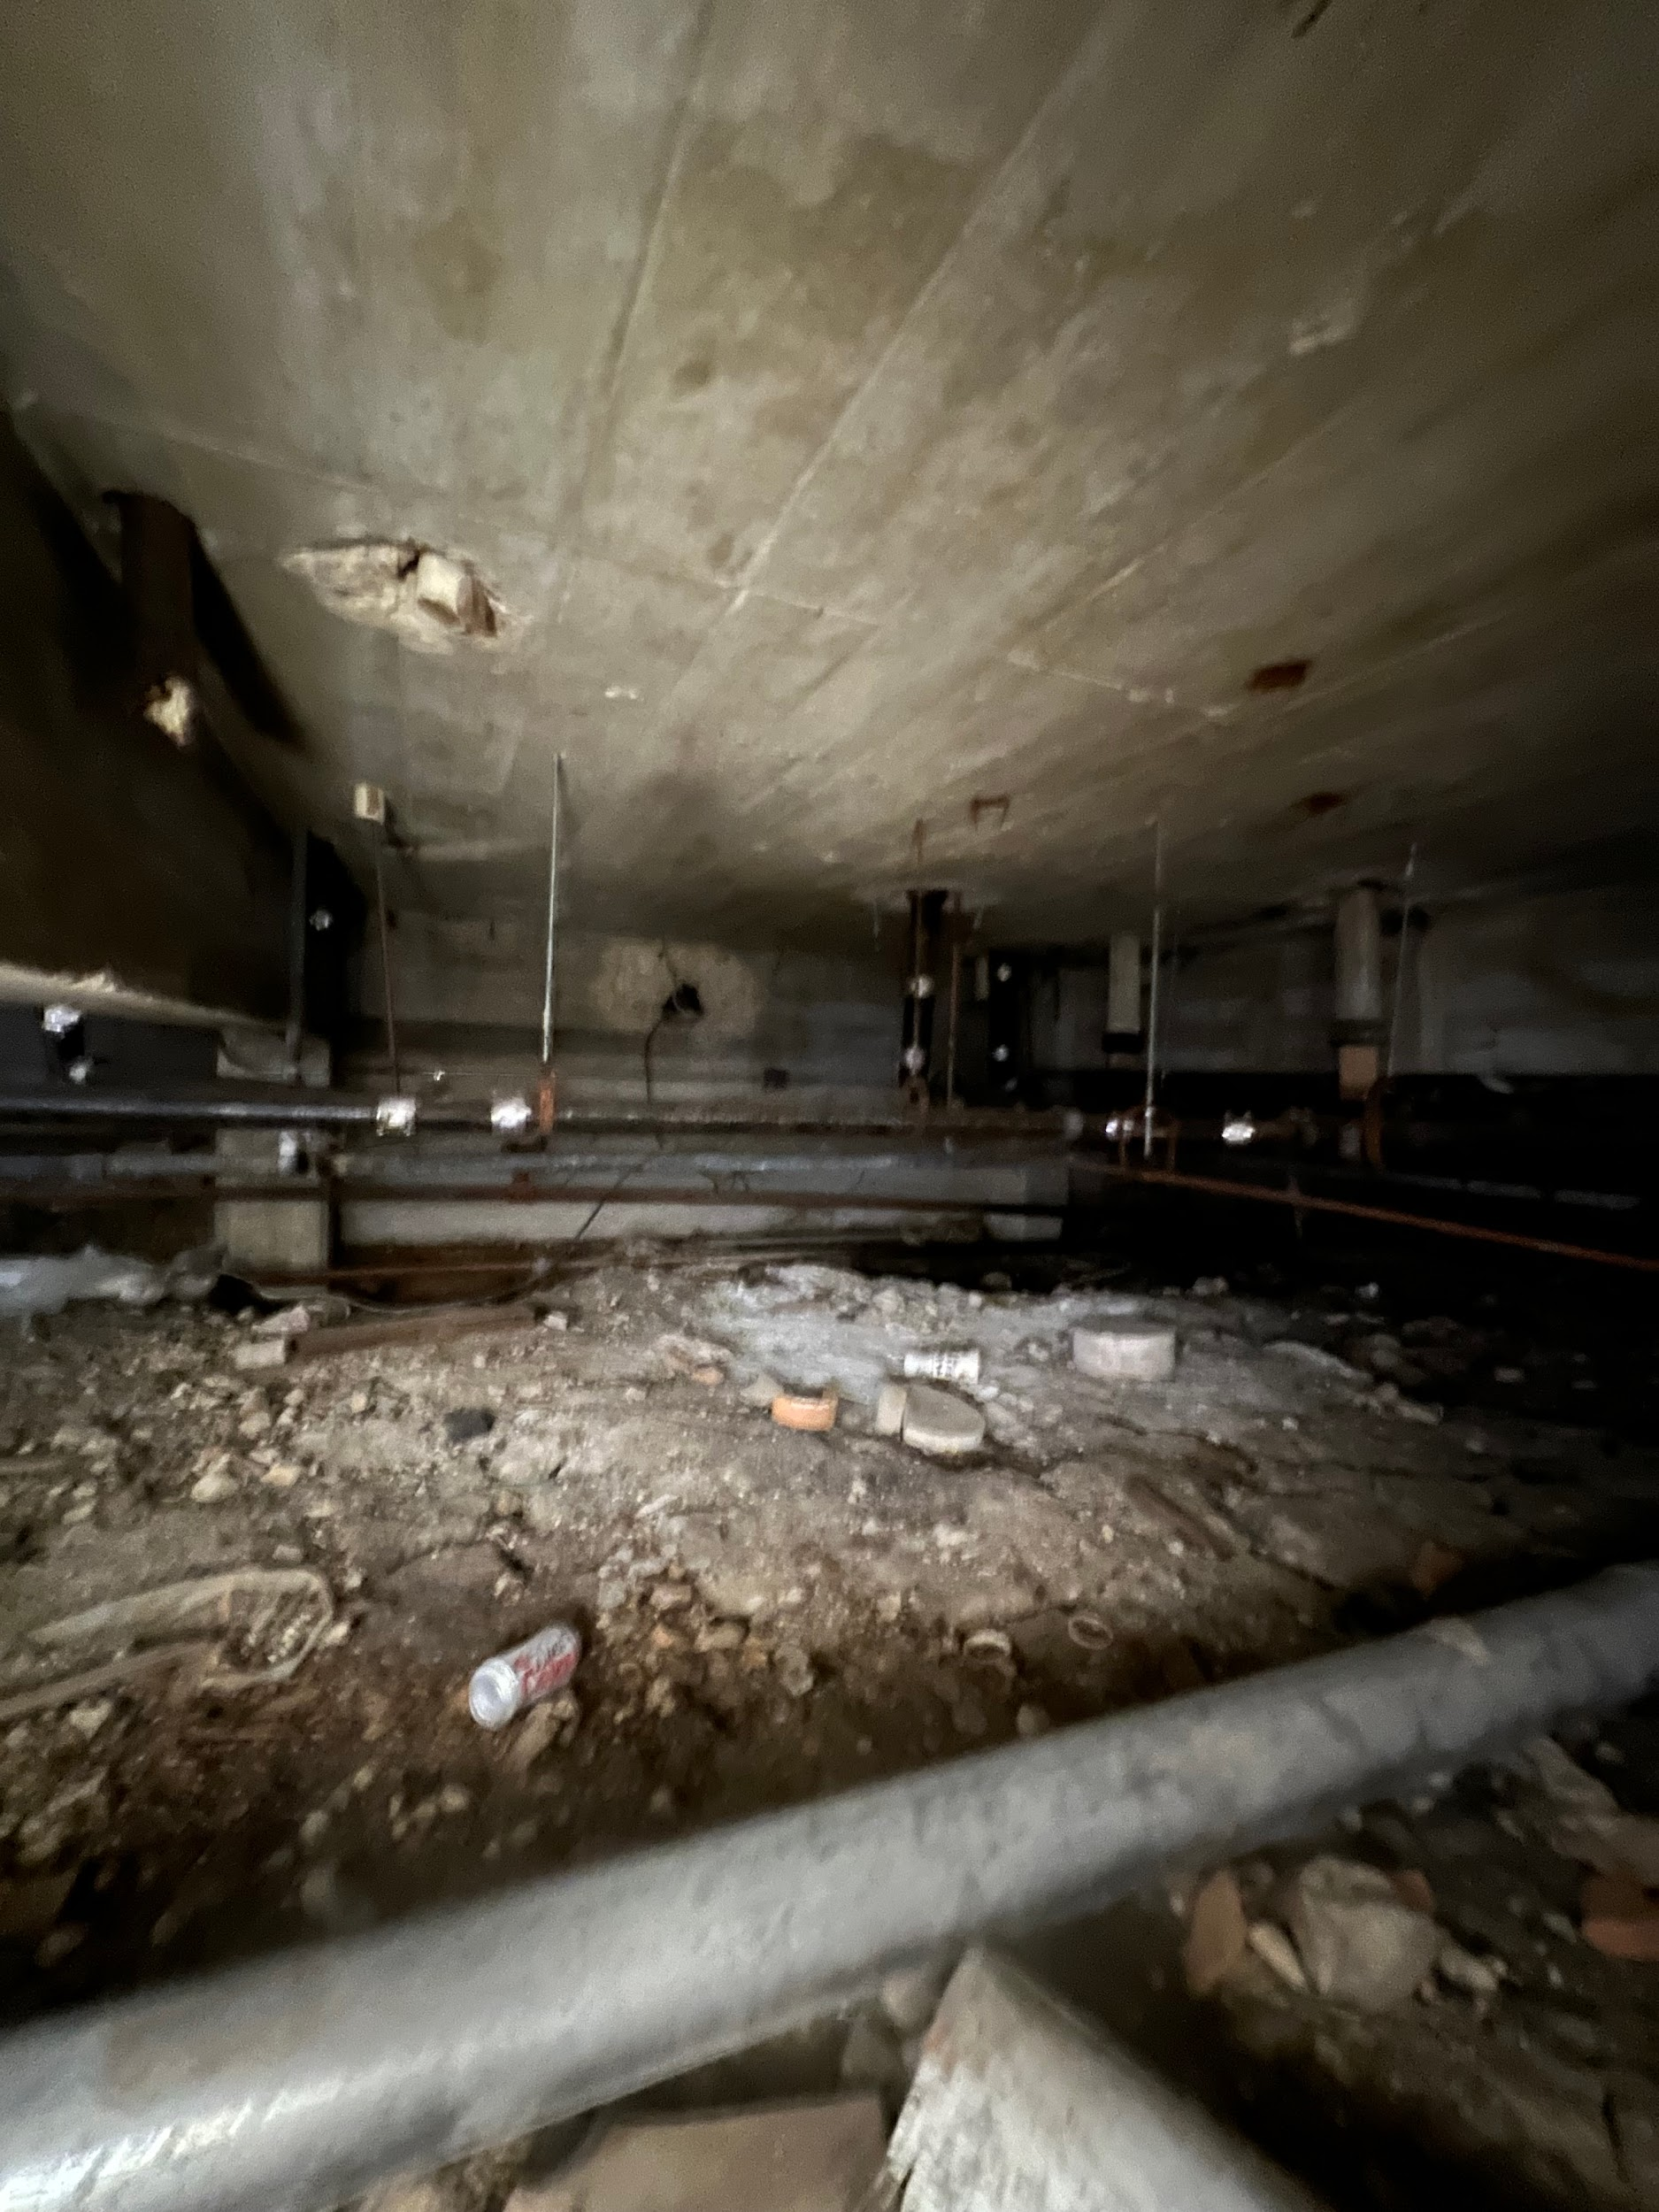
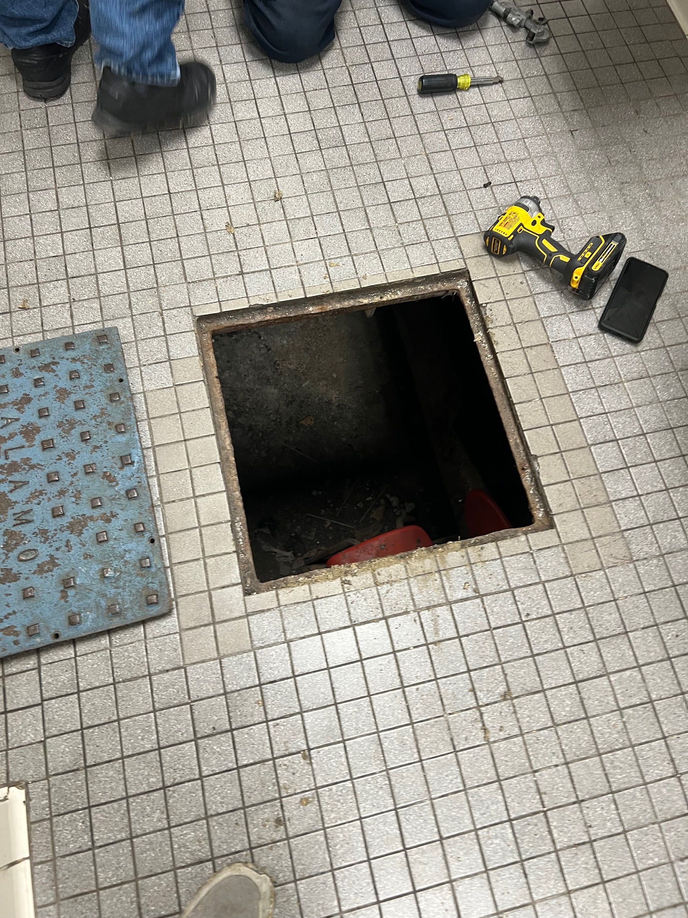
My supervisor would say the best thing I did was…
Helped open up boilers and disassemble them to get ready for our state inspections. I also got to help fix a chiller water supply leak.

Slide 83
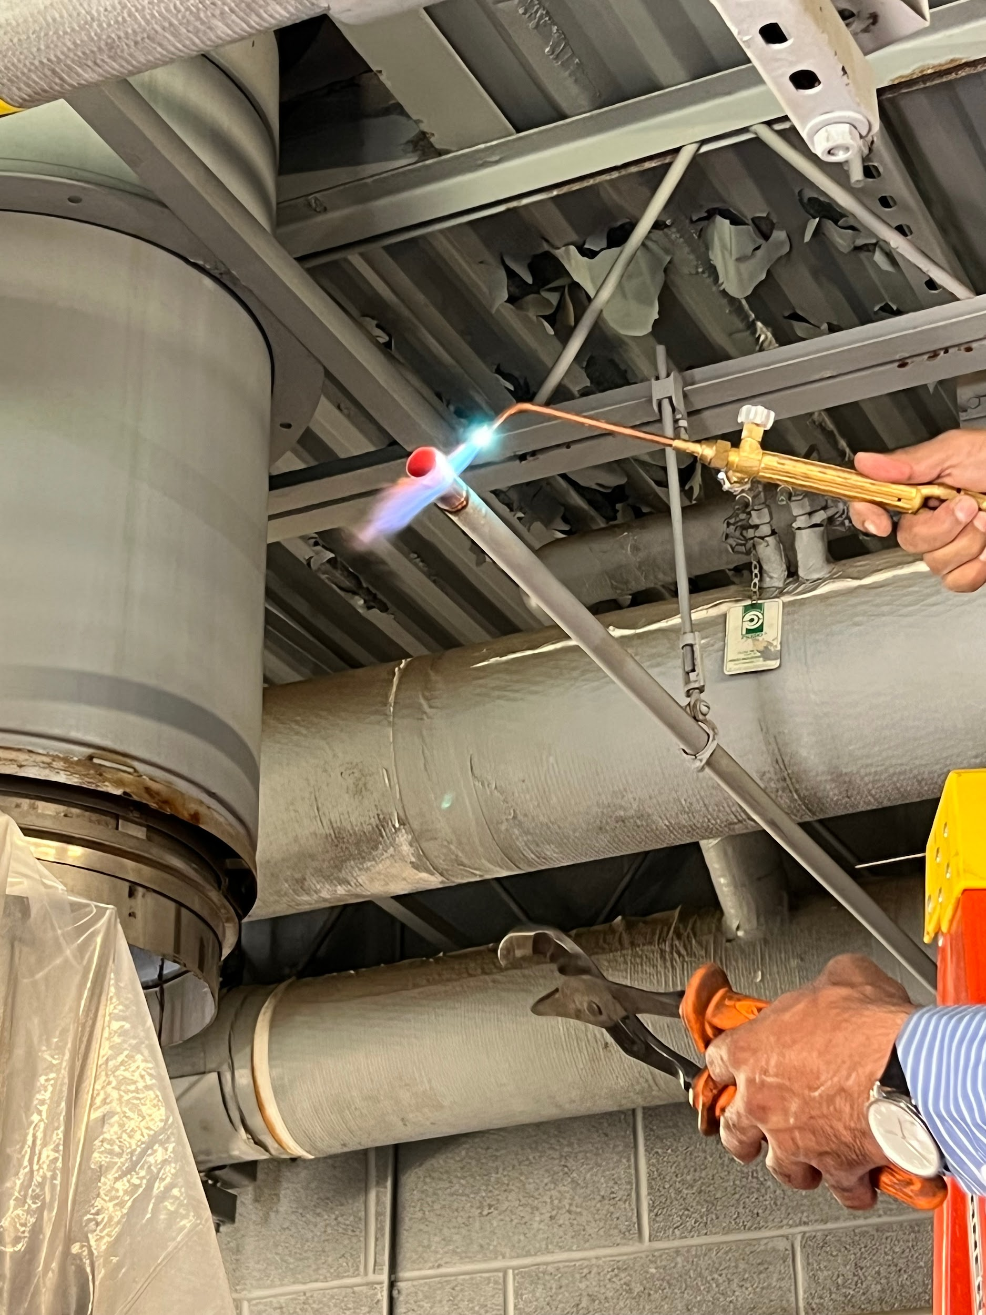
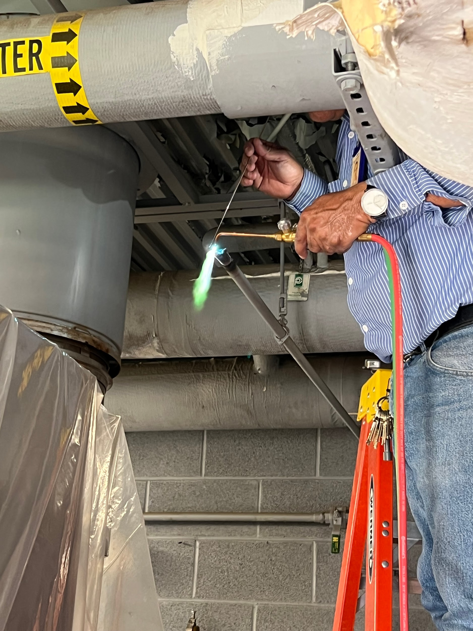
On thing that surprised me….
One thing that surprised me was the amount of problem solving you have to do as an HVAC technician.

Slide 84
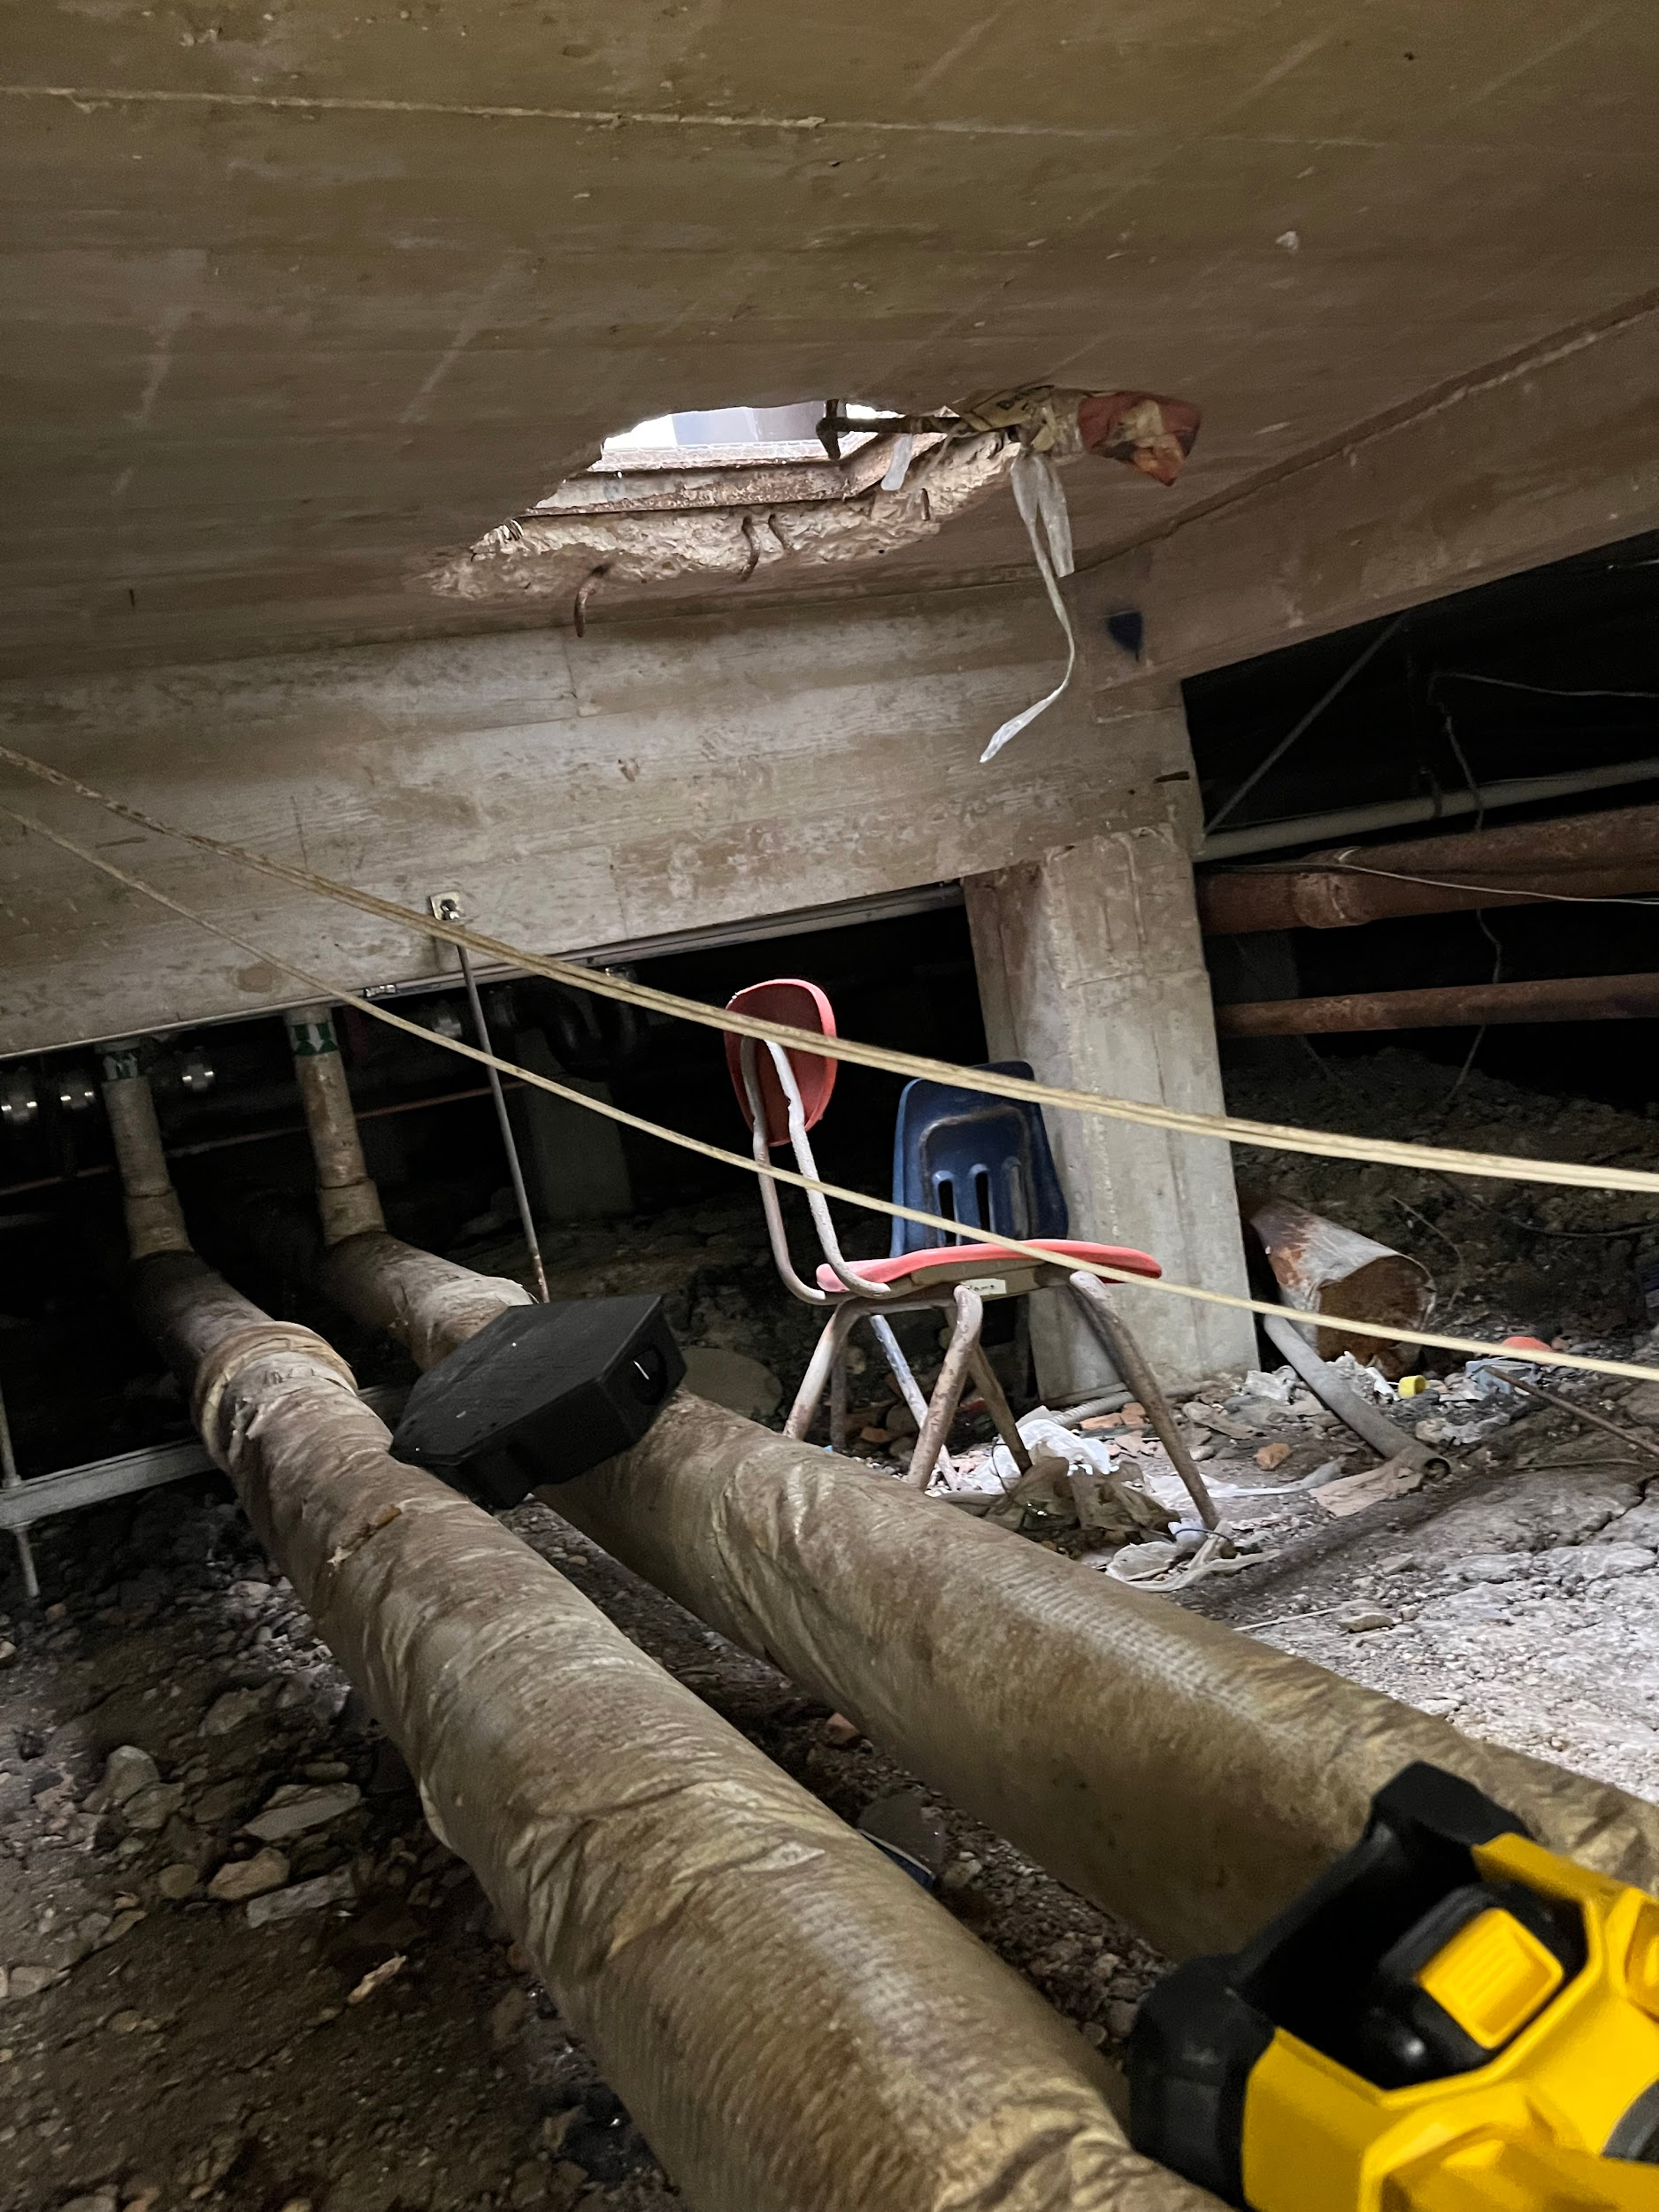
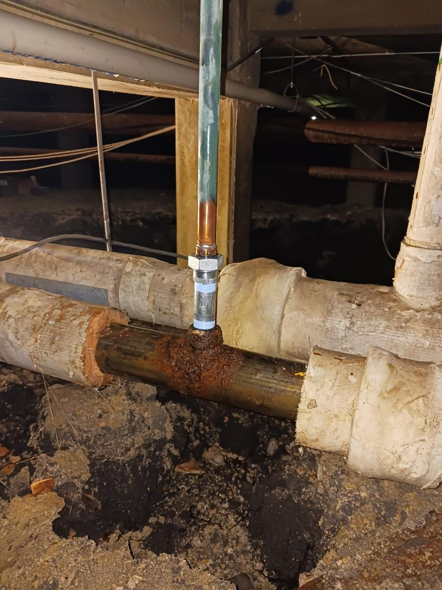
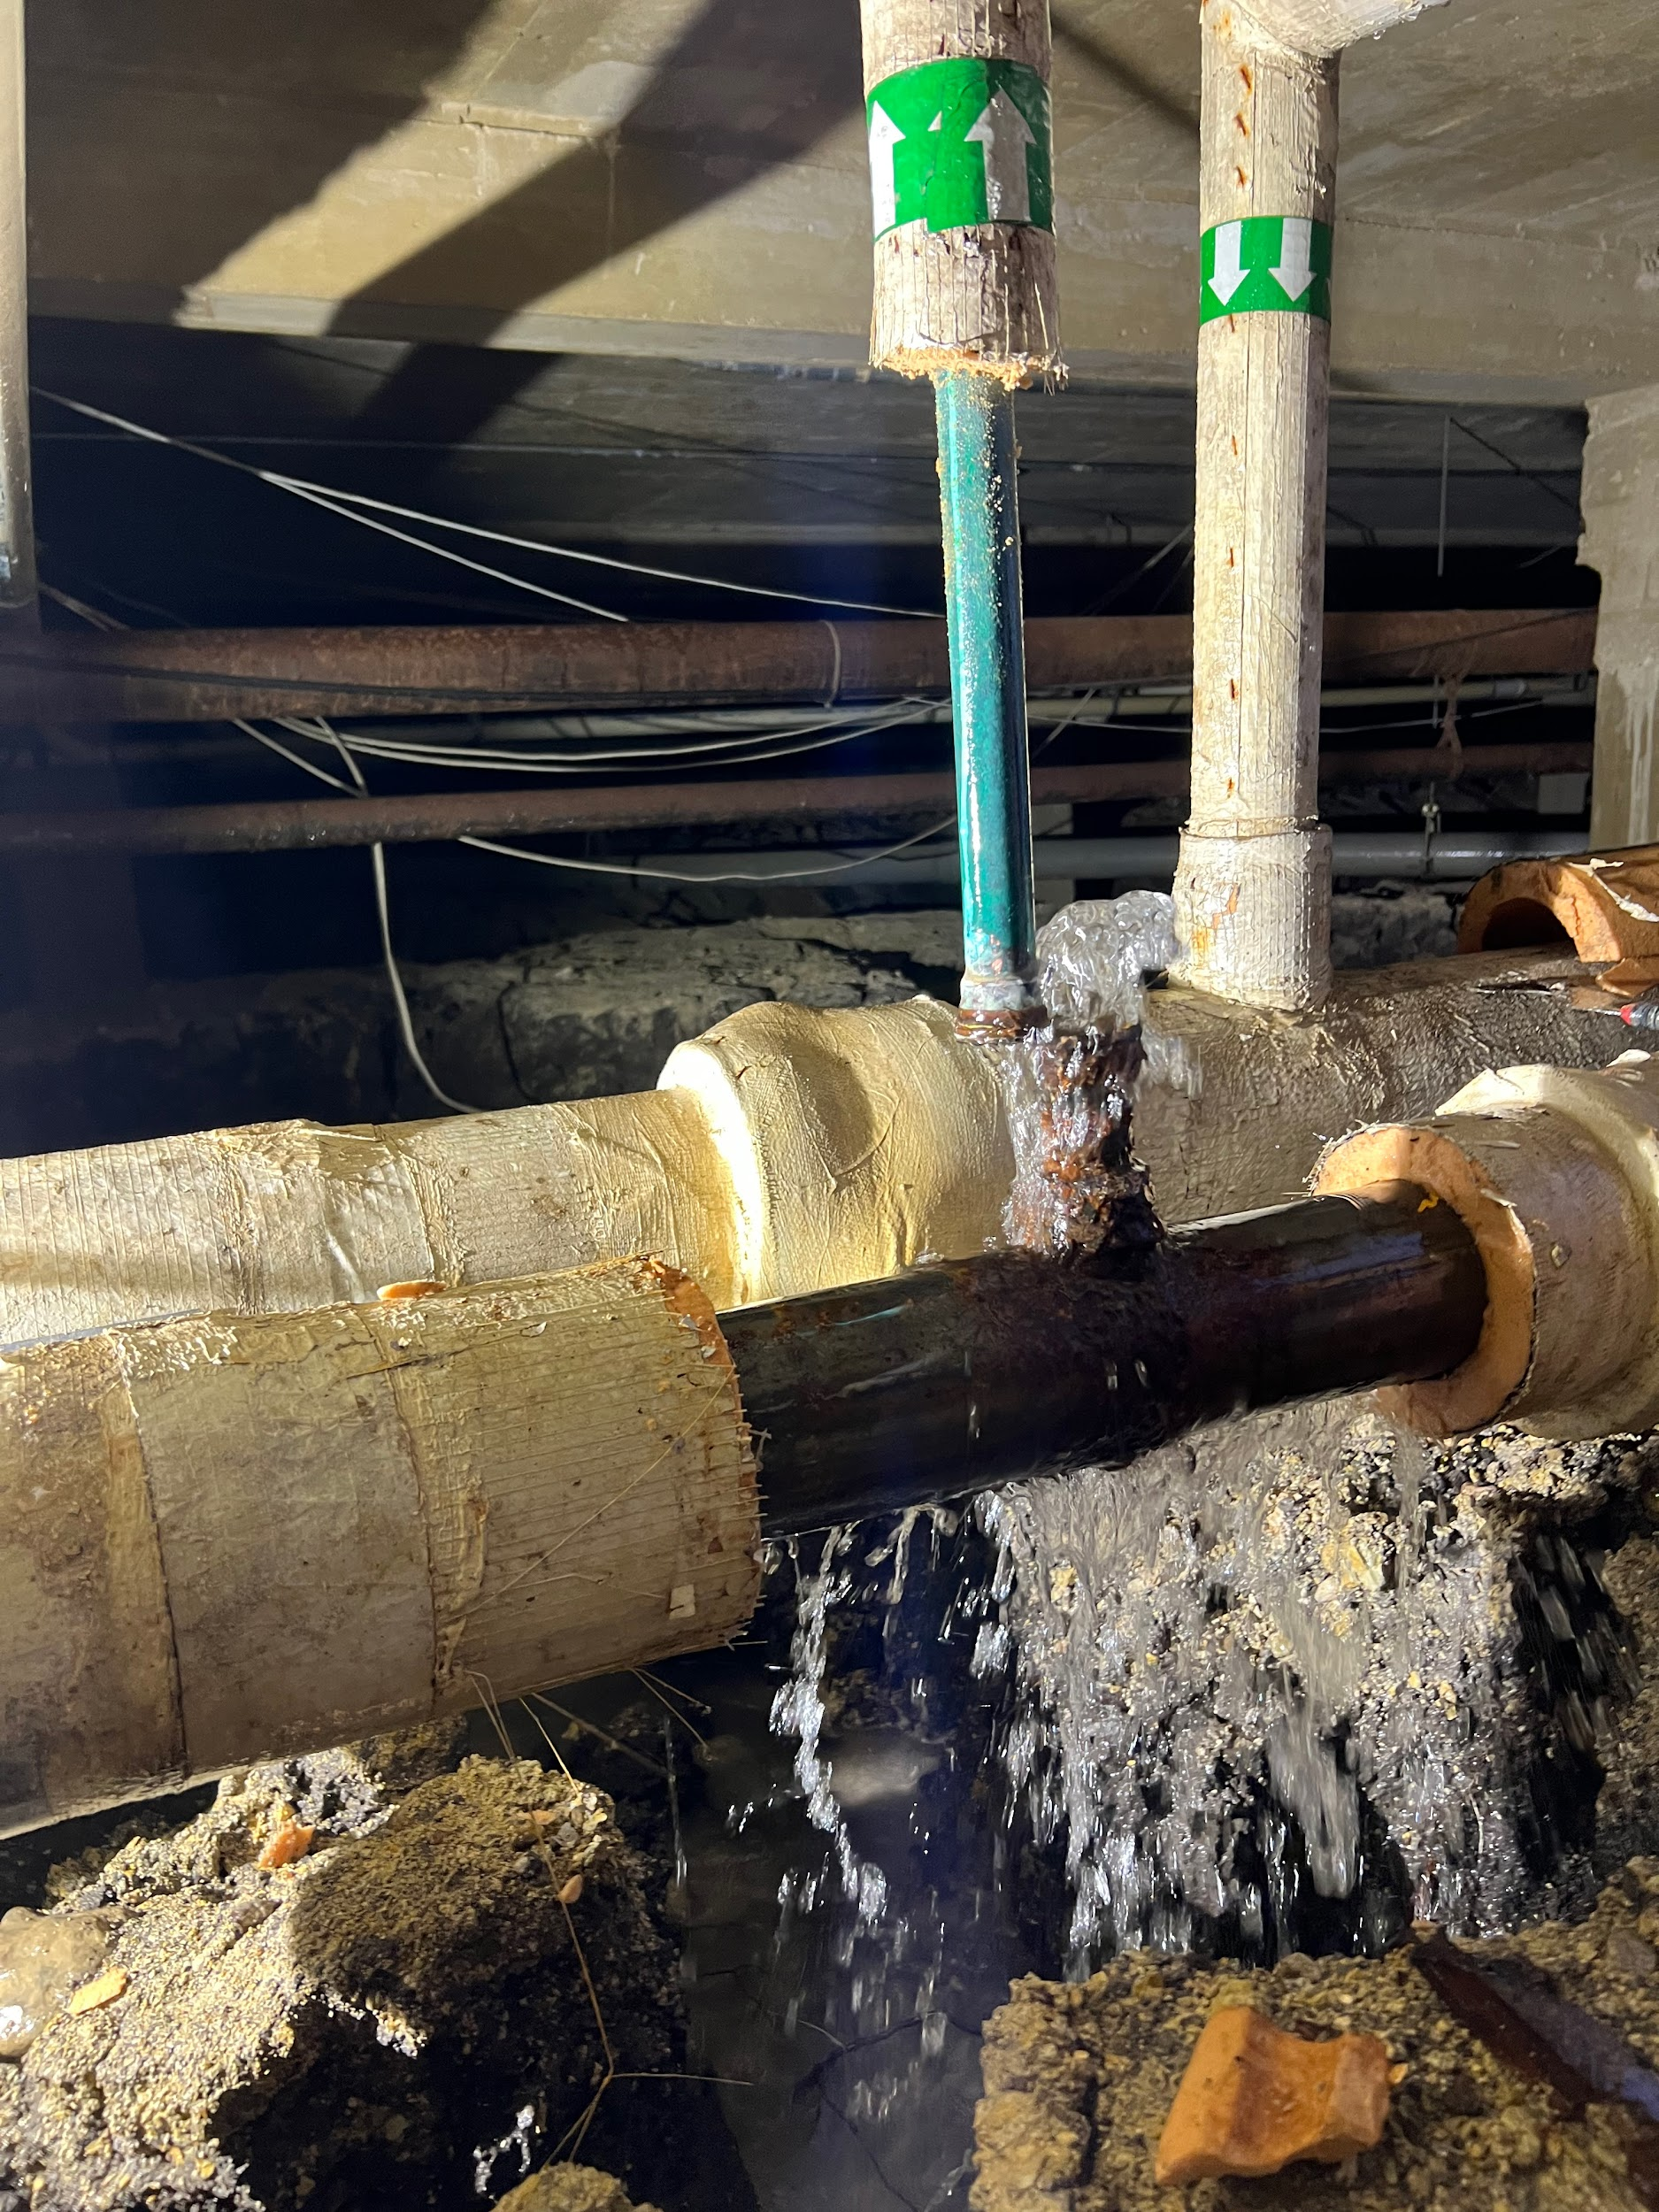
On thing that surprised me….
Another thing that surprised me was the amount of traveling required as a technician.

Slide 85
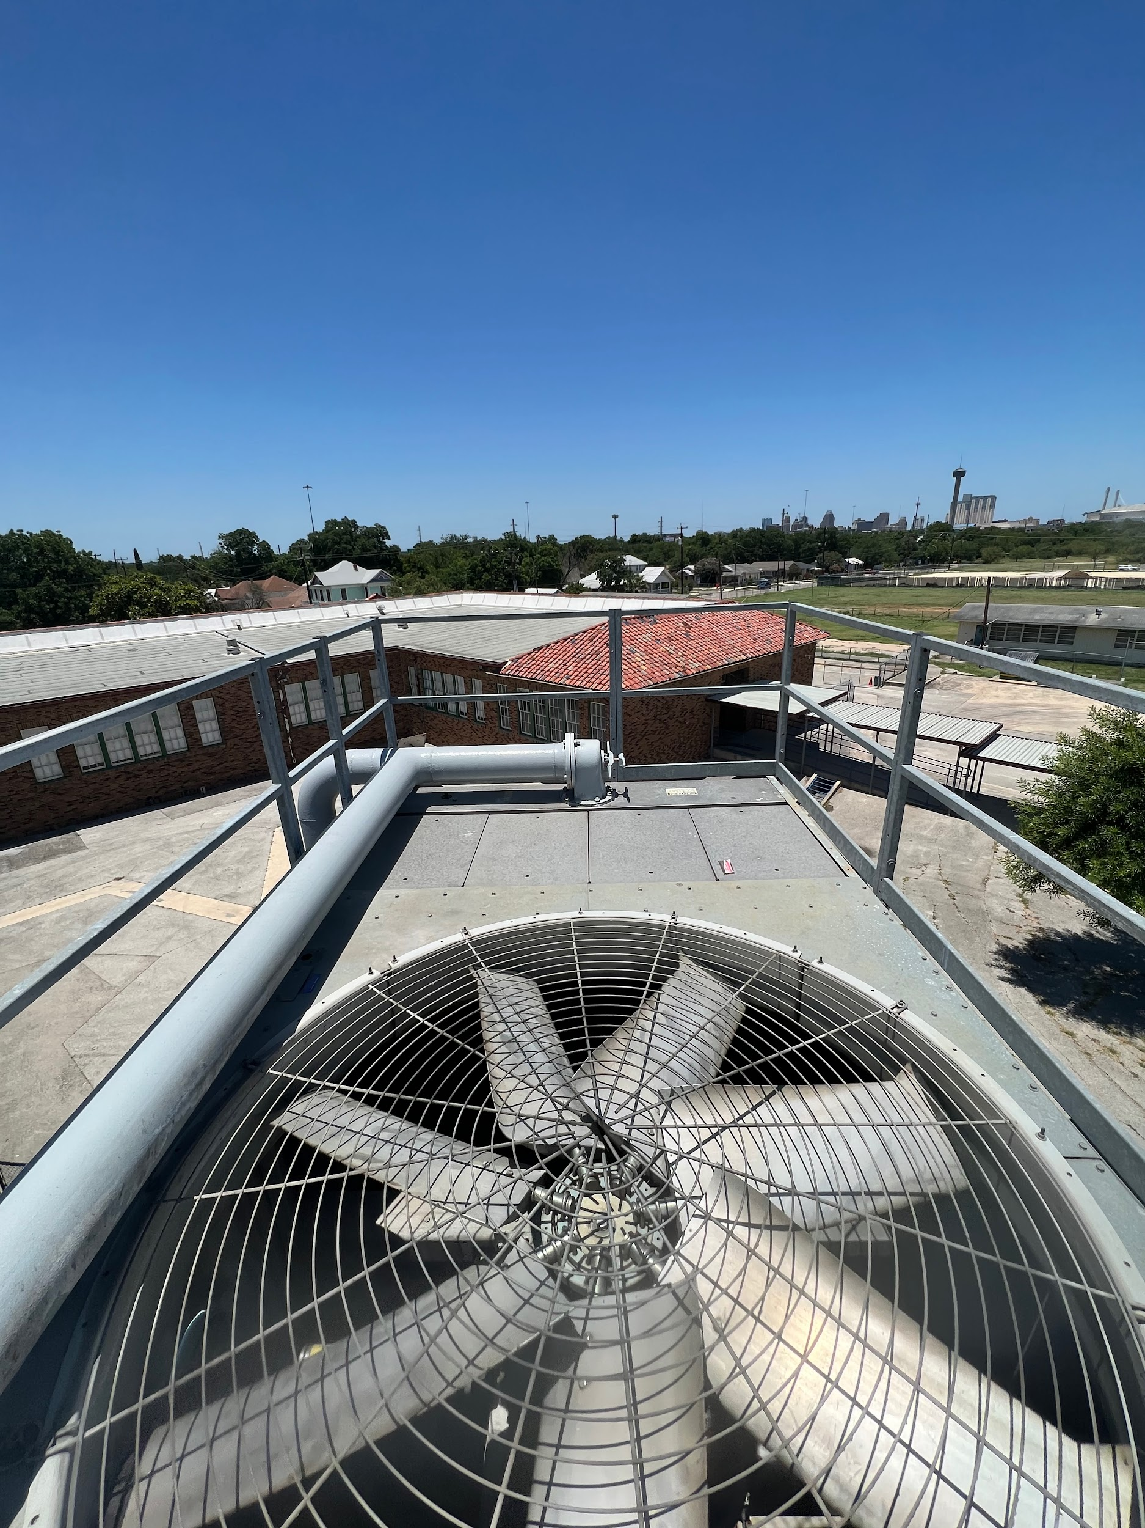
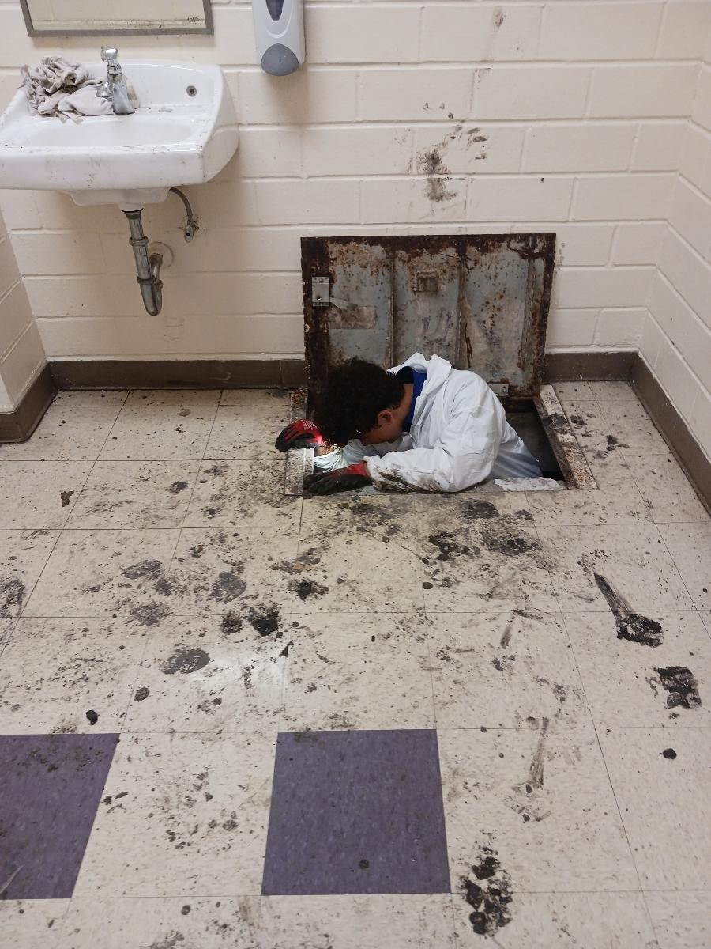
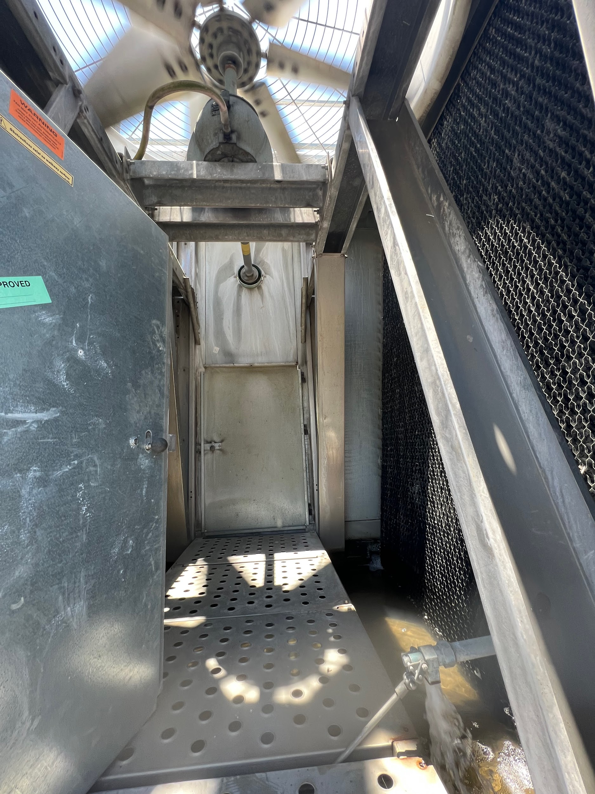
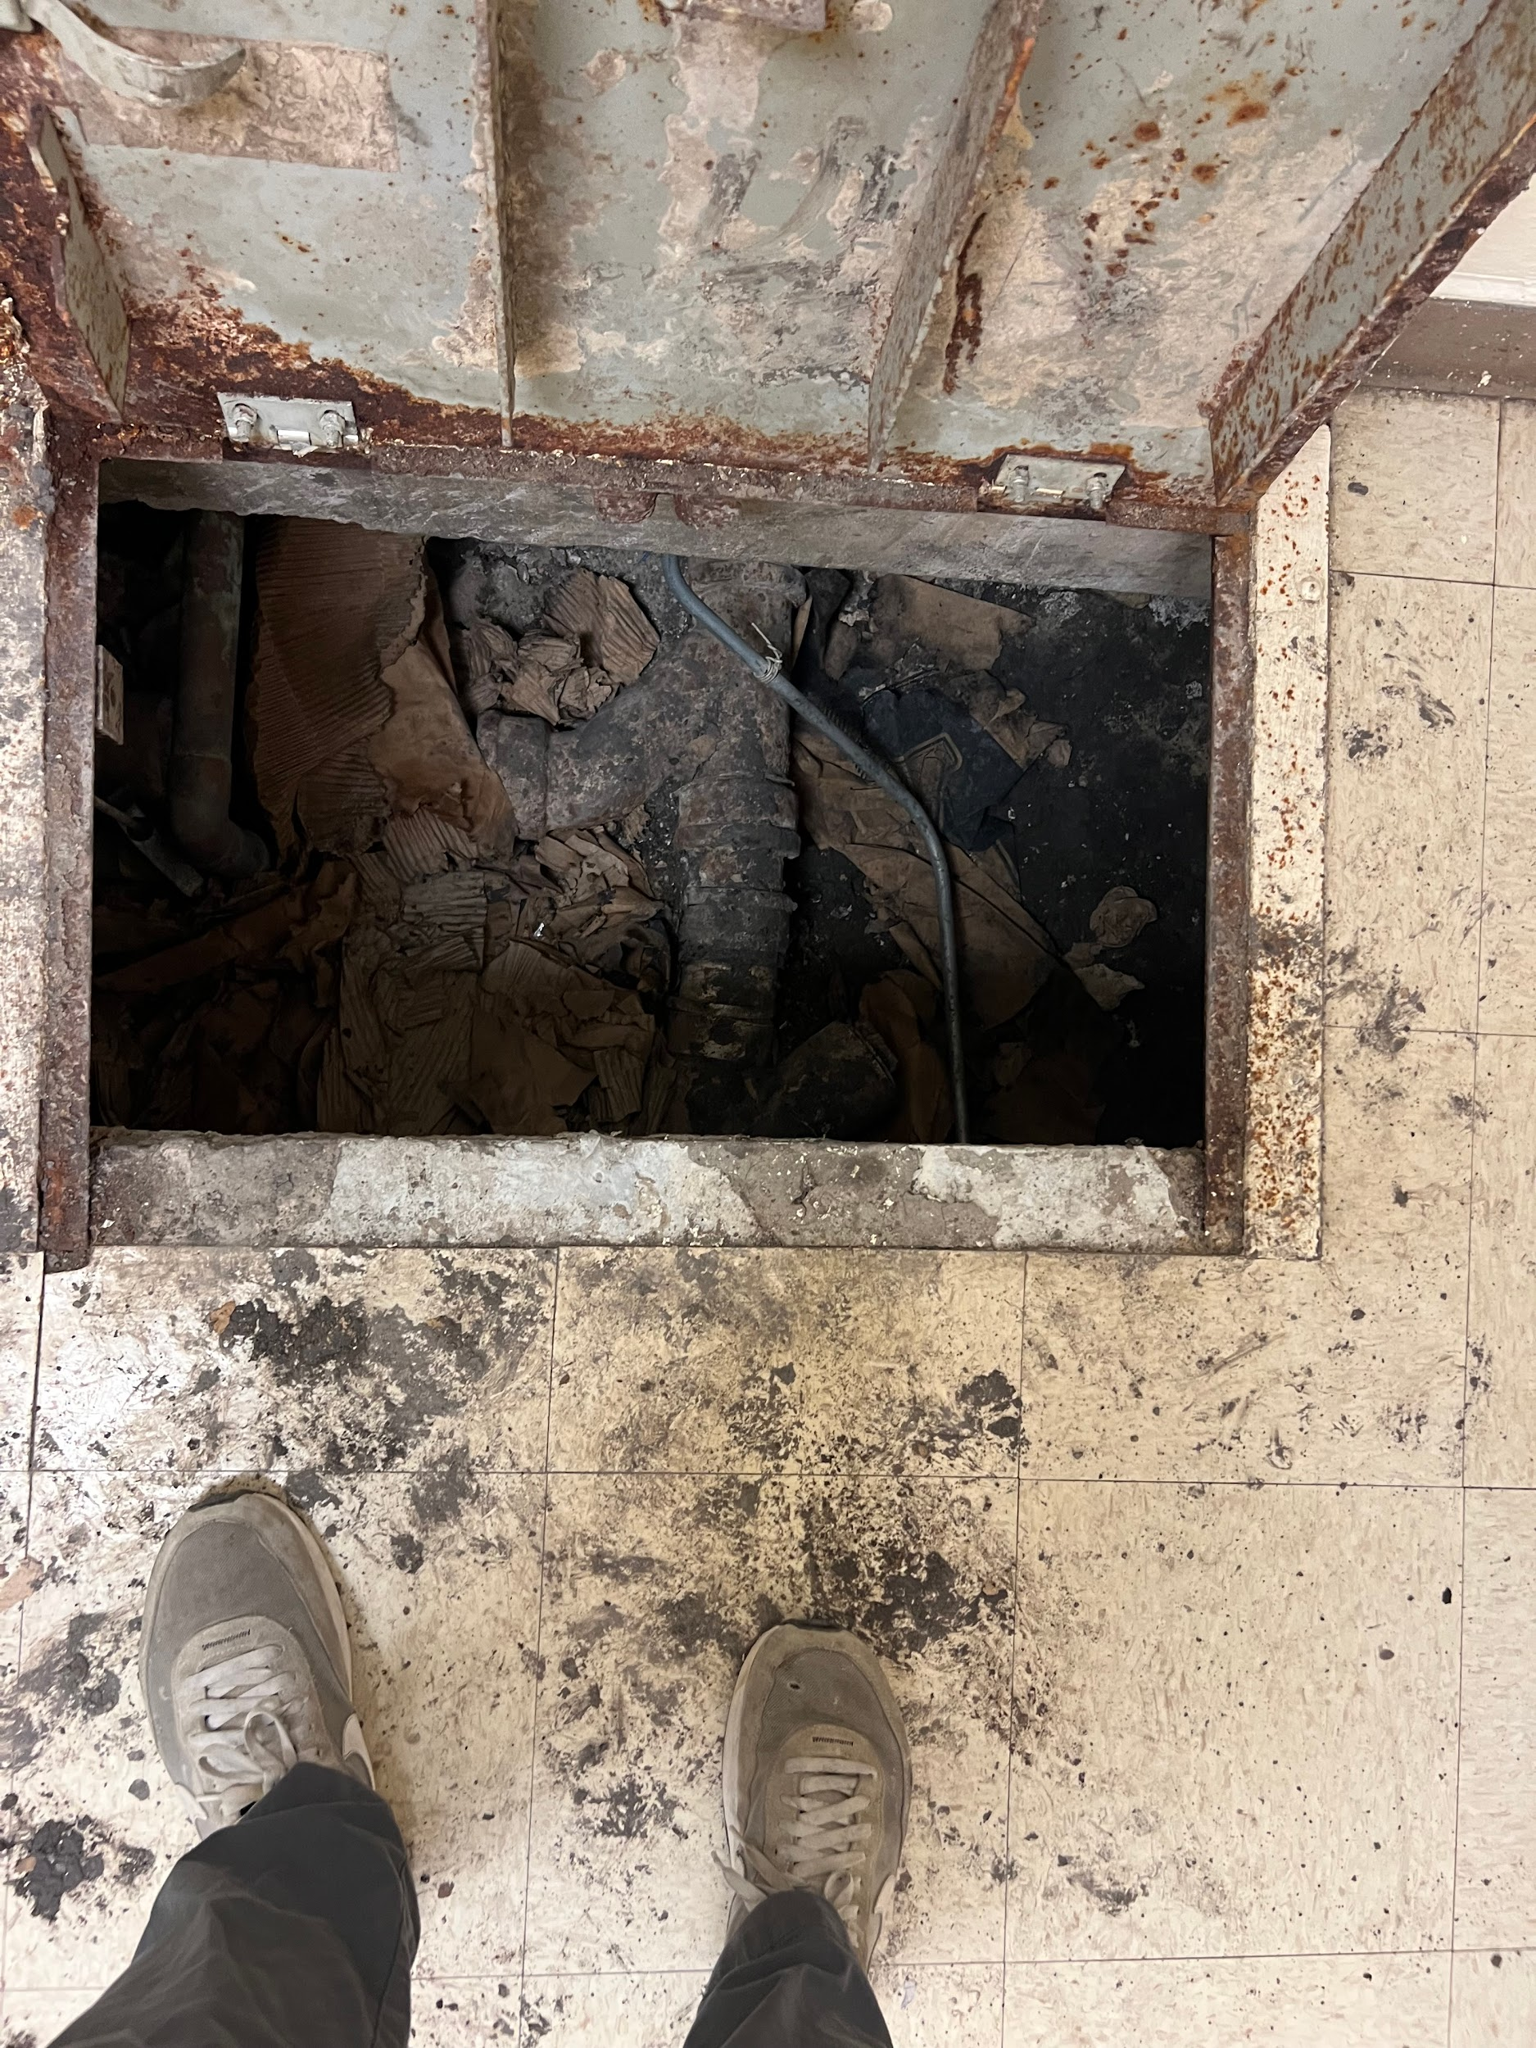
A Highlight of My Experience was….
My favorite experience throughout this internship was climbing on top of a cooling tower and getting to go under a building.

Slide 86
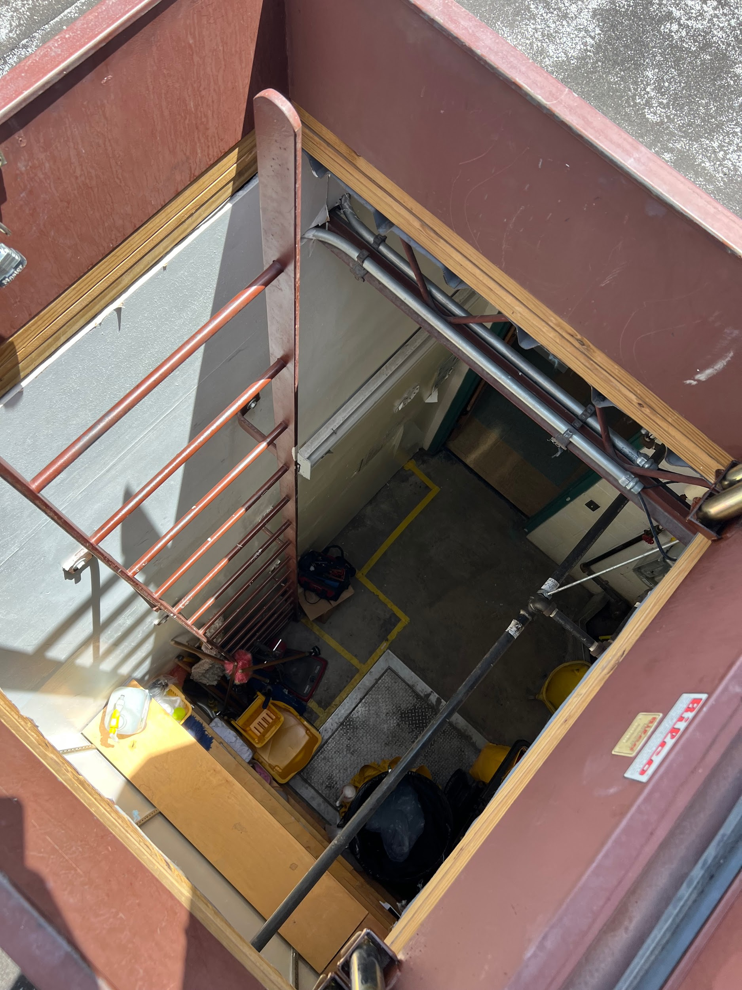
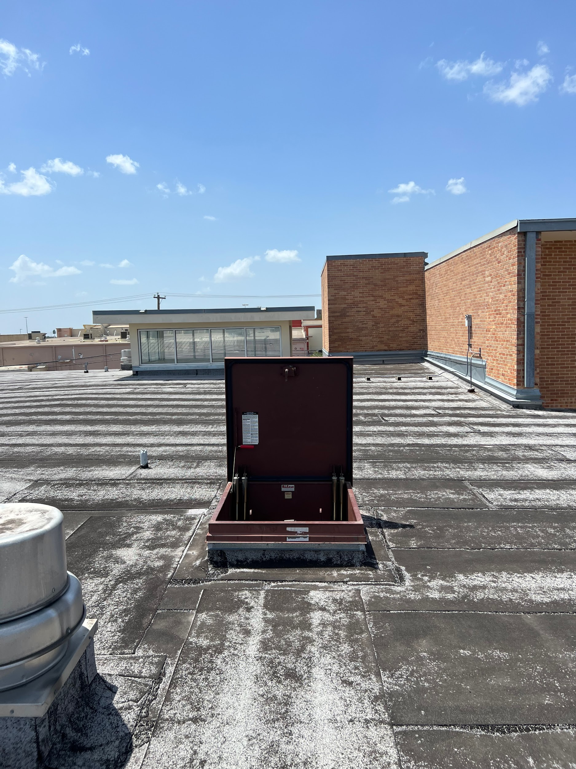
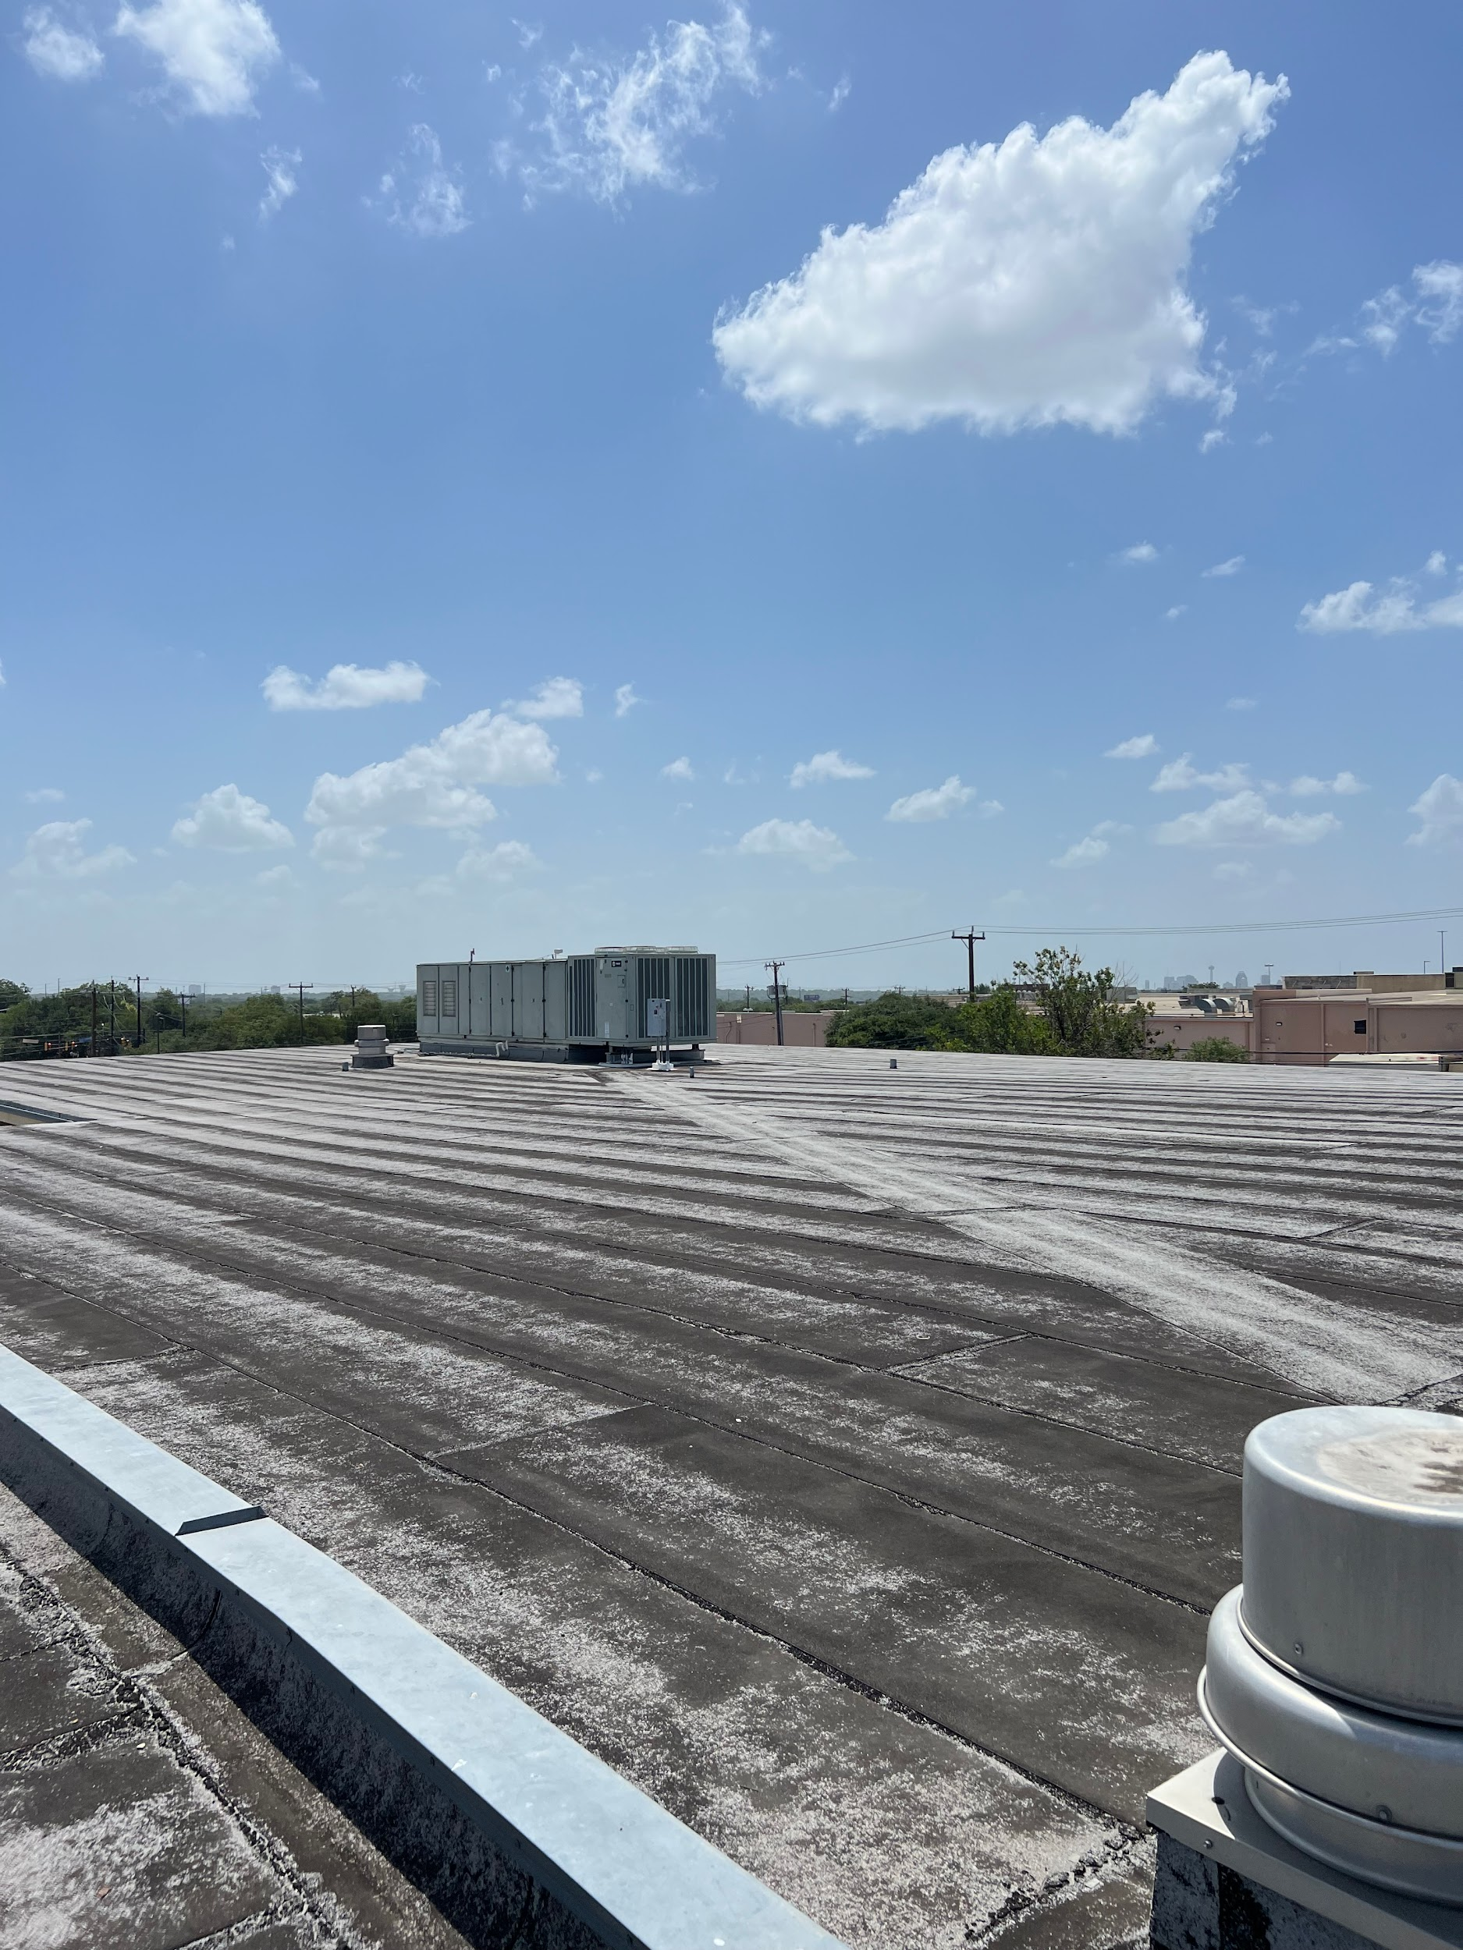
A Highlight of My Experience was….

Slide 87
In Conclusion…
I feel I gained valuable experience working in the field and getting to learn some of the basics of a AC systems, the 4 basic components of a refrigerant cycle, and basic HVAC technician and mechanical skills
I would tell my friends to apply for an internship because unlike most jobs available to teenagers you can learn trades and skills you can take with you for a lifetime. Once you've learned a skill like HVAC, or funds management you'll have valuable experience you can take with you anywhere you go. The first step is just to get your foot in the door and since not everyone gets the opportunity to be introduced to things like this, I would encourage everyone with the opportunity to do an internship.

Slide 88
Thank you
Presenter: Dominic Goff

Slide 89
Athan Saiz
in CTE department
Date: 08/03/2023

Slide 90
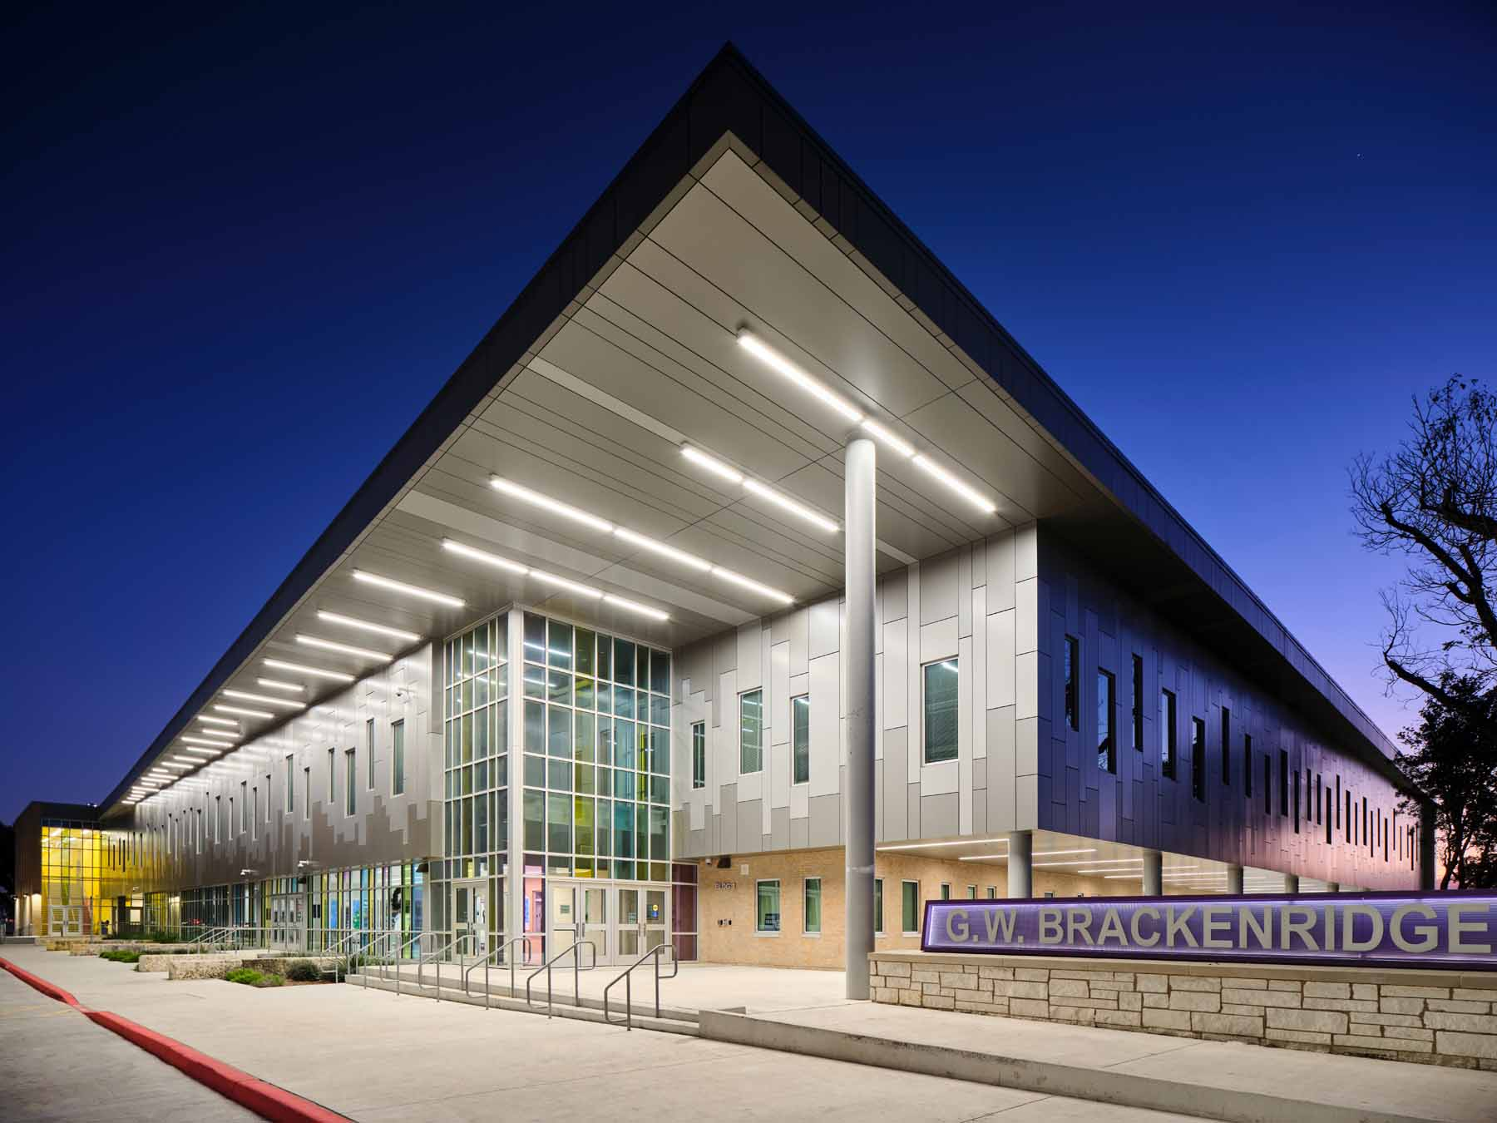
Athan Saiz
Brackenridge High School
12th Grade/ Senior
Computer Engineering or IT Support
I play basketball

Slide 91
CTE Department Highlight
Career & Technical Education Department’s mission is committed to supporting SAISD’s mission of preparing our students for an ever changing world by providing rigorous instruction aligned with the demands and expectations of industry needs and local workforce.

Slide 92
Job Description
Supported the CTE team in various projects including-
Kept inventory
Reviewing presentations for students and updating the lesson to be more student friendly
Assessing and testing equipment
Creating graphics for
Reviewing IT certification terms and re-writing definitions to help students easily understand the material
Created an apprenticeship database spreadsheet

Slide 93
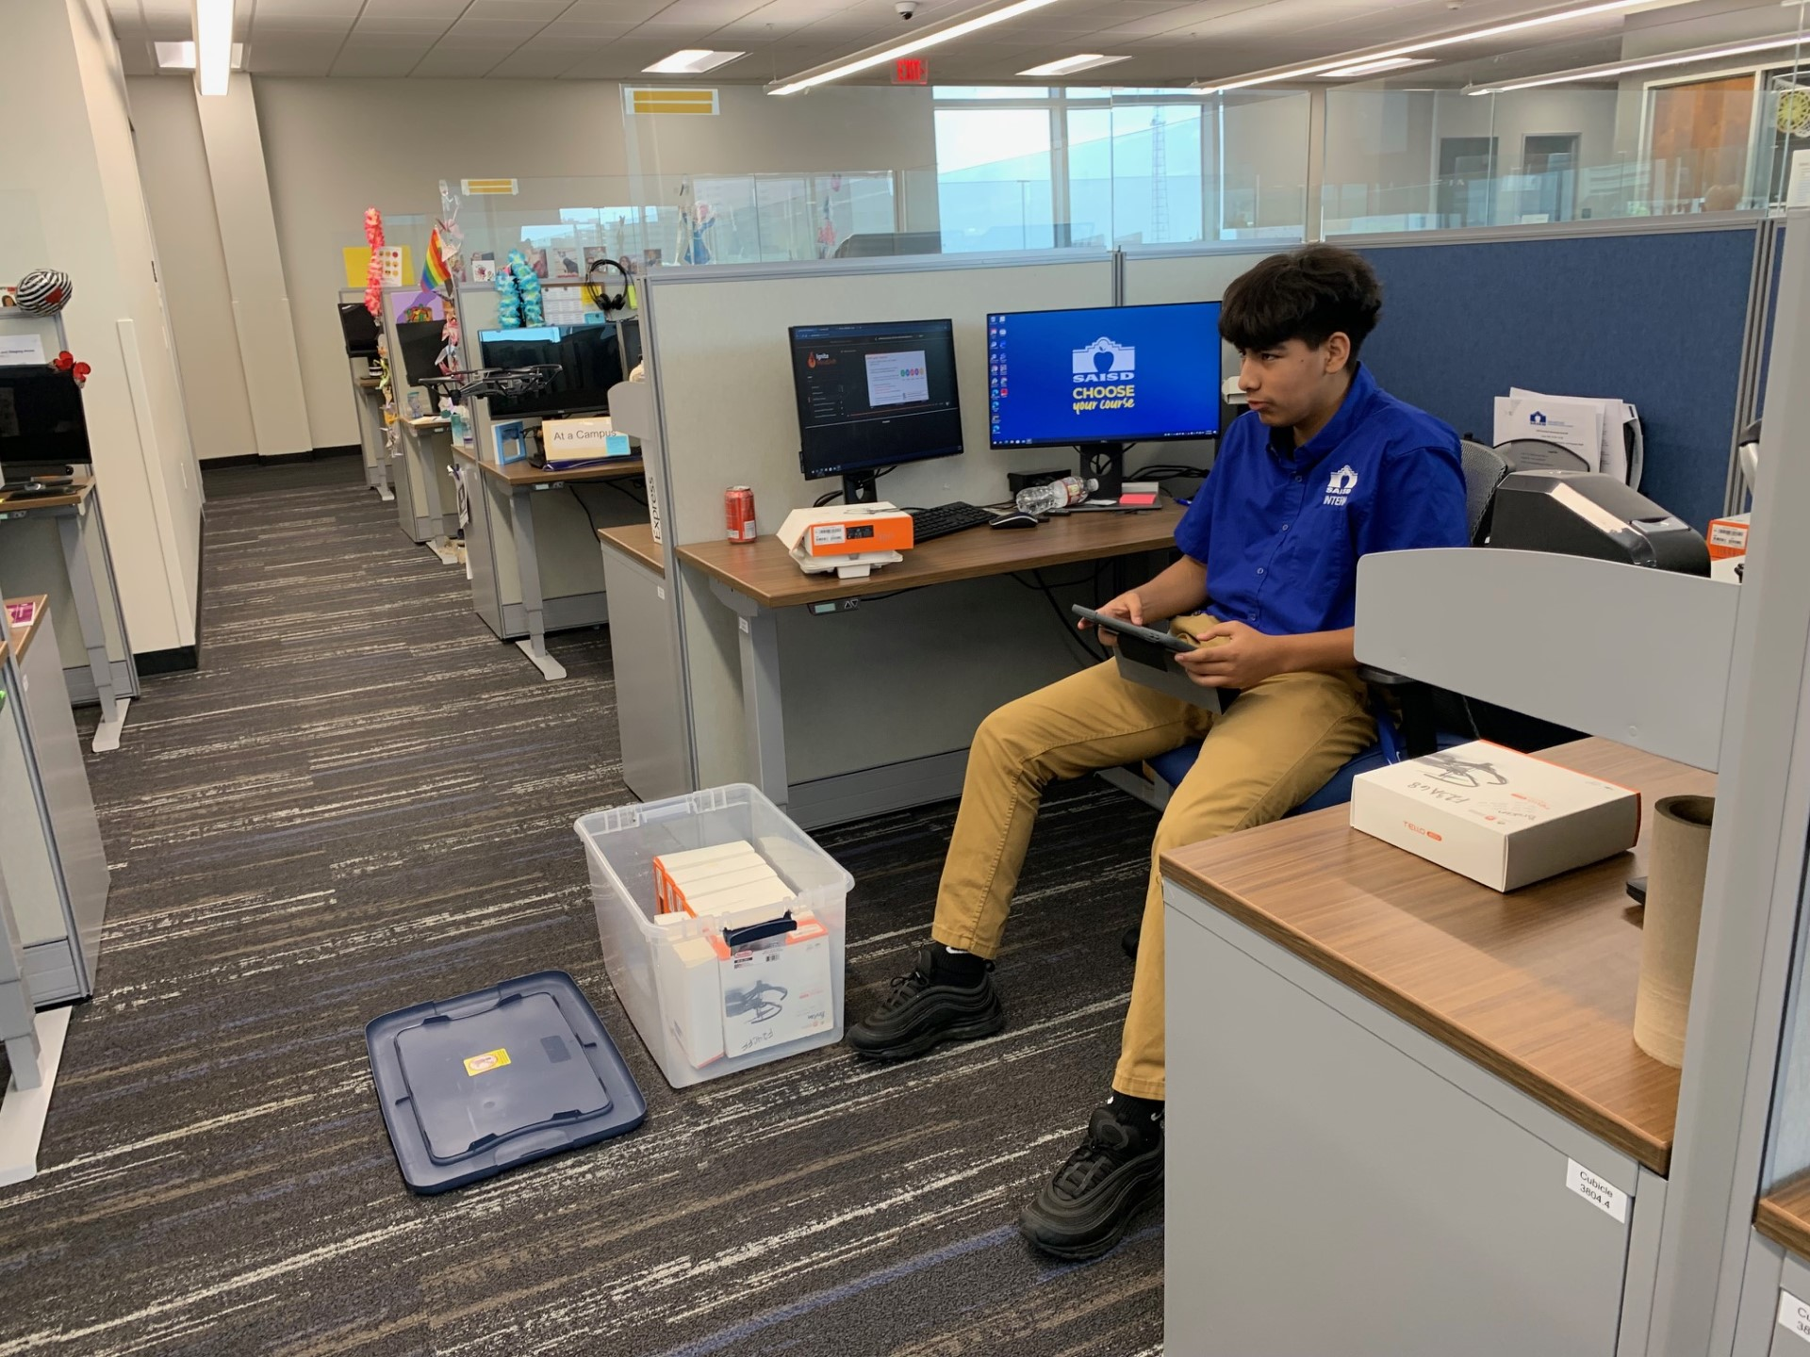
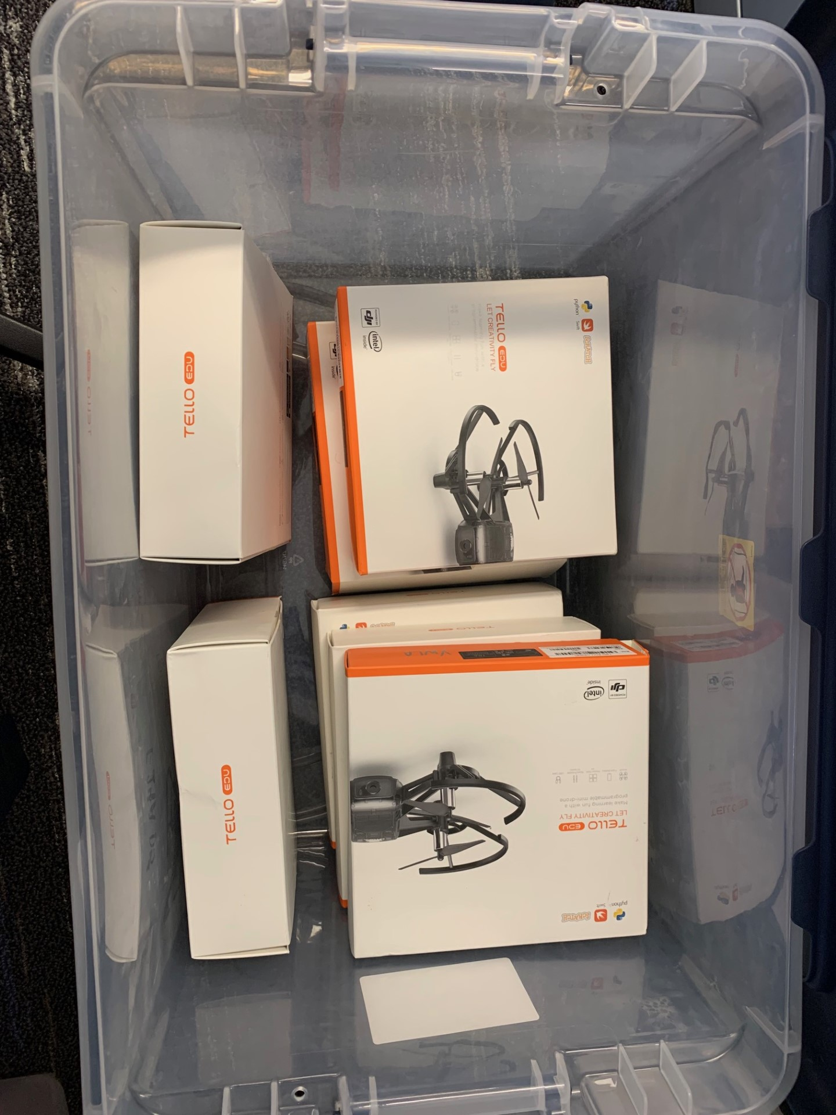
My supervisor would say the best thing I did was…
I helped save 7 drones!
Take apart drones
Update and Recalibrate
Look for any visual damage
Replace Propellers and/or Guards
Test drone

Slide 94
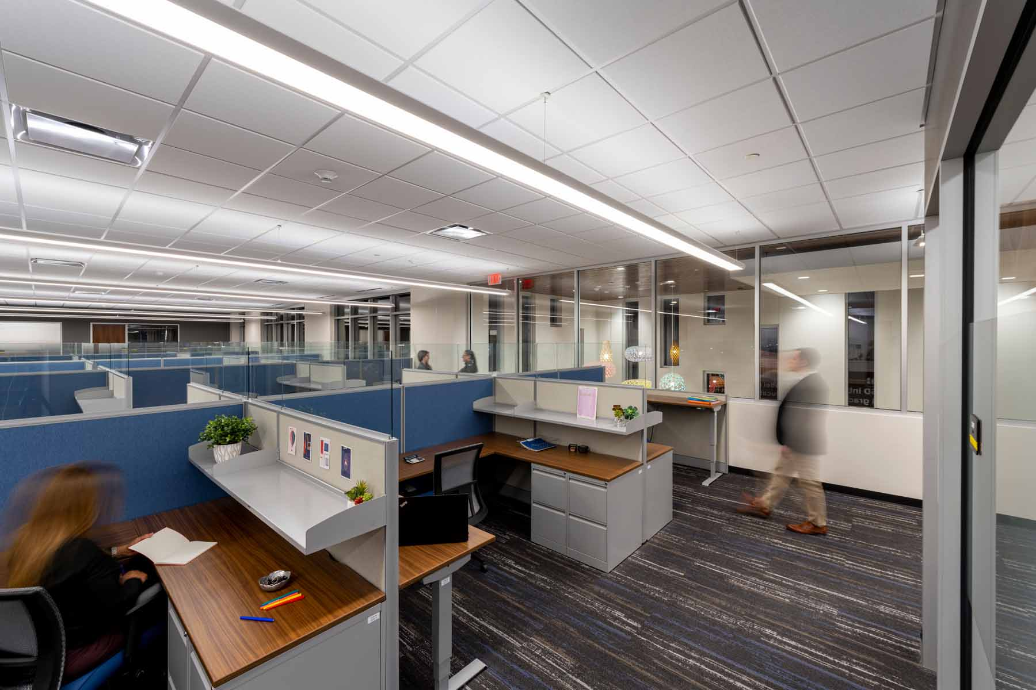
On thing that surprised me….
How calm and quiet the atmosphere is.

Slide 95
A Highlight of My Experience was….
Canva Projects

Slide 96
In Conclusion…
I feel like I gained valuable experience in an office setting and a better understanding of what takes place here at saisd.
I would tell my friends to apply for an internship because an internship offers greater opportunity and better experience than you would get at any fast food restaurant or job you would get at a mall.

Slide 97
Thank you
Date: 00/00/2018
Presenter: Athan Saiz

Slide 98
Nicolas Alonzo,
Emily Guardiola,
Kaylee Gomez
Jonah Tonick
Akan Rivera
Adan Barbosa
Andrew Flores
​
with the IT Department
Date: 07/21/23

Slide 99
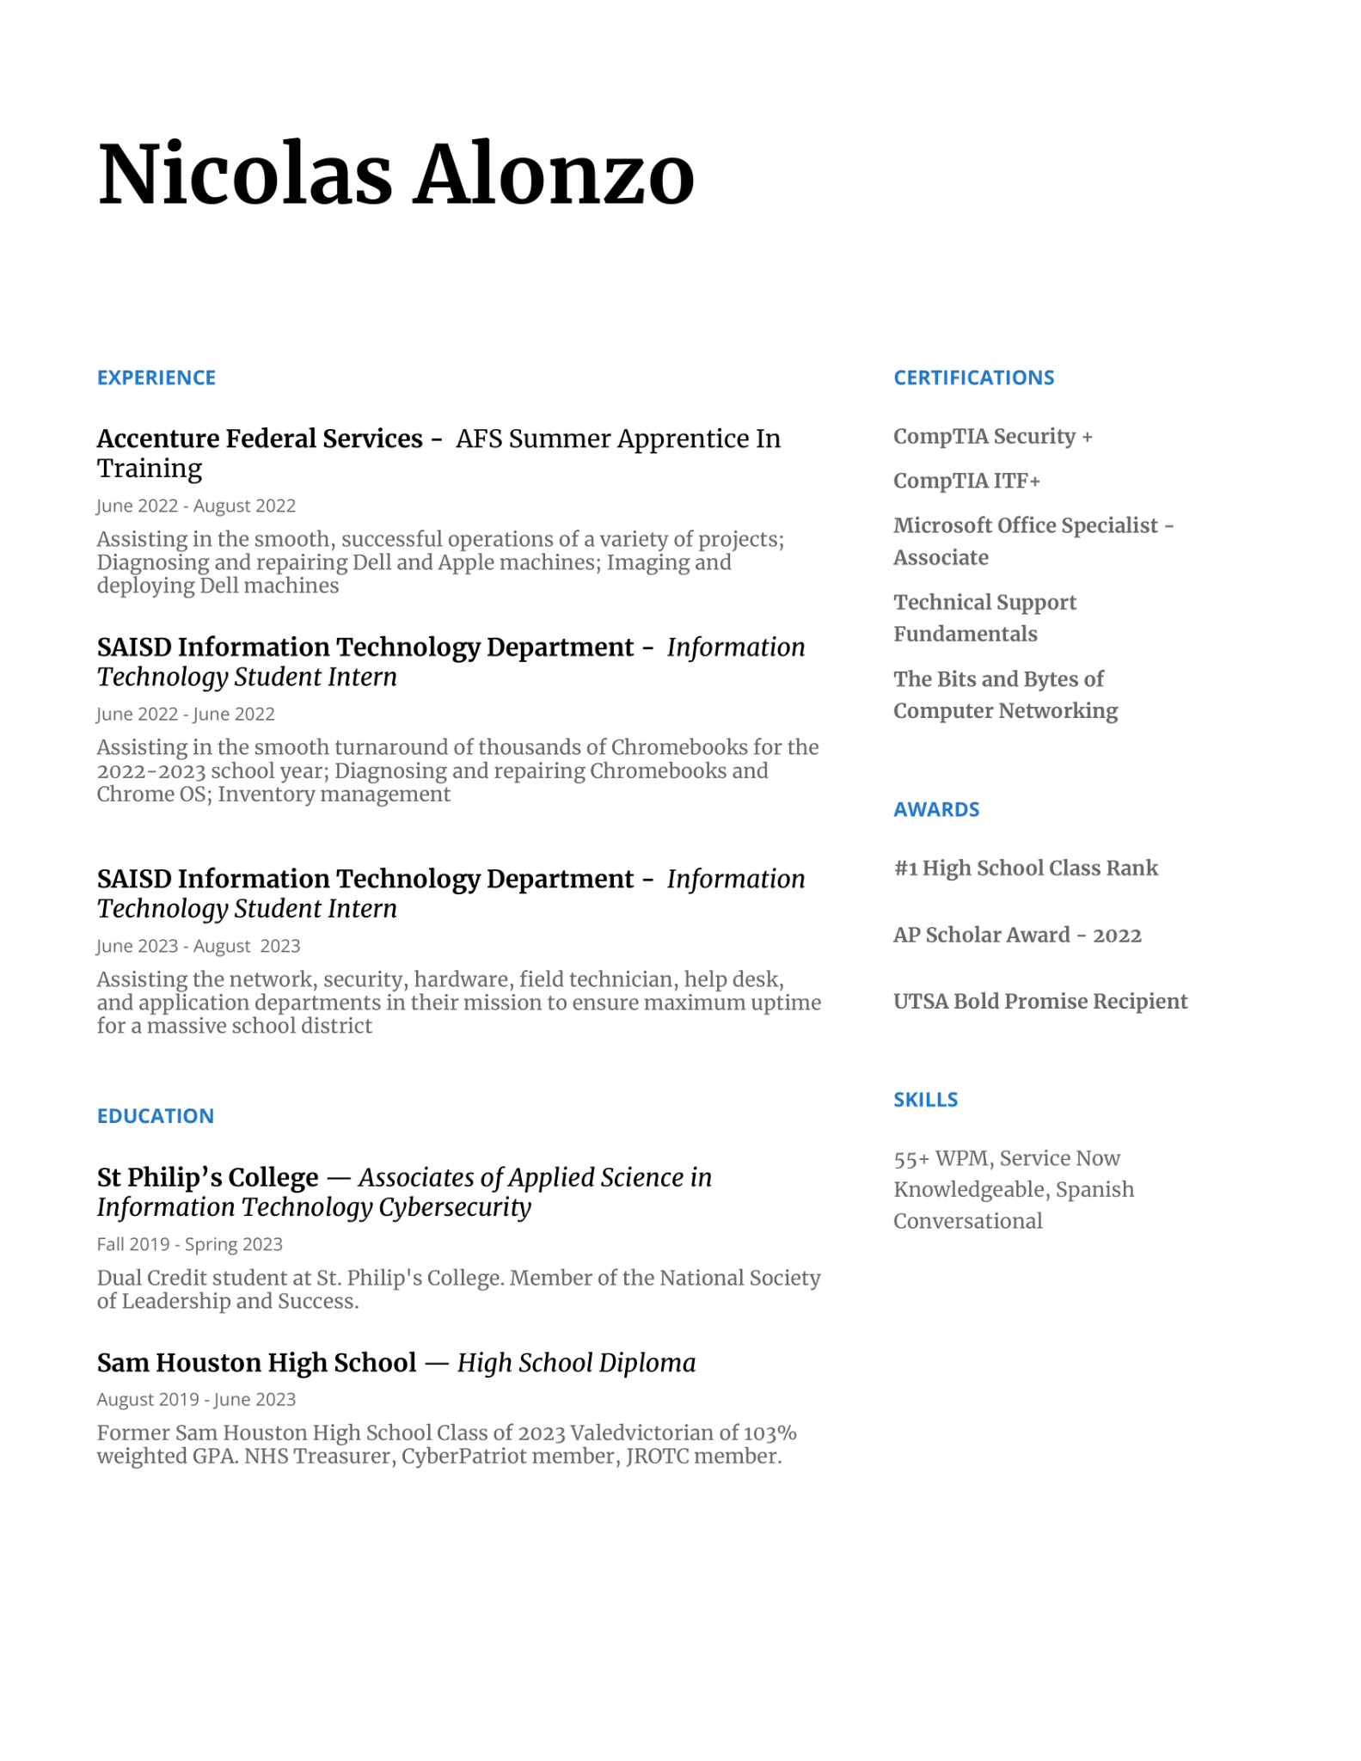
Nicolas Alonzo
I’m a recent graduate from Sam Houston and St. Philip's College and I will be attending UTSA for cybersecurity. One interesting fact is that I have over 2,200 hours in World of Tanks Blitz.

Slide 100
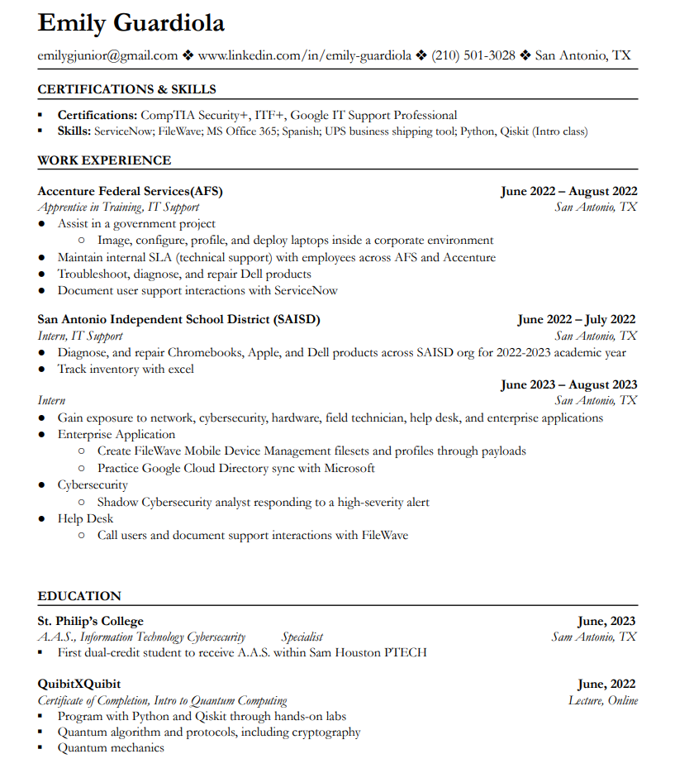
Emily Guardiola
I am a recent graduate from Sam Houston and St. Philip’s College. I will be finishing my bachelor’s degree at A&M San Antonio in pursuit of a cybersecurity analyst position. An interesting fact about me is that I love black coffee.

Slide 101
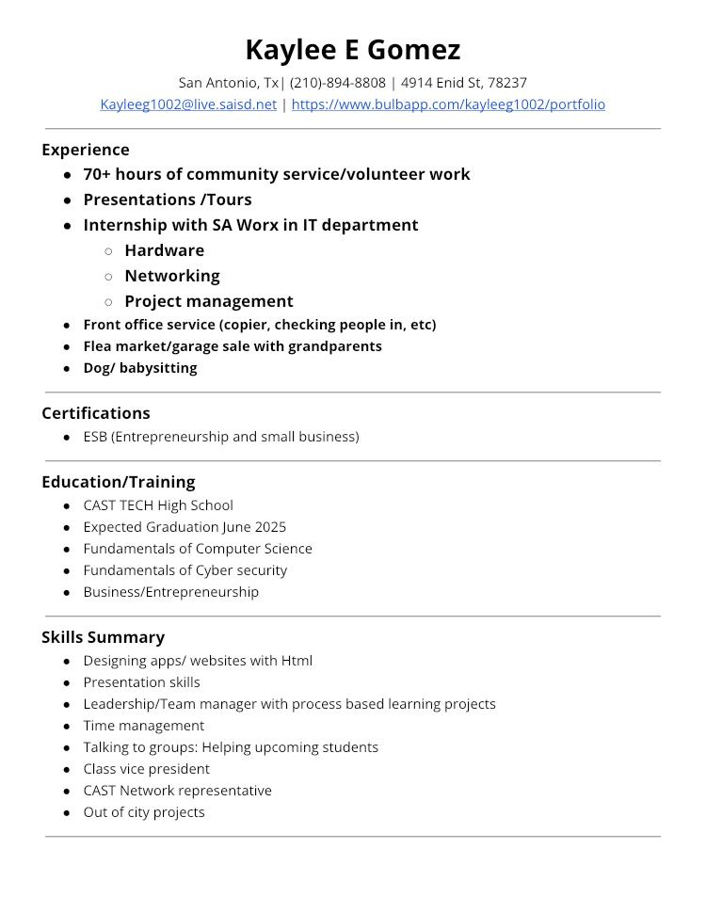
Kaylee Gomez
I go to Cast Tech. I’m going into my Junior year (11th) and focus on the cyber security and business pathway. One interesting fact is I play soccer.

Slide 102
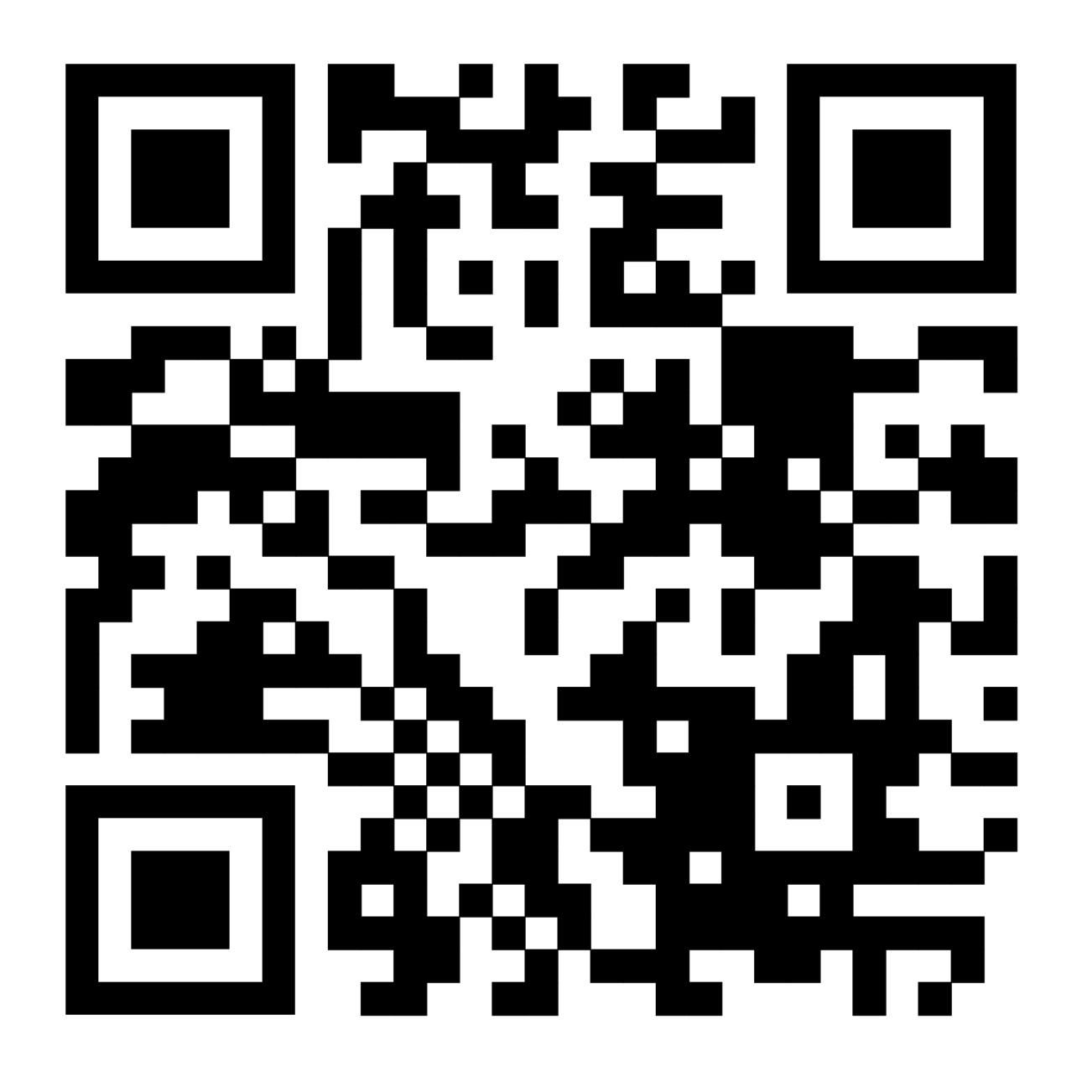
Jonah Tonick
I am a Junior at CAST Tech. Today, I am excited to share my educational journey with you, which revolves around the fields of UX Design and Cybersecurity. Additionally, I find joy in creating music and have been fortunate to perform in various concerts.
Resume

Slide 103
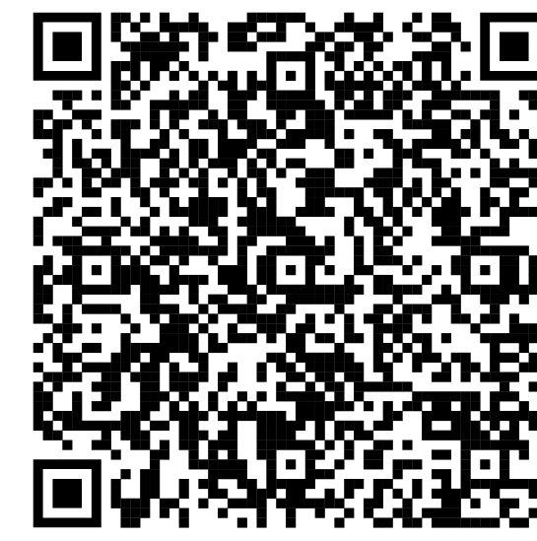
Akan Rivera
About me:
I go to CAST Tech High School
I am going into Junior year
My career path is Cyber Security, and I wish to pursue a career in Cyber Forensics
I enjoy traveling and cultural foods
Resume

Slide 104
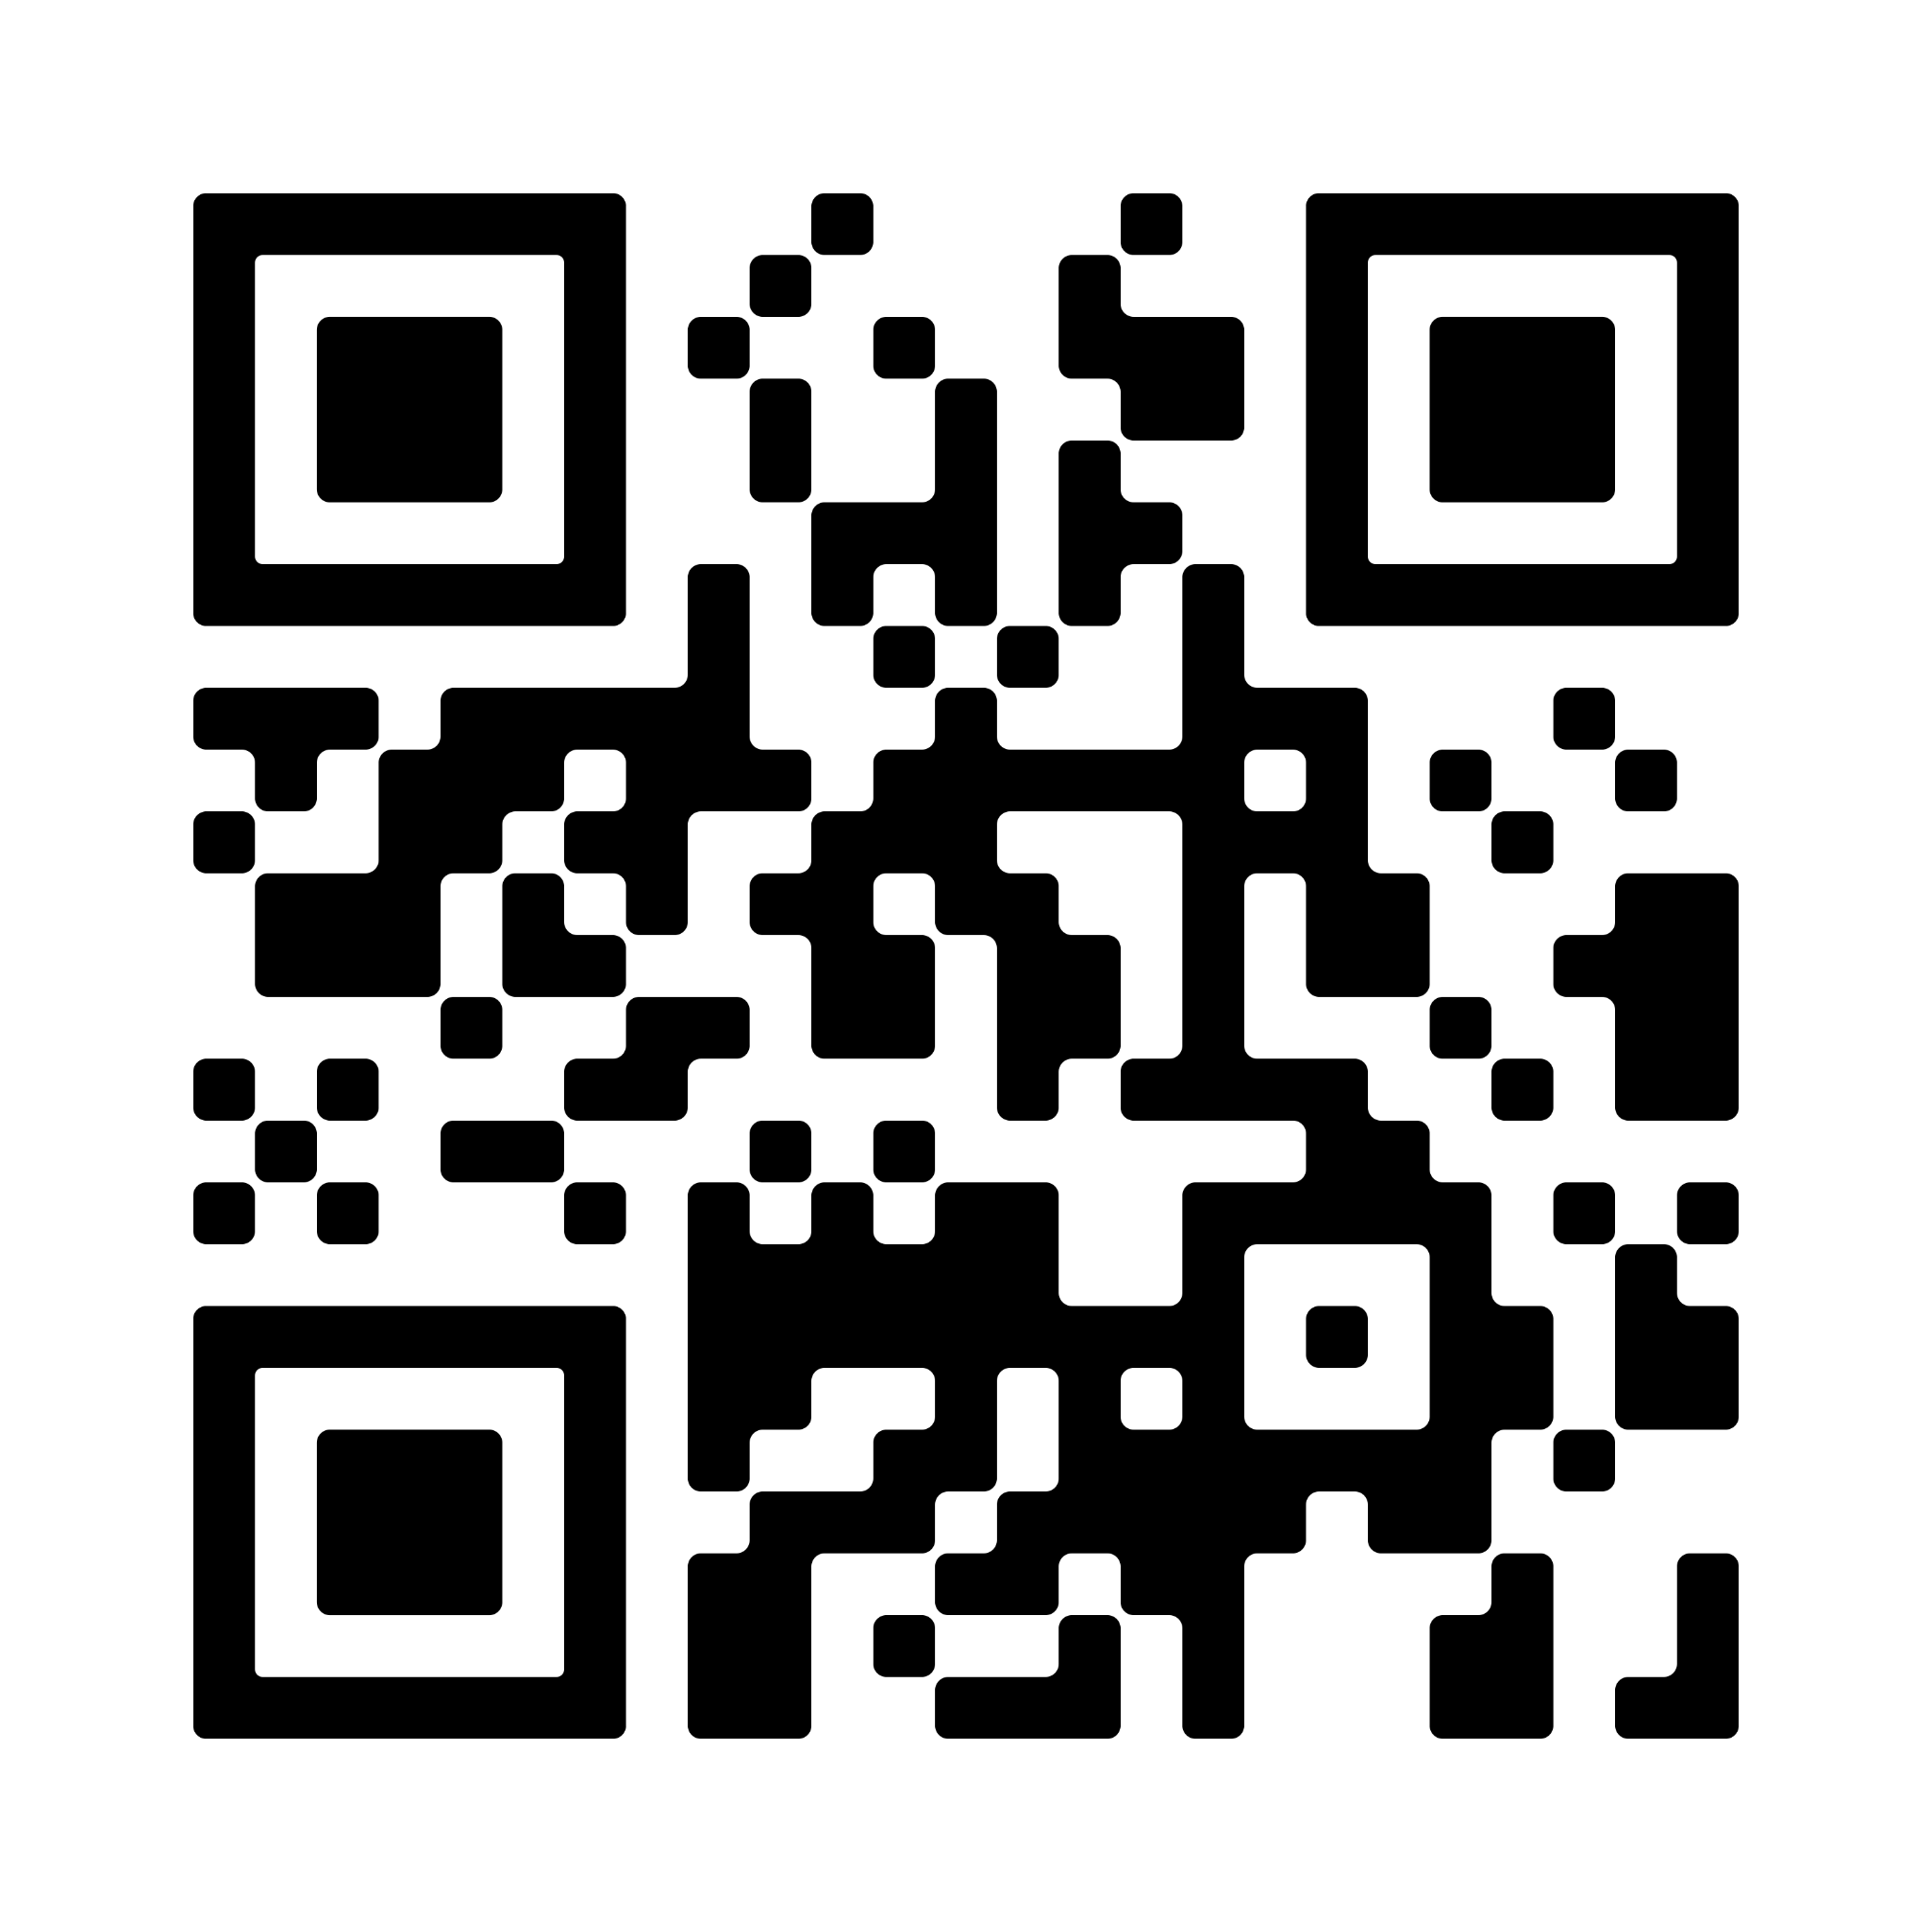
Adan Barbosa
I’m an upcoming senior at Cast Tech High School and i’m trying to further my career into IT and one of my hobbies is playing the guitar.
Resume

Slide 105
Andrew Flores
My name is Andrew Flores, I am an oncoming junior at CAST Tech HS. I have been involved in IT for years, and the SAISD Internship has been my first experience in an IT related job. I am looking forward to using the experience and networks I gained here in my future.
Resume

Slide 106
Department Highlight
The Information Technology Department ensures the smooth deployment and operations of technology across SAISD.
Presenter: Nicolas Alonzo

Slide 107
Job Description
Assisting the network, security, hardware, field technician, help desk, and application departments in their mission to ensure maximum uptime for SAISD.
Presenter: Jonah Tonick

Slide 108
Job Description
During my shadowing in the Cybersecurity area, I gained insights into cyber threats and protective measures, such as strong passwords and encryption.
While at Hardware Repair I have acquired hands-on experience troubleshooting hardware components and preventive maintenance.
In the networking field I have explored network setup, configuration, and security to ensure seamless data flow.
During my time in Help Desk I learned much about Enhanced problem-solving and communication skills in resolving user technical issues.
Presenter: Akan Rivera

Slide 109
My supervisor would say the best thing I did was…
“You guys have knocked out every task and have excelled at every challenge I have given [y'all].” -Justin Rios, Director of IT Services Delivery
“The interns' remarkable work ethic and dedication throughout the internship program have truly impressed us. Their contributions and fresh perspectives have undoubtedly enriched our projects and fostered a collaborative learning environment, making it one of the best internship experiences we've had thus far.” ~Justin Rios, Dir, IT Svc Delivery
Presenter: Kaylee Gomez

Slide 110
On thing that surprised me….
Something that surprised me was that I found out how many different fields of technology I would get to experience up close.
Presenter: Akan Rivera

Slide 111
On thing that surprised me….
One thing that surprised me was how much little things goes into their job and how there can be some many different ideas to fixing one problem at times.
.
Presenter: Kaylee Gomez

Slide 112
A Highlight of My Experience was….
Seeing how much patience you need to have for the users and the technology.
Presenter: Adan Barbosa

Slide 113
A Highlight of My Experience was….
My favorite part of the internship was when I shadowed a cybersecurity analyst who was in the process of resolving a high-severity alert.
Presenter: Emily Guardiola

Slide 114
In Conclusion…
I feel I gained transferable skills. In addition, I gained an idea of the workplace culture at SAISD.
I would tell my friends to apply for this internship because it gives them exposure to many departments, which helps in determining the type of career they want to pursue.
Overall, this internship gave me a clearer understanding of the career I want.
Presenter: Emily Guardiola

Slide 115
In Conclusion…
I feel I gained lots of experience in the technology field.
I would tell my friends to apply for an internship because I learned a lot from this internship, and I know for a fact that the skills I have acquired will be crucial later on in life.
These experiences will be carried with me and make a great impact on my career path.
Thank you very much for giving me this opportunity.
Presenter: Akan Rivera

Slide 116
Thank you
Date: 8/1/23

Slide 117
Lanier Print Shop Internship

Slide 118
Haylie Flores, Lanier HS
Hi my name is Haylie Flores from Sidney Lanier High School and I’m an incoming Junior. The pathway I’m currently enrolled in is the Lanier High School Graphic Design Printing Program and my hopes are to gain advance knowledge in designing to pursue a career in the Graphic Design field with the hopes of having my own business one day. As I’ve also been apart of the Mariachi Fine Arts Program I’d like to pursue this as my hobby as I love to play an instrument. Thank you SAISD for giving me an opportunity to be employed!

Slide 119
Job Description: Assistant Press Operators
Our Job Description and Summer Internship responsibilities.
Our Job Description is to confer with customers placing print orders in an effort to make sure all work is completed in a timely, effective, correct and positive manner
Our ability is to demonstrate the following core values: integrity, high expectations, commitment, respect, dedication to teamwork and passion for employee centered environment
Our Daily attendance at work and punctuality are essential functions of our job
Proficiencies we agreed on with supervisor at the orientation:
We agreed to be willing to learn beyond our level of knowledge, leadership, responsibility and communications skills.

Slide 120
My supervisor would say the best thing I did was…
My Supervisor would say my best performance task was…
My supervisor would say the best thing I did was collaborate well with clients, as a team player and roleplayed well as a leader, working great under pressure with multiple jobs given. She would also say I was a great reference to completions of work orders and on point with time management. I was awarded Best Customer Service from our Campus
Secretary this Summer 2023 .
Quotes!
“Welcome to Lanier Print Shop! How may I help you?”
“Good Morning! How are you doing?”
“My Pleasure”
“Thank you have a great day!”
Best Customer Service

Slide 121
One thing that surprised me….
My learning…
One thing I learned that surprised me was I learn an advance level of being creative with using not only one program but 3 programs such as Adobe InDesign, Photoshop and Illustrator. I also was surprised
by how I grew more confidence in dealing with
customers. I was amazed by how SAISD
Central Office staff motivated me to bring
back stronger communication skills. Touring
SAISD Printing Services was an awesome
experience in teaching me how to use similar
equipment.
SAISD Printing Service

Slide 122
A Highlight of My Experience was….
Favorite thing…
My favorite thing about my internship was designing multiple creative designs for very important customers. I got to learn not only creating but I learned a little bit about our customers by interacting with them.
Designing a Calendar under 10 minutes

Slide 123
In Conclusion…
Skills
We as Lanier Print Shop team feel we have gained many skills like designing skills, professionalism, positive work behaviors, critical thinking skills, hands on experiences with customers, and build friendships amongst ourselves as coworkers.
Recommend
We would refer our friends to apply for an internship because this experience will prepare them for future job and get them ready for the real world experience in the printing field.

Slide 124
Savanah Barron, Lanier HS
Hi my name is Savanah Barron from Sidney Lanier High School and I’m an incoming Sophomore. The pathway I’m currently enrolled in is the Lanier High School Graphic Design Printing Program and my hopes are to gain designing skills to pursue a career with a business company to create logos or any type of design work. As I’ve also been apart of the Band Fine Arts Program I’d like to pursue this as my hobby as I love to play an instrument but also further an opportunity to become an instructor. Thank you SAISD!

Slide 125
My supervisor would say the best thing I did was…
My Supervisor would say my best performance task was…
My supervisor would say the best thing I did was that I was willing to learn and grow my communication skills. So here I am today speaking!
Quotes!
“Welcome to Lanier Print Shop! How may I help you?”
“Good Morning! How are you doing?”
“My Pleasure”
“Thank you have a great day!”
@SAISD Receiving P-Card

Slide 126
One thing that surprised me….
I learned…
One thing I learned that surprised me was I learn how to be more creative with using Adobe InDesign and Photoshop. I also was surprised how I grew the confidence to help and contact customers.
SAISD Mail Room

Slide 127
A Highlight of My Experience was….
Favorite Thing…
My favorite thing about my internship was over seeing how the print shop operates daily and learning how to be apart of a team. I loved how every employee was supportive in my learning. I gain so many skills!
Team Work

Slide 128
Ana Estrada, Lanier HS
Hi my name is Ana Estrada from Sidney Lanier High School and I’m an incoming Junior. The pathway I’m currently enrolled in is the Lanier High School Graphic Design Printing Program and my hopes are to gain all required skills of a printing business to pursue a career in the work of graphics or establish a business in printing. As I’ve also been apart of the Mariachi Fine Arts Program I’d like to pursue this as my hobby and maybe a career as this is my passion! Thank you SAISD!

Slide 129
My supervisor would say the best thing I did was…
My Supervisor would say my best performance task was…
My supervisor would say the best thing I did was collaborate well as a team player and well pace myself with orders and my creativity.
Quotes!
“Welcome to Lanier Print Shop! How may I help you?”
“Good Morning! How are you doing?”
“My Pleasure”
“Thank you have a great day!”
Best Customer Service

Slide 130
On thing that surprised me….
I learned…
I learn how fast I can pick up on something such as designing and printing, and how fast I learned to be confident to talk and help customers.
Dealing with a Customer

Slide 131
A Highlight of My Experience was….
Favorite thing…
My favorite thing about my internship was learning more about the certain printing process, communicating with new customers and working as a team with all my coworkers.
Designing a Calendar under 10 minutes

Slide 132
Abraham Morales, Lanier HS
Hi my name is Abraham Morales from Sidney Lanier High School and I’m an incoming Senior. The pathway I’m currently enrolled in is the Lanier High School Practicum Design Printing Program and my hopes are to use all skills attained for my future career in a printing business. Also to pursue a career in the work of graphic arts or any establishment of business in printing. As I’ve also been coherent with the growth communication and hands on skills I’d like to pursue a secondary career as a veterinarian because animals are my passion! Thank you SAISD I officially gained various skill sets!

Slide 133
My supervisor would say the best thing I did was…
Ask your supervisor what your best performance task was.
My supervisor would say, the best thing I do is being a multi-tasker, being great with hands on experiences, willing to learn something new, also being a fast learner and a quick designer.
Quotes!
“Welcome to Lanier Print Shop! How may I help you?”
“Good Morning! How are you doing?”
“My Pleasure”
“Thank you have a great day!”
“I hope your days going well”
Developing Skills

Slide 134
One thing that surprised me….
I learned…
One thing I learned that surprised me was how to design with multiple programs such as Adobe Indesign and Illustrator. These were quick tool programs that help me develop great advertising creations for customers. I also gained experience on printing and helping customers with their orders.
1st Day Clocking In

Slide 135
A Highlight of My Experience was….
Favorite thing…
My favorite thing about my internship was learning from my supervisor in growing my communication skills, advancing on how to run the printers and how to work with my peer coworkers.
Designing a Calendar under 10 minutes

Slide 136
Thank you
Date: 00/00/2018
Presenter: First and last name

