Slide 1
History of the atom: Changing atomic models

Slide 2
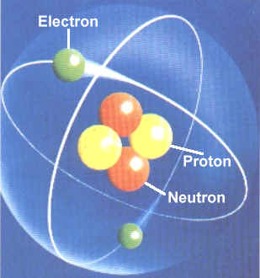
MODELS
A VISUAL, VERBAL, OR
MATHEMATEICAL
EXPLANATION OF HOW
PHENOMENA OCCUR OR
HOW DATA AND EVENTS
ARE RELATED.
MODELS HELP TO EXPLAIN THE STRUCTURE OF ATOMS BECAUSE THEY ARE TOO SMALL TO SEE.

Slide 3
Democritus (400 B.C. / Greece)
Proposed that matter was composed of tiny indivisible particles he called “atom”
Not based on experimental data
In Greek: atomos means “indivisible”

Slide 4
Greek Model of Atom (Democritus)

Slide 5
Aristotle (384 B.C. / Greece)
Greek model was not well accepted because Aristotle did not agree with Democritis
Believed in 4 elements: Earth, Air, Fire, and Water
Used observation and inference to explain the existence of everything, not experimentation
Mislead others to follow his beliefs for nearly 2000 years

Slide 6
1. John Dalton (1808 / England)
Described atoms as tiny particles that could not be divided, building on the ideas of Democritus.
His theory included:
4 Postulates
Law of Conservation of Mass
Law of Definite Proportions
Law of Multiple Proportions

Slide 7
Dalton’s 4 Postulates
1. Elements are composed of small indivisible particles called atoms.
2. Atoms of the same element are identical. Atoms of different elements are different.
3. Atoms of different elements combine together in simple proportions to create a compound.
4. In a chemical reaction, atoms are not created, destroyed or changed, only rearranged.

Slide 8
Law of Conservation of Mass
In a chemical reaction, matter is neither created nor destroyed just rearranged.

Slide 9
Law of Definite Proportions
Each compound contains the same element in the same proportions.

Slide 10
Law of Multiple Proportions
The same elements can combine in different proportions to form compounds.

Slide 11
Dalton’s Atomic Model
Billiard Ball Model
(atoms are uniform, solid spheres)

Slide 12
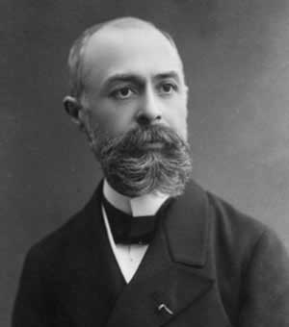
2. Becquerel ( France / 1896)
Accidentally discovered Radioactivity
Experimented with uranium salts, which spontaneously developed photographic film
Named Alpha (+), Beta (-), and Gamma (0) particles

Slide 13
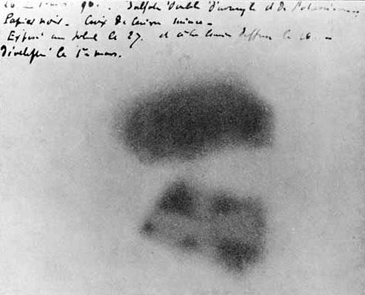
Becquerel’s Discovery
Becquerel's photographic plate

Slide 14
3. J.J. Thomson (1897 / England)
Thompson discovered that electrons were smaller particles of an atom and were negatively charged.
Thompson knew atoms were neutrally charged, but couldn’t find the positive particle.
Cathode Ray Tube Experiments
beam of negative particles
Plum-pudding Model

Slide 15
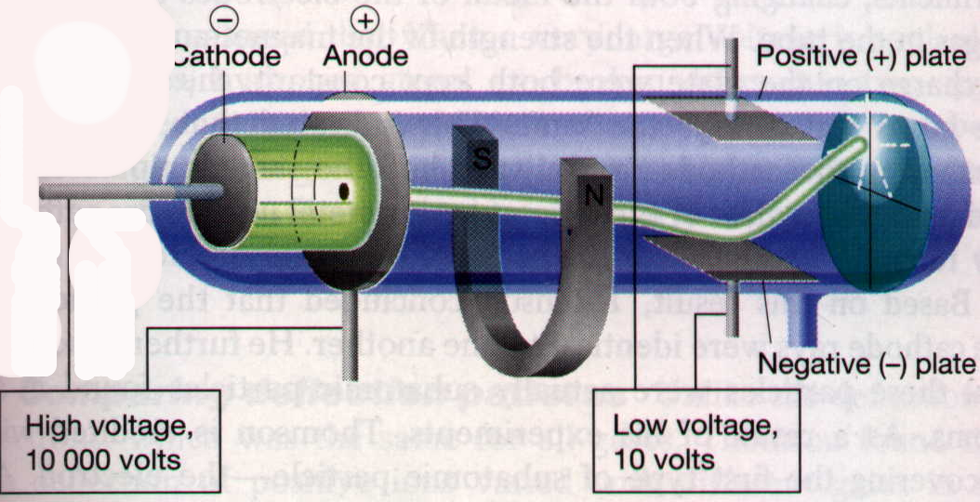
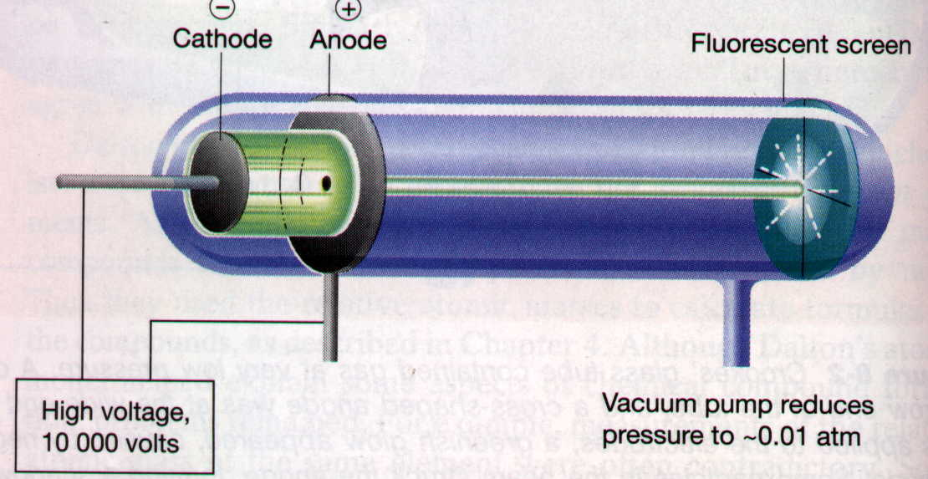
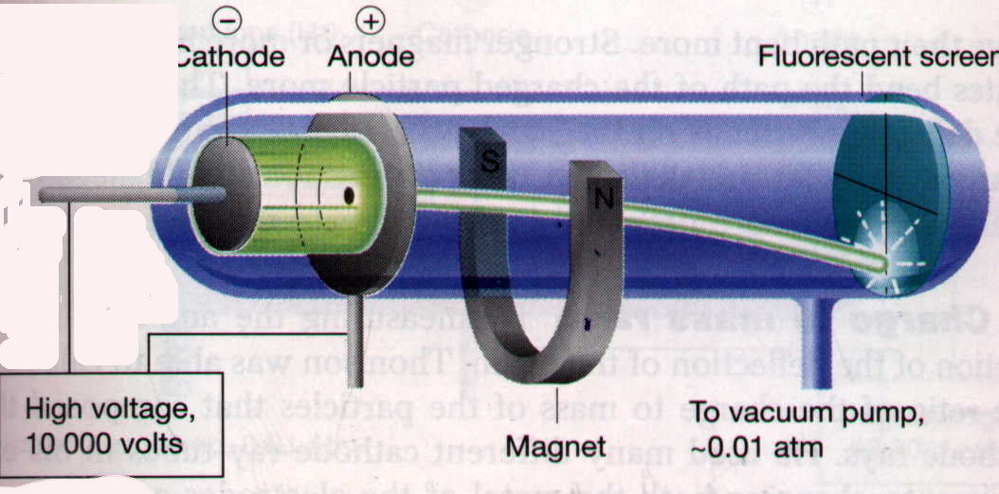
Thomson’s Experiment, 1897
Cathode Ray Tube Experiment (CRT):
demonstrated properties of electrons

Slide 16
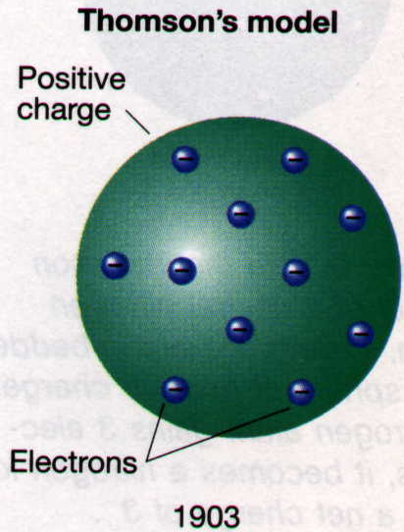
Thomson’s Atomic Model, 1903
Determined that the negatively charged particles have same mass and amount of charge
“Plum Pudding” model with negative electrons in positive sphere

Slide 17
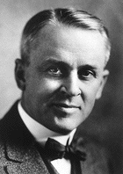
4. Robert Millikan (1909 / America)
Calculated the mass and charge of the electron in his “Oil Drop Experiment”
He did this by carefully balancing the gravitational and electric forces on tiny charged droplets of oil suspended between two metal electrodes.

Slide 18
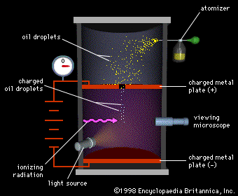
Millikan’s Oil Drop Experiment

Slide 19
Foldable Time!!
Folding Instructions:
Fold the paper that says “Atomic Timeline” hotdog style bringing one end of the paper only to the bold line.
Fold the paper in half hamburger style.
Tri-fold the half. When you unfold it, you should have 6 fold lines spaces evenly apart. Cut paper at the inside folds and it will look something like this (dotted lines are where you cut):

Slide 20
5. Ernest Rutherford (1911 / England)
Gold Foil Experiment
He knew that atoms had positive and negative particles, but could not decide how they were arranged.
Conducted an experiment to isolate the positive particles in an atom. Decided that the atoms were mostly empty space, but had a dense central core.
Nuclear Model

Slide 21
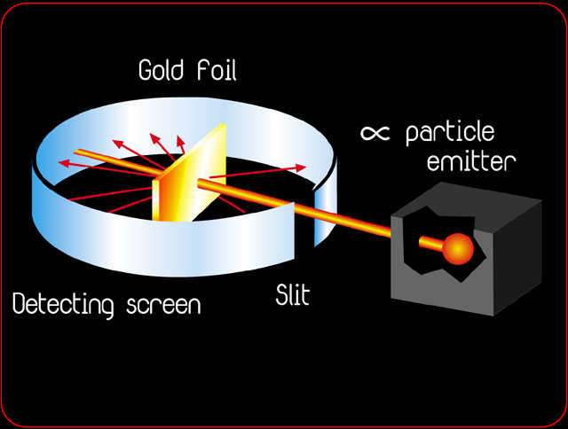
Rutherford’s Gold Foil Experiment

Slide 22
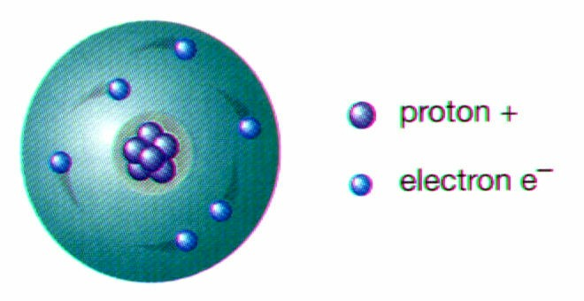
Ernest Rutherford’s Atomic Model
Nuclear Model:
Dense, positive nucleus surrounded by negative electrons

Slide 23
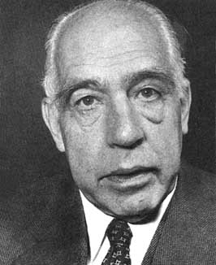
6. Niels Bohr (1913 / England)
Proposed that electrons traveled in fixed paths around the nucleus
Discovered Energy Levels
electrons can only exist in specific energy states
Scientists still use the Bohr model to show the number of electrons in each orbit around the nucleus
Planetary Model

Slide 24
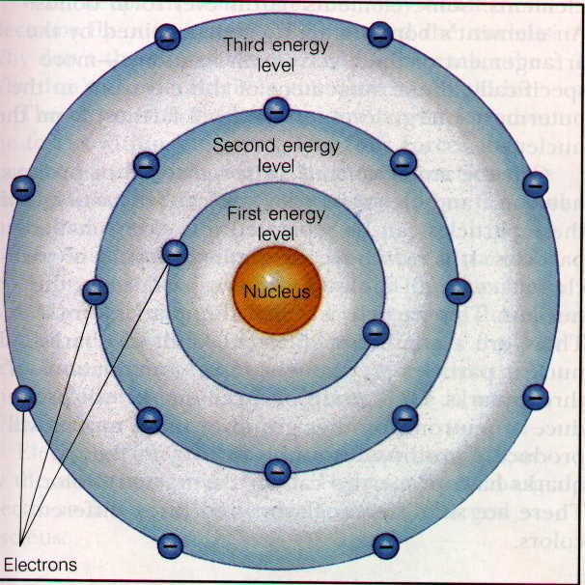
Niels Bohr’s Atomic Model
Planetary Model
electrons move in circular orbits within specific energy levels

Slide 25
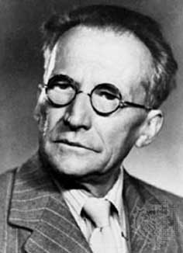
7. Erwin Schrödinger (1926 / Austria)
Used mathematical equations to predict location of electrons
Quantum mechanics
electrons can only exist in specified energy states
Electron Cloud Model
orbital: region around the nucleus where e⁻ are likely to be found

Slide 26
Schrödinger’s Electron Cloud Model
Electrons travel around the nucleus in random orbits.
Scientists cannot predict where they will be at any given moment.
Electrons travel so fast, they appear to form a “cloud” around the nucleus.

Slide 27
Schrödinger’s Atomic Model
Electron Cloud Model (orbital)
dots represent probability of finding an e⁻ not actual electrons

Slide 28
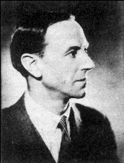
8. James Chadwick (1932 / England)
Mass of atom was too high to contain only protons and electrons
Discovered neutrons
neutral particles in the nucleus of an atom
Neutron Model

Slide 29
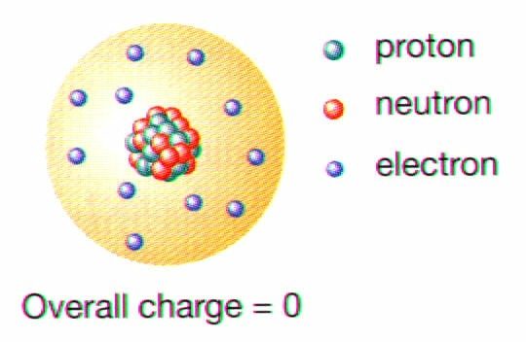
James Chadwick’s Atomic Model
Neutron Model
revision of Rutherford’s Nuclear Model

Slide 30
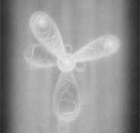
Quantum Mechanical Model of Atom
A mathematical model used to calculate where electrons are likely to be found

Slide 31
Particle | Sym-bol | Relative charge | Relative mass (amu) | Actual mass (g)
electron | -e | -1 | 1/1840 | 9.11 X 10⁻²⁸
proton | +p | +1 | 1 | 1.67 X 10⁻²⁴
neutron | ºn | 0 | 1 | 1.67 X 10⁻²⁴

