Slide 1
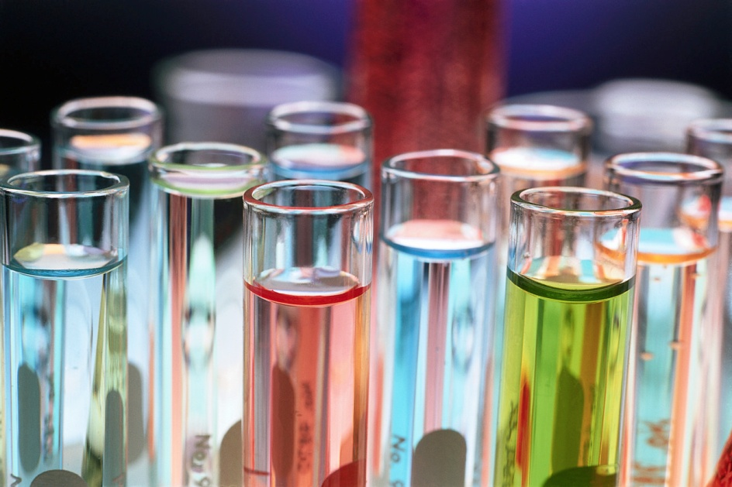
Balancing Chemical Equations
UNIT 7-CHEMICAL REACTIONS:

Slide 2
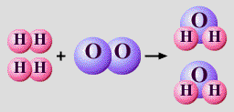
Law of Conservation of Mass:
In a chemical reaction mass is neither created nor destroyed
total mass stays the same
atoms can only rearrange
36 g
4 g
32 g

Slide 3
Examples
NaCl → Na + Cl₂
40 g 15g + _____
25 g
C₂H₆ + O₂ → CO₂ + H₂O 30 g + 15g ___ + 5g
40 g

Slide 4
__H₂ + __O₂ → __H₂O
2
1
2
Coefficient X subscript = # of atoms
4 H
2 O
4 H
2 O

Slide 5
Balancing Equations
“Trial and Error”
1. Count atoms on each side of arrow.
2. Add coefficients where needed.
3. If necessary, Reduce coefficients to lowest ratio.
4. Check your work!!!

Slide 6
Balancing Tips
Balance one element at a time.
Update ALL atom counts after adding a coefficient.
If an element appears more than once per side, balance it last.
Balance polyatomic ions as single units.
“1 SO₄” instead of “1 S” and “4 O”

Slide 7
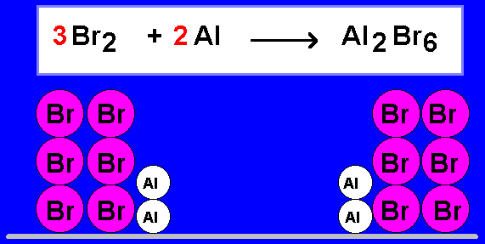
Examples
__Br₂ + __Al → __Al₂Br₆
3
2
NO
Is this balanced? ______

Slide 8
Aluminum and copper(II) chloride react to form copper and aluminum chloride.
3
3
2
Al + CuCl₂ → Cu + AlCl₃
2
1 1
1 1
2 3
2 ⁄
Al
Cu
Cl
⁄ 2
⁄ 6
3 ⁄
6 ⁄
⁄ 3

Slide 9
C₂H₆ + O₂ → CO₂ + H₂O
Answer:
2C₂H₆ + 7O₂ → 4CO₂ + 6H₂O

Slide 10
KClO₃ → KCl + O₂
Answer:
2KClO₃ → 2KCl + 3O₂

Slide 11
Na₃PO₄ + CaCl₂ → Ca₃(PO₄)₂ + NaCl
Answer:
2Na₃PO₄ + 3CaCl₂ → Ca₃(PO₄)₂ + 6NaCl

