Slide 1
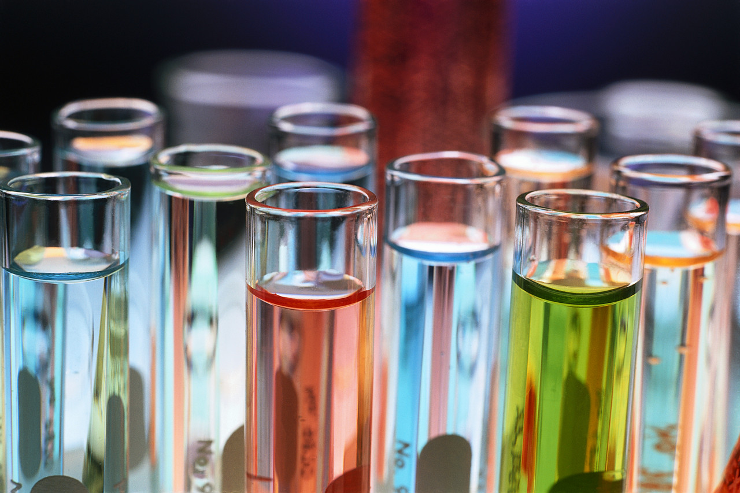
INTRO TO REACTIONS
UNIT 7-CHEMICAL REACTIONS:

Slide 2
CHEMICAL VS. PHYSICAL CHANGES
CHEMICAL
Color change
Gas production
Precipitate forms
Light/heat is produced
PHYSICAL
Change in:
Size
Shape
State of matter

Slide 3
CHEMICAL VS. PHYSICAL CHANGES
CHEMICAL
Color change
Gas production
Precipitate forms
Light/heat is produced
SIGNS OF CHEMICAL REACTIONS!

Slide 4
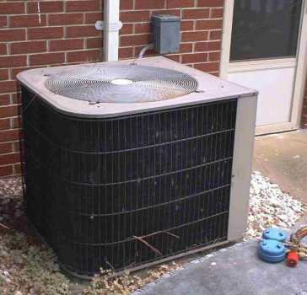
VOCABULARY
EXERGONIC: reaction that releases energy
ENDERGONIC: reaction that absorbs energy

Slide 5
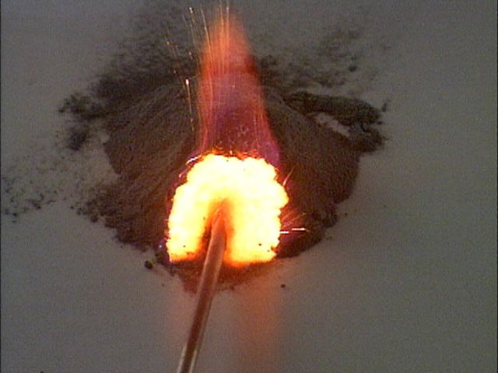
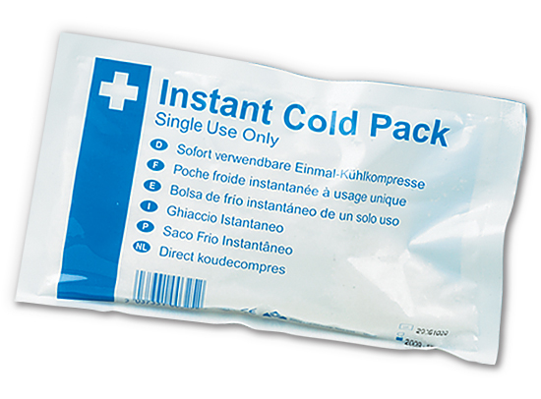
VOCABULARY
EXOTHERMIC: reaction that releases energy as heat
ENDOTHERMIC: reaction that absorbs energy as heat

Slide 6
Coefficient
A small whole number placed in front of a compound in a chemical reaction that multiplies its quantity.
= two water molecules
2
H₂O

Slide 7
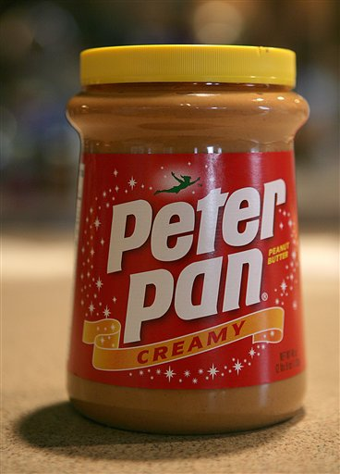
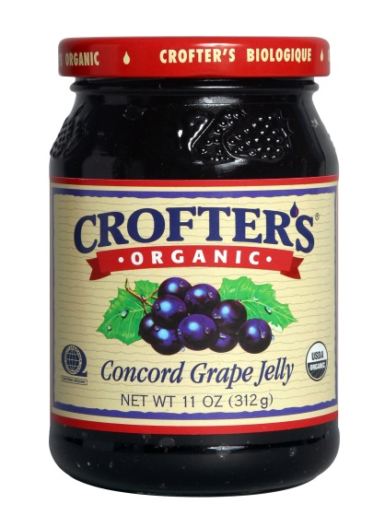
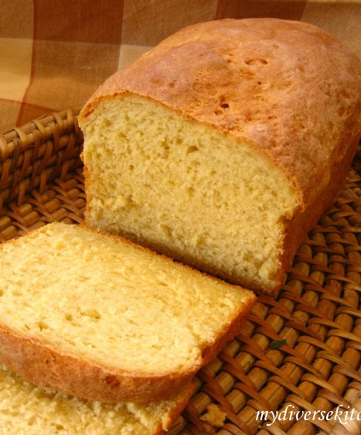
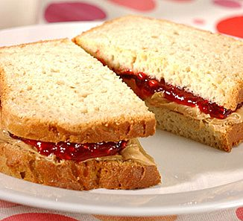
Chemical Equations
+
+
→
REACTANTS
PRODUCTS
Before → After

Slide 8
Chemical Equations
2H₂ (g) + O₂ (g) → 2H₂O (l)
2H₂ and O₂
REACTANTS: ____________
2H₂O
PRODUCTS: _____________

Slide 9
SYMBOLS in Chemical Equations
+
→
(s)
(l)
(g)
(aq)
Plus, and
Produces, forms, yields
solid
liquid
gas
Aqueous (solid in water)

Slide 10
Chemical Equations
2Al(s) + 3CuCl₂(aq) → 3Cu(s) + 2AlCl₃(aq)
Al =
CuCl₂ =
Cu =
AlCl₃ =
solid
aqueous
solid
aqueous

Slide 11
Writing Equations
2H₂(g) + O₂(g) → 2H₂O(g)
Identify the substances involved.
Use symbols to show:
How many? - coefficient
Of what? - chemical formula
In what state? - physical state
Remember the diatomic elements.

Slide 12
Writing Equations
Two atoms of solid aluminum react with three units of aqueous copper(II) chloride to produce three atoms of solid copper and two units of aqueous aluminum chloride.
How many?
Of what?
In what state?
Al
2
(s)
(aq)
+ 3
CuCl₂
→ 3
Cu
(s)
+ 2
AlCl₃
(aq)

Slide 13
Describing Equations
Describing Coefficients:
individual atom = “atom”
covalent substance = “molecule”
ionic substance = “unit”
3CO₂ ⇒
2Mg ⇒
4MgO ⇒
3 molecules of carbon dioxide
2 atoms of magnesium
4 units of magnesium oxide

Slide 14
Describing Equations
Zn(s) + 2HCl(aq) → ZnCl₂(aq) + H₂(g)
How many? Of what? In what state?
One atom of solid zinc
reacts with
two molecules of aqueous hydrochloric acid
to produce
one unit of aqueous zinc chloride
and one molecule of hydrogen gas.

