Slide 1
UNIT 1– Matter

Slide 2
What is matter anyway? Matter is ANYTHING that has MASS & takes up SPACE (has VOLUME)

Slide 3
Kinetic Molecular Theory
This is NOT in your notes…write it in!!!
KMT=Kinetic Molecular Theory
Particles of matter are always in motion.
The kinetic energy (speed) of these particles increases as temperature increases.

Slide 4
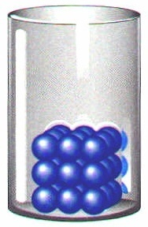
Four States of Matter
Solids
very low KE (kinetic energy) - particles vibrate but can’t move around
fixed shape
fixed volume

Slide 5
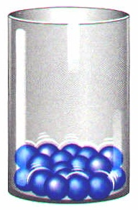
Four States of Matter
Liquids
low KE - particles can move over & around each other but are still close together
variable shape
fixed volume

Slide 6
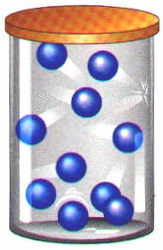
Four States of Matter
Gases
high KE - particles have enough energy to separate and move throughout container; so much so that gases are mostly empty space!
variable shape
variable volume

Slide 7
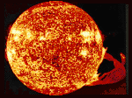
Four States of Matter
Plasma
Highest KE - particles collide with enough energy to break into charged particles (+/-)
gas-like, variable shape & volume
stars, fluorescent light bulbs

Slide 8
Fluids
What is a fluid?
a substance that can FLOW & has particles that are able to move around each other.
What 2 phases of matter are considered FLUIDS?
Liquids & Gases

Slide 9
Properties of Fluids
What is viscosity?
The ability of a liquid to flow or the resistance to flow. (Honey is MORE viscous than water)
What is buoyancy?
The upward force a fluid exerts on an object.

Slide 10
Properties of Fluids
What 3 properties allow an object to be “buoyant”?
The buoyant force exerted upward on the object is greater than the force downward of the object’s weight.
The density of the object is less than the density of the fluid.
The weight of the water displaced by the object is greater than the weight of the object

Slide 11
States of Matter…Test YOUR knowledge! ☺
Type of Matter | Kinetic energy | Shape | Volume
Solid
Liquid
Gas
Plasma

Slide 12
States of Matter…Test YOUR knowledge! ☺
Type of Matter | Kinetic energy | Shape | Volume
Solid | Very low | Definite/fixed | Definite/fixed
Liquid | Low | Indefinite/ not fixed/ variable | Definite/fixed
Gas | High | Indefinite/ Not fixed/ variable | Indefinite/ Not fixed/ variable
Plasma | Very high | Indefinite/ Not fixed/ variable | Indefinite/ Not fixed/ variable

Slide 13
Matter Flowchart
MATTER
yes
no
Can it be physically separated?
MIXTURE
PURE SUBSTANCE
yes
Is the composition uniform?
no
yes
Can it be chemically decomposed?
no
Homogeneous Mixture
(solution)
Heterogeneous Mixture
Compound
Element
Colloids
Suspensions

Slide 14
Matter Flowchart
Test yourself…
graphite
pepper
sugar (sucrose)
paint
soda
element
hetero. mixture
compound
hetero. mixture
solution

Slide 15
Pure Substances: only TWO types…element OR compound!
Element
composed of identical atoms
Found on the PERIODIC TABLE
EX: copper wire, aluminum foil

Slide 16
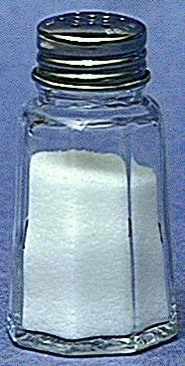
Pure Substances: only TWO types…element OR compound!
Compound
composed of 2 or more elements in a fixed ratio
It has a chemical formula!!!
properties differ from those of individual elements
EX: table salt (NaCl)

Slide 17
Pure Substances
Law of Definite Composition
A given compound always contains the same, fixed ratio of elements.
In other words, water is always H₂O with a 2:1 ratio of H to O and hydrogen peroxide is always H₂O₂ with a 2:2 ratio of H to O.

Slide 18
Pure Substances
Law of Multiple Proportions
Elements can combine in different ratios to form different compounds.
Same as before, ratios matter. You can have the same elements, such as H & O combined in DIFFERENT ratios. H₂O (water) and H₂O₂ (peroxide) are two very different compounds!!!

Slide 19
A. Matter Flowchart--REVIEW
MATTER
yes
no
Can it be physically separated?
MIXTURE
PURE SUBSTANCE
yes
Is the composition uniform?
no
yes
Can it be chemically decomposed?
no
Homogeneous Mixture
(solution)
Heterogeneous Mixture
Compound
Element
Colloids
Suspensions

Slide 20
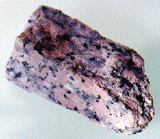
Mixtures
Variable combination of 2 or more pure substances. NOT chemically combined!
Heterogeneous
Homogeneous

Slide 21
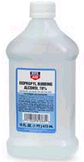
Mixtures
Homogeneous Mixtures are called Solutions
Appear the same throughout
very small particles
no Tyndall effect (light doesn’t scatter)
particles don’t settle; they are dissolved
EX: rubbing alcohol

Slide 22
Mixtures
Heterogeneous Mixtures: Two Types
Colloid
medium-sized particles
Tyndall effect (will scatter light)
particles don’t settle (they’re too small)
EX: milk

Slide 23
Mixtures
Suspension
large particles
Tyndall effect
particles settle (because they are so large)
EX: fresh-squeezed lemonade; pond water

Slide 24
C. Mixtures
You try…
mayonnaise
muddy water
fog
saltwater
Italian salad dressing
colloid
suspension
colloid
solution
suspension

Slide 25
Properties of & Changes in Matter…
Intensive vs. Extensive
Physical vs. Chemical

Slide 26
Extensive vs. Intensive
Extensive Property
depends on the amount of matter present
Can be “extended” or changed
Intensive Property
depends on the identity of substance, not the amount

Slide 27
A. Extensive vs. Intensive
Examples:
boiling point
volume
mass
density
conductivity
intensive
extensive
extensive
intensive
intensive

Slide 28
Physical vs. Chemical Property
Physical Property
can be observed without changing the identity of the substance
Chemical Property
describes the ability of a substance to undergo changes in identity

Slide 29
Physical vs. Chemical PROPERTY
You try it…
melting point
flammable
density
magnetic
tarnishes in air
physical
chemical
physical
physical
chemical

Slide 30
Physical Changes
Changes the composition of a substance without changing its identity.
ex: cutting, separating, dissolving

Slide 31
Changes of state (phase changes) are physical changes that involve changes of energy.

Slide 32
Phase Changes (physical change)
sublimation
vaporization
melting
SOLID
LIQUID
GAS
freezing
condensation
deposition

Slide 33
Chemical Changes (Reactions)
Changes the identity of the substance. Products have different properties from the original
ex: burning, tarnishing, cooking

Slide 34
Indicators of Chemical Change
New Substance Formed
Change of color or odor
Release or formation of gas
Formation of precipitate (solid)olid)
Changes in heat or light (change in energy)

Slide 35
Exothermic: Release energy as heat
Exergonic: Release energy
Exo- means RELEASE
Endothermic: Absorb energy as heat
Endergonic: Absorb energy
Endo- mean ABSORB

Slide 36
Physical vs. Chemical CHANGE
You try it…
rusting iron
dissolving in water
burning a log
melting ice
grinding spices
chemical
physical
chemical
physical
physical

