Slide 1
Understanding Chemical Hazard Labels

Slide 2
Numbers go in the diamond, on a scale…
0
4
Not a
Danger
Watch Out

Slide 3
NFPA (National Food Processors Association) Chemical Hazard Label
Health

Slide 4
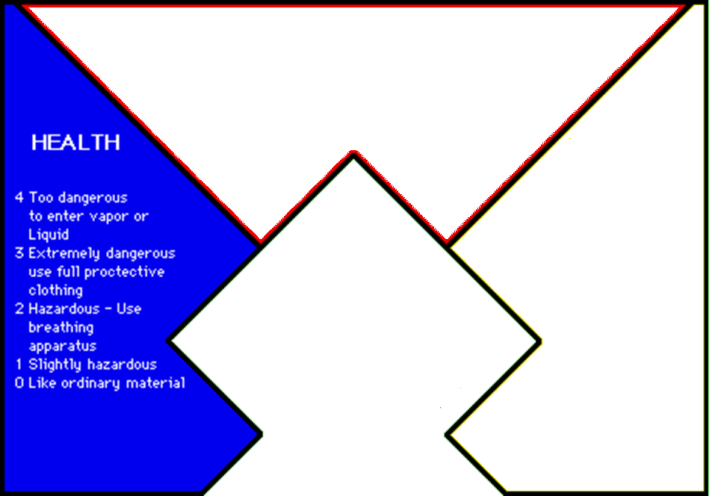

Slide 5
Health
Radioactivity – Radioactivity is the spontaneous emission of energy from unstable atoms in the nucleus from decay. (destroys cells, cancer, birth defects)
Toxicity – capacity of a substance to poison
Carcinogen- agent directly involved in causing cancer
Irritant – inflammation or painful reaction to allergy or cell lining damage

Slide 6
NFPA Chemical Hazard Label (National Food Processors Association)
Flammability
Health

Slide 7
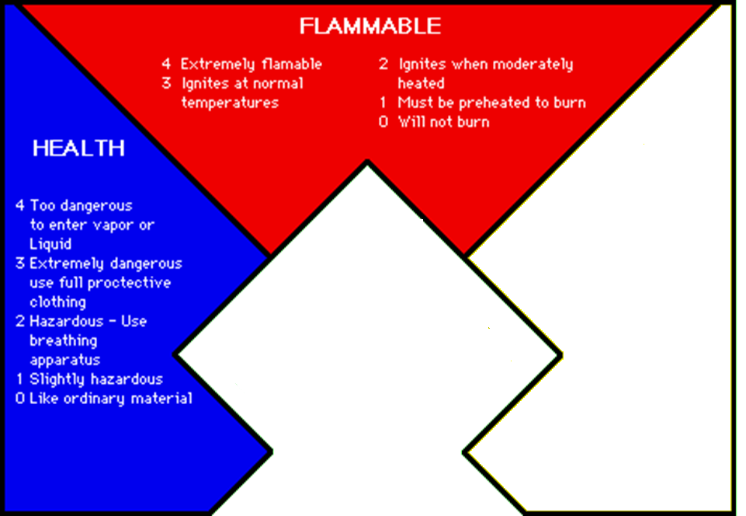

Slide 8
NFPA Chemical Hazard Label
Flammability
Health
Reactivity (Stability)

Slide 9
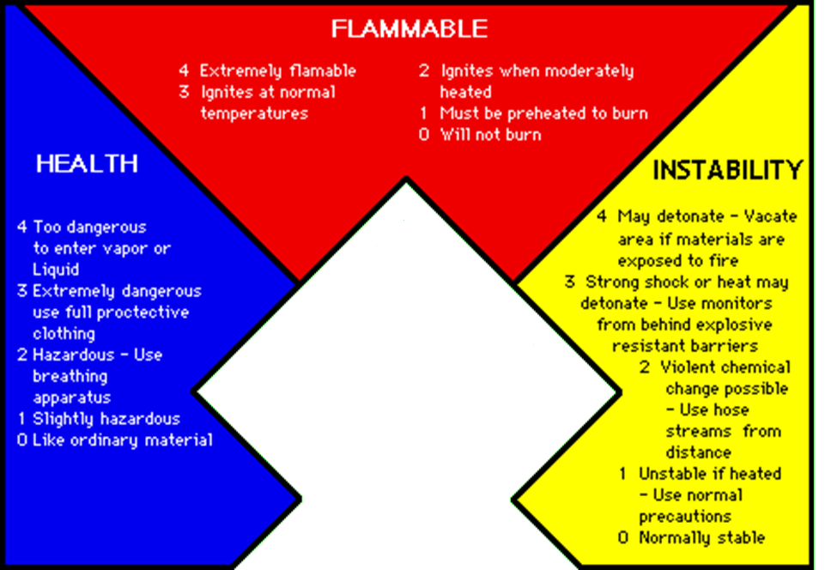

Slide 10
NFPA Chemical Hazard Label
Health
Flammability
Reactivity (Stability)
Special

Slide 11
Reactivity
Corrosiveness – one that will destroy or irreversibly damage another surface or substance with which it comes into contact, a gradual destruction (more from acids, pH < 2)
Causticness – burns or destroys living tissue (more from bases…pH > 12.5)
Oxidizer – takes electrons in a reaction (Cl), may cause a combustion of other chemicals

Slide 12
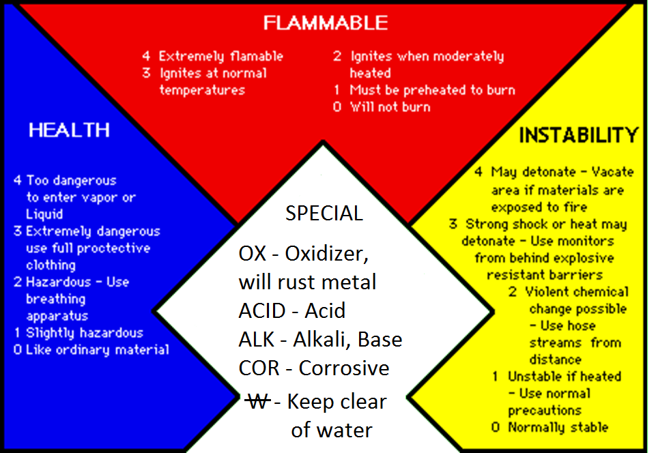

Slide 13
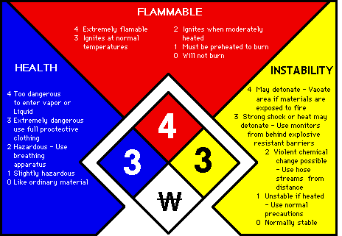

Slide 14
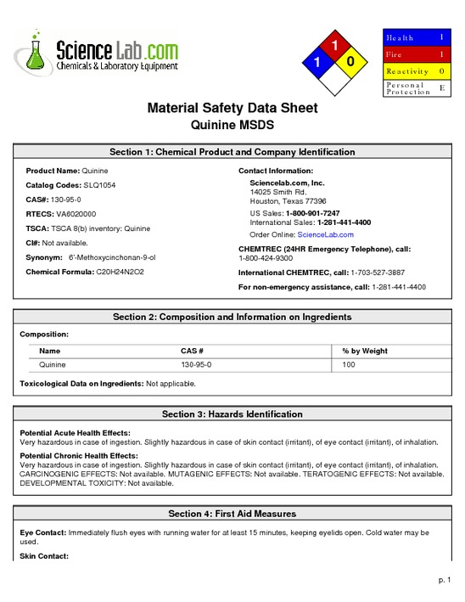
What is an MSDS?!???!!

Slide 15
What is an MSDS?
Material Safety Data Sheet
A concise document that contains all known information about the chemical
…including any safety hazards, and …
…the protective gear you will need to wear to avoid injury to your person.

