Slide 1
Chapter 5 Thermochemistry

Slide 2
Thermochemistry
Thermochemistry is the study of the relationship between ENERGY and chemical reactions.
What is energy?
Notes:
1

Slide 3
Energy
Energy is the ability to do work or transfer heat.
Energy used to cause an object that has mass to move is called work.
Energy used to cause the temperature of an object to rise is called heat.

Slide 4
Kinetic Energy
Kinetic energy is energy possessed by matter because it is in motion.
The SI unit of energy is the joule (J).
An older, non-SI unit is still in widespread use: the calorie (cal).
1 cal = 4.184 J
1
kg m²
KE = ⎯ mv²
1 J = 1 ⎯⎯
2
s²
Notes:
1

Slide 5
Kinetic Energy
Thermal energy is kinetic energy in the form of random motion of particles in any sample of matter. As temperature rises, thermal energy increases.
Heat is energy that causes a change in the thermal energy of a sample. Addition of heat to a sample increases its temperature.

Slide 6
Potential Energy
Potential energy is energy possessed by matter because of its position or condition.
A brick on top of building has potential energy that is converted to kinetic energy when it falls.
Chemical energy is energy possessed by atoms as a result of their state of chemical combination. The energy of 2 mol of H₂ and 1 mol of O₂ is different than that of 2 mol of H₂O.
Notes:
1

Slide 7
Basic Definitions
The system is a sample of matter on which we focus our attention, generally the atoms involved in a chemical reaction.
The surroundings are all other matter in the universe.
In thermochemistry, we study the exchange of energy between the system and surroundings.
Notes:
1

Slide 8
Conservation of Energy
The law of conservation of energy states that the energy of the system and surroundings does not change during a chemical or physical change.
Energy may move between the system and surroundings in many different forms, but the total energy does not change.
Notes:
1

Slide 9
Internal Energy
Energy of our system can be represented by either E or U.
Represents all energies in the system
Usually cannot know E.
Can determine ΔE
Determine E_{initial} and E_{final}
ΔE = E_{final} – E_{initial}
Since we cannot create or destroy energy, just knowing ΔE is okay

Slide 10
Internal Energy
ΔE has three components
Numerical value
Units (J)
Sign (positive or negative)

Slide 11
Internal Energy
We are talking about the system
-ΔE energy lost to surroundings
+ΔE energy gained from surroundings

Slide 12
Changes in Internal Energy
If ΔE > 0, E_{final} > E_{initial}
Therefore, the system absorbed energy from the surroundings.
This energy change is called endergonic.

Slide 13
Changes in Internal Energy
If ΔE < 0, E_{final} < E_{initial}
Therefore, the system released energy to the surroundings.
This energy change is called exergonic.

Slide 14
Changes in Internal Energy
When energy is exchanged between the system and the surroundings, it is exchanged as either heat (q) or work (w).
That is, ΔE = q + w.

Slide 15
ΔE, q, w, and Their Signs
Example:
q = -47 kJ w = +88 kJ ΔE = ?
q = -47 kJ w = 0 kJ ΔE = ?

Slide 16
Work
Usually in an open container the only work done is by a gas pushing on the surroundings (or by the surroundings pushing on the gas).

Slide 17
Work
We can measure the work done by the gas if the reaction is done in a vessel that has been fitted with a piston.
w = -PΔV

Slide 18
Enthalpy
If a process takes place at constant pressure (as the majority of processes we study do) and the only work done is this pressure-volume work, we can account for heat flow during the process by measuring the enthalpy of the system.
Enthalpy is the internal energy plus the product of pressure and volume:
H = E + PV

Slide 19
Enthalpy
When the system changes at constant pressure, the change in enthalpy, ΔH, is
ΔH = Δ(E + PV)
This can be written
ΔH = ΔE + PΔV

Slide 20
Enthalpy
Since ΔE = q + w and w = -PΔV, we can substitute these into the enthalpy expression:
ΔH = ΔE + PΔV
ΔH = (q+w) − w
ΔH = q
So, at constant pressure, the change in enthalpy is the heat gained or lost.

Slide 21
Change in Enthalpy
The enthalpy is a measure of the total energy of the system as a given temperature and pressure.
Although the total enthalpy is not known, changes in enthalpy can be measured.
The change in enthalpy, ΔH, is equal to the change in heat experienced by the system at constant pressure.
Notes:
1

Slide 22
Classes of Thermochemical Reactions
A reaction is called exothermic when the system (atoms involved in the reaction) transfers heat to the surroundings.
A reaction that absorbs heat from the surroundings is called endothermic.
CH₄(g) + 2O₂(g) → CO₂(g) + 2H₂O() + energy
N₂(g) + O₂(g) + energy → 2NO(g)
Notes:
1

Slide 23
The Truth about Enthalpy
Enthalpy is an extensive property.
Directly proportional to the amount of material
ΔH for a reaction in the forward direction is equal in size, but opposite in sign, to ΔH for the reverse reaction.
ΔH for a reaction depends on the state of the products and the state of the reactants.

Slide 24
Thermochemical Equations
A thermochemical equation is an equation for which ΔH is given. For example:
The enthalpy changes assume that the coefficients are moles of the substances.
Enthalpy change is a stoichiometric quantity.
CH₄(g) + 2O₂(g) → CO₂(g) + 2H₂O() ΔH = -890 kJ
N₂(g) + O₂(g) → 2NO(g) ΔH = +181.8 kJ
Notes:
1

Slide 25
Classes of Thermochemical Reactions
Consider the thermochemical equation
The thermochemical equivalencies are
1 mol C₃H₈(g) react to give off 2.22×10³ kJ
5 mol O₂(g) react to give off 2.22×10³ kJ
3 mol CO₂(g) are formed and give off 2.22×10³ kJ
4 mol H₂O() are formed and give off 2.22×10³ kJ
C₃H₈(g) + 5O₂(g) → 3CO₂(g) + 4H₂O() ΔH = -2.22×10³ kJ
Mass of CO₂
Molar mass of CO₂
Moles of CO₂
Thermochemical equivalent
Enthalpy change
Notes:
1

Slide 26
Example: Enthalpy Calculation
Calculate the enthalpy change when 11.0 g of CO₂ forms from the combustion of propane (C₃H₈).
C₃H₈(g) + 5O₂(g) → 3CO₂(g) + 4H₂O()
ΔH = -2.22×10³ kJ
Notes:
1
Answer: -185 kJ

Slide 27
Test Your Skill
It takes 74 kJ to heat enough water for a cup of tea. What mass of methane (CH₄) must burn to provide this heat?
CH₄(g) + 2O₂(g) → CO₂(g) + 2H₂O()
ΔH = -890 kJ
Notes:
1

Slide 28
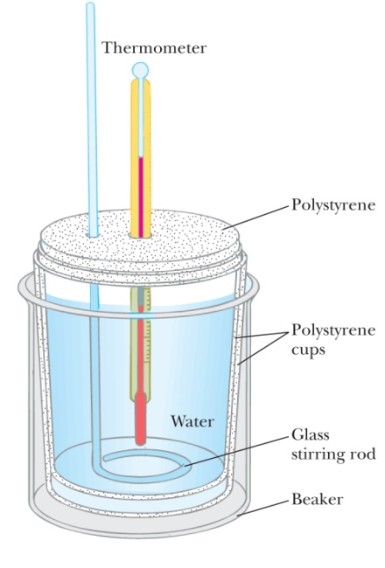
Calorimetry
Calorimetry is the experimental measurement of heat released or absorbed by a chemical reaction.
A calorimeter is the device used to measure heat.
The quantity of heat transferred by the reaction causes a change of temperature inside the calorimeter.
A simple calorimeter can be made from styrofoam coffee cups.
Notes:
1

Slide 29
Specific Heat
The specific heat (C_{s}) is the heat needed to increase the temperature of a 1-gram of matter by 1 K.
The specific heat has units of J/g·ºC or J/g·K.
The relation between heat (q), mass (m), and change in temperature (ΔT) is
q = mC_{s}ΔT
Notes:
1

Slide 30
Example: Heat
How much heat must be added to 120 g of water (C_{s} = 4.184 J/g·ºC) to raise its temperature from 23.4 ºC to 36.8 ºC?
Notes:
1
Answer: 6730 J

Slide 31
Calorimetry Calculations
The calorimeter and its contents are the surroundings, so q_{surr} is found from the mass, heat capacity, and temperature change.
The chemical reaction is the system, so q_{sys} equals ΔH.
The law of conservation of energy requires that
q_{surr} + ΔH = 0 or ΔH = -q_{surr}
Notes:
1

Slide 32
Example: Calorimetry
When 100 g of a AgNO₃ solution mixes with 150 g of NaI solution, 2.93 g of AgI precipitates, and the temperature of the solution raises by 1.34 ºC. Assume 250 g of solution and a heat capacity of 4.18 J/g·ºC. Calculate the ΔH of the following equation.
Ag⁺(aq) + I⁻(aq) → AgI(s)
Notes:
1
Answer: ΔH = 1.40×10³ J = 112 kJ/mol.

Slide 33
State Functions
There are two kinds of thermodynamic functions.
A state function is a property of the system that is fixed by the present conditions and is independent of the system’s history.
A path function is a property that depends on how the particular change took place.
Enthalpy is a state function.
Notes:
1

Slide 34
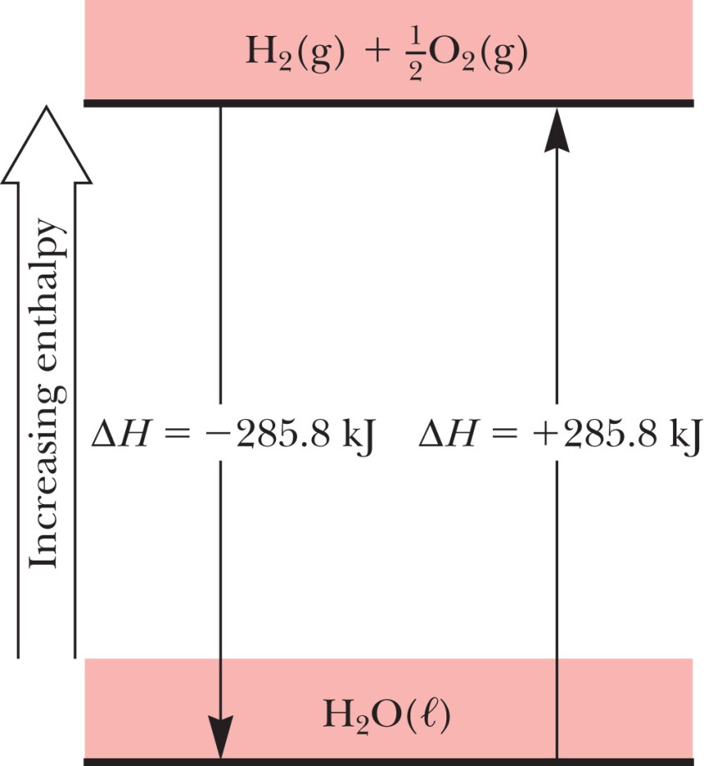
Energy-Level Diagrams
An energy-level diagram can represent the enthalpy change for a reaction.
H₂(g) + ½O₂(g) → H₂O() ΔH = −285.8 kJ
Notes:
1

Slide 35
Hess’s Law
Hess’s Law states that when two or more thermochemical equations are added, the enthalpy change of the resulting equation is the sum of those for the added equations.
C(s) + O₂(g) → CO₂(g) ΔH = -393.5 kJ
CO₂(g) → CO(g) + ½O₂(g) ΔH = +283.0 kJ
C(s) + ½O₂(g) → CO(g) ΔH = -110.5 kJ
Notes:
1

Slide 36
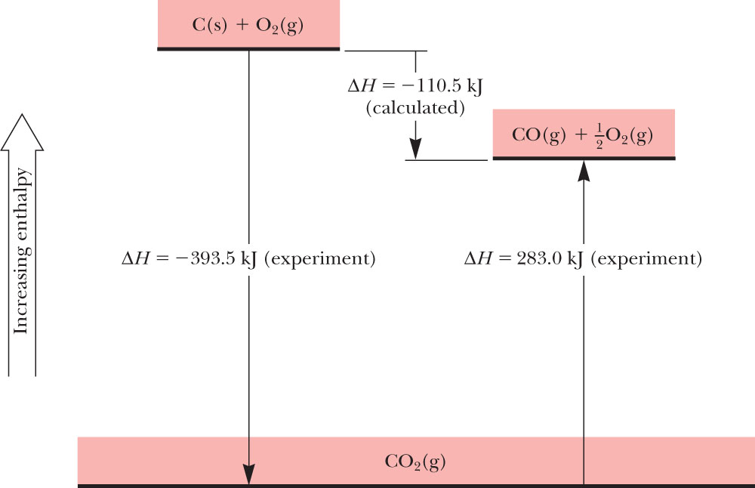
Energy level Diagram: Hess’s Law
C(s) + ½O₂(g) → CO(g) ΔH = -110.5 kJ
Notes:
1

Slide 37
Hess’s Law
Calculate ΔH for
given the thermochemical equations:
3C₂H₂(g) → C₆H₆()
2C₂H₂(g) + 5O₂(g) → 4CO₂(g) + 2H₂O() ΔH = -1692 kJ
2C₆H₆() + 15O₂(g) → 12CO₂(g) + 6H₂O() ΔH = -6339 kJ
Notes:
1

Slide 38
Test Your Skill
Given the thermochemical equations
calculate the enthalpy change for
2WO₂(s) + O₂(g) → 2WO₃(s) ΔH = -506 kJ
2W(s) + 3O₂(g) → 2WO₃(s) ΔH = -1686 kJ
2W(s) + 2O₂(g) → 2WO₂(s)
Notes:
1

Slide 39
Standard State
The standard state of a substance at a specified temperature is the pure form at 1 atm pressure.
Tabulated values for the enthalpy refer to the standard state, usually at a temperature of 25 ºC.
Notes:
1

Slide 40
Standard Enthalpy of Formation
The standard enthalpy of formation is the enthalpy change when one mole of a substance in its standard state is formed from the most stable form of its constituent elements in their standard states.
Notes:
1

Slide 41
Standard Enthalpy of Formation
The symbol used for standard enthalpy of formation is ΔHº_{f}.
C(graphite) + O₂(g) → CO₂(g) ΔHº_{f}[CO₂(g)]
H₂(g) + ½O₂(g) → H₂O() ΔHº_{f}[H₂O()]
2Na(s) + Se(s) + 2O₂(g) → Na₂SeO₄(s) ΔHº_{f}[Na₂SeO₄(s)]
H₂(g) → H₂(g) ΔHº_{f}[H₂(g)] = 0
Notes:
1

Slide 42
Use of Enthalpies of Formation
The standard enthalpy change of the reaction is found using:
ΔHº_{rxn} = ΣnΔHº_{f}[products] - ΣmΔHº_{f}[reactants]
where n and m are the coefficients of the equation.
Notes:
1

Slide 43
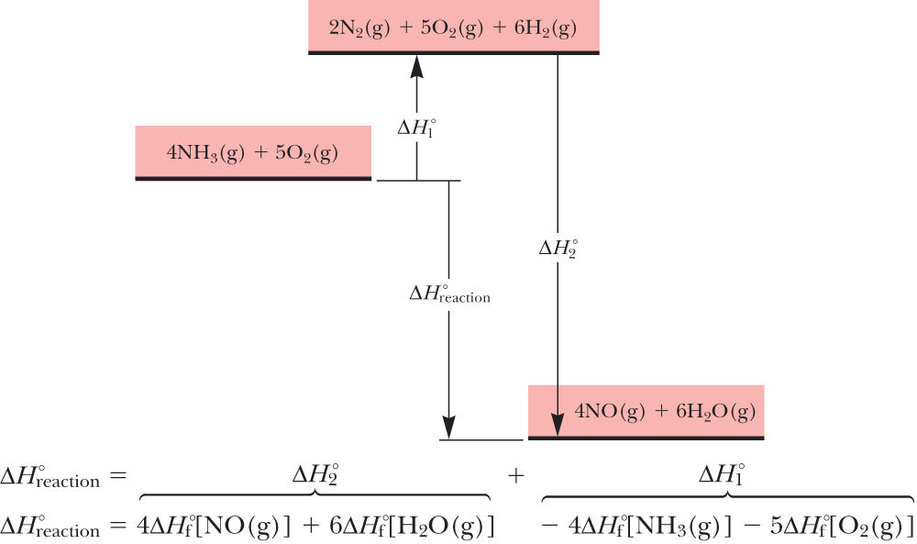
Use of Enthalpies of Formation
4NH₃(g) + 5O₂(g) → 4NO(g) + 6H₂O(g)

Slide 44
Example: Enthalpy of Reaction
Use the standard enthalpies of formation to calculate the enthalpy change for the reaction
P₄O₁₀(s) + 6H₂O(g) → 4H₃PO₄(s)
Substance | ∆H°_{f} (kJ/mol)
P₄O₁₀(s) | -1640
H₂O(g) | -242
H₃PO₄(s) | -1279
Notes:
1
Answer: ΔH = -745 kJ

