Slide 1
I. Introduction to Acids & Bases (p. 453 - 473)
Ch. 15 & 16 - Acids & Bases

Slide 2
A. Properties
ACIDS
BASES
electrolytes  electrolytes
sour taste
bitter taste
turn litmus red
turn litmus blue
react with metals to form H₂ gas
slippery feel
vinegar, milk, soda, apples, citrus fruits
ammonia, lye, antacid, baking soda
ChemASAP

Slide 3
B. Definitions
Arrhenius - In aqueous solution…
Acids form hydronium ions (H₃O⁺)
HCl + H₂O → H₃O⁺ + Cl–
H
H
⁺
–
O
O
Cl
Cl
H
H
H
H
acid

Slide 4
B. Definitions
Arrhenius - In aqueous solution…
Bases form hydroxide ions (OH⁻)
NH₃ + H₂O → NH₄⁺ + OH⁻
H
H
–
⁺
N
O
N
O
H
H
H
H
H
H
H
H
base

Slide 5
B. Definitions
Brønsted-Lowry
Acids are proton (H⁺) donors.
Bases are proton (H⁺) acceptors.
HCl + H₂O → Cl– + H₃O⁺
acid
base
conjugate base
conjugate acid

Slide 6
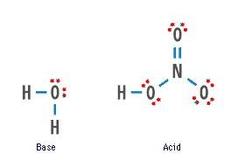
B. Definitions
H₂O + HNO₃ → H₃O⁺ + NO₃–
B
A
CA
CB

Slide 7
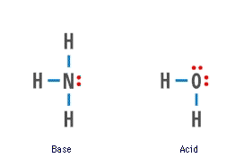
B. Definitions
NH₃ + H₂O → NH₄⁺ + OH⁻
B
A
CA
CB
Amphoteric - can be an acid or a base.

Slide 8
B. Definitions
Give the conjugate base for each of the following:
HF
H₃PO₄
H₃O⁺
F ⁻
H₂PO₄⁻
H₂O
Polyprotic - an acid with more than one H⁺

Slide 9
B. Definitions
Give the conjugate acid for each of the following:
Br ⁻
HSO₄⁻
CO₃²⁻
HBr
H₂SO₄
HCO₃⁻

Slide 10
B. Definitions
Lewis
Acids are electron pair acceptors.
Bases are electron pair donors.
Lewis base
Lewis acid

Slide 11
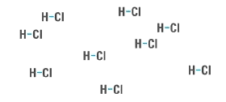
C. Strength
Strong Acid/Base
100% ionized in water
strong electrolyte
-
+
HCl
HNO₃
H₂SO₄
HBr
HI
HClO₄
NaOH
KOH
Ca(OH)₂
Ba(OH)₂

Slide 12
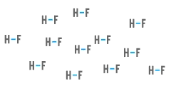
C. Strength
Weak Acid/Base
does not ionize completely
weak electrolyte
-
+
HF
CH₃COOH
H₃PO₄
H₂CO₃
HCN
NH₃

