Slide 1
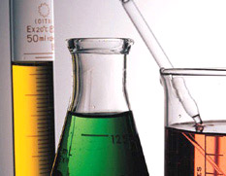
Unit 10: Acids & Bases: Neutralization & Titration

Slide 2
Neutralization Reaction
Chemical reaction between an acid and a base.
Products are:
a salt (ionic compound)
water (H₂O).
ACID + BASE → SALT + WATER

Slide 3
Examples:
ACID + BASE → SALT + WATER
HCl + NaOH → NaCl + H₂O
strong
strong
neutral
HC₂H₃O₂ + NaOH → NaC₂H₃O₂ + H₂O
weak
strong
basic
Salts can be neutral, acidic, or basic.
Neutralization does not mean pH = 7.

Slide 4
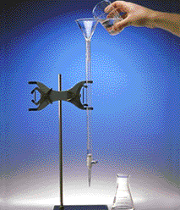
B. Titration
standard solution
(known)
Titration:
Analytical method in which a standard solution is used to determine the concentration of an unknown solution.
unknown solution

Slide 5
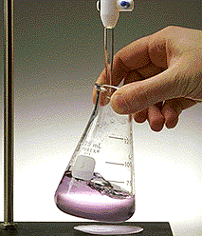
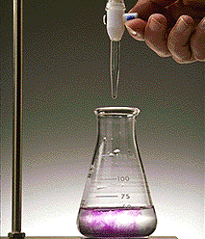
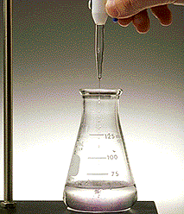
Equivalence Point
(AKA: endpoint)
Point at which equal amounts of H₃O⁺ and OH⁻ have been added.

Slide 6
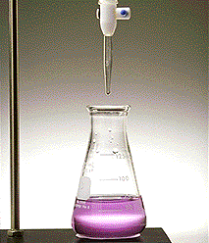
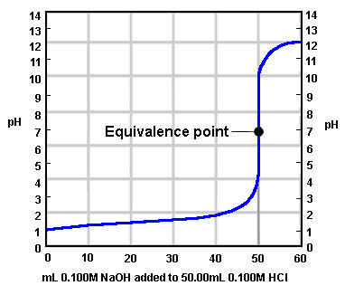
Equivalence Point
Determined by…
indicator color change
dramatic change in pH

Slide 7
Titration Calculations
standard solution
(known)
The known solution can be used to determine the molarity of an unknown solution by titration
unknown solution

Slide 8
Titration Calculations
M_{a}V_{a} = M_{b}V_{b}
M_{a}: Molarity of acid
V_{a}: Volume of acid
M_{b}: Molarity of base
V_{b}: Volume of base

Slide 9
Titration Calculations
42.5 mL of 1.3M KOH are required to neutralize 50.0 mL of HCl. Find the molarity of HCl
H₃O⁺
M = ?
V = 50.0 mL
OH⁻
M = 1.3M
V = 42.5 mL
M_{a}V_{a} = M_{b}V_{b}
M(50.0mL)
=(1.3M)(42.5mL)
M = 1.1 M HCl

Slide 10
Practice TAKS Questions
1) Two clear solutions are placed in separate beakers. The first solution has a pH of 4, and the pH of the second solution is unknown. If the two solutions are mixed and the resulting pH is 5, the second solution must have —
A fewer suspended solids
B a lower temperature
C more dissolved salt (NaCl) particles
D a higher concentration of OH– ions

Slide 11
2) The table shows data from an investigation designed to find a liquid solution that is both an acid and a strong electrolyte. Based on the data, a solution that is both an acid and a strong electrolyte is
A Solution 1
B Solution 2
C Solution 3
D Solution 4

