Slide 1
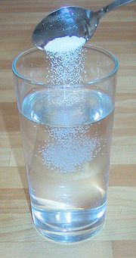
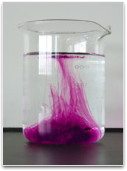
Intro to Solutions
Unit 9 - Solutions

Slide 2
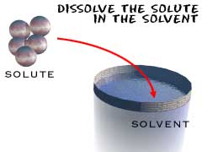
Solution:
homogeneous mixture that consists of:
1. Solute - substance being dissolved
2. Solvent – substance doing the dissolving; (present in greater amount)

Slide 3
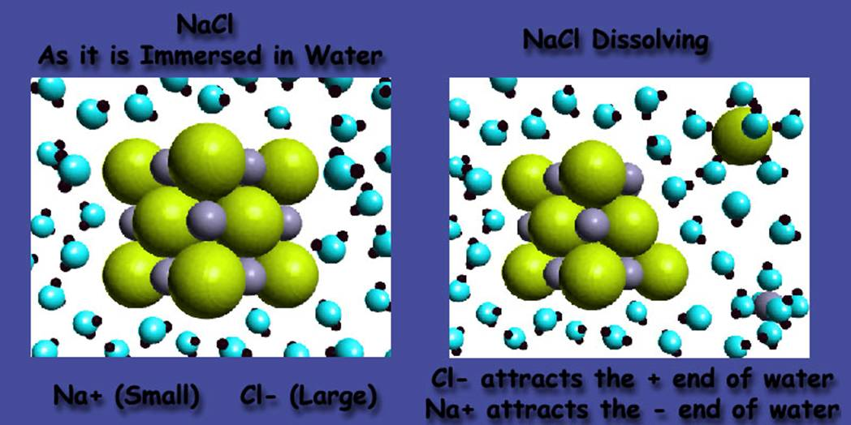
Solvation: the process of dissolving
First: solute particles are surrounded by solvent particles

Slide 4
Solvation: the process of dissolving
Second: solute particles are separated and pulled into solution

Slide 5
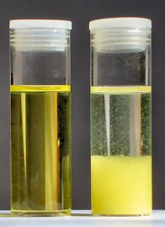
Solubility
  maximum grams of solute that will dissolve in 100 g of solvent at a given temperature
  varies with temp
  based on a saturated solution

Slide 6
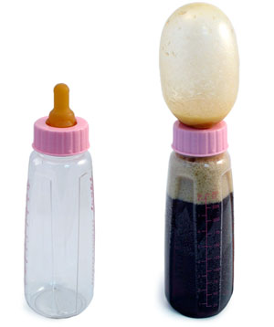
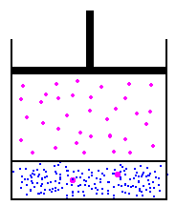
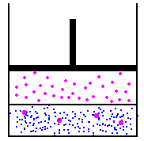
Solubility
Solids are more soluble at...
  high temperatures.
Gases are more soluble at...
  low temperatures &
  high pressures
  EX: soda

Slide 7
Solubility
UNSATURATED SOLUTION
more solute dissolves
SATURATED SOLUTION
no more solute dissolves
SUPERSATURATED SOLUTION
becomes unstable, crystals form
concentration

Slide 8
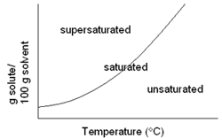
Solubility Curve:
shows how temperature affects solubility
Solids: solubility ↑ w/ Temp.
Gases: solubility ↓ w/ Temp.

Slide 9
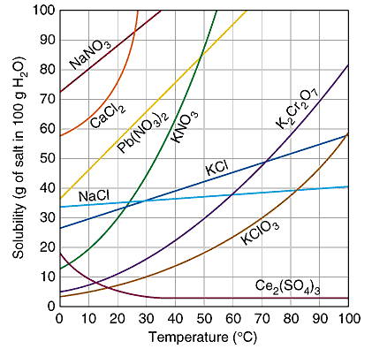

Slide 10
A
B
C

Slide 11
Video on Nitrogen Narcosis
Click Here

Slide 12
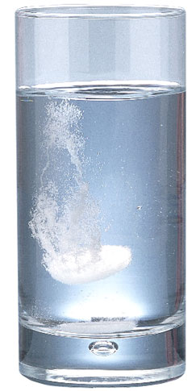
Unit 9 - Solutions
Water & Electrolytes

Slide 13
Water: the Universal Solvent
It dissolves most things because it’s POLAR
OXYGEN has a (-) charge, HYDROGEN has a (+) charge
“Opposites Attract”
O
Water is POLAR!

Slide 14
Water: the Universal Solvent
Water is like a magnet
It pulls on things that are electrically charged.
O
O
Na⁺
Cl⁻
O
O
O

Slide 15
Wax does not repel water
We’ve heard that wax or oils repel water. But that isn’t true. Water is so attracted to other water molecules that anything between them is squeezed out of the way.
O
Oil
droplet
O
O
O
O

Slide 16
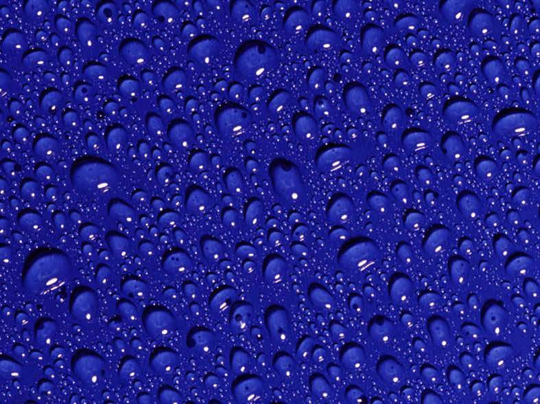
Water is always trying to pull itself into a tight ball as long as there is nothing nearby that has a charge on it. Therefore, this surface is not repelling water; it’s simply not attracting it and keeping water from doing what it does naturally.

Slide 17
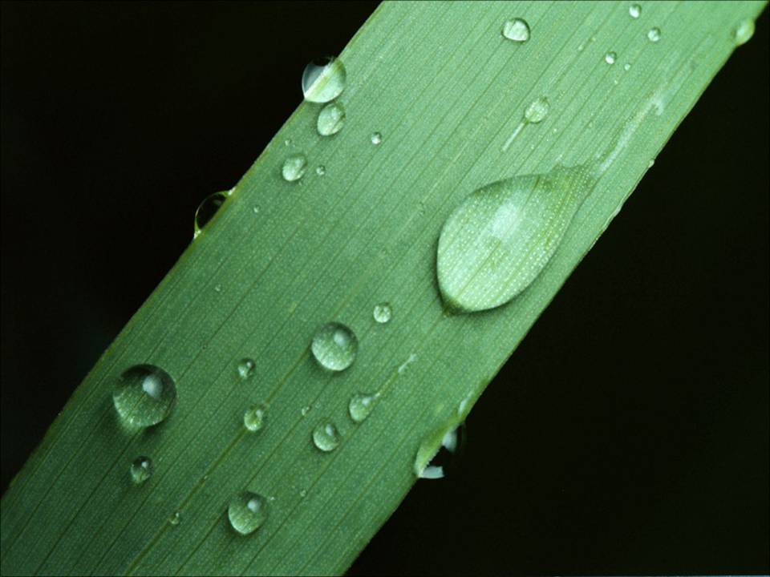
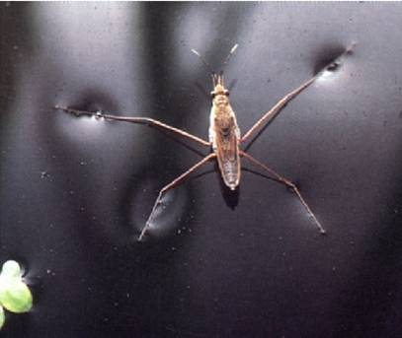
We see the same effect on waxy leaves.
Water pulls on itself so much that it forms a “skin.” It’s called surface tension.

Slide 18

We are lucky that water has this strong attraction force otherwise we’d never see raindrops. The water would just breakup into a mist as it fell. Very few liquids would remain as drops if they fell from a large height.

Slide 19
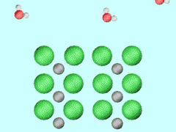
DISSOCIATION
  separation of an ionic solid into aqueous ions
NaCl _{(s)} → Na⁺ _{(aq)} + Cl– _{(aq)}

Slide 20
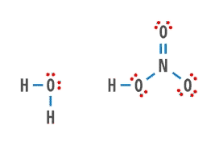
IONIZATION
  breaking apart of some polar molecules into aqueous ions
HNO_{3 (aq)} + H₂O _{(l)} → H₃O⁺ _{(aq)} + NO₃– _{(aq)}

Slide 21
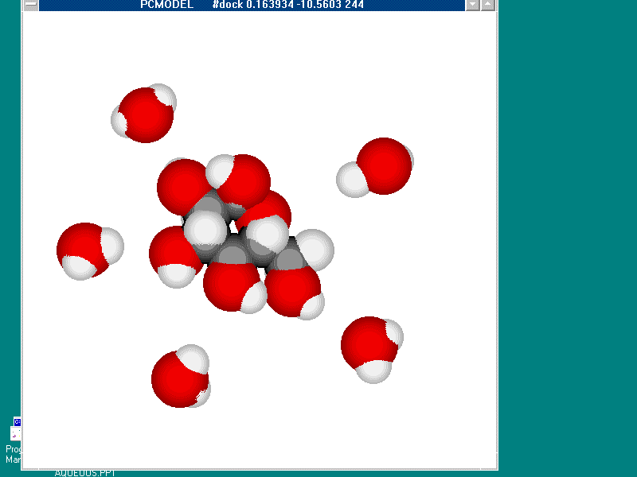
MOLECULAR SOLVATION
molecules stay intact
C₆H₁₂O_{6 (s)} → C₆H₁₂O_{6 (aq)}

Slide 22
“Like Dissolves Like”
NONPOLAR
NONPOLAR
POLAR
POLAR
OR

Slide 23
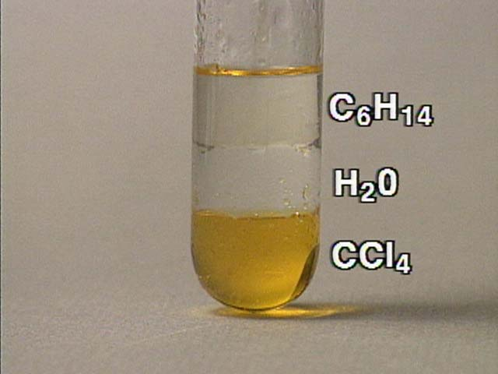

Slide 24
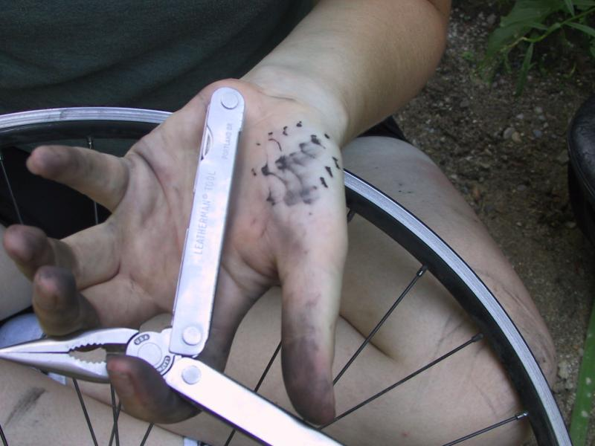
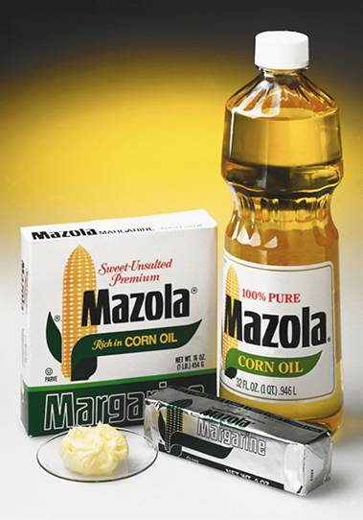
Like dissolves like
To dissolve grease, use something that is also greasy or oily.

Slide 25
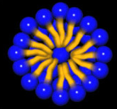
Soap/Detergent
  Have a polar “head” with a long nonpolar “tail”
  dissolves nonpolar grease in polar water

Slide 26
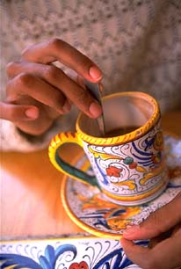
Rates of Solution
Solids dissolve faster when...
  Stirred
  Crushed
  (increased surface area)
  At higher temperatures

Slide 27

Rates of Solution
Gases dissolve faster when...
  At high pressure
  At low temperature

Slide 28
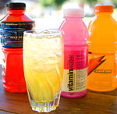
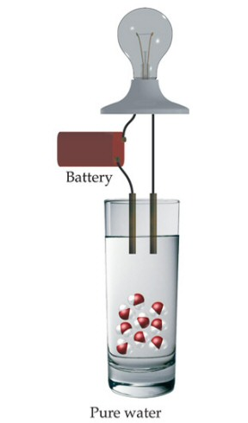
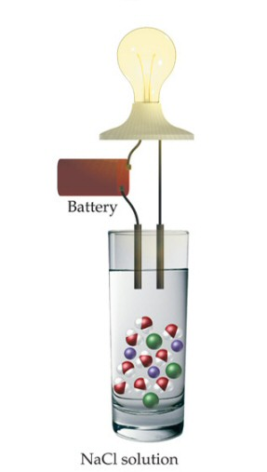
Electrolytes
electrolytes are substances whose water solution is a conductor of electricity
all electrolyte have ions dissolved in water

Slide 29
Electrolytes vs. Nonelectrolytes
-
+
-
+
-
+
sugar
acetic acid
salt
Non-
Electrolyte
Weak
Electrolyte
Strong
Electrolyte
solute exists as
molecules only
solute exists as
ions and
molecules
solute exists as
ions only

Slide 30
Electrolyte or Non-Electrolyte?
Non-electrolyte
Electrolyte

Slide 31
Types of Electrolytes
salts = water soluble ionic compounds
  all strong electrolytes
acids = form H⁺¹ ions in water solution
  sour taste
  react and dissolve many metals
  strong acid = strong electrolyte, weak acid = weak electrolyte
bases = water soluble metal hydroxides (OH-)
  bitter taste, slippery (soapy) feeling solutions
  increases the OH⁻¹ concentration

Slide 32
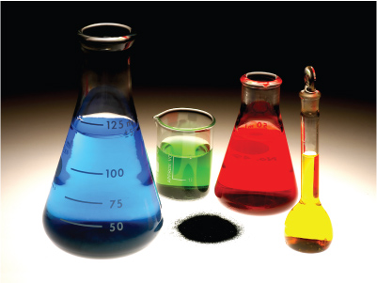
Unit 9 - Solutions
Concentration

Slide 33
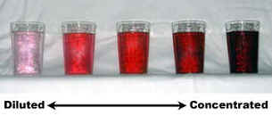
Concentration
The amount of solute in a solution.

Slide 34
Molarity (mol/L):
Concentration of a solution.
substance being dissolved
total combined volume

Slide 35
If a solution contains 4.67 moles of MgCl₂ in 1.6 L, what is the solution’s molarity?
4.67 mol MgCl₂
1.6 L MgCl₂
= 2.9 M MgCl₂

Slide 36
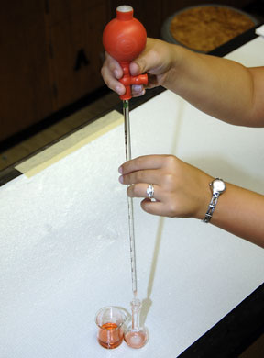
Dilution
Preparation of a desired solution by adding water to a concentrate.
Moles of solute remain the same.

Slide 37
Dilution
Molarity
Volume
1: measurements of original solution
2: measurements of new solution

Slide 38
What volume of 15.8M HNO₃ is required to make 250 mL of a 6.0M solution?
GIVEN:
M₁ = 15.8M
V₁ = ?
M₂ = 6.0M
V₂ = 250 mL
WORK:
M₁ V₁ = M₂ V₂
(15.8M) V₁ = (6.0M)(250mL)
V₁ = 95 mL of 15.8M HNO₃

Slide 39
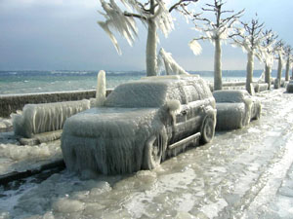
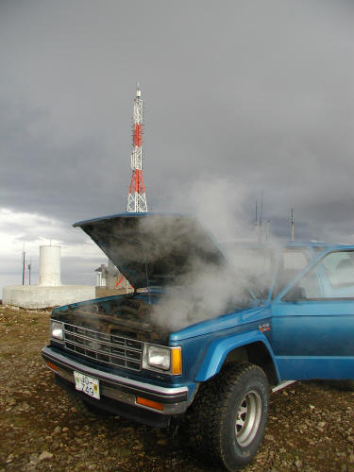
Colligative
Properties
Unit 9 - Solutions

Slide 40
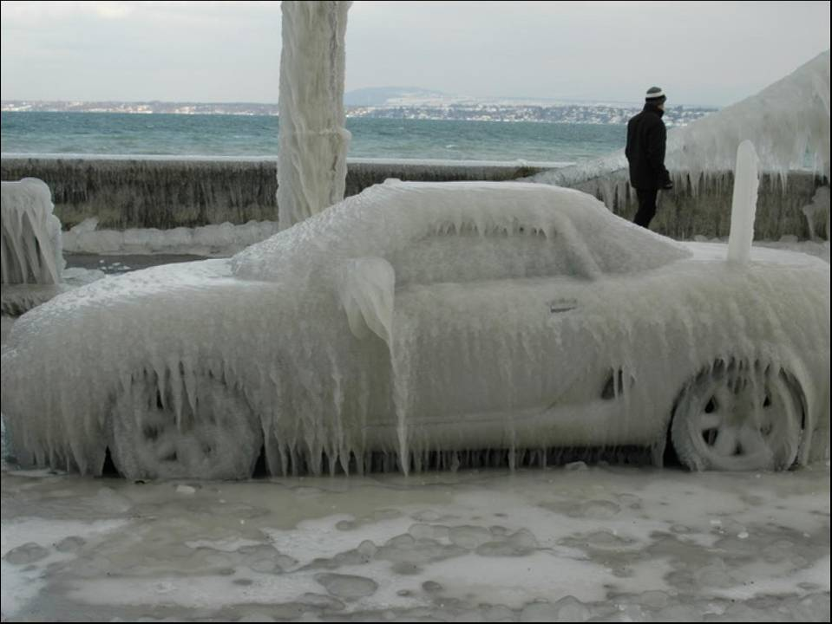
Colligative Property
property that depends on the concentration of solute particles, not their identity

Slide 41
B. Types
Freezing Point Depression (Δt_{f})
  f.p. of a solution is lower than f.p. of the pure solvent
  Ex: sanding icy roads; ice cream
Boiling Point Elevation (Δt_{b})
  b.p. of a solution is higher than b.p. of the pure solvent
  Ex: Adding salt to water before boiling

Slide 42
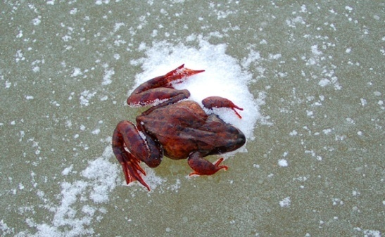
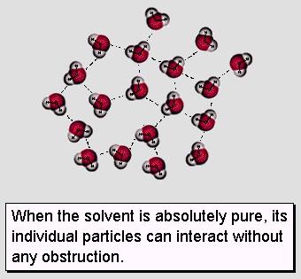
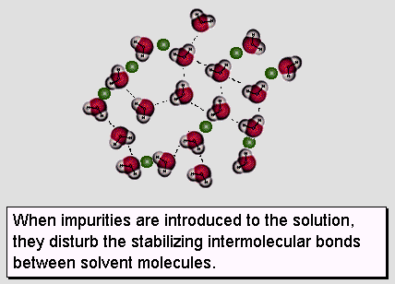
B. Types
Freezing Point Depression
View Flash animation. http://antoine.frostburg.edu/chem/senese/101/solutions/faq/why-salt-melts-ice.shtml

Slide 43
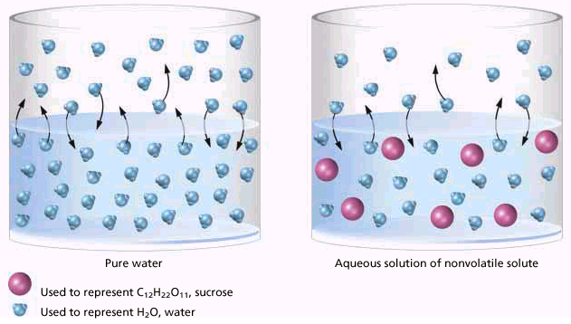
B. Types
Boiling Point Elevation
Solute particles weaken IMF in the solvent.

Slide 44
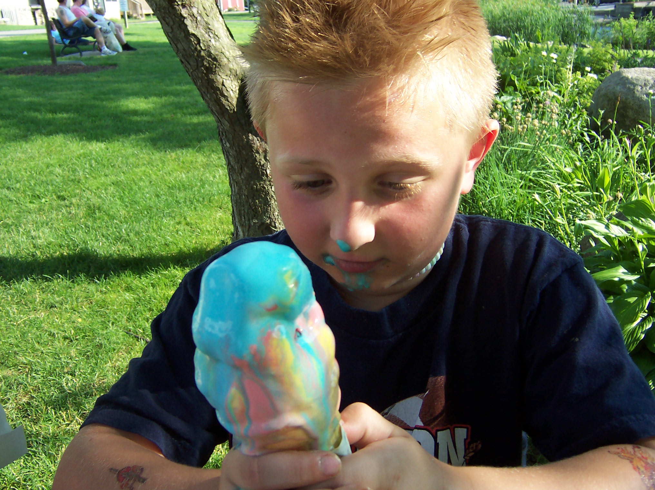
B. Types
Applications
  salting icy roads
  making ice cream
  antifreeze
    cars (-64°C to 136°C)
    fish & insects

