Slide 1
III. Ionic Compounds (p. 176 – 180, 203 – 211)
Ch. 6 & 7 - Chemical Bonding

Slide 2
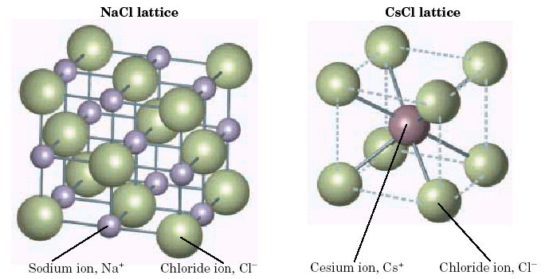
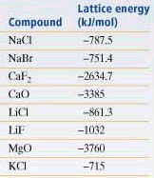
A. Energy of Bond Formation
Lattice Energy
Energy released when one mole of an ionic crystalline compound is formed from gaseous ions

Slide 3
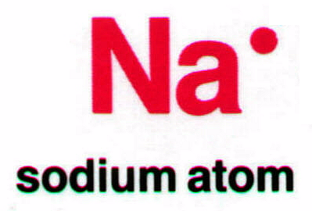
B. Lewis Structures
Covalent – show sharing of e⁻
Ionic – show transfer of e⁻

Slide 4
B. Lewis Structures
Covalent – show sharing of e⁻
Ionic – show transfer of e⁻

Slide 5
C. Ionic Nomenclature
Ionic Formulas
Write each ion, cation first. Don’t show charges in the final formula.
Overall charge must equal zero.
If charges cancel, just write symbols.
If not, use subscripts to balance charges.
Use parentheses to show more than one polyatomic ion.
Stock System - Roman numerals indicate the ion’s charge.

Slide 6
C. Ionic Nomenclature
Ionic Names
Write the names of both ions, cation first.
Change ending of monatomic ions to -ide.
Polyatomic ions have special names.
Stock System - Use Roman numerals to show the ion’s charge if more than one is possible. Overall charge must equal zero.

Slide 7
C. Ionic Nomenclature
Consider the following:
Does it contain a polyatomic ion?
-ide, 2 elements ⇒ no
-ate, -ite, 3+ elements ⇒ yes
Does it contain a Roman numeral?
Check the table for metals not in Groups 1 or 2.
No prefixes!

Slide 8
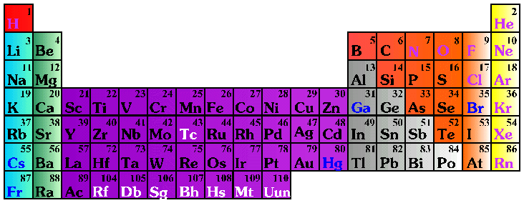
C. Ionic Nomenclature
Common Ion Charges
1+
0
2+
3+
NA
3-
2-
1-

Slide 9
C. Ionic Nomenclature
potassium chloride
magnesium nitrate
copper(II) chloride
K⁺ Cl⁻
⇒ KCl
Mg²⁺ NO₃⁻
⇒ Mg(NO₃)₂
Cu²⁺ Cl⁻
⇒ CuCl₂

Slide 10
C. Ionic Nomenclature
NaBr
Na₂CO₃
FeCl₃
sodium bromide
sodium carbonate
iron(III) chloride

