Slide 1
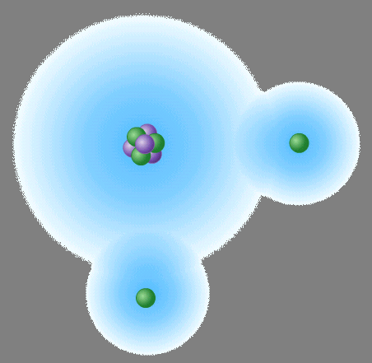
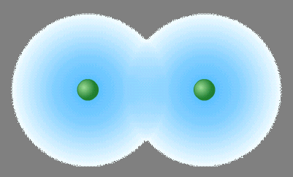
II. Molecular Compounds (p. 164 – 172, 211 – 213)
Ch. 6 & 7 - Chemical Bonding

Slide 2
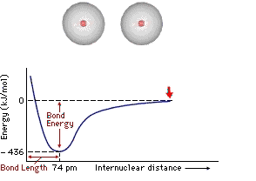
A. Energy of Bond Formation
Potential Energy
based on position of an object
low PE = high stability

Slide 3
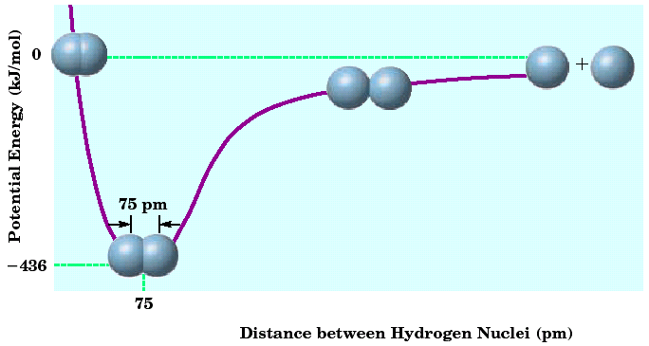
A. Energy of Bond Formation
Potential Energy Diagram
attraction vs. repulsion
no interaction
increased attraction

Slide 4
A. Energy of Bond Formation
Potential Energy Diagram
attraction vs. repulsion
increased repulsion
balanced attraction & repulsion

Slide 5
A. Energy of Bond Formation
Bond Energy
Energy required to break a bond
Bond Energy
Bond Length

Slide 6
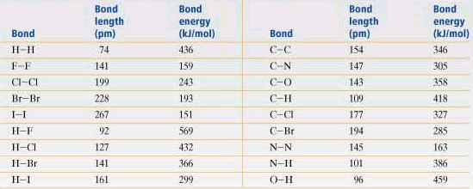
A. Energy of Bond Formation
Bond Energy
Short bond = high bond energy

Slide 7
B. Lewis Structures
Electron Dot Diagrams
show valence e⁻ as dots
distribute dots like arrows in an orbital diagram
4 sides = 1 s-orbital, 3 p-orbitals
EX: oxygen
X
O
2s
2p

Slide 8
B. Lewis Structures
Octet Rule
Most atoms form bonds in order to obtain 8 valence e⁻
Full energy level stability ~ Noble Gases
Ne

Slide 9
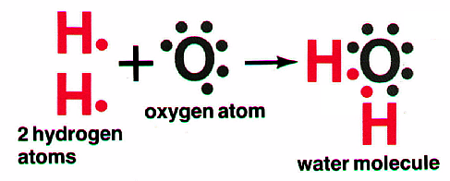
B. Lewis Structures
Nonpolar Covalent - no charges
Polar Covalent - partial charges
δ⁺
δ⁻
δ⁺

Slide 10
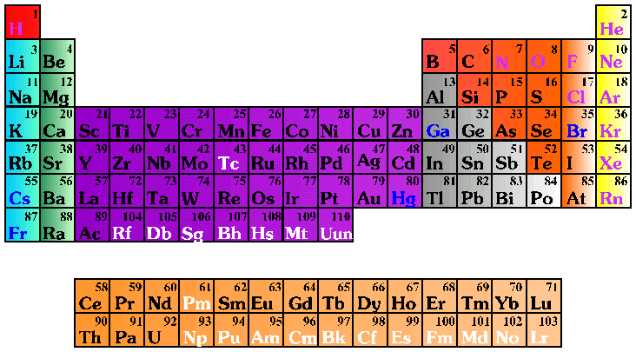
C. Molecular Nomenclature
Prefix System (binary compounds)
1. Less e⁻neg atom comes first.
2. Add prefixes to indicate # of atoms. Omit mono- prefix on first element.
3. Change the ending of the second element to -ide.

Slide 11
C. Molecular Nomenclature
PREFIX
mono-
di-
tri-
tetra-
penta-
hexa-
hepta-
octa-
nona-
deca-
NUMBER
1
2
3
4
5
6
7
8
9
10

Slide 12
C. Molecular Nomenclature
CCl₄
N₂O
SF₆
carbon tetrachloride
dinitrogen monoxide
sulfur hexafluoride

Slide 13
C. Molecular Nomenclature
arsenic trichloride
dinitrogen pentoxide
tetraphosphorus decoxide
AsCl₃
N₂O₅
P₄O₁₀

Slide 14
C. Molecular Nomenclature
The Seven Diatomic Elements
Br₂ I₂ N₂ Cl₂ H₂ O₂ F₂
H
N
O
F
Cl
Br
I

