Slide 1
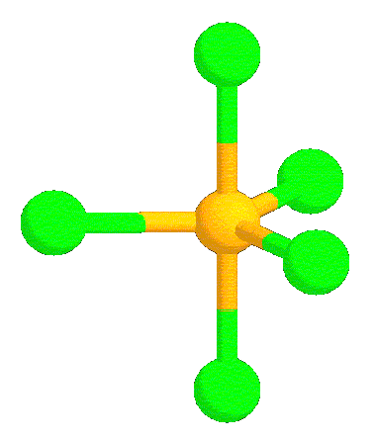
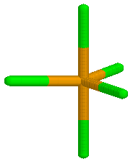
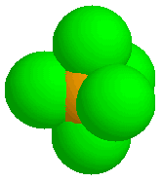
II. Molecular Geometry (p. 183 – 187)
Ch. 6 – Molecular Structure

Slide 2
A. VSEPR Theory
Valence Shell Electron Pair Repulsion Theory
Electron pairs orient themselves in order to minimize repulsive forces.

Slide 3
A. VSEPR Theory
Types of e⁻ Pairs
Bonding pairs - form bonds
Lone pairs - nonbonding e⁻
Lone pairs repel more strongly than bonding pairs!!!

Slide 4
A. VSEPR Theory
Lone pairs reduce the bond angle between atoms.
Bond Angle

Slide 5
B. Determining Molecular Shape
Draw the Lewis Diagram.
Tally up e⁻ pairs on central atom.
double/triple bonds = ONE pair
Shape is determined by the # of bonding pairs and lone pairs.
Know the 8 common shapes
& their bond angles!

Slide 6
C. Common Molecular Shapes
2 total
2 bond
0 lone
LINEAR
180°
BeH₂

Slide 7
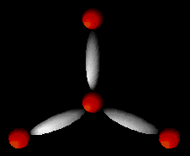
C. Common Molecular Shapes
3 total
3 bond
0 lone
BF₃
TRIGONAL PLANAR
120°

Slide 8
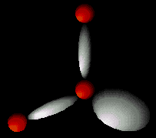
C. Common Molecular Shapes
3 total
2 bond
1 lone
SO₂
BENT
<120°

Slide 9
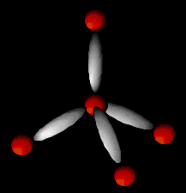
C. Common Molecular Shapes
4 total
4 bond
0 lone
CH₄
TETRAHEDRAL
109.5°

Slide 10
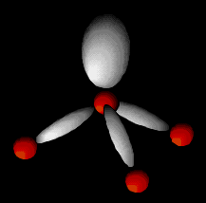
C. Common Molecular Shapes
4 total
3 bond
1 lone
NH₃
TRIGONAL PYRAMIDAL
107°

Slide 11
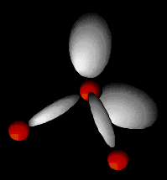
C. Common Molecular Shapes
4 total
2 bond
2 lone
H₂O
BENT
104.5°

Slide 12
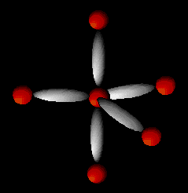
C. Common Molecular Shapes
5 total
5 bond
0 lone
PCl₅
TRIGONAL BIPYRAMIDAL
120°/90°

Slide 13
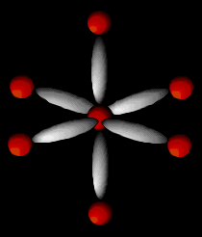
C. Common Molecular Shapes
6 total
6 bond
0 lone
SF₆
OCTAHEDRAL
90°

Slide 14
D. Examples
F P F
F
PF₃
4 total
3 bond
1 lone
TRIGONAL PYRAMIDAL
107°

Slide 15
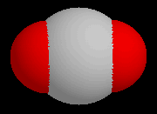
D. Examples
O C O
CO₂
2 total
2 bond
0 lone
LINEAR
180°

