Slide 1
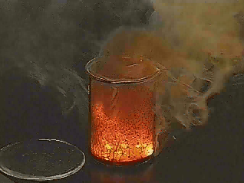
IV. Reaction Energy (p. 514 - 517)
Ch. 17 – Chemical Reactions

Slide 2
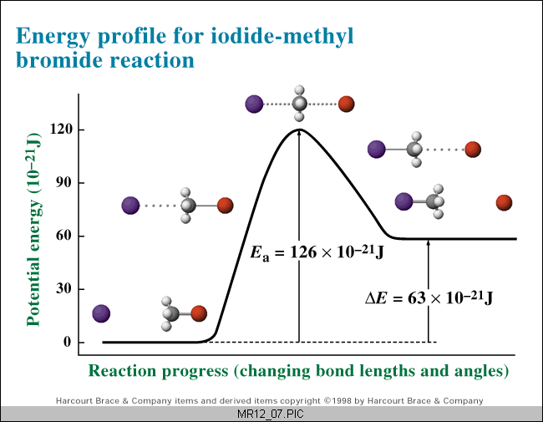
A. Reaction Pathway
Shows the change in energy during a chemical reaction

Slide 3
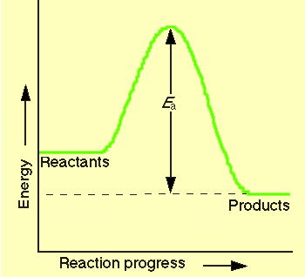
B. Exothermic Reaction
reaction that releases energy
products have lower PE than reactants
energy released
2H₂(l) + O₂(l) → 2H₂O(g) + energy

Slide 4
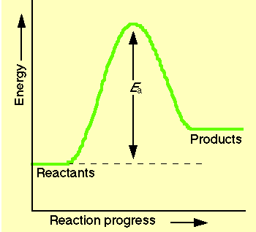
C. Endothermic Reaction
reaction that absorbs energy
reactants have lower PE than products
energy absorbed
2Al₂O₃ + energy → 4Al + 3O₂

