Slide 1
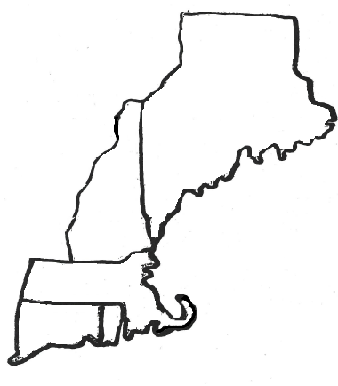
New England Colonies

Slide 2
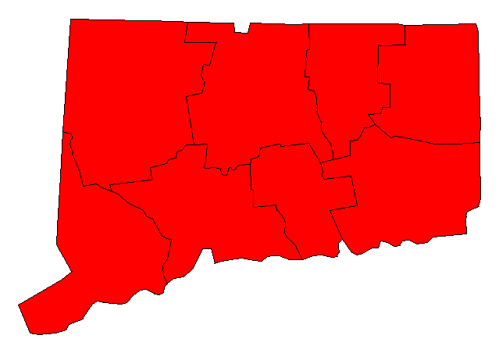
Connecticut

Slide 3
Connecticut
Founded: 1636 by Thomas Hooker
Reason for Founding: believed government should be based on free consent
Economy: small subsistence farms, fishing, livestock, whaling, corn, grain, iron, shipping/trade, lumber
Climate & Geography: rocky soil, cold snowy winters, mild summers, thick forests
Other Things You Should Know: Fundamental Orders of Connecticut - first written plan of government (constitution) in America.

Slide 4
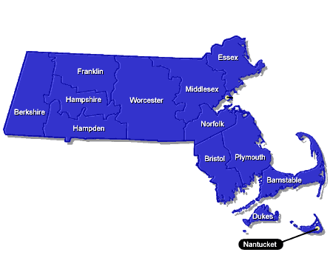
Massachusetts

Slide 5
Massachusetts
Founded: 1620 by the Pilgrims, escaping religious persecution. 1630 by John Winthrop and others part of the Great Migration from the 1630s - 1640s,founded the Mass.Bay Colony "a City on a Hill"
Reason for Founding: religious freedom
Economy: small subsistence farms, fishing, livestock, whaling, corn, manufacturing, shipbuilding, lumber
Climate & Geography: rocky soil, cold snowy winters, mild summers, thick forests
Other Things You Should Know: Mayflower Compact in 1620 - to create laws for the general good of the colony major port city: Boston - because of its deep natural harbor good for trade

Slide 6

Rhode Island

Slide 7
Rhode Island
Founded: 1636 by Roger Williams accompanied by Anne Hutchinson, both dissenters from Mass. Bay Colony
Reason for Founding: they believed in the right to have different religious faiths
Economy: small subsistence farms, fishing, livestock, whaling, dairy, manufacturing, shipbuilding, lumber
Climate & Geography: rocky soil, cold snowy winters, mild summers, thick forests, coastal lowlands

Slide 8
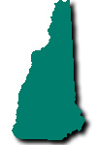
New Hampshire

Slide 9
New Hampshire
Founded: 1638 by John Wheelwright and others
Reason for Founding: to be a separate colony from Mass.
Economy: small subsistence farms, fishing, livestock, fur, manufacturing, shipbuilding, lumber, textiles
Climate & Geography: rocky soil, cold snowy winters, mild summers, thick forests

Slide 10
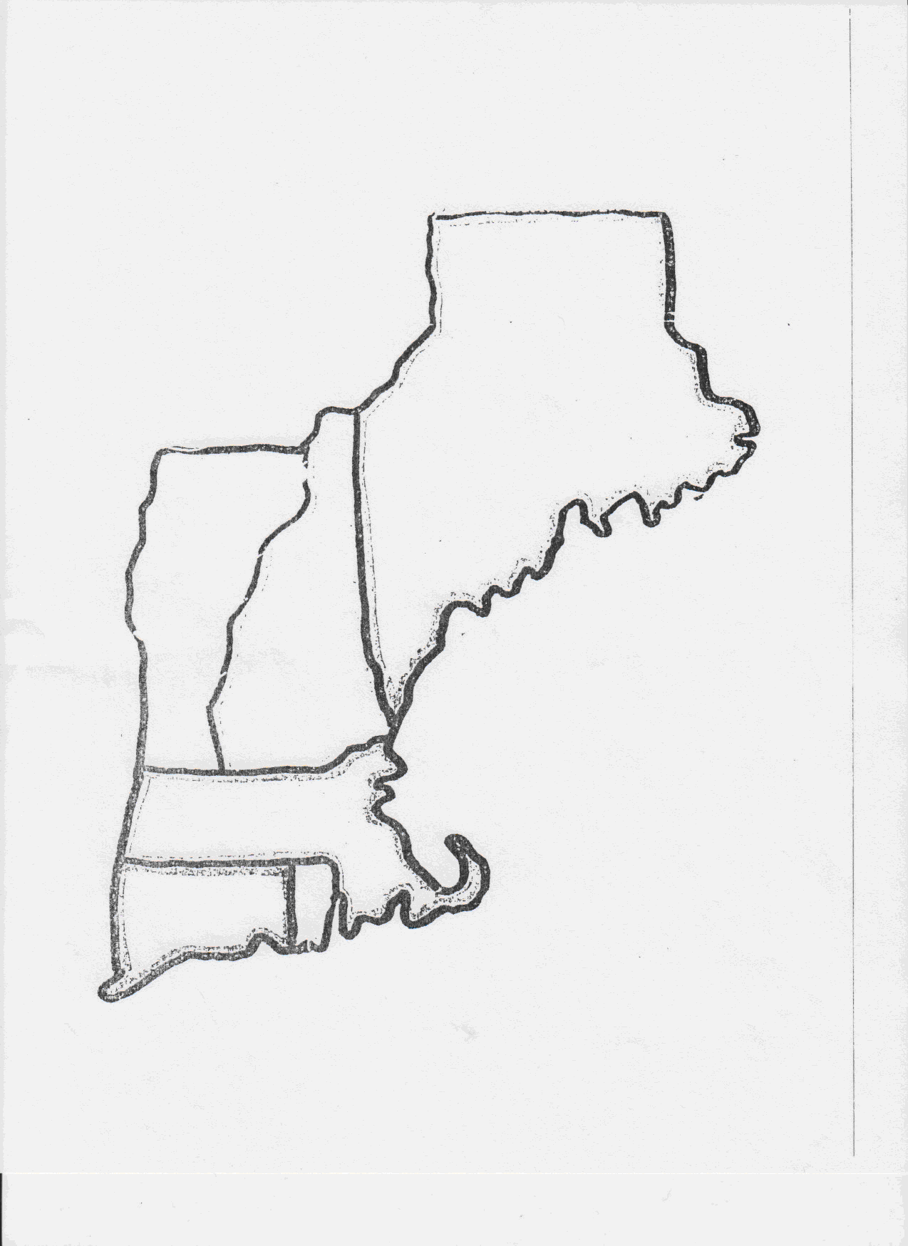

New England Colonies Map
unorganized territory
Mass.
William Bradford
Key
fishing
New
Hampshire
Cold winters
whaling
Trade/shipping
Mass.
lumber
cattle
Forested hills/hilly
Conn.
R.I.
textiles
Thomas Hooker
Roger Williams
Anne Hutchinson
Warm summers

Slide 11
Middle Colonies

Slide 12
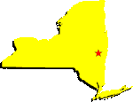
New York

Slide 13
New York
Founded: 1626 by the Dutch taken over by the English by the Duke of York
Economy: large farms, shipbuilding, iron works, shipping for the slave trade, lumber, livestock, and grains
Climate and Geography: cold snowy winters, hot humid summers, wetlands along the coast & Hudson River, mountains/hills
Other Things I Should Know: originally part of New Netherland, the English wanted New York for increased trade opportunities, one of the “Bread Basket Colonies” Major port city: New York

Slide 14
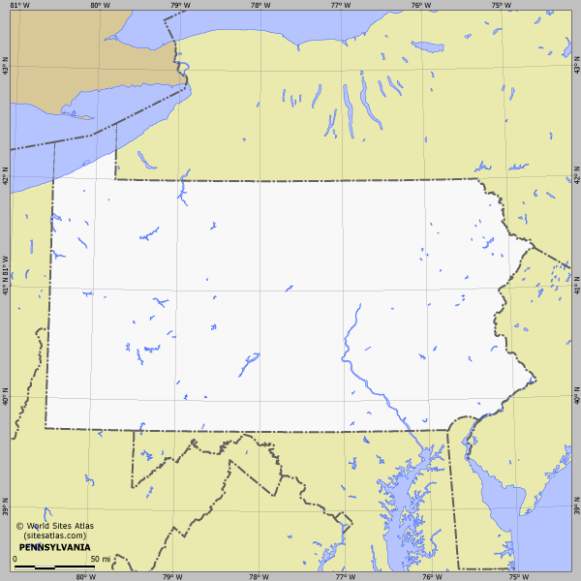
Pennsylvania

Slide 15
Pennsylvania
Founded: 1682 by William Penn a Quaker for religious freedom for his Quaker followers
Economy: large farms, wheat, corn, livestock, dairy, iron, merchants and tradesmen, shipbuilding
Climate and Geography: cold snowy winters, hot humid summers, rolling hills, fertile soil good for farming
Other Things I Should Know: allowed other religions who were fleeing persecution, Quakers were the 1st abolitionists - they did not agree with slavery. One of the "Bread Basket Colonies”. Major city - Philadelphia

Slide 16
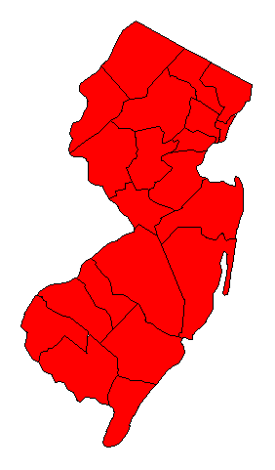
New Jersey

Slide 17
New Jersey
Founded: 1664 by Lord Berkley and Sir George Carteret to make New York into two different colonies
Economy: large farms, ironworking, lumbering, grain, fishing, livestock
Climate and Geography: hot humid summers, cold winters, rocky soil, hilly, fertile farmland
Other Things I Should Know: One of the "Bread Basket Colonies"

Slide 18
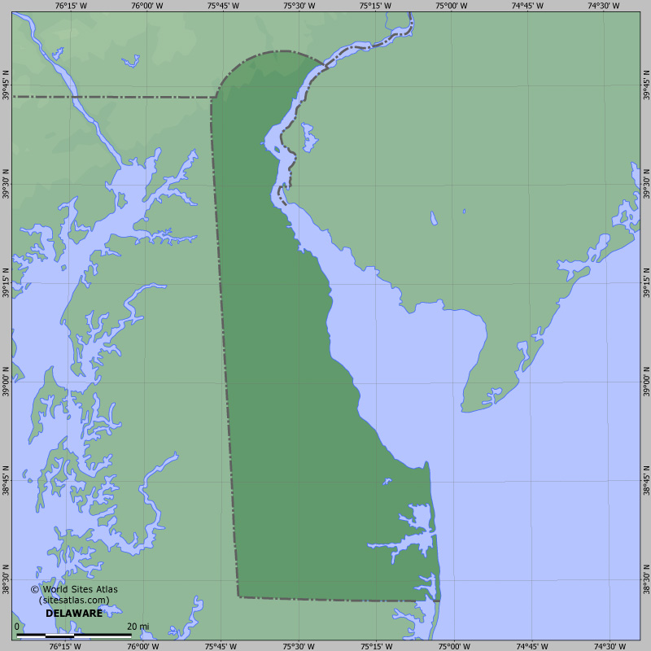
Delaware

Slide 19
Delaware
Founded: 1638 by William Penn and the Duke of York to get a direct outlet to the Atlantic Ocean
Economy: large farms, fishing, lumber, shipbuilding, grains, dairy
Climate and Geography: hot humid summers, mild winters, rich soil
Other Things I Should Know: One of the "Bread Basket Colonies"

Slide 20
Which group below bests describes the geography and economy of the middle colonies?
  A. winters, summers, wheat shipbuilding, small farms
  B. plantations, tobacco, indigo, humid summers, winters
  C. grains, large farms, lumbering, fishing, summers, winters
  D. Cattle, forested hills, textiles, small farms, winters, summers

Slide 21
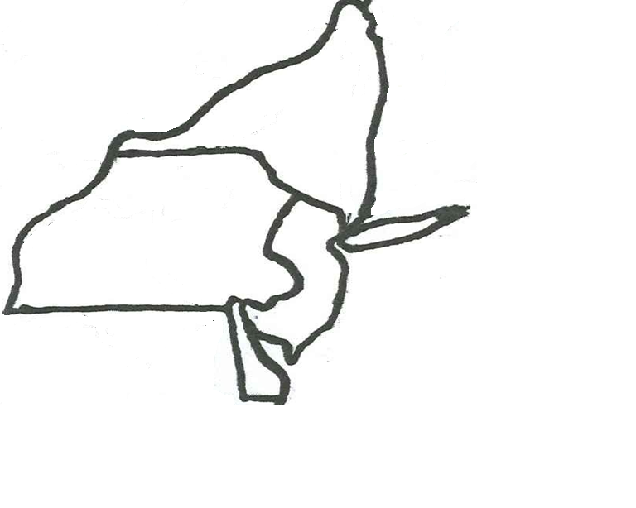

Middle Colonies Map
Key
New York
cold winters
ship building & shipping slaves
lumber
Pennsylvania
cattle
iron
warm summers
New Jersey
Forested hills/hilly
Delaware
fishing
large farms

Slide 22
Southern Colonies

Slide 23
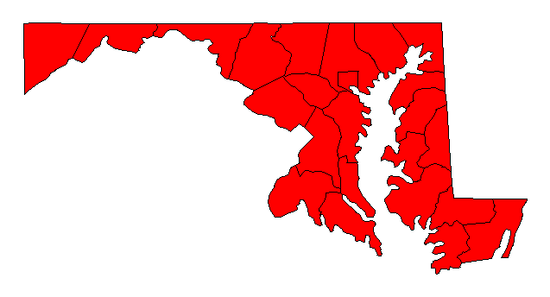
Maryland
Chesapeake Bay

Slide 24
Maryland
Founded: 1633 by Lord Baltimore for Catholics
Economy: Cash Crop Agriculture, Plantations, shipbuilding, iron, tobacco, livestock, fishing, lumber, oysters
Climate and Geography: cold rainy winters, warm summers, coastal lowlands, rich soil
Other Things I Should Know: passed the Act of Toleration in 1649 providing religious freedom to all Christians. Major port city Baltimore.

Slide 25
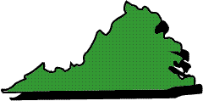
Virginia

Slide 26
Virginia
Founded: 1607 by the London Company of Virginia seeking profit
Economy: Cash Crop Agriculture, Plantations, tobacco, corn, fishing, livestock
Climate and Geography: mild winters, hot humid summers, coastal lowlands, wooded mountains, rich soil
Other Things I Should Know: had a self-governing government, House of Burgesses - 1st representative government in America

Slide 27
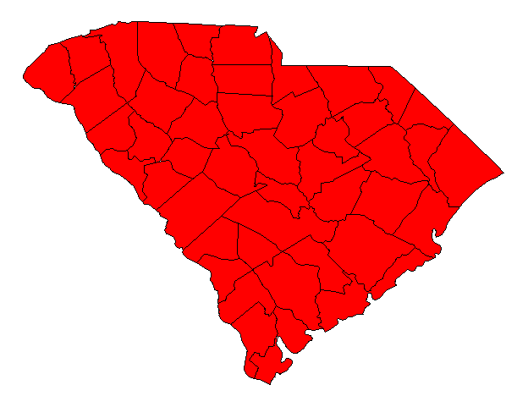
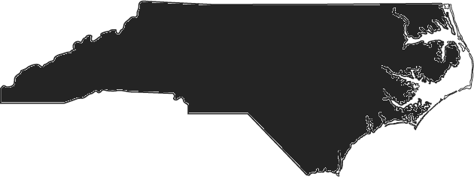
North and South Carolina

Slide 28
North and South Carolina
Founded: 1653 by a group of 8 English nobles
Economy: Cash Crop Agriculture, Plantations, rice, tobacco, livestock, lumber ***
Climate and Geography: short mild winters, hot humid summers, swampy lowlands, wooded mountains
*** Only in South Carolina add Indigo to the economy box and major port city - CharlesTown

Slide 29
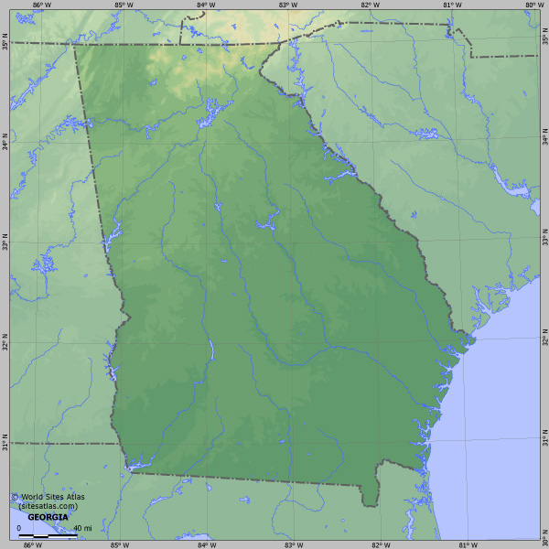
Georgia

Slide 30
Georgia
Founded: 1732 by James Oglethorpe
Economy: Cash Crop Agriculture, Plantations, indigo, rice, sugar, lumber, grains, livestock
Climate and Geography: short mild winters, hot humid summers, wooded mountains
Other Things I Should Know: founded for 2 reasons:
As a buffer zone between Spanish Florida and the English colonies -- to keep out the Florida Indians from raiding colonial villages
A place to send debtors and poor people

Slide 31
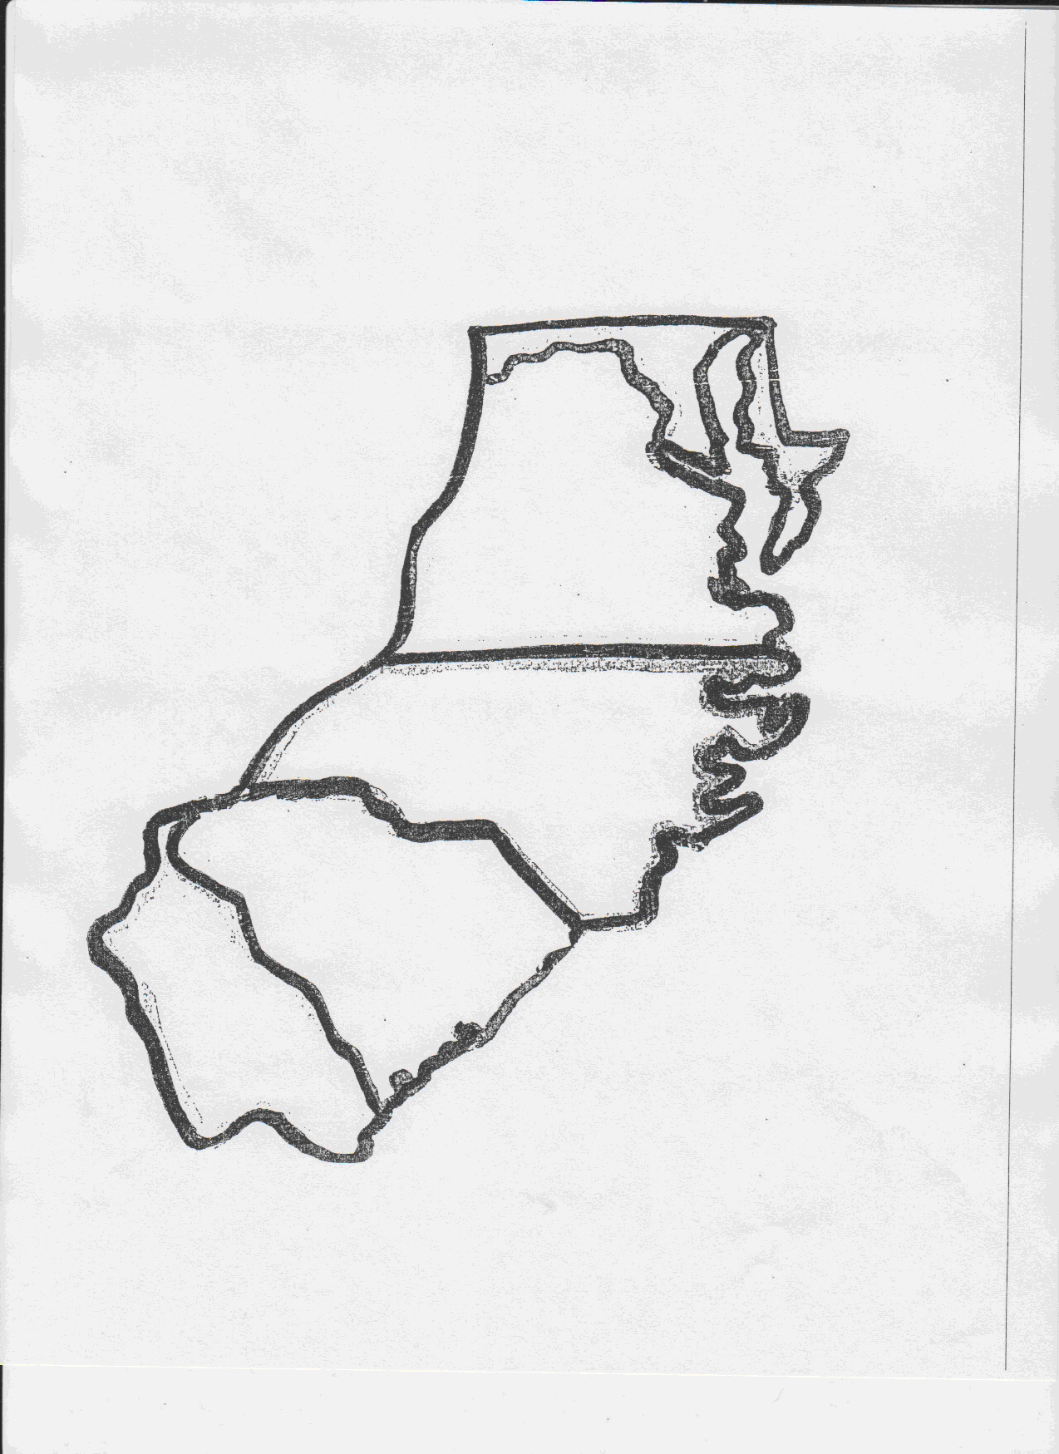


Southern Colonies Map
Maryland
Chesapeake Bay
Virginia
Appalachian Mountains
key
warm summers
North Carolina
Tobacco
sugar
South Carolina
rice
Georgia
cattle
iron
indigo
lumber
Fishing
Thick forests

