Slide 1
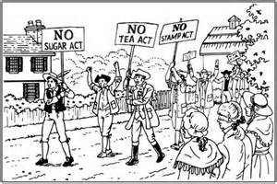
Causes of the American Revolution

Slide 2
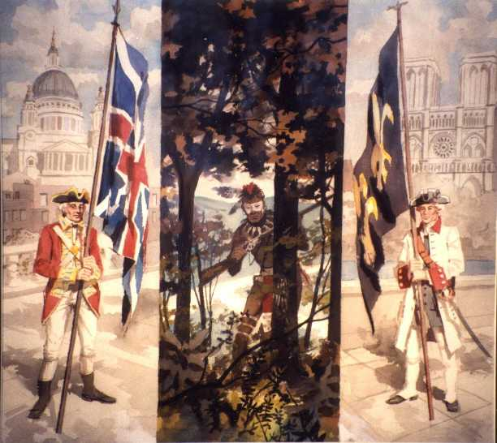
French & Indian War 1754-1763

Slide 3
Turmoil over Taxation
In 1763, colonists in the 13 colonies had the same rights as freeborn Englishmen given to them by the Magna Carta and the English Bill of Rights.
They had created their own representative assembles like the House of Burgesses.

Slide 4
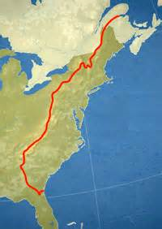
Proclamation Line of 1763
Proclamation Line of 1763: statement issued by King George III that stated the colonists were forbidden to settle west of the Appalachian Mountains. He hoped to end the fighting between colonists and the Indians.
The colonists did not like this. They thought Britain was trying to control them.

Slide 7
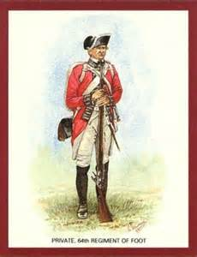
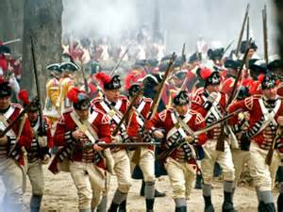
British Army
The British continued to keep an army in North America to enforce taxes and the laws.

Slide 8
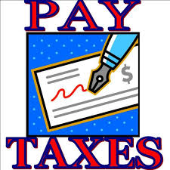
Taxes
When British citizens complained about the taxes, British officials decided that the colonists needed to help pay for things and began taxing them too.

Slide 9
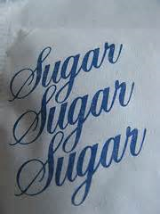
Sugar Act - 1764
The Sugar Act: a tax passed in 1764, which placed a tax on sugar and molasses. This law also made it easier for British officials to try smugglers.
Samuel Adams organized protest against the Sugar Act and it was repealed in 1766.

Slide 10
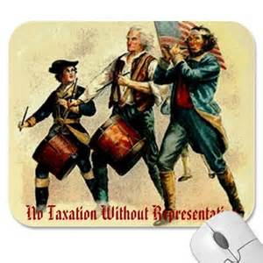
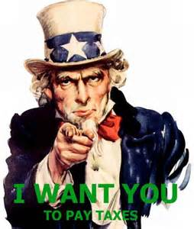
Issue of Taxation
Colonists resented (disliked) these new taxes because they went against the principle of “No Taxation without Representation.”

Slide 11
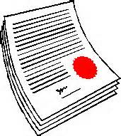
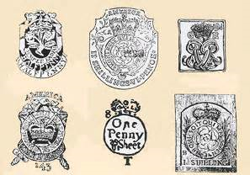
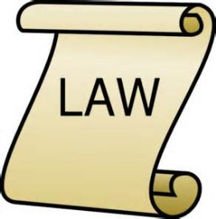
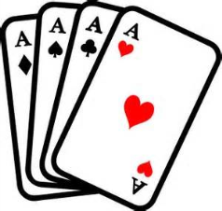
Stamp Act - 1765
The Stamp Act: a tax passed in 1765, which placed a tax on newspapers, playing cards, dice, and legal documents such as marriage licenses and wills.

Slide 12
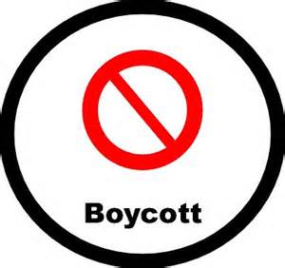
Boycott
The Stamp Act created a firestorm of protest and united the colonists.
Colonists also agreed to boycott British goods. Boycott means to refuse to buy British goods.
Patrick Henry denounces the Stamp Act and the House of Burgesses passed resolutions against it.

Slide 13
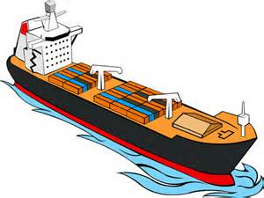
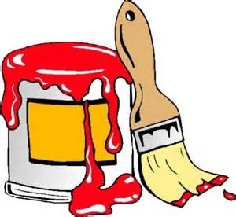
Townshend Acts - 1767
The Townshend Acts taxed goods like glass, paper, paint, lead, and tea.
Also allow British officials to use legal documents known as writs of assistance to inspect or search a ship’s cargo without giving a reason.

Slide 14
What does Massacre mean?

Slide 15
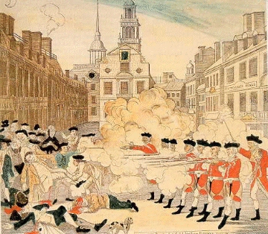

Slide 16
Boston Massacre - 1770
A group of people in Boston taunted the soldiers and threw snowballs at them.
By accident, the soldiers fired into the crowed, and several protesters were killed.

Slide 17
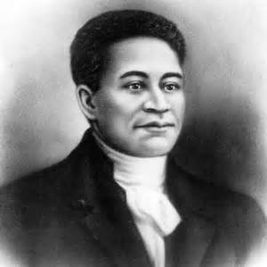
Boston Massacre - 1770
Crispus Attucks – an African American, was the first colonist killed.
Soldiers were put on trial but their attorney, John Adams, said they acted out of self defense and were found innocent.

Slide 18
Boston Tea Party - 1773
The British East India Company sold tea to colonial tea merchants. The tea merchants then sold the tea in their stores to the colonists for a higher price, that way they made a profit.
When the British East India Company had financial troubles, Parliament passed the Tea Act. The Tea Act stated that the British East India Company could sell tea directly to the colonists.
American tea merchants protested being cut out of the tea trade, because they were losing money or revenue. Other colonists thought that the Tea Act was a trick by the British

Slide 19
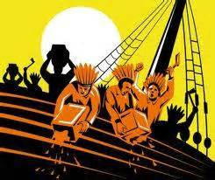
Boston Tea Party - 1773
The Sons of Liberty in Boston showed their displeasure with the Tea Act by staging (holding) the Boston Tea Party. Disguised as Indians, they raided three British ships and dumped the cargo of tea into the Boston Harbor.

Slide 20
Intolerable Acts - 1774
Closed the port of Boston.
Forbade Massachusetts colonists from holding town meetings.
Quartering Act required colonists to house British troops in their homes.
Allowed British officials charged with a crime to escape prosecution.

Slide 21
Committees of Correspondence
Letter writing campaign started by Sam Adams, spread the news about the Intolerable Acts.

