Slide 1
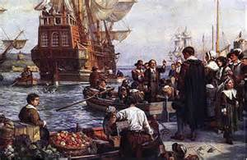
Life in Colonial America

Slide 2
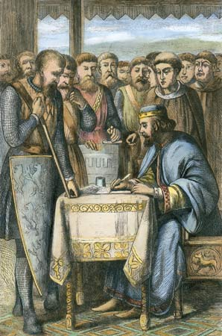
Differences Emerge in the Colonies
New patterns of life are developing in the 3 separate regions of the 13 colonies.
The colonists are benefitting from the traditions of political liberty and representative government.
(*Test Alert!: Remember, the Magna Carta, was the foundation of representative government in the colonies)

Slide 3
“Turn And Talk”
For two minutes answer this question with your group and write them on a piece of paper.
1. What important individual rights and beliefs about government did the colonists bring from England?

Slide 4
Education and Enlightenment
The Enlightenment: took place in the late 1600s and continued into the 1700s.
People started to use reason and scientific methods to study society and the environment. (flooding, the weather, medicine)

Slide 5
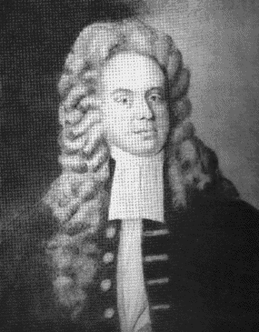
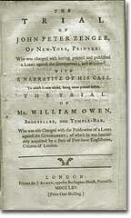
Freedom of the Press
In the 1730’s, John Peter Zenger published a newspaper accusing the Governor of New York of corruption.
New York’s Governor put Zenger on trial. Zenger won his case when his lawyer, showed that his statements he published were true.
*The case established the right of the press to criticize those in power, so long as the writer told the truth.

Slide 6
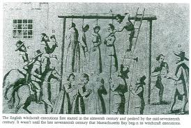
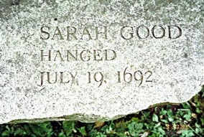
Salem Witchcraft Trials
The famous Salem Witchcraft trials took place in Massachusetts in 1692.
A West Indian slave told a group of children tales of voodoo.
The girls claimed they were being tortured by witches.
Those accused of witchcraft were asked to repent to avoid punishment.
Twenty people were hanged and then dumped into the rivers.

Slide 7
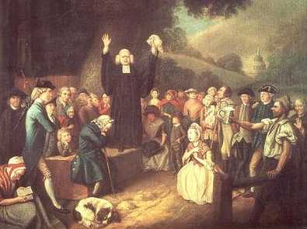
First Great Awakening
Roger Williams and Anne Hutchison established the principle of religious toleration in the colonies.
During the First Great Awakening, (a religious revival that brought people closer to God) preachers like Jonathan Edwards and George Whitfield, addressed large crowds in open fields and stirred religious feelings. These preachers also supported religious toleration.
The Puritans promoted virtue. (goodness)

Slide 8
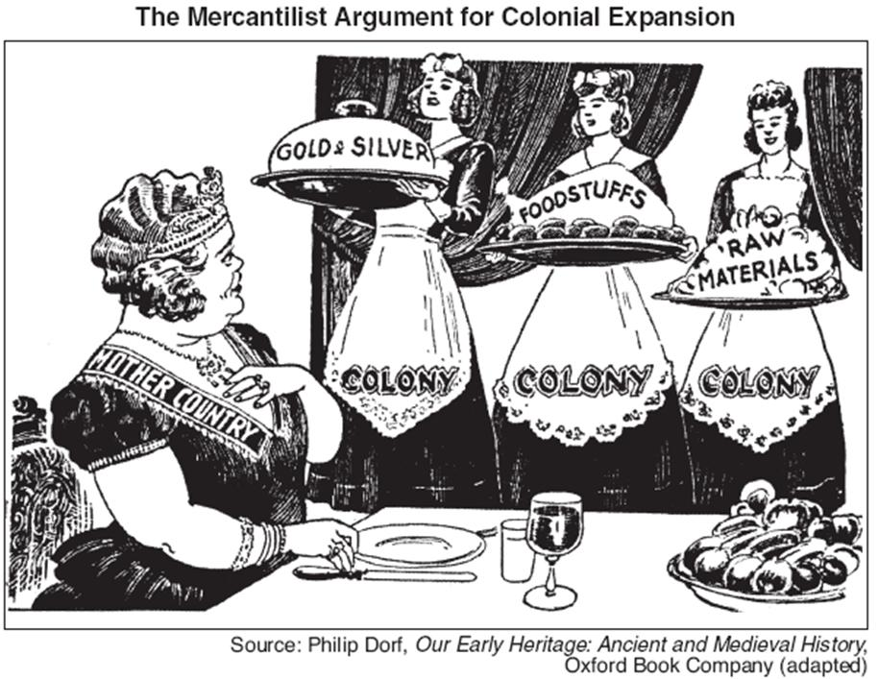
Mercantilism (Making MONEY for England!!!)
England & King George III, saw that the colonies were thriving! King George III then decided to make money off the colonists!
Mercantilism was the policy of using colonies to bring wealth to the “Mother Country.” (England)
Mercantilism forced the colonists to sell cash crops for a cheaper price to the “Mother Country” and in return purchase more expensive goods from England.

Slide 9
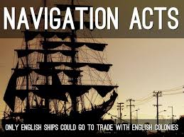

Slide 10
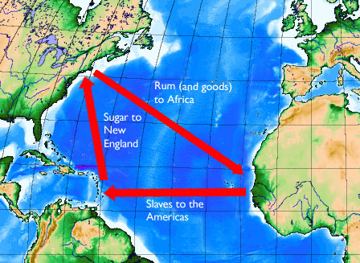
Triangular Trades
Colonists purchased Sugar from the West Indies and turned it into rum in the colonies. The colonists then shipped the rum to England and Africa and obtained goods from England and slaves from Africa. These exchanges across the Atlantic Ocean are known as the “Triangular Trades.” (all of the routes formed a triangle.)

Slide 11
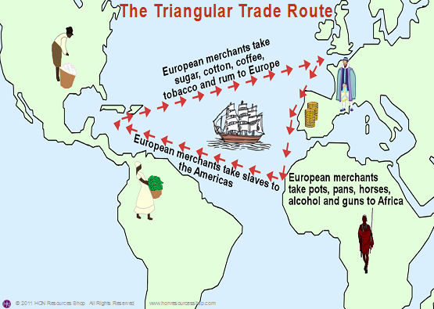

Slide 12
Colonial Society (Roles of Men, Women & Children)
In colonial times, men The husband spent
enjoyed power and authority. most of his time farming.
Women had few rights and The wife did the cooking,
children had none. Cleaning, sewing,
washing, weaving,
making candles,
churning butter,
and other
household
tasks.
***Draw this diagram in your notes. We will fill it in together.***
Notes:
Wealthy landowners and merchants
Independent farmers
Tradesmen, shopkeepers, and craftsmen
Apprentices or servants
Unskilled laborers and slaves

Slide 13
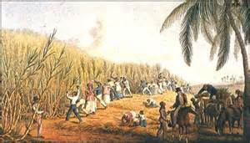
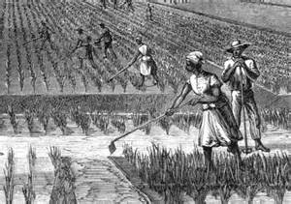
Slaves in the Colonies
The slave trade was very profitable for the colonists.
The colonists did not care about the feelings or comfort of the victims of the slave trade.
Slaves were crammed and chained together on ships.
Many suffocated and many starved themselves to death and jumped over board.
The number of slaves in New England colonies grew from 1,000 in 1700 to about 16,000 in the 1770’s. In the Southern colonies, there were 125,000 by 1740.

Slide 14
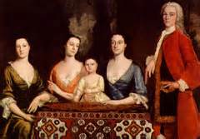
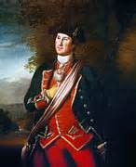
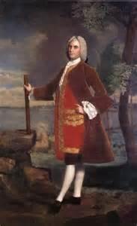
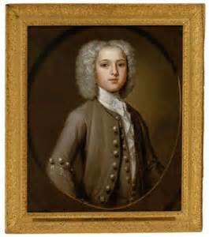
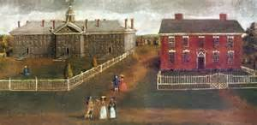
The Arts in the Colonies
Portrait paintings were the primary subject matter for colonial artists.
In a time where there were no photographs, colonists desired to be remembered by future generations.

