Slide 1
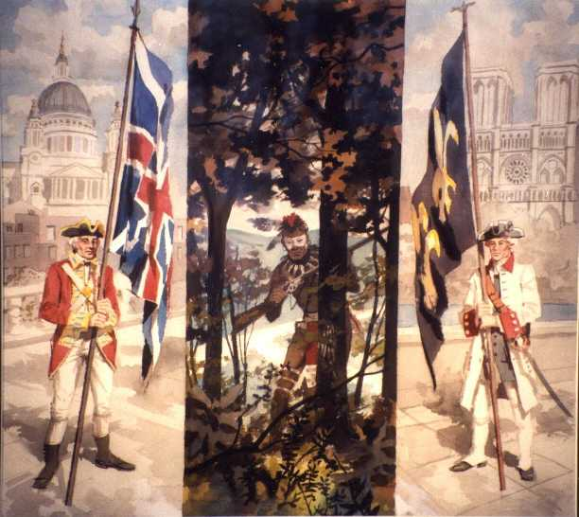
French & Indian War
Unit 2

Slide 2
Essential Questions
How did the French and Indian War make the colonies ripe for change?
Which British policies in the colonies led to disagreement?
How did colonial protests against British policies escalate to armed conflict?
How did individual leaders influence the course and outcome of the revolution?

Slide 3
The war was the product of a clash between the French and English over colonial territory and wealth. In North America, the war can also be seen as a product of the local rivalry between British and French colonists.

Slide 4
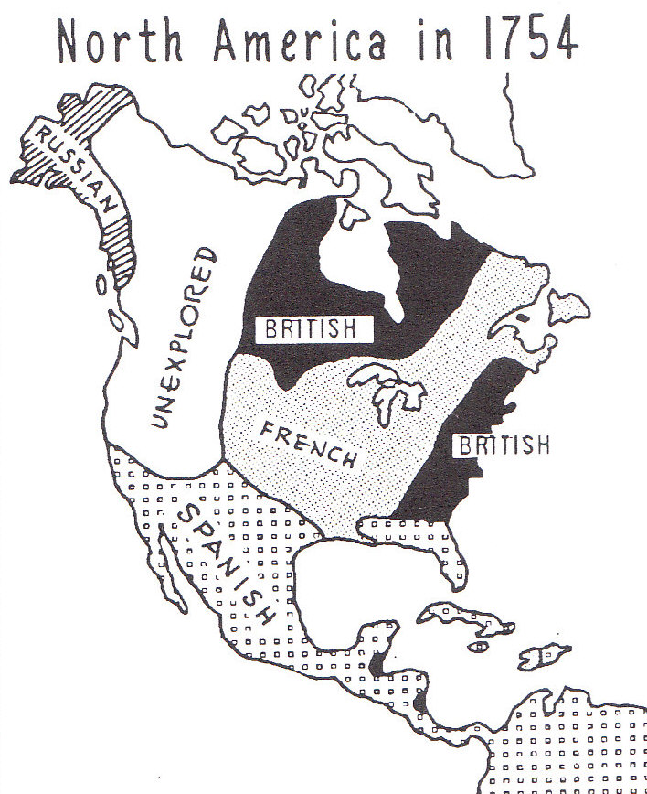
Boundaries Claimed
By the 1700s, four European nations had set up colonies in North America France, Spain, England, and Russia)
France, however, posed the biggest threat to the English Colonies.

Slide 6
Tensions arise!
Problems arose when English trappers and farmers began moving west of the Appalachian Mountains looking for fur and new land.
France did not approve of this expansion by the English and were determined to stop it.

Slide 7
Natives side with the French
Many Native American tribes, like the Huron and the Algonquin, sided with the French because the French didn’t destroy Indian land and had tried hard to befriend the Native Americans. Some French trappers had even married Indian women and become part of the tribes.

Slide 8
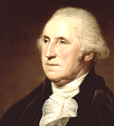
How it all started
The war began when the English became alarmed at the Forts being built by the French in the Ohio River Valley.
In 1754, a young George Washington and his men attacked a group of French scouts.

Slide 9
Defending the colonies
At the same time, delegates from several of the English Colonies met in Albany, New York. Their job was to cement an alliance with the Iroquois and plan the defense of the colonies.

Slide 10
Albany Plan of Union
Ben Franklin knew that the colonies had to work together to win the war. So he proposed the Albany Plan of Union.
This plan called for the colonies to join together and form one central government that would run the war.

Slide 12
What does this mean?
If the 13 Colonies fought together they would be strong and hard to beat.
If the 13 Colonies decided to fight separately they would be weak and easy to beat.

Slide 13
The Albany Plan of Union was rejected by the colonies because they did not want to give up their power.
During the first two years of the war the French were winning. They won important victories at Fort William Henry and Fort Oswego.

Slide 14
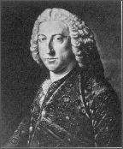
William Pitt
The tide of battle changed in1757, when William Pitt took over the English Government. He was determined to win the war, so he sent the best British soldiers and generals to North America.
Pitt also promised large payments for military service and supplies.

Slide 15
British win
The French were finally defeated in North America when the British captured Quebec, the capital of New France. Quebec was also the supply point for many French forts.
After losing Quebec, the French ended the war by signing the Treaty of Paris in 1763. The treaty gave the British Canada and all French land east of the Mississippi River.

Slide 16
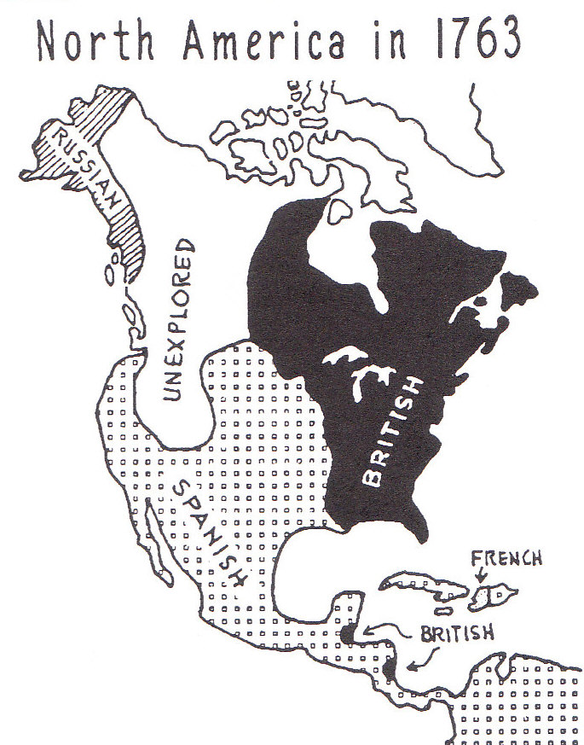

Slide 17
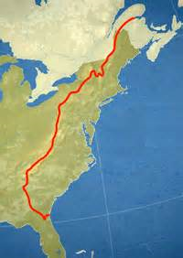
Proclamation Line of 1763
England decides that no one can settle west of the Appalachian Mountains

