Slide 1
Rhetorical Situation: An Introduction to Rhetorical Analysis
English 3 AP/ AP Dual

Slide 2
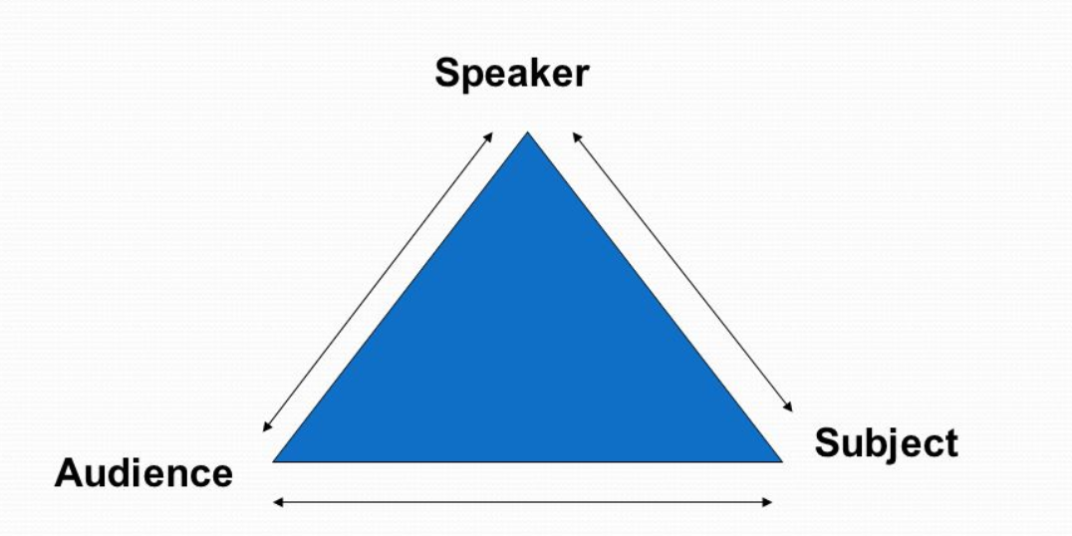
Rhetoric
Rhetorical analysis is a form of criticism or close reading that employs the principles of rhetoric to examine the interactions between a text, an author, and an audience.

Slide 4
5 Parts of a Rhetorical Situation
The text, which is the actual communication, whether written or spoken
The author, which is the person who creates a specific communication
The audience, who is the recipient of a communication

Slide 5
5 Parts of a Rhetorical Situation (continued)
The purpose(s), which are the various reasons for authors and audiences to engage in communication. Also includes exigence (later).
The setting, which is the time, place, and environment that surrounds a particular communication.

Slide 6
Rhetorical Analysis is understanding how these 5 parts work together
We will practice annotating and understanding these 5 parts of a rhetorical analysis with, “You May Want to Marry my Husband” by By Amy Krouse Rosenthal (New York Times). Take out your annotation guide and reading guide.

Slide 7
AS we read, think about where these 5 ideas are found
1st Read
2nd Read
Read to understand.
Be cognizant of what we are looking for.
Notice and note shifts in tone, repetition, where the title is said, etc. All the “good stuff” you have been learning.
We will go back to find the 5 parts.
We will go back to think about how they all work together—how does the author encourage the audience to accept their message?
And, finally, we will think about the message and its success overall.

