Slide 1
Exigence: Defining terms

Slide 2
Rhetorical Situation
5 Parts—what are they? Look at notes.

Slide 3
But, wait there’s more!
A new curriculum requirement is to teach the word: Exigence.

Slide 4
Rhetorical Situation
1. Purpose—more clearly tied to exigence
2. Setting—more clearly tied to exigence
3. text
4. author
5. audience

Slide 5
Exigence
A hurricane is a non-rhetorical exigence. Thinking about what needs to be in a speech in order to comfort those who lost everything in the hurricane is a Rhetorical exigence.

Slide 6
exigence
The problem that needs to be solved.
The hurdle to overcome.
The action to stop.
The push, the motivation.
what makes you write that angry text message or write a letter to the editor or comment on that youtube video.

Slide 7
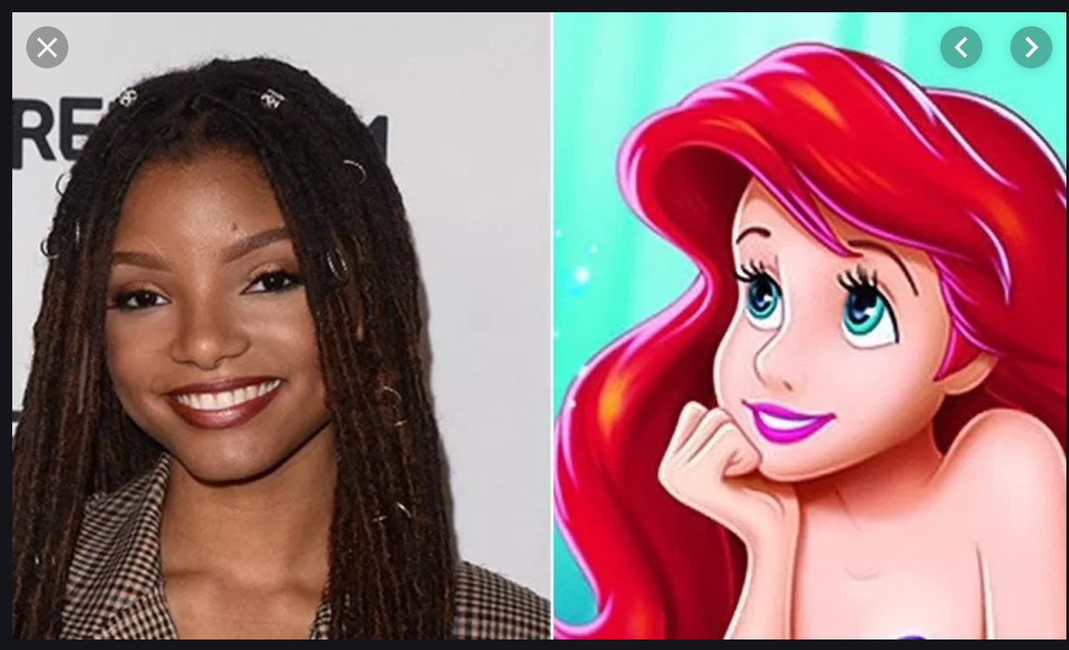
Exigence example
https://www.huffpost.com/entry/halle-bailey-reaction-little-mermaid-casting_n_5d4b4fb2e4b09e729740a4b8

Slide 8
Let’s practice
1. Purpose—Let’s do purpose and exigence last.
2. Setting
3. text
4. author
5. audience

Slide 9
Possible ideas
1. Purpose—people’s negative reactions were so strong that she needed to address that hostility but she seems to be very gracious in just wanting to say she was happy to get the role because she knows it’s important.
2. Setting—it’s been a hostile time for discussions of race
3. text
4. author
5. audience

Slide 10
SPACECAT
Ok, we are going to introduce our first strategy—SPACECAT.
It’s like Soapstone—but for AP English.

Slide 11
Practice with—Remembering all the Boys”
We will read and--
Annotate for rhetorical situation
Then, fill out our SPACECAT form.

