Slide 1
Annual Title I, Part A Meeting 2020-2021
Brackenridge High School
September 3, 2020
Sign in on Google Link

Slide 2
Why Are We Here?
The Every Student Succeeds Act (ESSA) requires that each Title I, Part A School hold an Annual Meeting with parents and families for the purpose of:
Informing parents and families of their school’s participation in Title I, Part A
Explaining the requirements of the Title I, Part A Program
Explaining your rights as parents and families to be involved
ESSA Public Law 114-95, Section 1116 (c)(1)

Slide 3
Agenda
Title I, Part A School
Title I, Part A Schoolwide Program
Requirements and Parent/Family Rights under Title I, Part A Programs

Slide 4
Title I, Part A School

Slide 5
Title I, Part A School
Receives federal funding (Title I, Part A dollars) to supplement the school’s existing programs
Provides high-quality education so that all students will meet the State student performance standards
Supplemental Staff, programs, materials and supplies
Identifies students experiencing academic difficulties and provides timely assistance to help these students meet the challenging State Academic Standards
Conducts Parent and Family Engagement meetings, trainings and activities
Recruits, hires and retains Highly Effective Teachers

Slide 6
Title I, Part A Schoolwide Program

Slide 7
Title I, Part A Schoolwide Program
(Campus Name) participates in a Schoolwide Program:
Purpose is to upgrade the entire educational program in order to raise academic achievement for all students
Is built on Schoolwide Reform Strategies, rather than separate, add-on services
Provides flexibility in spending Title I, Part A funds
Permits flexibility to coordinate with other funds in support of the Schoolwide Program
Focuses on academic results

Slide 8
Title I, Part A Schoolwide Program Activities
Discuss the Title I, Part A Schoolwide Program Activities that are provided at your campus:
Provide a description and explanation of the school’s curriculum
Provide information on the forms of academic assessment used to measure student progress
Provide information on the achievement levels of the State Academic Standards

Slide 9
Title I, Part A Schoolwide Program Activities
Continuation of - Discuss the Title I, Part A Schoolwide Program Activities that are provided at your campus:
Provide information on Parent and Family Engagement Opportunities available at your school:
Provide parents and families with parent and family engagement training/meeting session dates and times, if scheduled
Provide parents and families with volunteer opportunities
Provide/Discuss information on any other Title I, Part A Schoolwide Program Activities at your campus

Slide 10
Requirements and Parent/Family Rights
Under Title I, Part A Program

Slide 11
1% Set-Aside For Parent and Family Engagement
A school district with a Title I, Part A allocation exceeding $500,000 is required by law to set aside (reserve) 1% of its Title I, Part A allocation for parent and family engagement.
Of that 1% set aside, 10% may be reserved at the district level for system-wide initiatives related to parent and family engagement.
Of that 1% set aside, the remaining 90% must be allocated to all Title I, Part A schools in the district to implement school-level parent and family engagement.
Title I, Part A - Parents and families have the right to be involved in the decisions regarding
how these funds will be used for parent and family engagement activities.
ESSA Public Law 114-95, Section 1116 (a)(3)(A)(B)(C)(D)

Slide 12
Title I, Part A Parent and Family Engagement Reservation for (Campus Name)
Amount reserved for:
Campus Parent and Family Engagement Program:
Supplies* $___,____
Refreshments* $___,____
*Parent and Family Engagement funds can be redistributed within their supplies and refreshments allocation, as needed. For example, if more supplies are needed to increase the number of “Make and Take” activities, funds can be moved out of the Refreshments code into the Supplies code to accommodate the need.
Title I, Part A - Parents and families have the right to be involved in the decisions regarding
how these funds will be used for parent and family engagement activities.
Notes:
(Federal Programs Department will be providing this information to each campus)

Slide 13
Eligible Parent and Family Engagement Expenditures
Expenses directly related to the Parent and Family Engagement Program.
For example (Refreshments/Supplies):
To discuss the District/School Policy, School-Parent Compact and Annual Title I, Part A Meeting
Parent meetings/trainings that are connected to improving student achievement with flexible meeting times and dates
Family Math/Science Night, Family Literacy event
All expenses not related to the purpose and intent of Title I, Part A are ineligible.

Slide 14
CNA and CIP
The purpose of the Comprehensive Needs Assessment (CNA) is to identify the campus’s educational strengths and the areas that need improvement to include Parent and Family Engagement needs.
The Campus Improvement Plan (CIP) is a written plan that addresses the needs identified in the CNA:
Goals, Performance Objectives and Strategies to address academic needs of students
Supplemental Services to assist struggling students
Coordination and integration of federal funds and programs
Strategies to implement effective parent and family engagement
Title I, Part A - Parents and families have the right to be involved in the development and request a copy of this plan.

Slide 15
School’s Parent and Family Engagement Policy
The policy addresses how the school will implement the Parent and Family Engagement Program Requirements of the Every Student Succeeds Act (ESSA).
The Policy includes:
A description on how the school will convene an annual meeting for all Title I, Part A parents and families
Information on flexible number of meetings and if requested, additional meetings with parents to discuss decisions for the education of their child
How the school will involve parents in an organized, ongoing, and timely manner, in the planning, review, evaluation, and improvement of the Parent and Family Engagement Policy and Program
How the school will provide timely information about Parent and Family Engagement Activities
Information to parents and families about curriculum and assessment
Title I, Part A - Parents and families have the right to be involved in the development of the
Parent and Family Engagement Policy and Program.
ESSA Public Law 114-95, Section 1116 (c)

Slide 16
School-Parent Compact
The School-Parent Compact is a written agreement that describes how the school staff, students, parents and families share in the responsibility for improved student academic achievement.
It is developed with parents, agreed upon with parents, and distributed to parents.
It addresses high-quality curriculum and instruction to meet State academic standards.
It stresses the importance of frequent communication between school and home, and the value of parent-teacher conferences (REQUIRED in elementary schools).
It affirms the importance of parents and families in decisions relating to the education of their children.
*All PK-5 grade students are required to have a parent-teacher conference to discuss the compact.
*All 6th-12th grade students are required to have the compact distributed to them at the beginning of the year. A conference is recommended.
Title I, Part A - Parents have the right to be involved in the development of the School-Parent Compact.

Slide 17
Shared Responsibilities
A school-parent compact can also address shared responsibilities such as:
Staff Responsibilities:
Building and developing a partnership between the school staff and parents
Providing a supportive and effective learning environment
Parents’ and Family Members’ Responsibilities:
Incorporating techniques in which parents and family members will be responsible for supporting their children’s learning
Volunteering in their child’s classroom
Positive use of extracurricular time

Slide 18
Teacher Qualifications
Schools are required to notify parents of students participating in the Title I, Part A Schoolwide Program of their right to request and receive information on the qualifications of their child’s teachers.
ESSA Public Law 114-95, Section 1112 (e)(1)(A)

Slide 19
Parents Right-to-Know
Schools are required to notify parents that the student has been assigned, or has been taught for 4 or more consecutive weeks by, a teacher who does not meet applicable state certification or licensure requirements at the grade level and subject area in which the teacher has been assigned.
Sample letter can be found on the School Improvement & Federal Programs Share Point.
ESSA Public Law 114-95, Section 1112 (e)(1)(B)(ii)

Slide 20
Evaluation of the Parent and Family Engagement Policy and Program
Annually evaluate the content and effectiveness of the current Parent and Family Engagement Policy and Program (usually in the spring).
Identify:
Barriers to participation in parent and family engagement
The needs of parents to assist with the learning of their children
Strategies to support successful school-family interactions
Data and Input may include:
Parent Survey and questionnaires
Focus Groups or other face to face meetings
Parent Advisory Committees input
Process and Timeline
How the evaluation informs next year’s policy
Campus reports findings to parents and families and will utilize the results to revise the Parent and Family Engagement Policy and Program as well as the School-Parent Compact.

Slide 21
(Campus Name) Contacts
For more information please contact:
(Campus Name) Contacts
Name | Title | Phone | E-mail Address
Contact 1
Contact 2
Contact 3
Contact 4
Recommended contacts: Principal, Teacher, FACE Specialist, Nurse, Counselor, Food Services, Transportation

Slide 22
Thank you!
Please visit the Federal Programs website or
ask your campus FACE Specialist for additional information
https://livesaisd.sharepoint.com/sites/SchoolImprovementandFederalPrograms

Slide 23
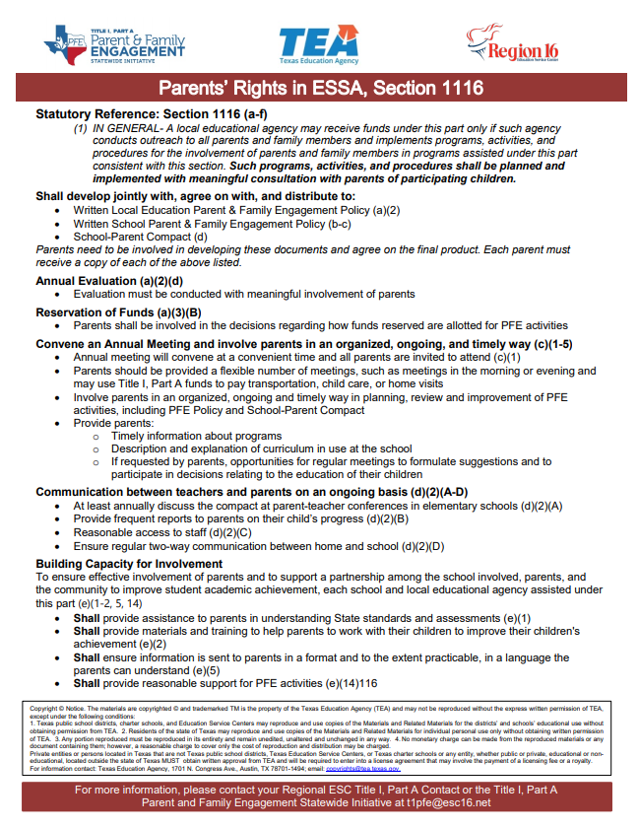
Parents Rights in ESSA
Please print this document for your parents and family members and share with them during this presentation.
Click on link below for a copy:
Parents Rights in ESSA, Section 1116

