Slide 1
Welcome- Class of 2021 to our Back to School Grade Level Meeting and Title I Annual Meeting
St. Philip’s ECHS- 9th Grade
Parent Night
August 16,2017

Slide 2
Meet the St. Philip’s ECHS Administrators and Support Staff
Principal- Dr. D. Thomas
Asst. Principal- Ms. P. Ortiz
Counselor- Ms. M. Martinez
College Bound Advisor- Mr. G. Hiett
Counselor’s Clerk-Ms. Joy Carey
Parent Family Liason- Mrs. D. Miller
Secretary-Ms. Rosa McHaskell
Data Clerk/Registrar-Ms. Lear Taylor
Clerk-Mr. Alex Sandoval

Slide 3
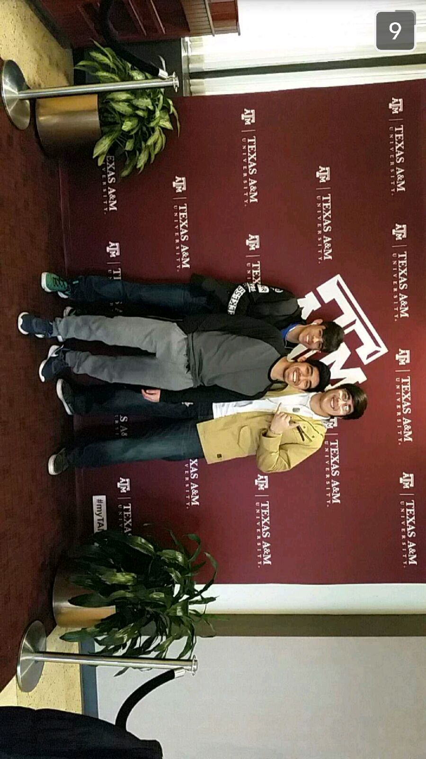
Learning Opportunities
This is how “we” learn at St. Philips ECHS!

Slide 4
9th Grade Vocabulary
Grade Classification
Credits
GPA
Class Rank
Transcript

Slide 5
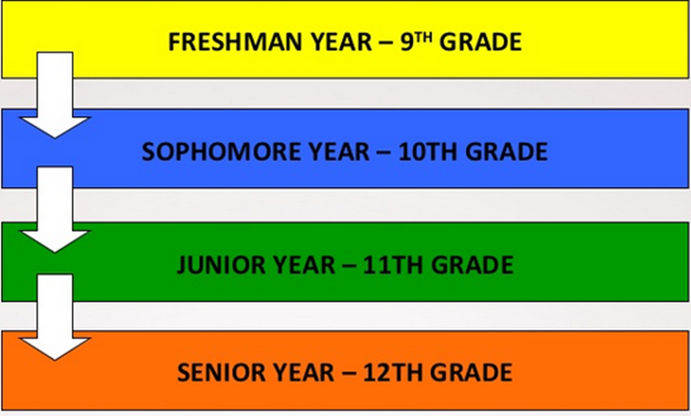
Grade Classification
10th Grade= 6 credits (Sophomore)
11th Grade=12 Credits (Junior)
12th Grade = 18 Credits (Senior)
HIGH SCHOOL GRADUATE= 26 Credits

Slide 6
Credits
In high school, credits are earned by PASSING classes with a grade of 70 or above.
The High School Transcript is where credits are recorded each semester.
You must attend class to receive credits earned.

Slide 7
Speaking of Attendance….
AGAIN….. Students must attend a class in order to receive credit.
Credit is granted or denied every semester.

Slide 8
GPA (Grade Point Average)
San Antonio ISD determines both an un-weighted GPA (4.0 scale) and a weighted GPA.
The weighted GPA is used in determining class rank.
Pre-Advanced Placement (Pre-AP), and Dual Credit courses contain weighted grades for ranking.

Slide 9
Class Rank
Unweighted-4.0 Scale
Weighted GPA- Points or “weight” added to D.C./Pre-AP courses.
Class rank is typically considered for college admissions.
GPA Exempt Courses- M.S. Courses for high school credit

Slide 10
Transcript
Your High School Transcript is a copy of your permanent academic record. This includes all courses you have taken, all grades received, and all credits earned.

Slide 11
Community Service
All 9th grade students at St. Philip’s ECHS are expected to complete 40 community service hours during the 2017-2018 school year. Of those hours 15 were expected to be completed during the summer in any area the student chooses. Once students have completed their hours, they are to give the counselor, Ms. Martinez, a copy of their documented hours with supervisor’s signature.

Slide 12
Title I Information
Goals of Title I Program
Increase academic achievement
Provide direct instructional support to students.
Provide professional development for teachers.
Promote parent education and involvement.

Slide 13
Schoolwide Program We operate a school-wide program in SAISD
Parental Rights:
Review the parent involvement plan.
Review and provide input in the Title I Parent Involvement Policy and Home/School Compact.
You, as Title I Parents, have the right to know the qualifications of your child’s teachers
All of our teachers and staff are meet and/or exceed the highly qualified requirements for their content.
How can you be involved?
Parent Volunteer
Volunteer Form (Background Check)
Parent Information
Newsletters
Website, PENS message
Parent-Teacher-Student Organization

Slide 14
