Slide 1
Using the Student Account Manager
Password resets work for computer and Chromebook logins as well as school email, iData Portal and Google accounts.

Slide 2
Logging in
https://dwintranet.saisd.net/ADStudentsManager/login.aspx
Use the first part of your school email address and then use your school email password.

Slide 3
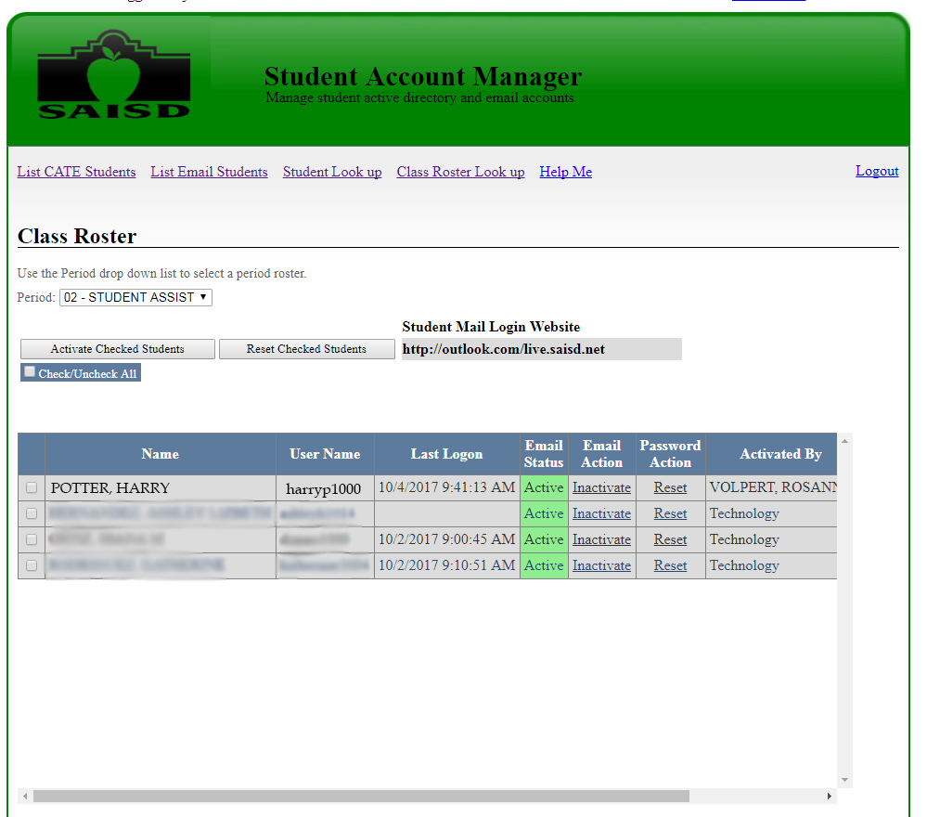
Resetting passwords
Select class period
Click reset

Slide 4
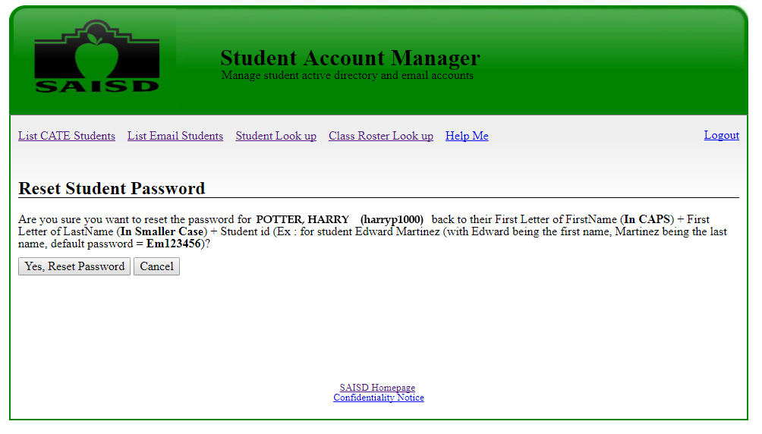
Resetting passwords
Click Yes, Reset Password

Slide 5
Password Reset
Passwords are always reset to the student’s first initial (capitalized), last initial (lower case) and their student ID number.

